Slide 1
Summary of Eval so far
High – 50-100% over baseline
Medium – 10% over baseline
Low – 2-3% over baseline
Baseline runs without any of these features.
What helps Eden perform better?
Feature | Synthetic | Memcached | Parallel Sort | Dataframe
1. Eviction batching (EvB) | High | High | High | TBA
2. Hiding Network latency (HL) | High | High | TBA (low?) | TBA
3. (Hint-specific) Read-ahead (Rd) | No | No | Medium | TBA
4. Eviction Policy (SC) | Low | Low | Hurts | TBA
5. Eviction Priority (EvP) | High | No | No | TBA
2, 3, 5 – motivate Eden i.e., Hints.
1, 4 – do not motivate Eden; instead, they make a “our design is no worse than Fastswap despite being in Userspace” argument
Notes:
Check with Emmanuel: Does linux do TLB flush batching?

Slide 2
One Story
We need application-exposed calls for page faults
Efficient latency hiding without too many kernel transitions
Information like read-ahead – helps with page fault batching
Eviction priority
Two possible designs for this:
Kernel-provided syscalls + modifying page management kernel
User-level hints + page management in userspace + Userfaultfd interface
Efficient latency hiding with User-level threads, convenient and easy?

Slide 3
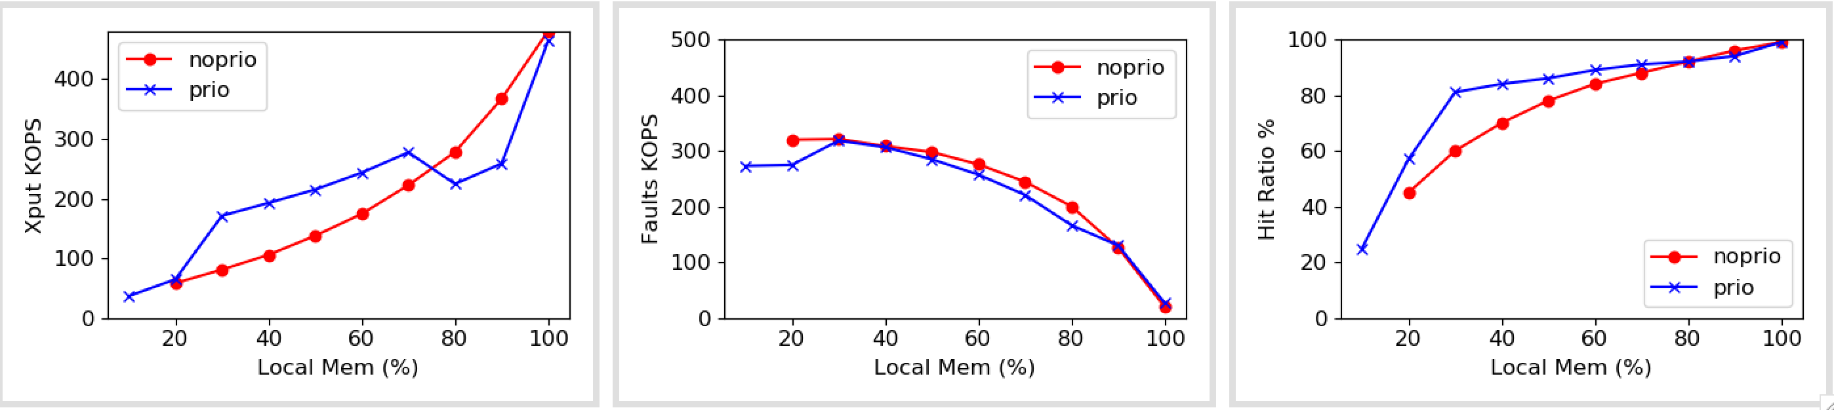
Eval: Synthetic
Does eviction priority help?
Notes:
TODO: What’s happening with blue on the right?

Slide 4
Unpolished

Slide 5
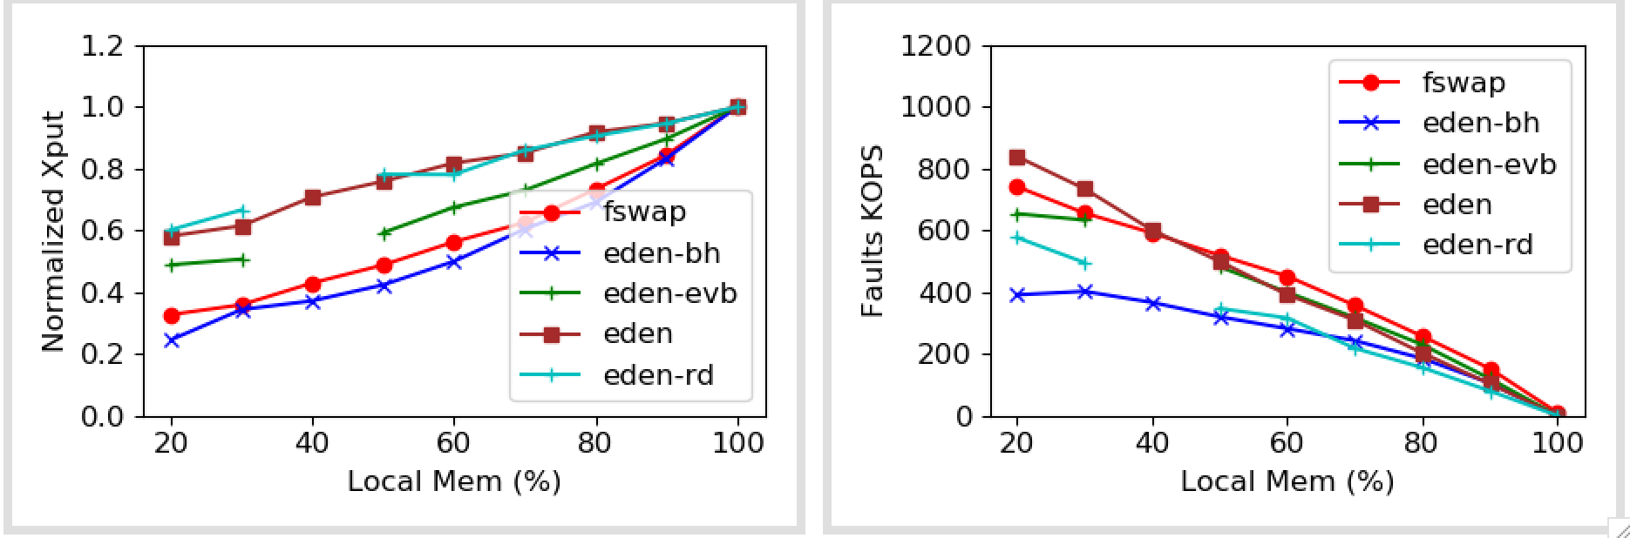
Eval: Synthetic

Slide 6
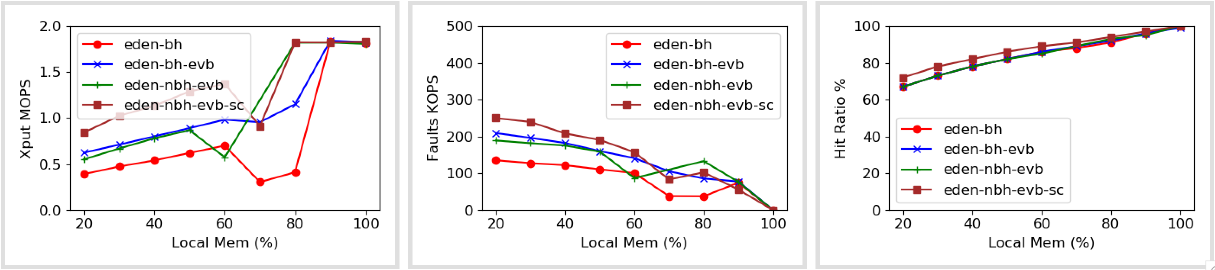
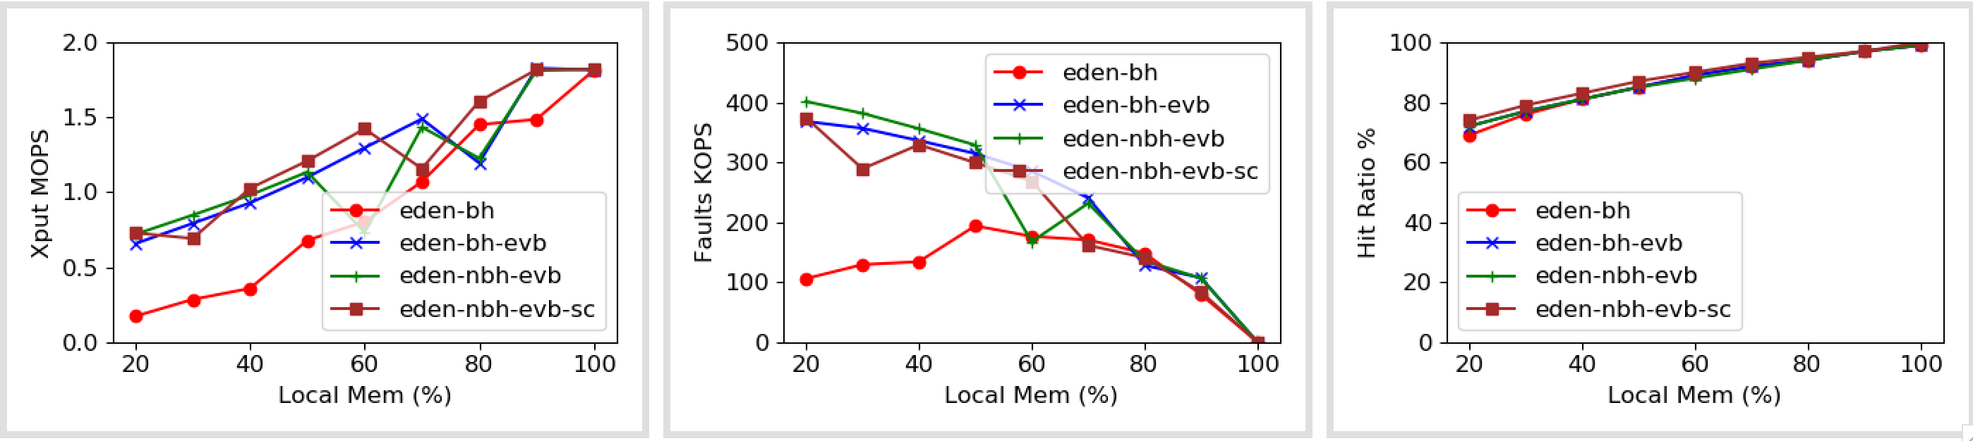
Eval: Memcached
No dirtying
No local changes
Notes:
TODO: Bugs

Slide 7
Eval: Parallel Sort
Setting | Overhead (compared to 100%)
Fastswap | 62%
Eden blocking hints | 125%
Eviction batching | 87%
Non-blocking hints, 2 threads per core | 76%
Blocking quicksort hints | TBD
Read-ahead | TBD (~5%)
Inverted Read-ahead | TBD

Slide 8
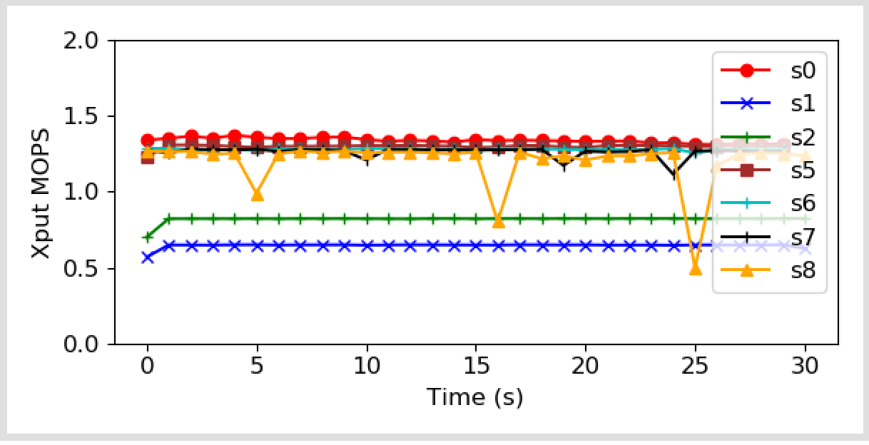

Slide 9
