Slide 1
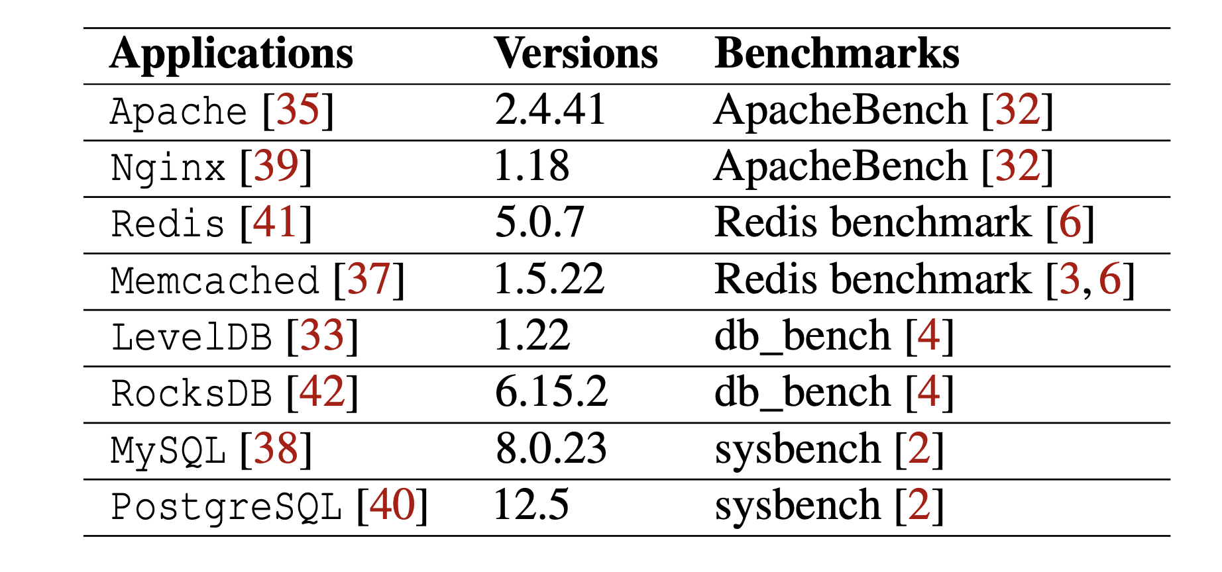
Agenda
Tracing tool ready!
Bugs galore - infinite loops, init-deinit mismatch, etc.
Can run with multiple handler cores
Supports full or partial sampling
Working on portability e.g., dependencies, architecture, etc.
Stew working on VMs
Roadmap for HotOS
Meetings next week

