Slide 1
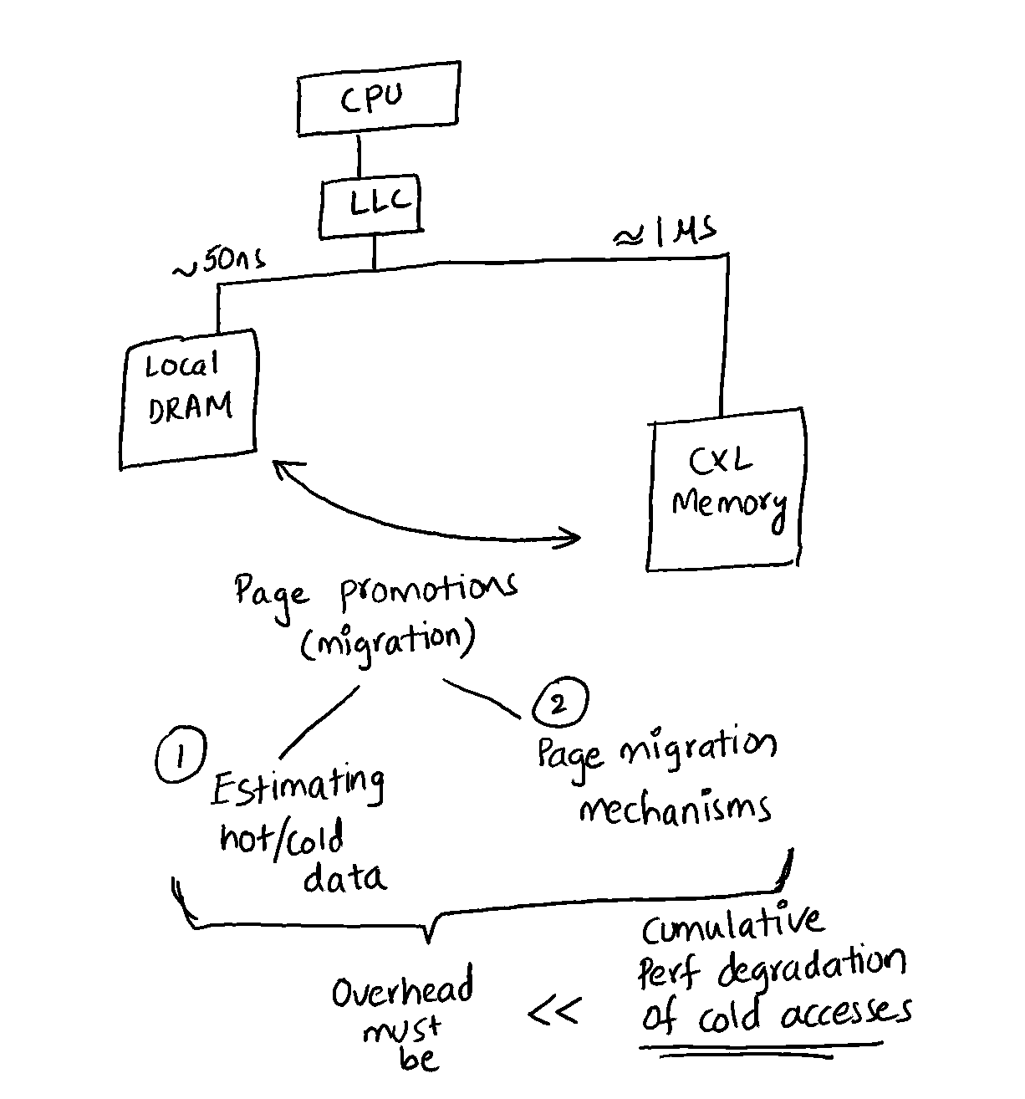
CXL-based Far Memory
No page faults, but still page-based cache-line based
Proactive or asynchronous page migration

Slide 2
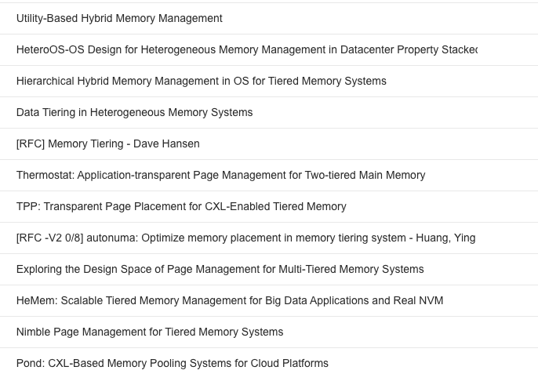
Literature
“Hybrid” or “tiered” memory
Mostly with NVRAM
Various ways to estimate hotness
Page access bits
TLB misses with minor page faults
L3 and TLB misses with PEBS
In-kernel vs userspace
Page migration mechanisms

Slide 3
How relevant is Eden?
No page fault overheads
Hiding far memory latencies does not apply
However, this may still apply during page migrations
How useful are Eden hints, or faulting locations in general?
Access statistics without NUMA soft faults
How does it compare to PEBS?
Still page granular and does not capture access “intensity”
Can it aid existing page “temperature” metrics?
Does hint priorities help with better migration?
Does the asynchrony help? E.g., switching to other work during page migrations

Slide 4
Feedback
More interest into faulting code analysis
[Radhika] Fundamentally explaining the page fault locations will still be very interesting and can help us find new use-cases (even for CXL)
[Marcos] There could be interesting correlations between the locations
[Marcos] Think about “Eden” for CXL – small code changes, big wins in case of CXL too
The idea of PEBS is not very comforting
Cache-line prefetching for cache lines in the same page with help of hints
Targeting CXL in general
[Amy] Should be careful because as (far) latencies reduce, so do the gains
No CXL 2.0 prototype this year, NUMA-node emulations are ok

Slide 5
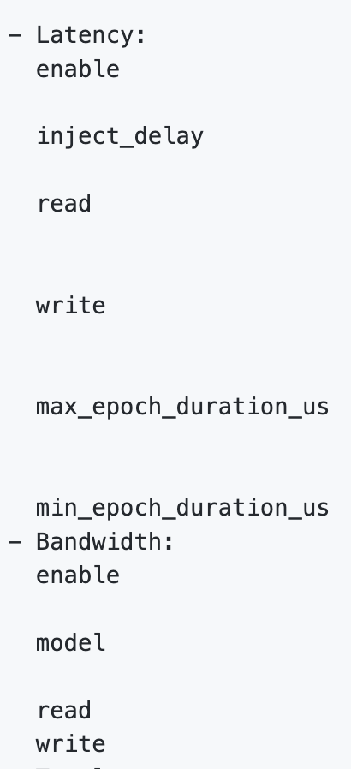
Emulator Candidates
For Persistent Memory
NUMA node based (most promising)
Using another NUMA socket as remote node
Bandwidth control with “DRAM thermal control feature”
Latency emulation with software-added delay
Intel PMEM, HP Quartz, etc.
FPGA-based emulators
Memory System “Simulators”
DRAMSim, NVMain, Gem5, etc.

Slide 6
Coming week
Faulting Locations
Pick a few applications and investigate their faulting code
How to figure out cache-lines accessed for each faulted page?
Thesis Proposal slides

