Slide 1
Outline
SOSP Plan
New Memcached results
Synthetic app comparison with AIFM
Dataframe setup

Slide 2
SOSP Paper Revision
Eval Revision
“Programmer Effort” section
More details from the HotOS paper
Address OSDI comments on hinting limitations
Potentially new DataFrame case study
Benchmarks section
New AIFM lines for Synthetic
New app: DataFrame
Other sections
New discussion section?
Text changes wherever necessary to address OSDI comments
Please have a look at SOSP plan for OSDI comments doc
Notes:
HotOS results may go in Motivation

Slide 3
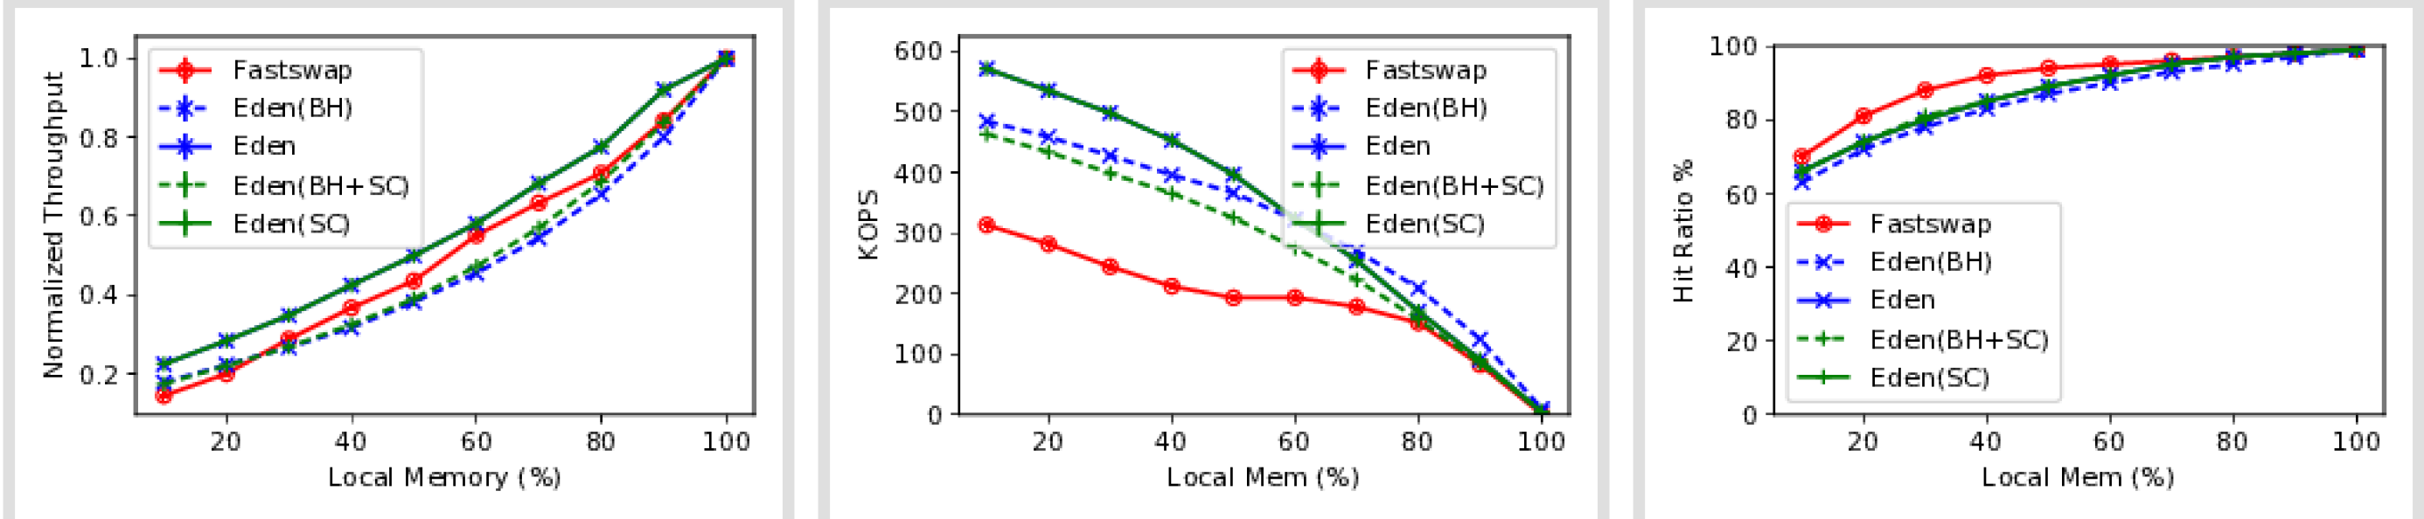
Memcached results (no-priority)

Slide 4
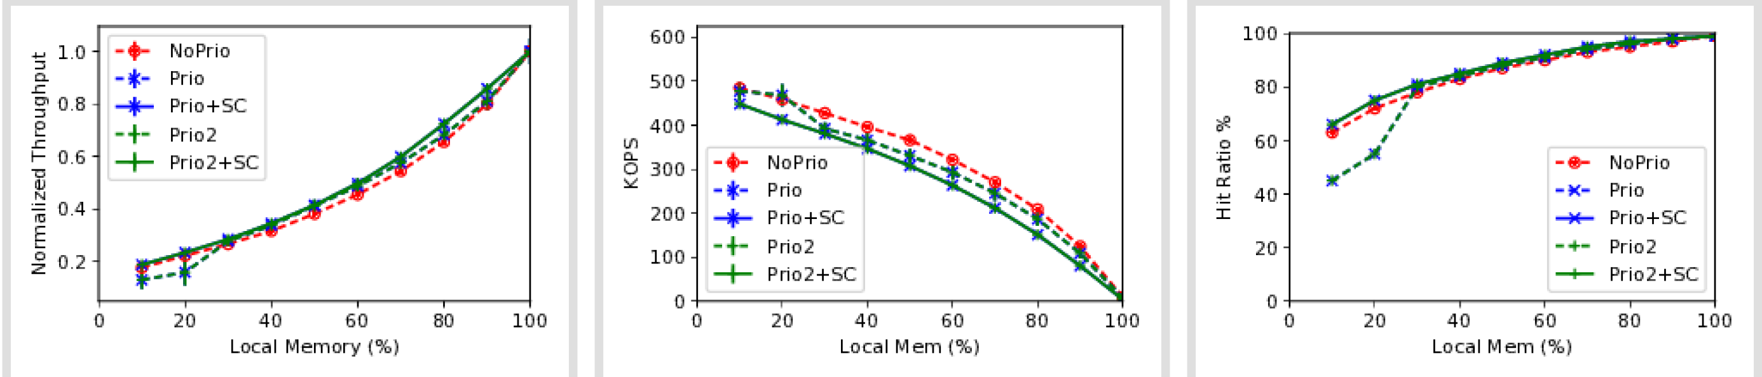
Memcached Priority
All runs with blocking hints

Slide 5
Questions
Why is Fastswap seeing significantly lower (major) page faults?
What is the best Eden’s Reclaim could do (if the distribution is known ahead of time)?

Slide 6
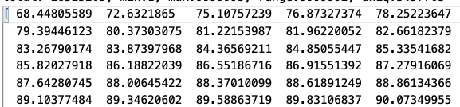
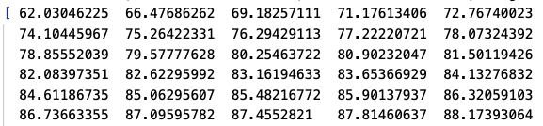
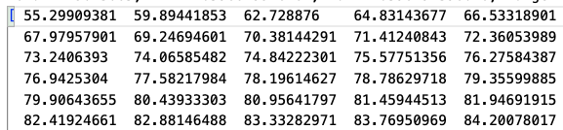
Estimating an upper-bound
Two data structure accesses: pointer array and item lists
Does key locality transfer to page locality? – Yes
Keys
Item
Pages
(7GB)
Array
Pages
(2GB)

Slide 7
Synthetic App
AIFM version | Eden’s port
AIFM-provided far memory (hopscotch) Hash table | A generic hopscotch implementation
C++ | Wrote in C (no C++ bindings and malloc interposition in Eden back then)
Snappy compression & AES from Crypto C++ library | Only snappy compression (Couldn’t get C-port of AES running at the same speed 5x’ed compression to get to similar MOPS)
Using AIFM’s port with Eden
Author pointed out a local version of hash table
Eden C++ bindings (needed for Dataframe anyway)
Eden’s malloc shimming (needed for Dataframe anyway)
+ Easy to get AIFM’s baseline
- Redo all of Eden’s numbers

Slide 8
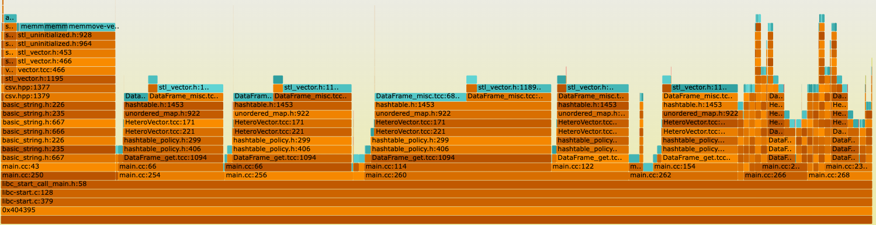
DataFrame
1 load-from-file + 7 analytics queries

Slide 9
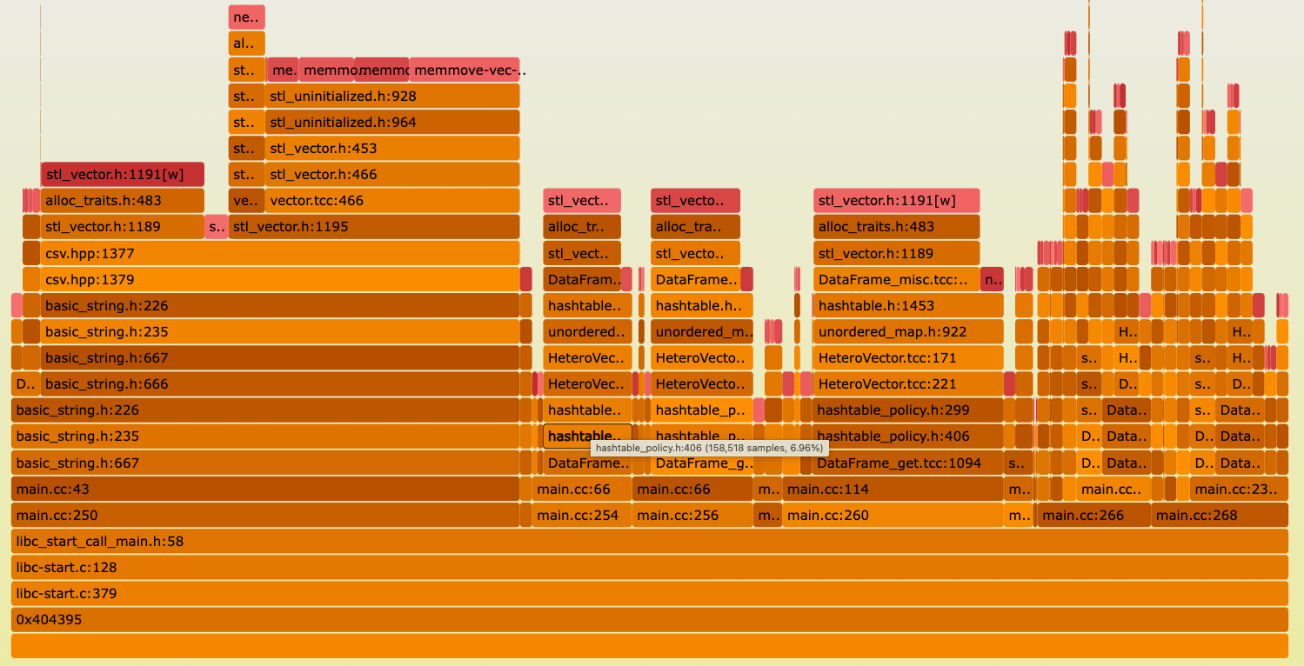
Dataframe (allocation faults)

Slide 10
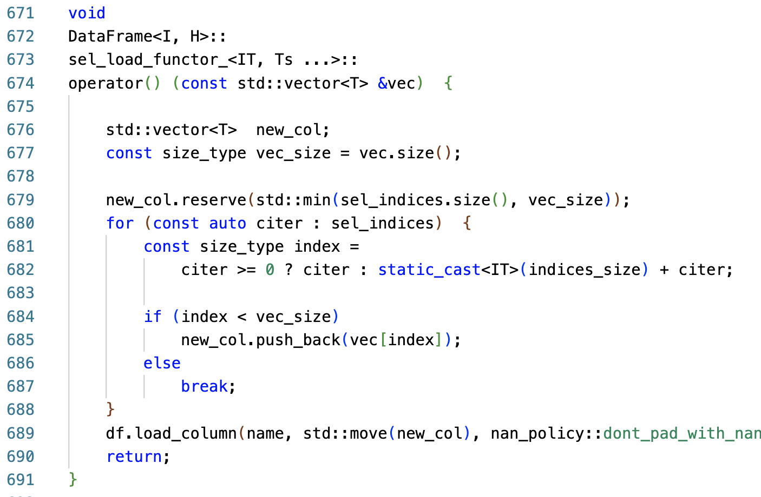
DataFrame major faulting locations
Lines 680 & 685
Basic lookup-and-fill block
All columns dealt with vectors
Hints can be beneficial if these are (semi-)contiguous, allowing read-ahead

Slide 11
What it takes for hinting DataFrame
Task | Expected Effort
Figure out any read-aheads | Few hours – 1 day
Linking with Eden libs + C++ bindings for hints | Few hours – 1 day
Update Eden’s malloc shimming | 1-2 days
Results | 1-2 days/more?

Slide 12
AIFM baseline
Going with the cloud lab setup
We’ll have to work with normalized performance
Setup done, launching initial runs

Slide 13
Prioritization
Memcached reclaim improvements
Synthetic vs Dataframe efforts
Focusing on common tasks first
AIFM baseline
C++ bindings
Malloc shimming for Eden
Plan to get there by next Wed

