Slide 1
Agenda
DataFrame study, mostly
Throwback to the CXL idea & next steps

Slide 2
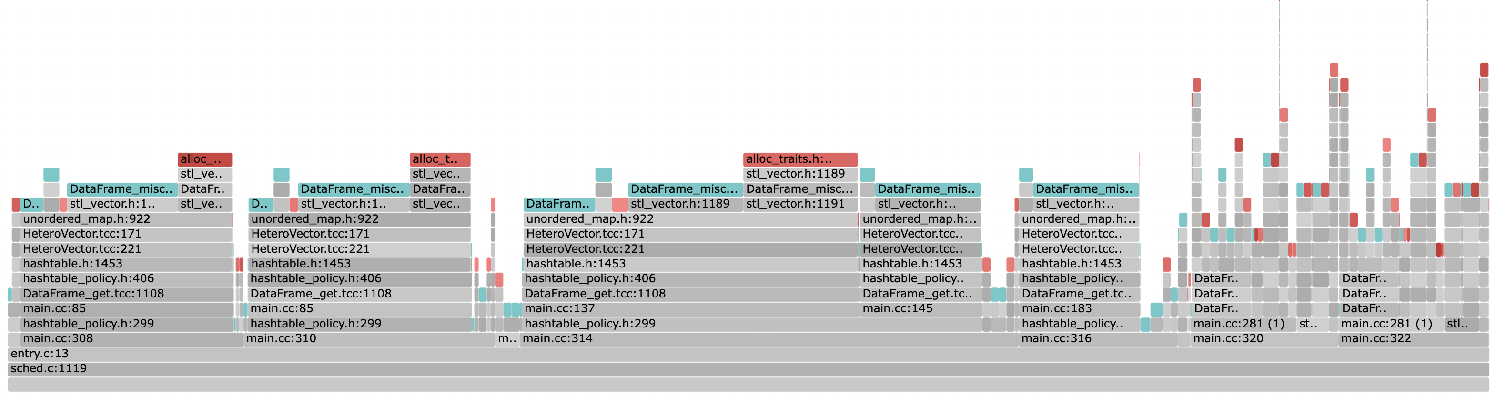
DataFrame Fault Graph
Includes first-time faults too, non-localized
(at 10% local memory – for all the analysis here and after)

Slide 3
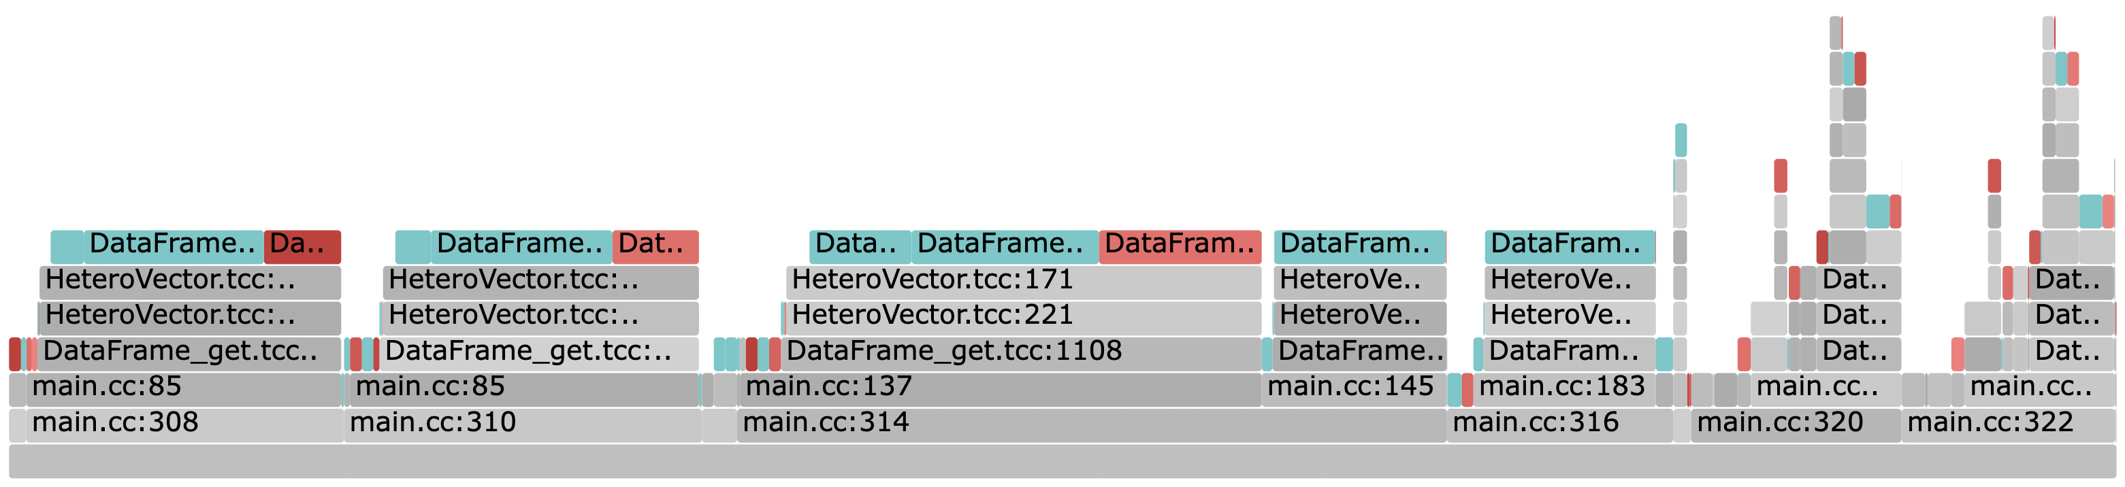
DataFrame Fault Graph
Localized to the benchmark and the library

Slide 4
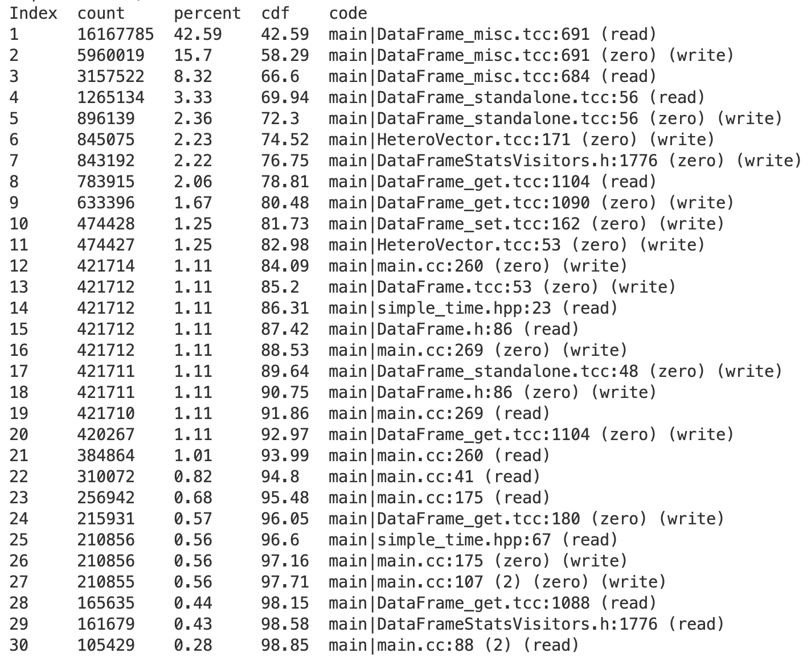
DataFrame stats
24 23 locations for 95%
Top 3 locations cover ~66%
13 first-time faulting locations (out of 22)

Slide 5
Hinting experience: Summary
Started off with basic hints
Got to ~92% fault coverage with ~25 hints (not all top 25)
Some first-time faults were challenging (example shortly)
Remaining 8% was still hurting TODO: numbers!
Turned-off demand paging for small-ish allocations
Got rid of the long tail of first-time locations
>97% coverage (reported in the paper)
More analysis needed
Turn iterating hints into sequential or range hints
Add Read-Ahead

Slide 6
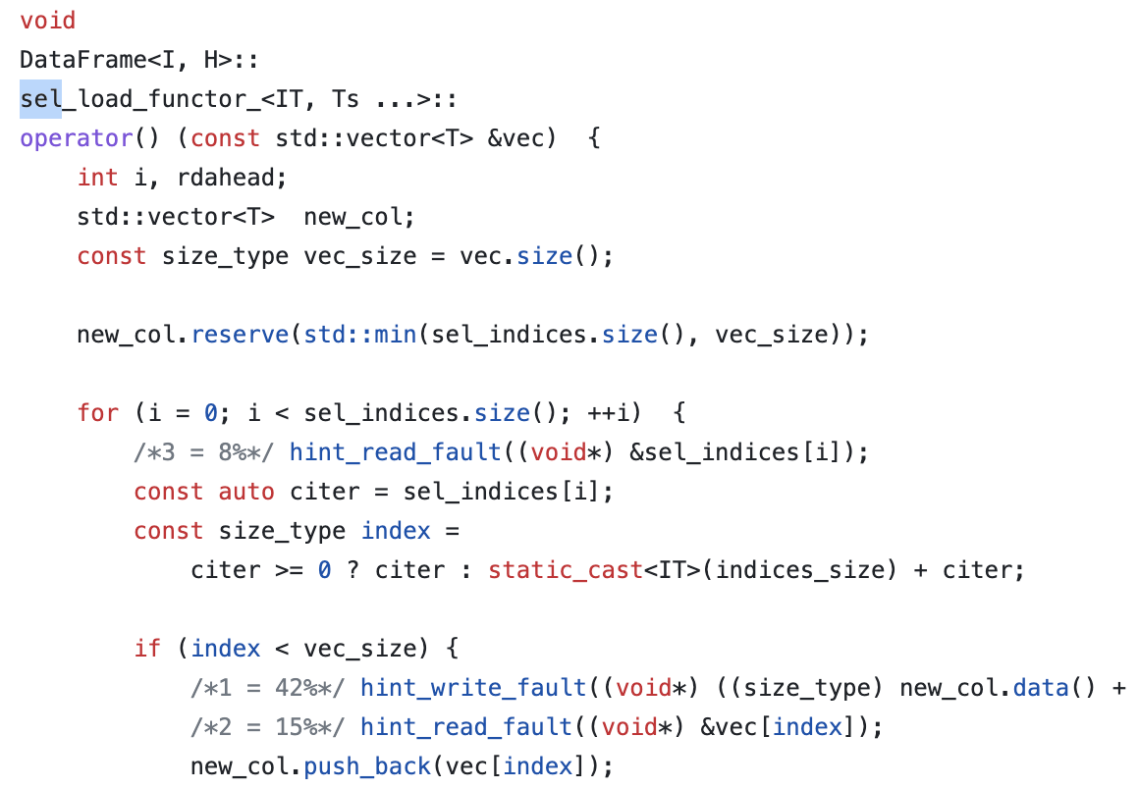
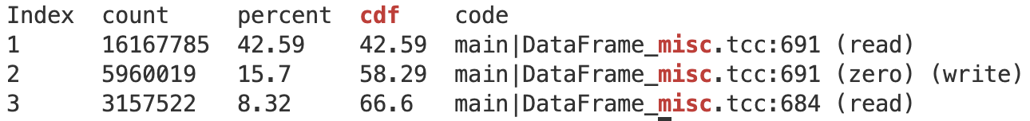
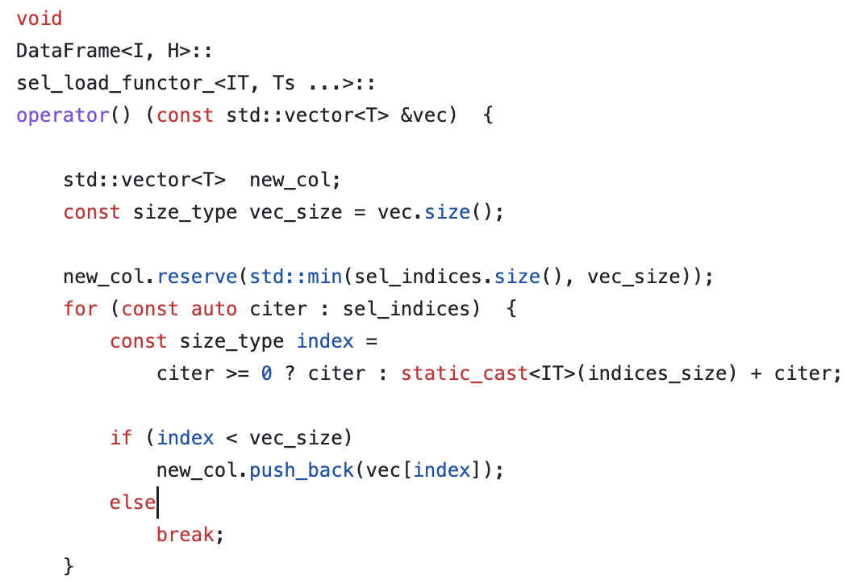
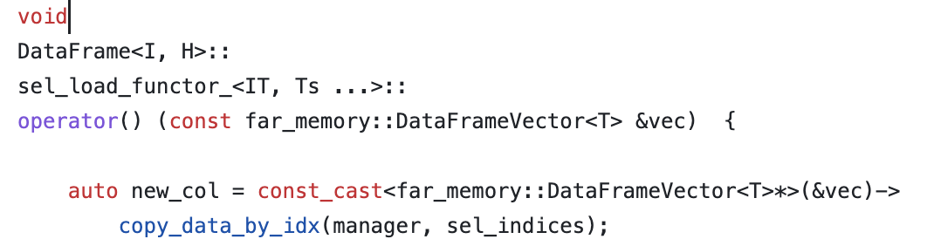
Hotspot 1: Select (66%)
Eden hints
Original
AIFM Copy Offload

Slide 7
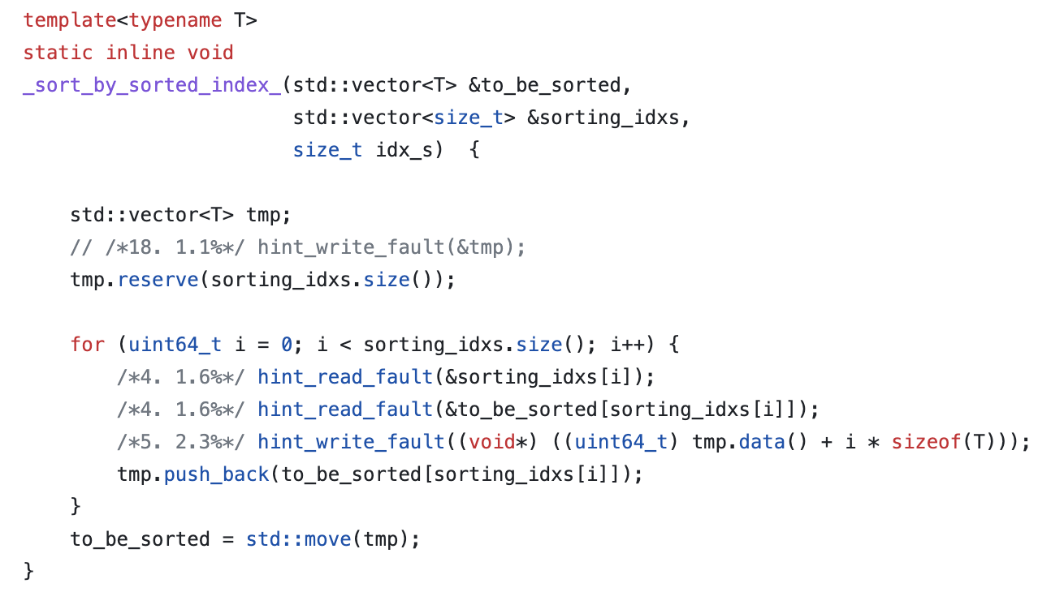
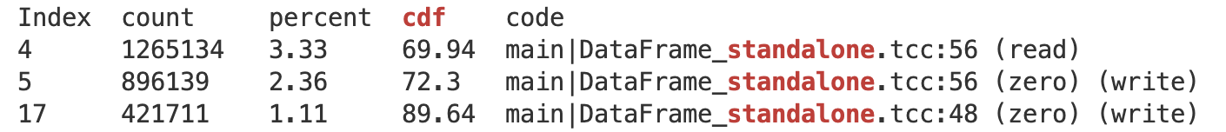
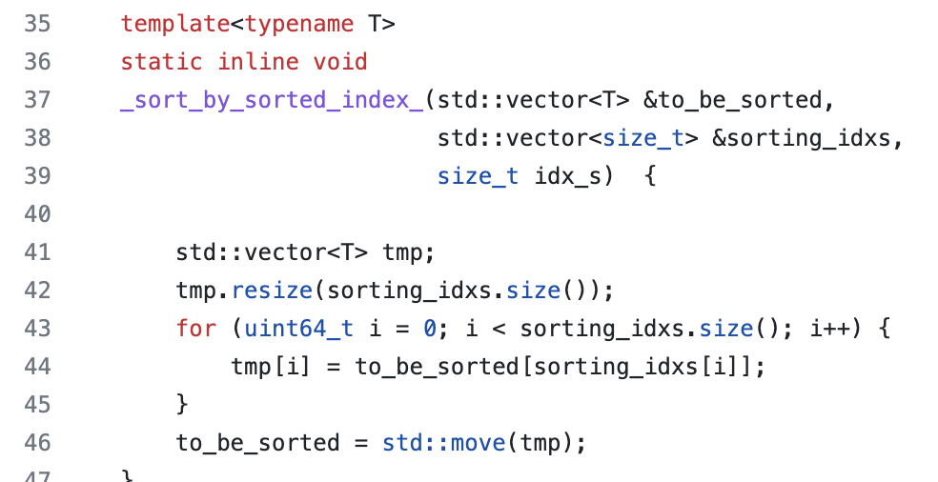
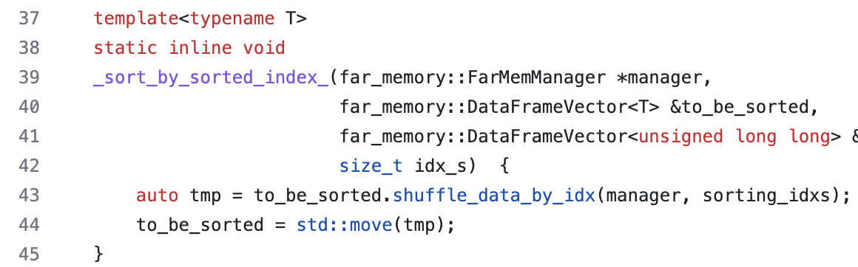
Hotspot 2: Shuffle (~7%)
Eden hints
Original
AIFM Shuffle Offload

Slide 8
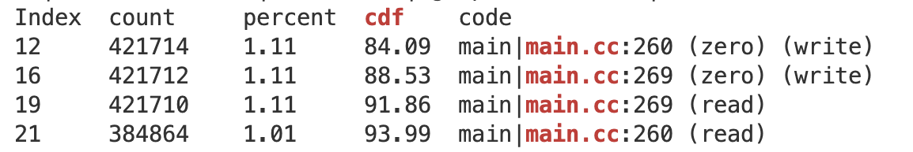
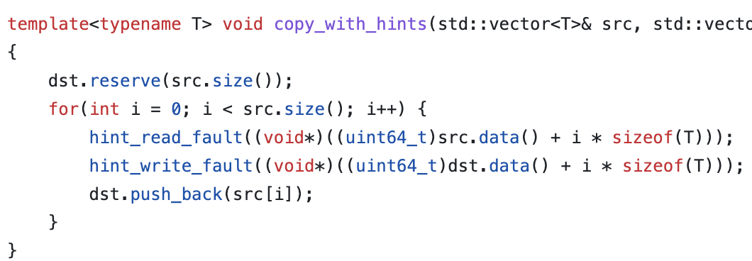
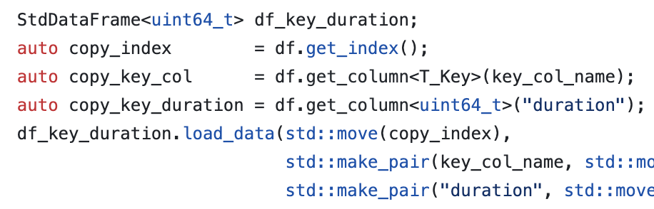
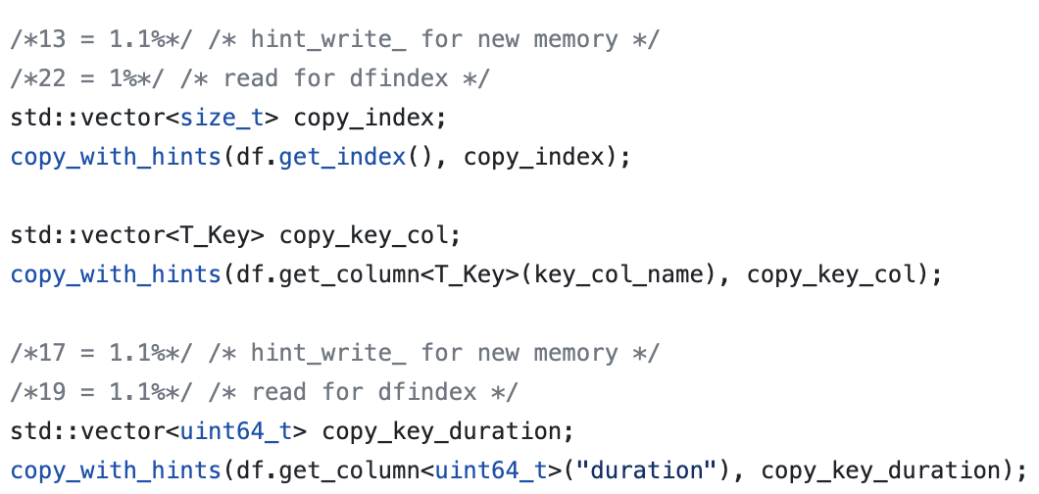
Hotspot 3: Copying in the benchmark (~5%)
An example of default copy constructor usage where hinting first-time write faults is not possible
One option: explicit copy which allows hints
Alternative 1: Use custom vector and overload the constructor (e.g., AIFM)
Alternative: Use range fault to bring in the source vector and turn-off first-time faults
Eden hints

Slide 9
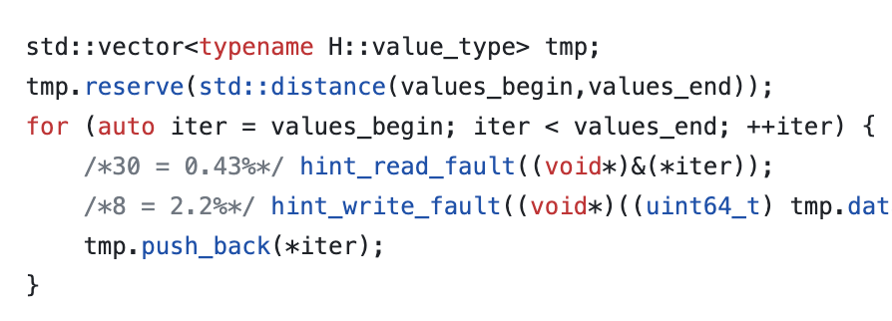
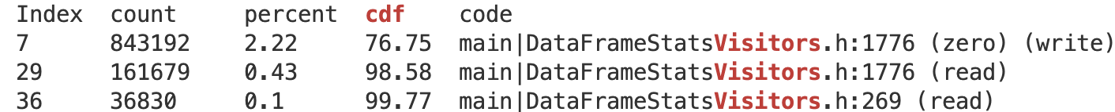
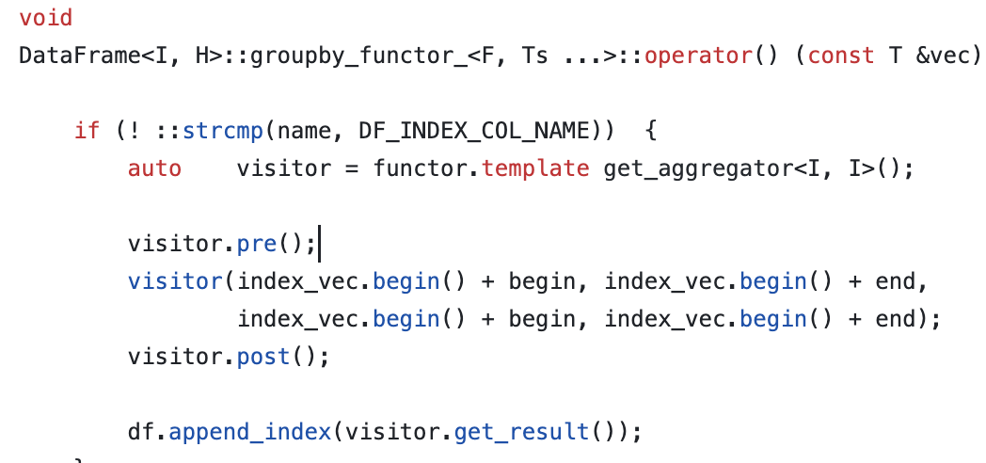
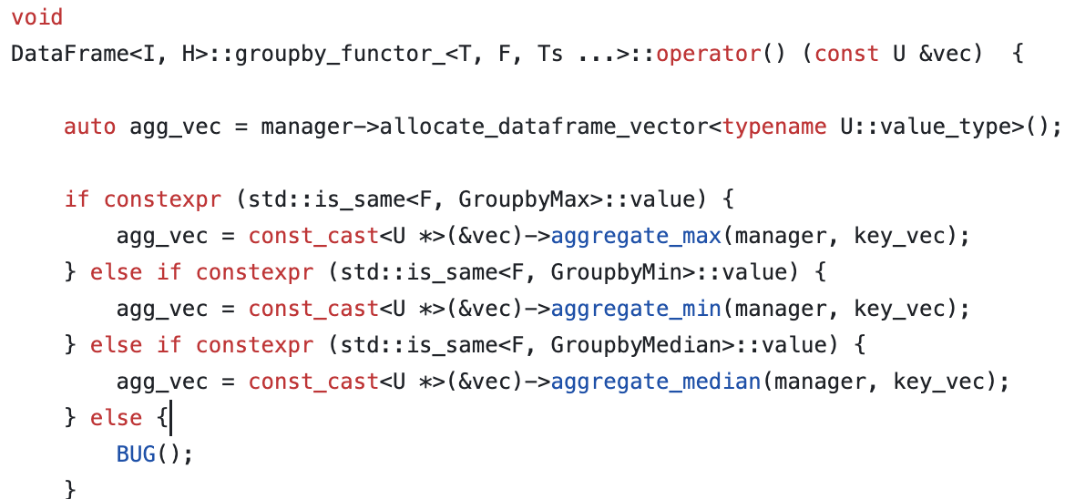
Hotspot 4: Aggregate (~3%)
Eden hints in median()
AIFM Aggregate Offload

Slide 10
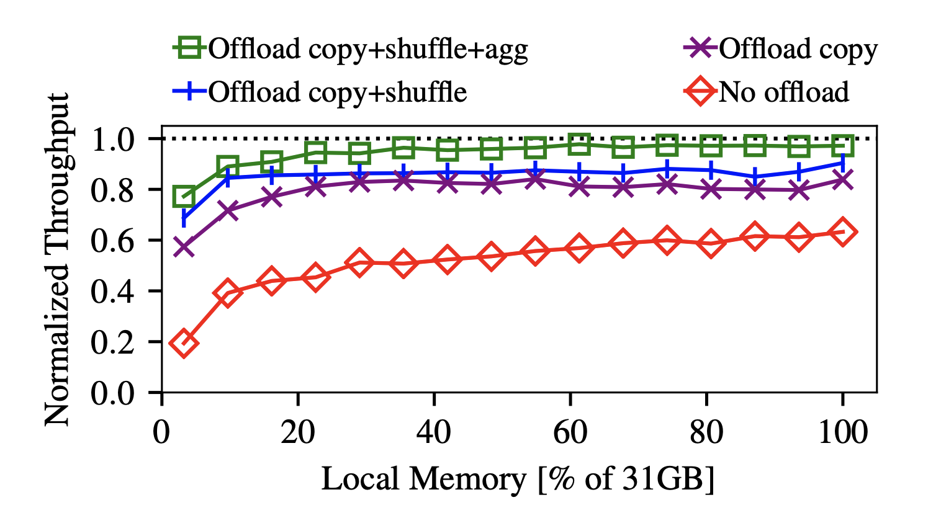
AIFM’s offloads
Note: We don’t compare to the offloaded version
Impact of offloads agree with their fault intensity
Maybe even CPU intensity?
These offload CPU cycles too – wonder why the norm perf doesn’t go above 1 though…
@Amy: Good candidates for copy acceleration?

Slide 11
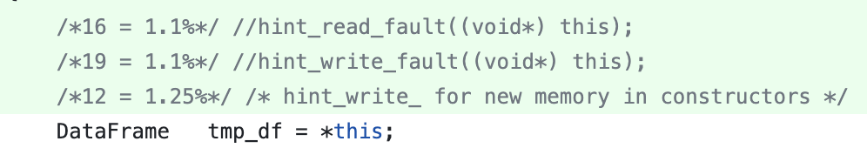
Hinting first-time faults
Copy constructor example
(I think) AIFM overloads operator=(other)
We can do that too, but this requires data structure changes
Maybe many of them e.g., Vector, Dataframe, etc.
What about the stl ones?

Slide 12
Pre-faulting
for all allocations up to certain size
Allocates all the new pages before application touches them
mmap() POPULATE and madvise() POPULATE to explicitly prefault
Issues:
Redundant page allocations that may bloat memory usage and pollute local memory
We won’t be able to use extended hints
But on the good side:
The tail of first-time locations could vanish! (I commented out all but one write hints!)
Batching first-time page faults: entire allocation (e.g., 100MB) in one go

Slide 13
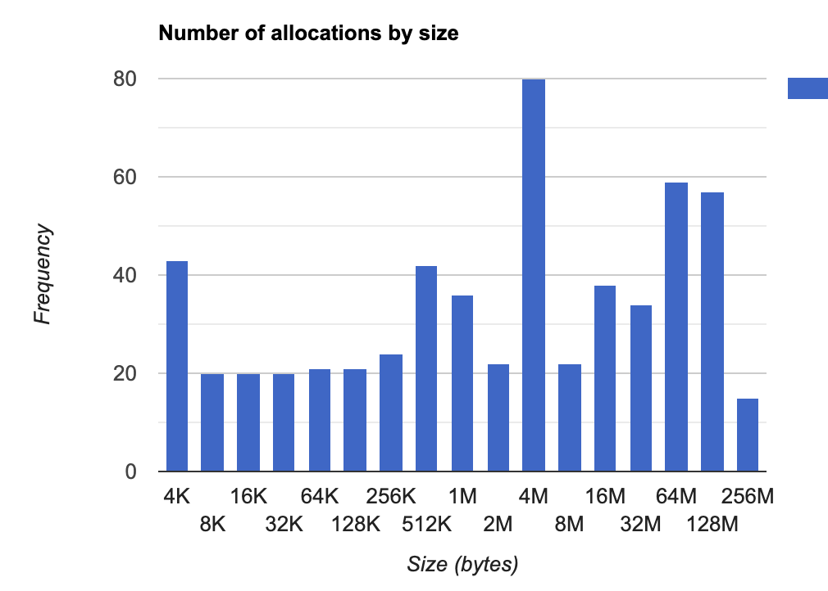
For Dataframe
Collected stats on allocation sizes
Use 128 MB as a cut-off
Our smallest local memory setting was 1.5 GB
One write fault (of the top 3) was enough to remove all first-time faults and didn’t see memory explosion – so worked well for Dataframe
So, it is a hack or a nice feature?

Slide 14
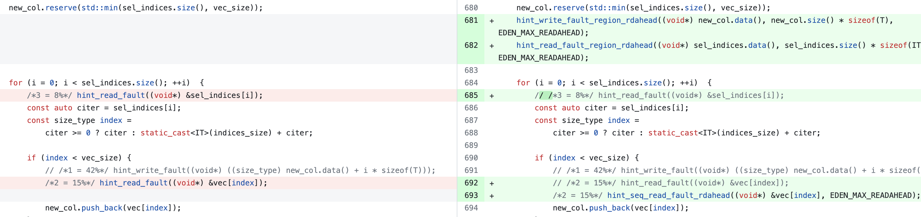
Sequential or range hints
Bring entire vector in one go (range hint out of the loop)
Or, set sequential flag to reduce hinting overhead
Both can take read-ahead – huge impact from batching

Slide 15
Throwback
Hints for CXL-based memory tiering
Intuition: hints can still encapsulate static profiling information
e.g., cache-lines accessed, page access intensity, relative priority, etc.
We first need a CXL emulator + runtime.

Slide 16
Topics
Internship
Eden directions
Exploring hinting in more complicated apps
Pushing a bit more on faulting locations
E.g., how does fault flame graph differ from CPU flame graph?
Hinting for CXL
CXL (emulator) runtime with remote NUMA socket
Latency emulation
We may not need b/w emulation
Most pieces are already in place in Eden
Memory interposition
Page tracking/management structures
Local swap – directly addressable
Move_pages() to migrate pages between nodes
May want to build PEBS and others later

