Slide 1
CXL emulator + runtime
First step to get experiments going
Emulation with a CPU-less NUMA node seems fine
Need Library/runtime with basic tiering mechanisms
Key: page allocation and migration among tiers (i.e., nodes)
Found Intel memkind, flexmalloc, etc. but these only do allocations
We can also build anew on Eden

Slide 2
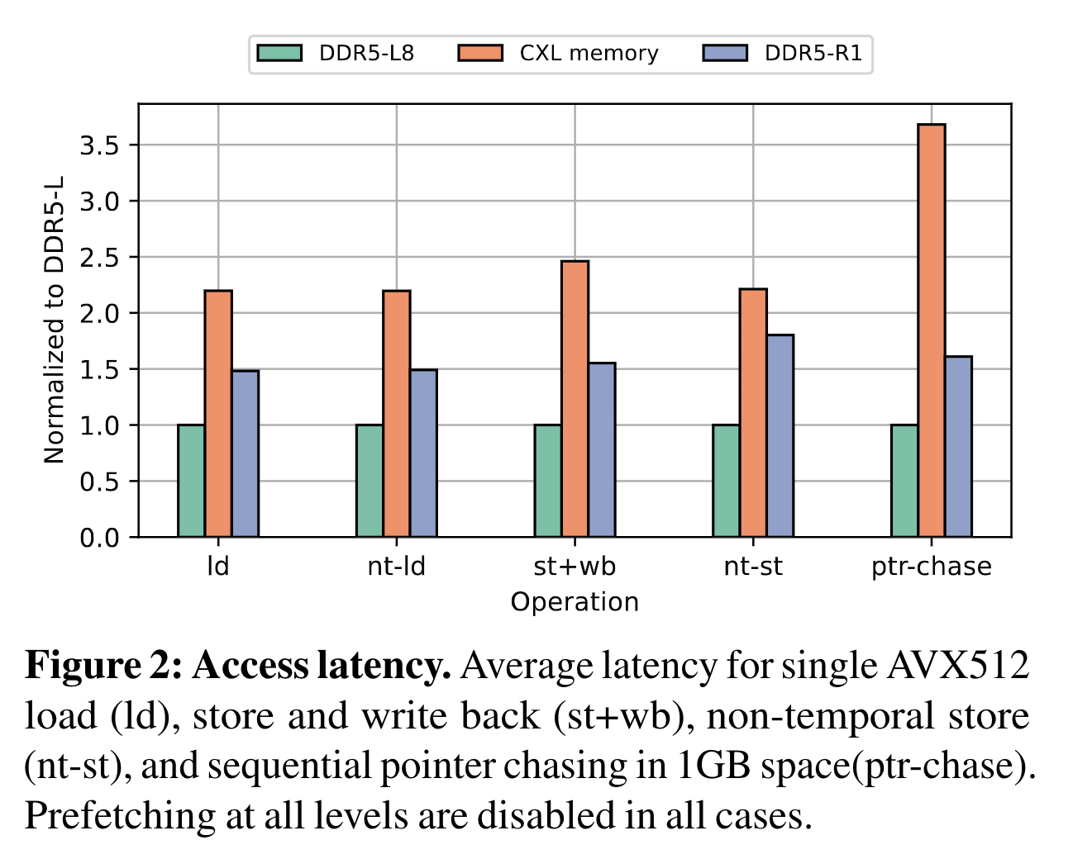
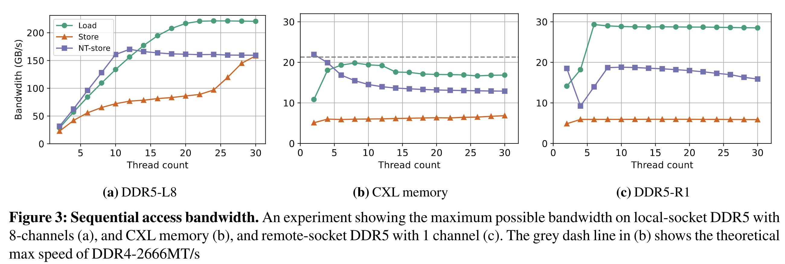
CXL emulation
With remote NUMA socket seems ok!
Latency emulation may be off by ~2x
Bandwidth is not hugely different (at least for single channel)
Source: Demystifying CXL Memory with Genuine CXL-Ready Systems and Devices, arXiv

Slide 3
Requirements for Tiering
Directing allocations
Libnuma provides explicit numa alloc/frees but page-granular
Intel memkind uses jemalloc and forwards allocations to different nodes either transparently or through custom API
When transparent, you specify policy e.g., node ratios
Either way, allocations stay put
We can already do this in Eden
Both these do not know what memory is faulted in at any point
Required for migration
Tracking possible with userfaultfd (UFFD_COPY to specified NUMA node) but it is better to avoid userfaultfd

Slide 4
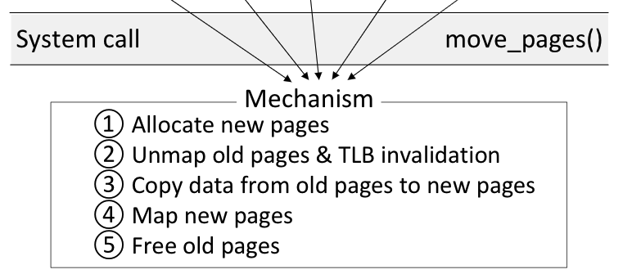
Requirements for Tiering
Page migration
move_pages() migrates pages among nodes (in batches)
Nimble’s improvements to the above sycall (open-sourced!)
Nimble also adds a new syscall: exchange_pages() which speeds up bi-directional movement

Slide 5
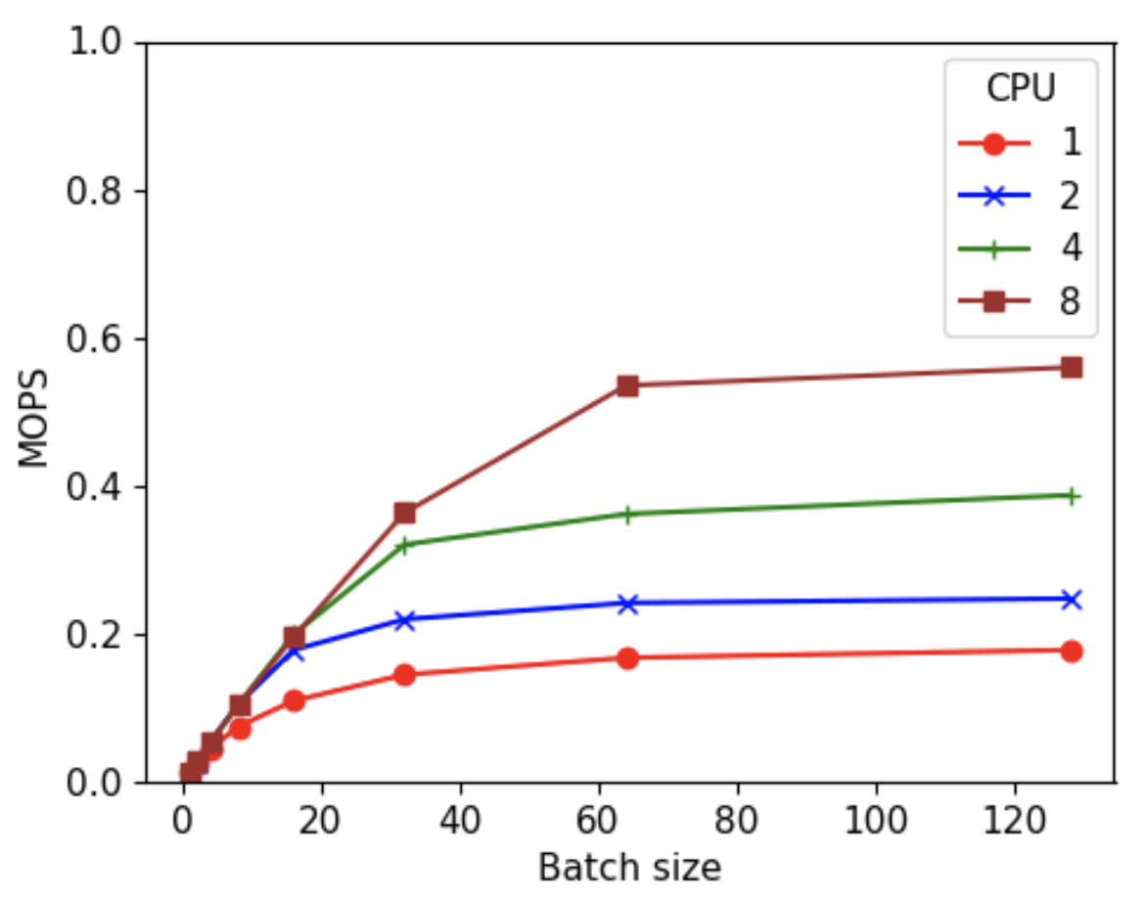
Requirements for Tiering
Page migration
move_pages() migrates pages among nodes (in batches)
Nimble’s improvements to the above syscall (open-sourced!)
Nimble also adds a new syscall: exchange_pages() which speeds up bi-directional movement

Slide 6
Memory tiering library: One option
Register a big region with Userfaultfd
Point jemalloc into the region (same as Eden)
On zero-page faults, direct allocations with (modified) UFFD_COPY
Need to know what pages are registered and where they reside
There won’t be any other page faults; how can we avoid Userfaultfd?
Page migration using move_pages()/exchange_pages()
What pages to move depends on policies we can build on later
I see no need for Shenango (so far)
Hiding latencies not possible nor necessary
Page migration throughout not a concern – we should be conservative with migration anyway because it cuts into CPU time and inter-tier bandwidth

