Slide 1
Agenda
High-level plan for resubmission
New Eden design
New insights into faulting code locations

Slide 2
High-level Plan
Reinforcing design choices
User-level threads
Hints
Evaluation
Clear comparisons with kernel threads, AIFM & Fastswap
Programmer effort as another metric
Big benchmarks: SiloDB

Slide 3
Reinforcing design choices
User-level threads
Clear comparison with Pthreads/Fastswap
Use flexibility of scheduling decisions – RSS aware scheduling for Sort
Hints
Show that hint locations are few (and does not require app context)
Demonstrate benefits of hints – find more uses
Read-ahead (with variable, automatically-inferred window size)
Hotness tracking with hints (& second-chance eviction)
Find other uses from page fault traces?
Notes:
Self-paging work –
how is remote memory different?

Slide 4
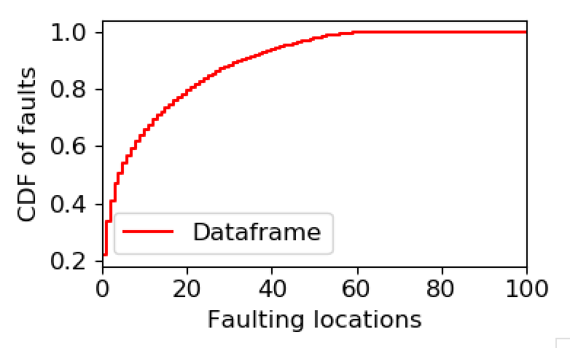
Improving Eval
Clear comparisons with kernel threads, AIFM & Fastswap
Programmer effort as another metric
Big benchmarks: SiloDB
AIFM Dataframe – 12k lines
AIFM changes around ~1k lines & requires application context
Argument: we change 50 and no context?
Challenge: No multi-threading for Dataframe

Slide 5
Agenda
High-level plan for resubmission
New Eden design
New insights into faulting code locations

Slide 6
New design
Each shenango core handles its (hinted) faults
Dedicated handler core(s) for kernel faults & proactive eviction
Every core handles eviction if completely out of memory
All cores get dedicated RDMA QP/CQ
Faults on the same page are completely E2E serialized
Concurrent faults are placed on wait_q – polled often
Extended work stealing to fault completions & waiting faults
Malloc interception with Shenango shim lib (no LD_PRELOAD)

Slide 7
New additions
Opportunistic read-ahead
Opportunistic eviction batching
Facility for local memory backend
No-wake for pure user faults
Facility for multiple handler cores (statically for now)
Better eviction policy with hot bits
Facility for injecting additional latency
Set single-use on pages

Slide 8
Changes summary
4200 LOC added to Shenango
All features added – except je_malloc integration
Tested & benchmarked handler fault path
Yet to do:
Benchmark with Eviction & Hints
Re-take results for Memcached, Synthetic and Sort

Slide 9
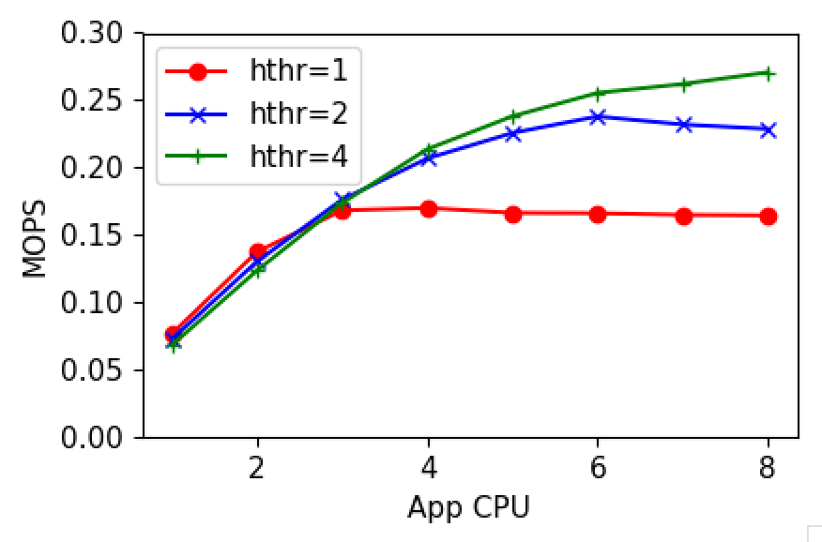
Fault performance
1 core: 232228
Stealing not working as expected
Kernel faults
Hinted faults

Slide 10
Agenda
High-level plan for resubmission
New Eden design
New insights into faulting code locations

Slide 11
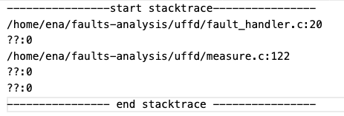
Faulting code locations
Most IP locations either:
Don’t resolve to a code location (precompiled libs)
End up in header/lib files (no control over source)
Examples
Must get stack traces
No tools
Signal faulting thread while it waits
Backtrace in the signal handler
CDF of traces might look very different!

Slide 12
Next
Wrap up benchmarking with the new design
Get back traces for all apps
Revert to the planned work – AIFM Dataframe & SiloDB

Slide 13
Misc

Slide 14
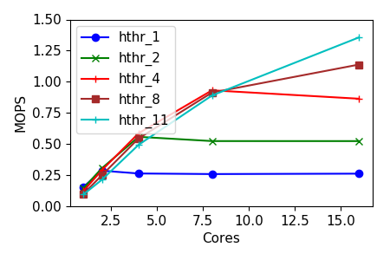
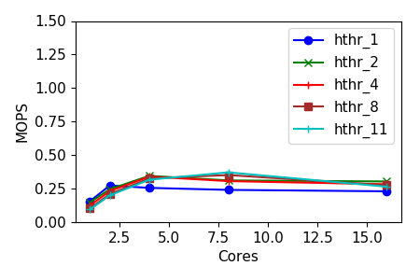
UFFD quirks
FD per core
Shared FD

Slide 15
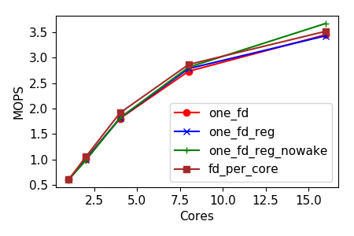
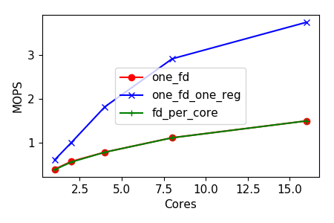
UFFD quirks

Slide 16
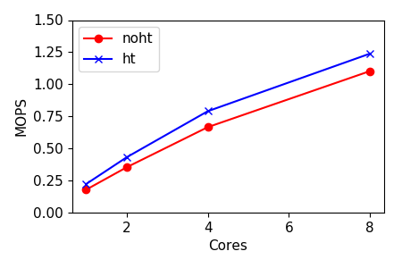
UFFD quirks

