Slide 1
Update
Debugging Shenango baseline
Throughput/pagefaults with Kona

Slide 2
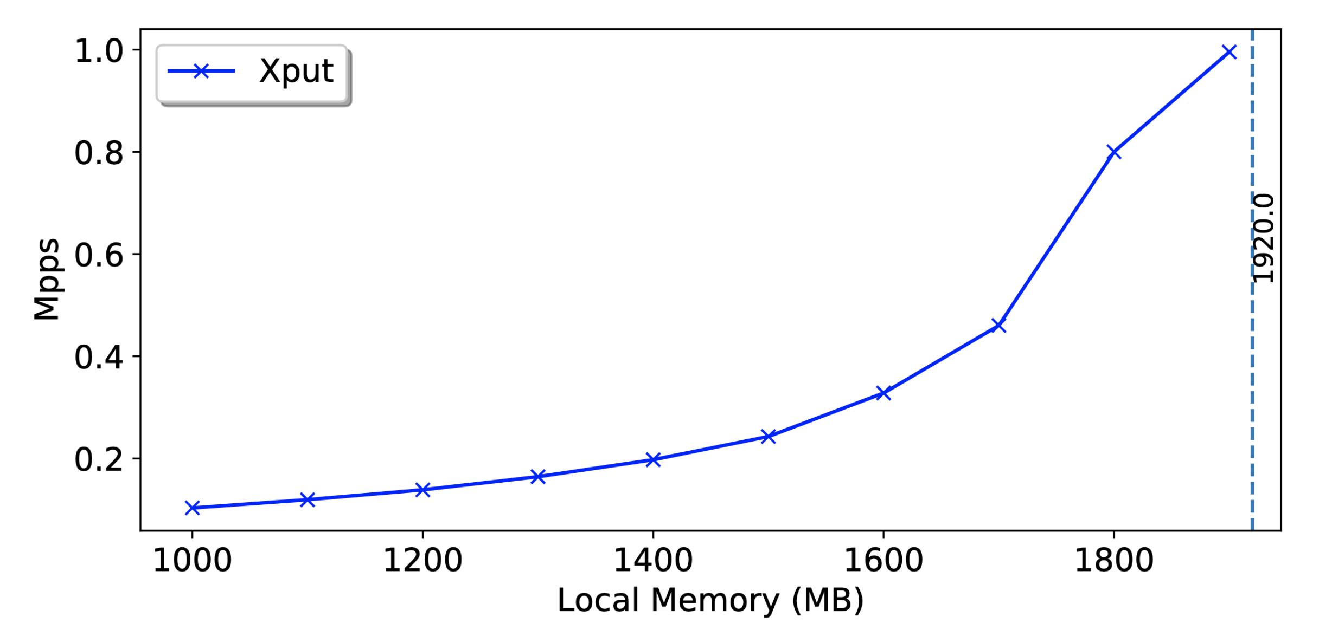
Throughput
Offered load: 1Mpps
Total memory footprint: ~2GB
TODO: Add exp parameters

Slide 3
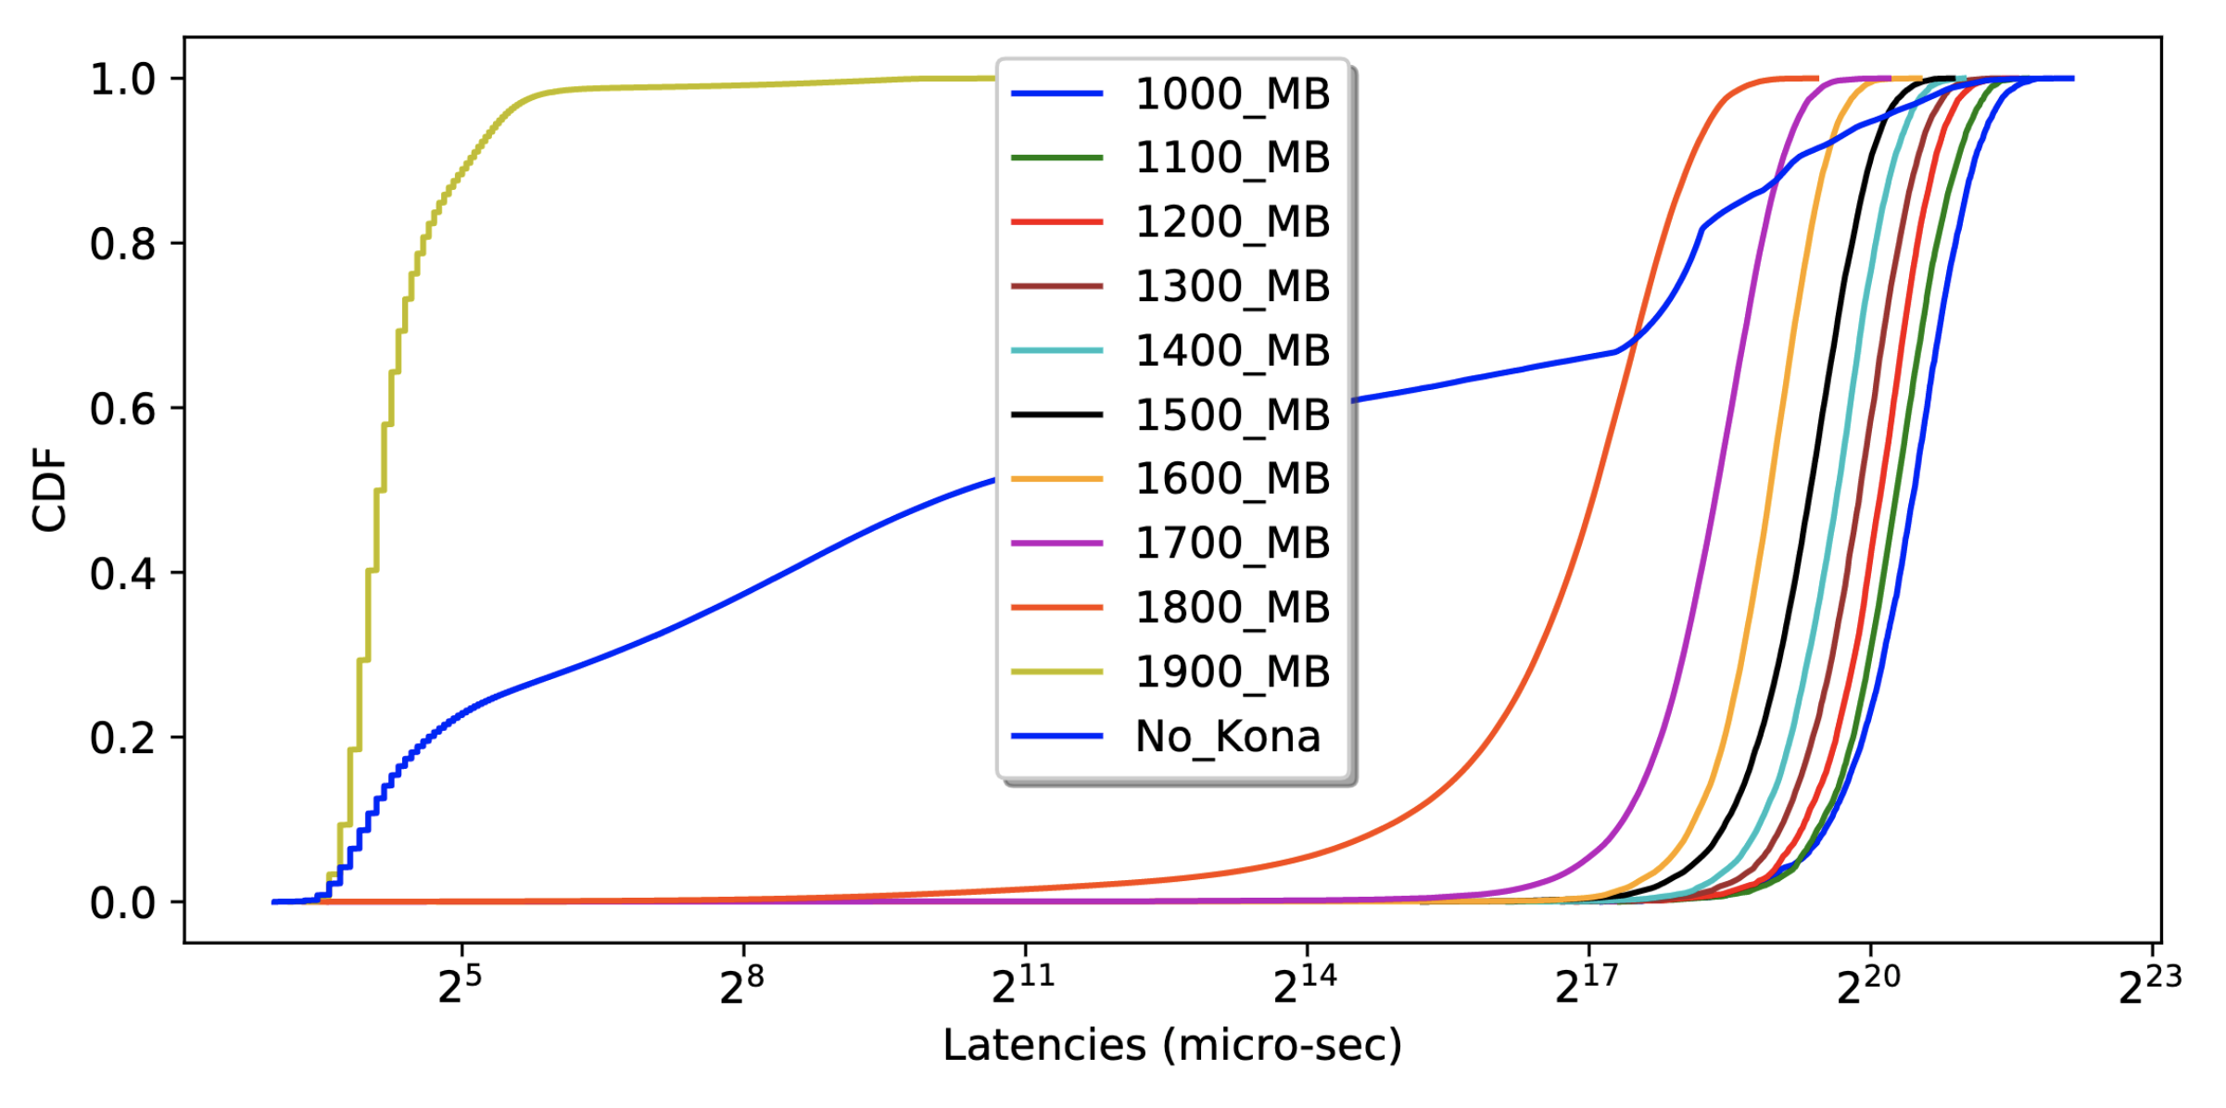
Latencies

Slide 4
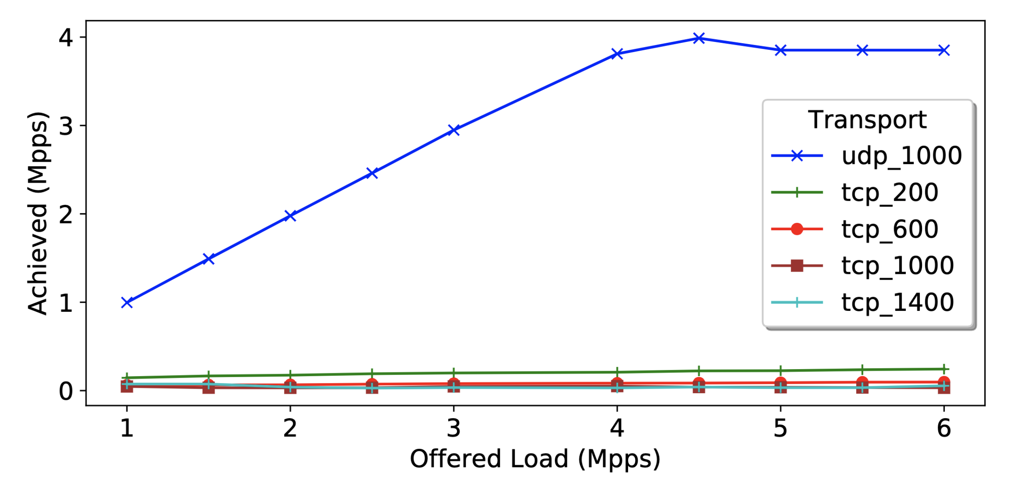
TCP vs UDP

Slide 5
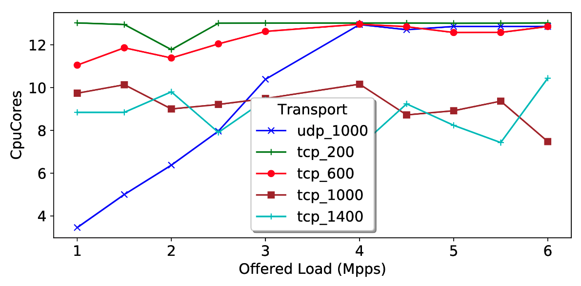
TCP vs UDP
Increasing TCP connections were not helping that much
Throwing extra cores did not help with UDP saturation – iokernel?

Slide 6
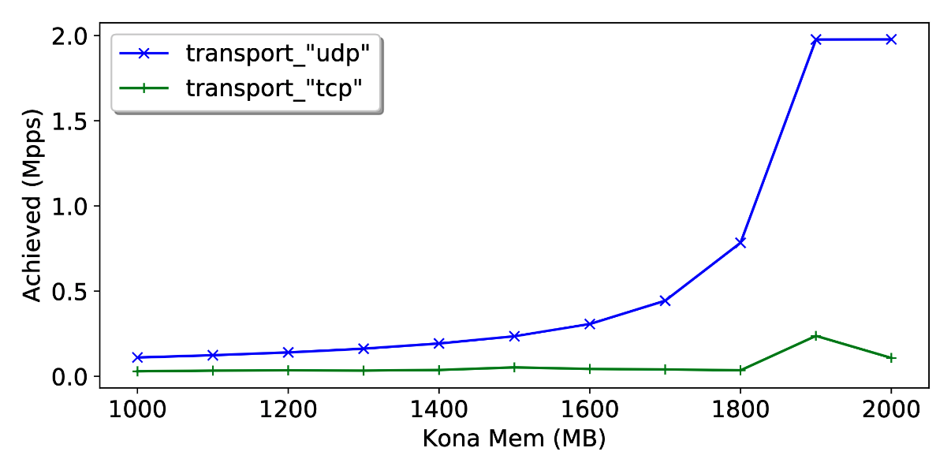
Kona: TCP vs UDP

Slide 7
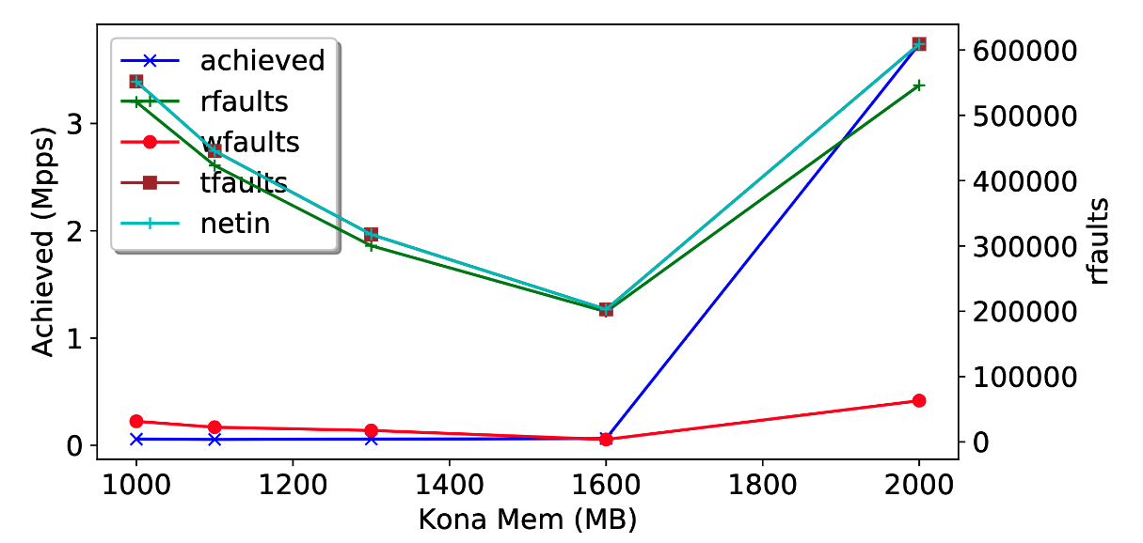
Kona UDP Page faults

Slide 8
Misc

Slide 10
Setup
b1640
Rack Controller
b1630 (Cores)
Memcached Process
Memory
Server
Shenango
IO Core
User Threads
Kona Threads
Poller
User faults
Eviction
Shenango Runtime
b1607
Memcached
Client
Shenango
NIC (DPDK +RDMA)

