Slide 1
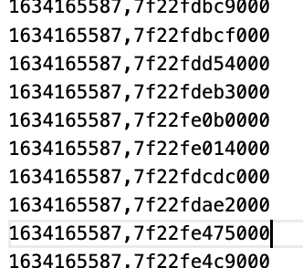
Status
Exploring Memcached for write faults
Tried addresses from userfaultfd

Slide 2
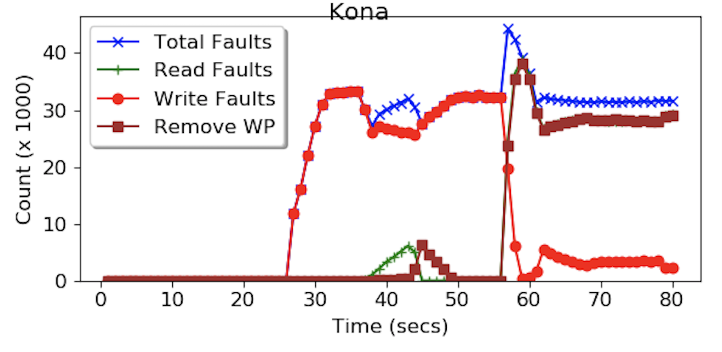
Faults

Slide 3
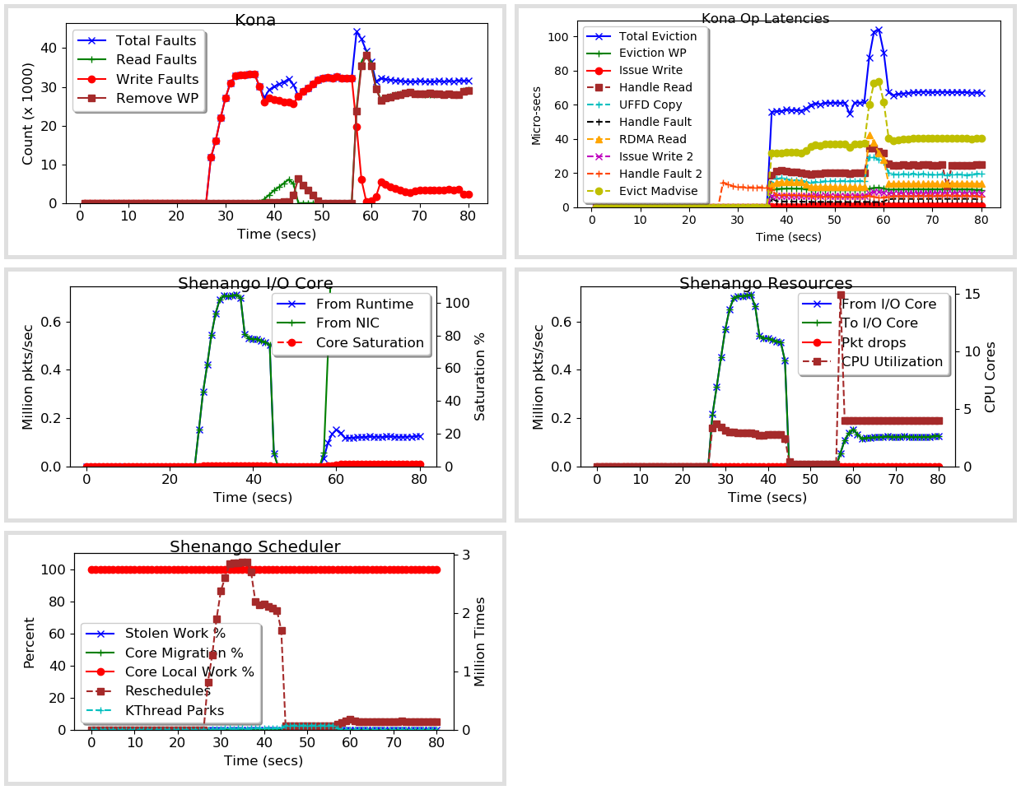

Slide 4
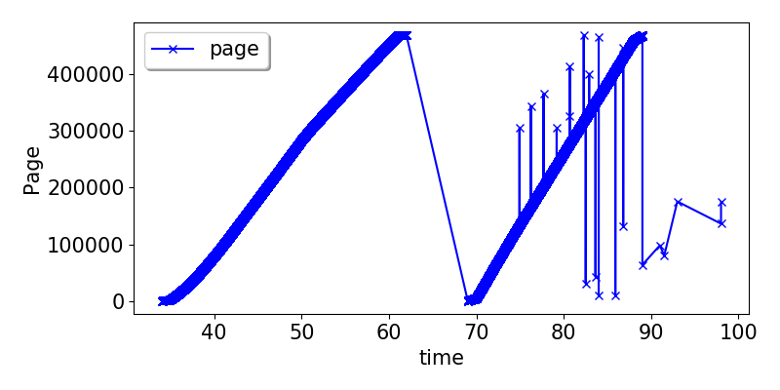
Fault pages: writes

Slide 5
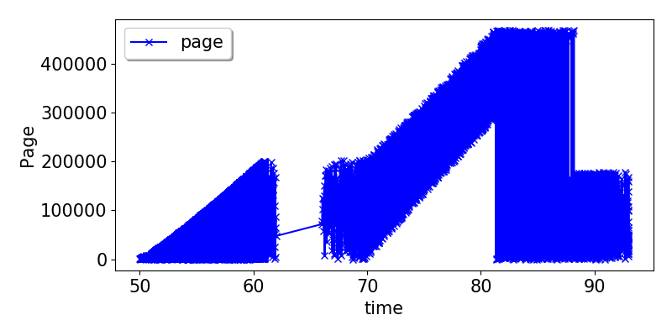
Fault pages: reads

Slide 6
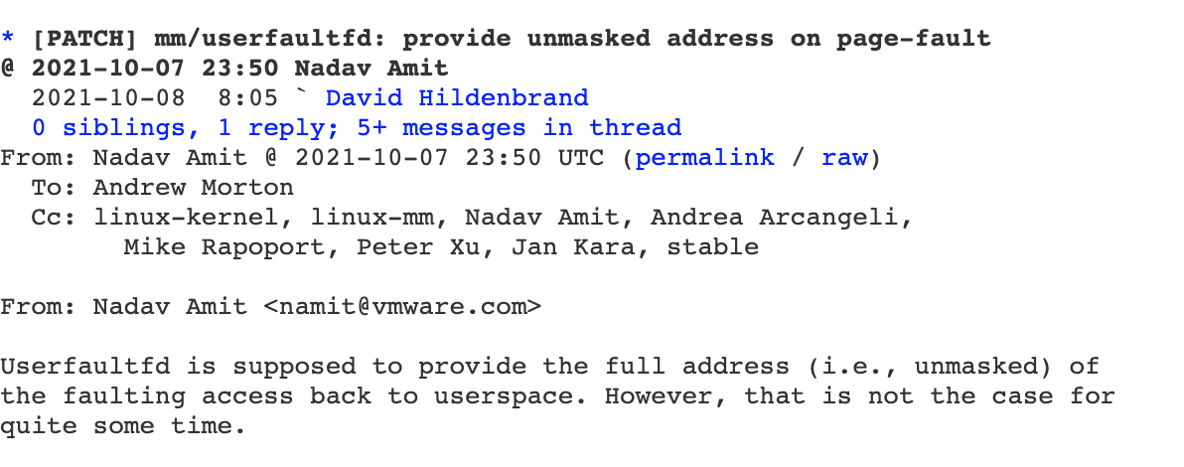
Unmasked addresses
Trying to apply the patch.

Slide 7
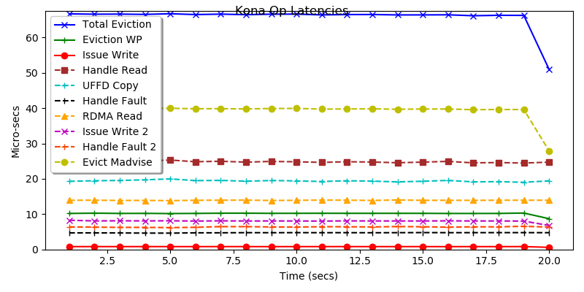
What we’ll save: ~10%

Slide 8
Misc

Slide 9
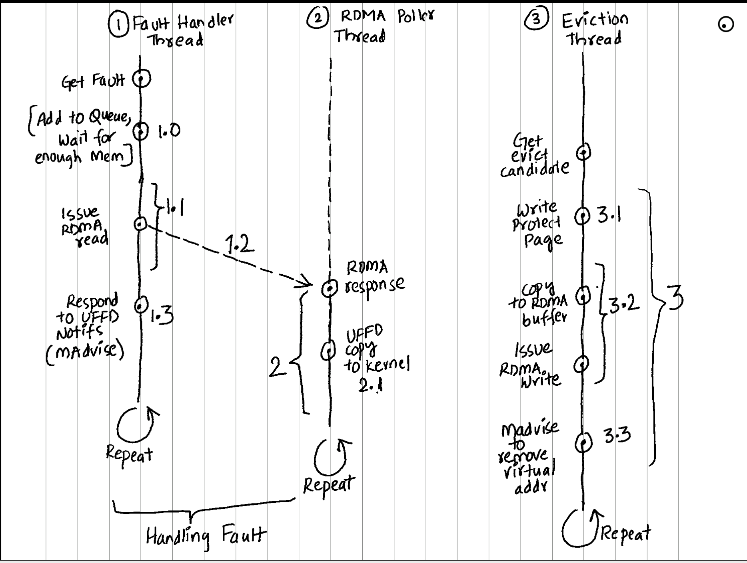
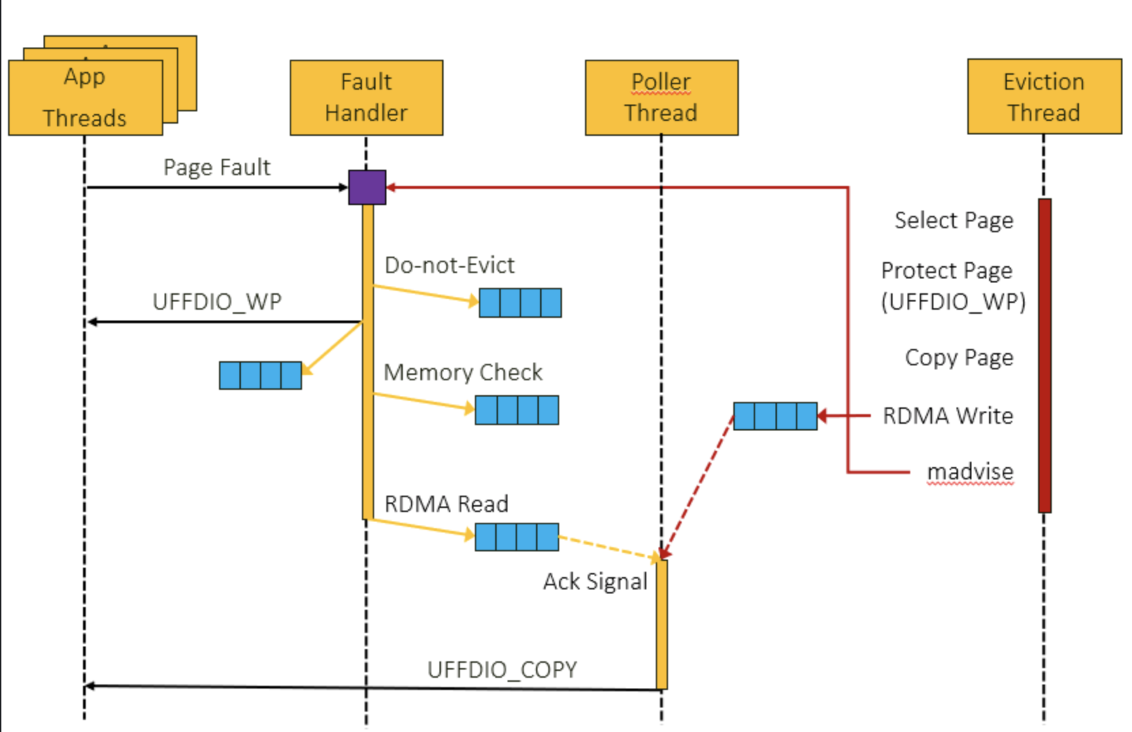
Kona Flowchart

