Slide 1
Status
Madvise notification
Benefit
Correctness
Madvise batching
Benefit
Correctness

Slide 2
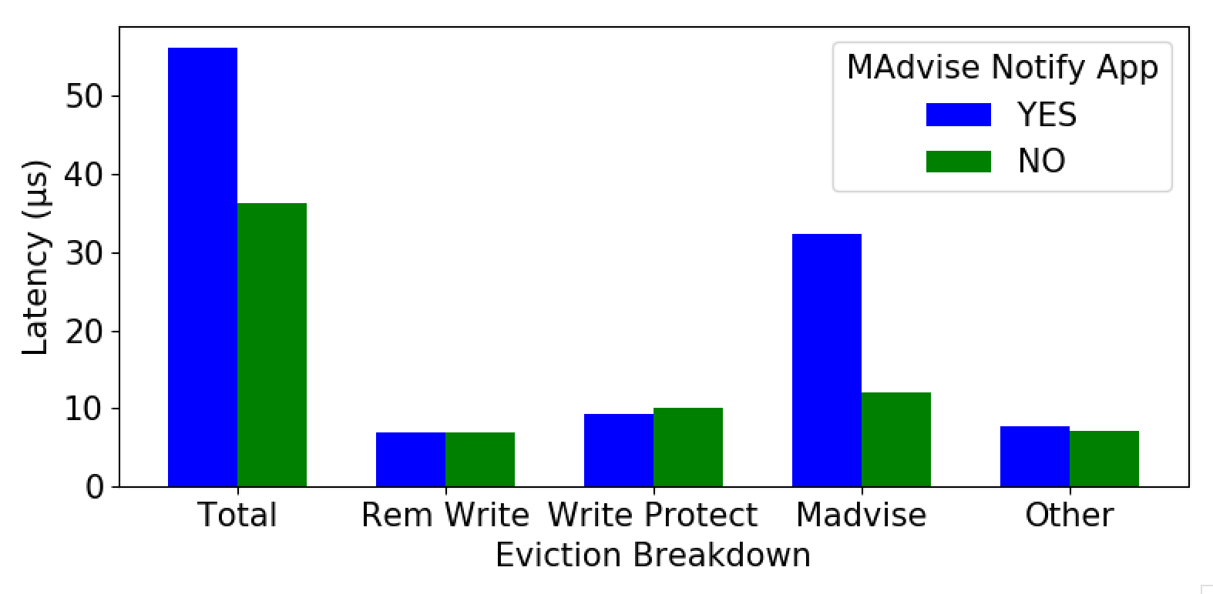
Madvise notif: Cost

Slide 3
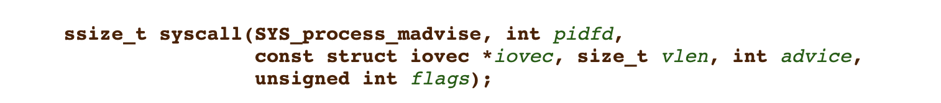
Madvise batching
Vectoring not supported – pages need to be contiguous.
Kona’s eviction may allow us that.
Current policy round-robins the allocated region

Slide 4
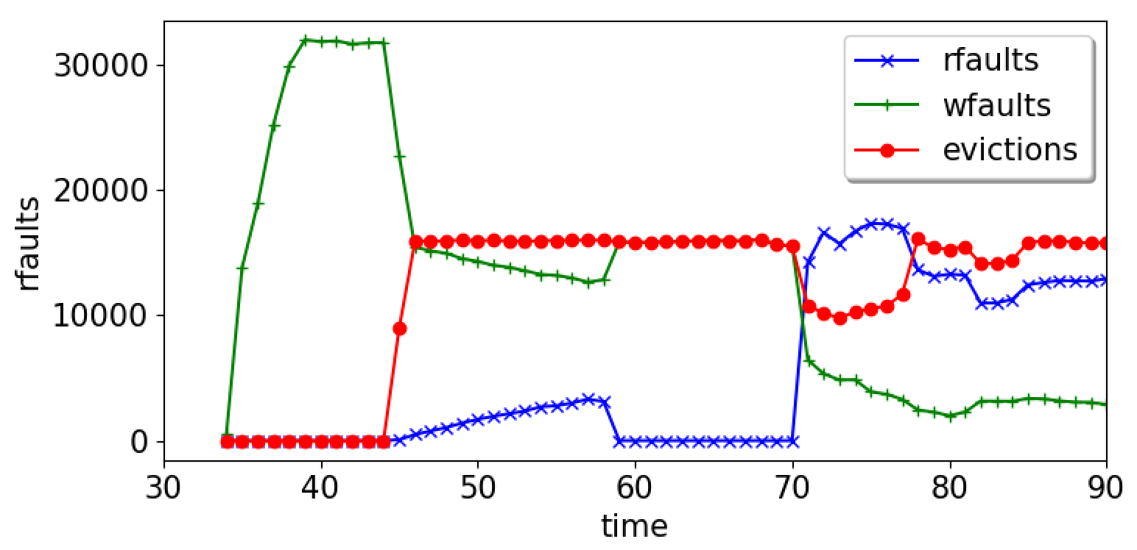
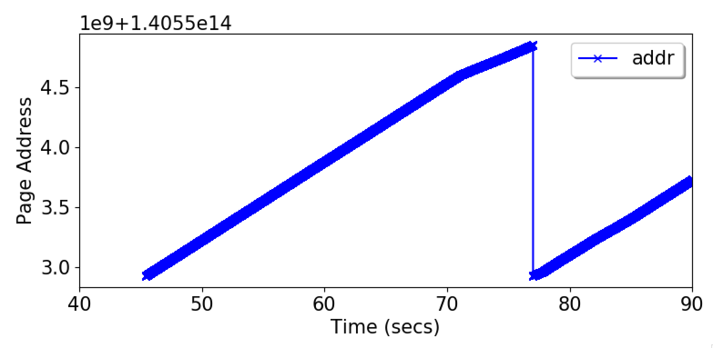
Evicted Pages Over Time

Slide 5
Misc

Slide 6
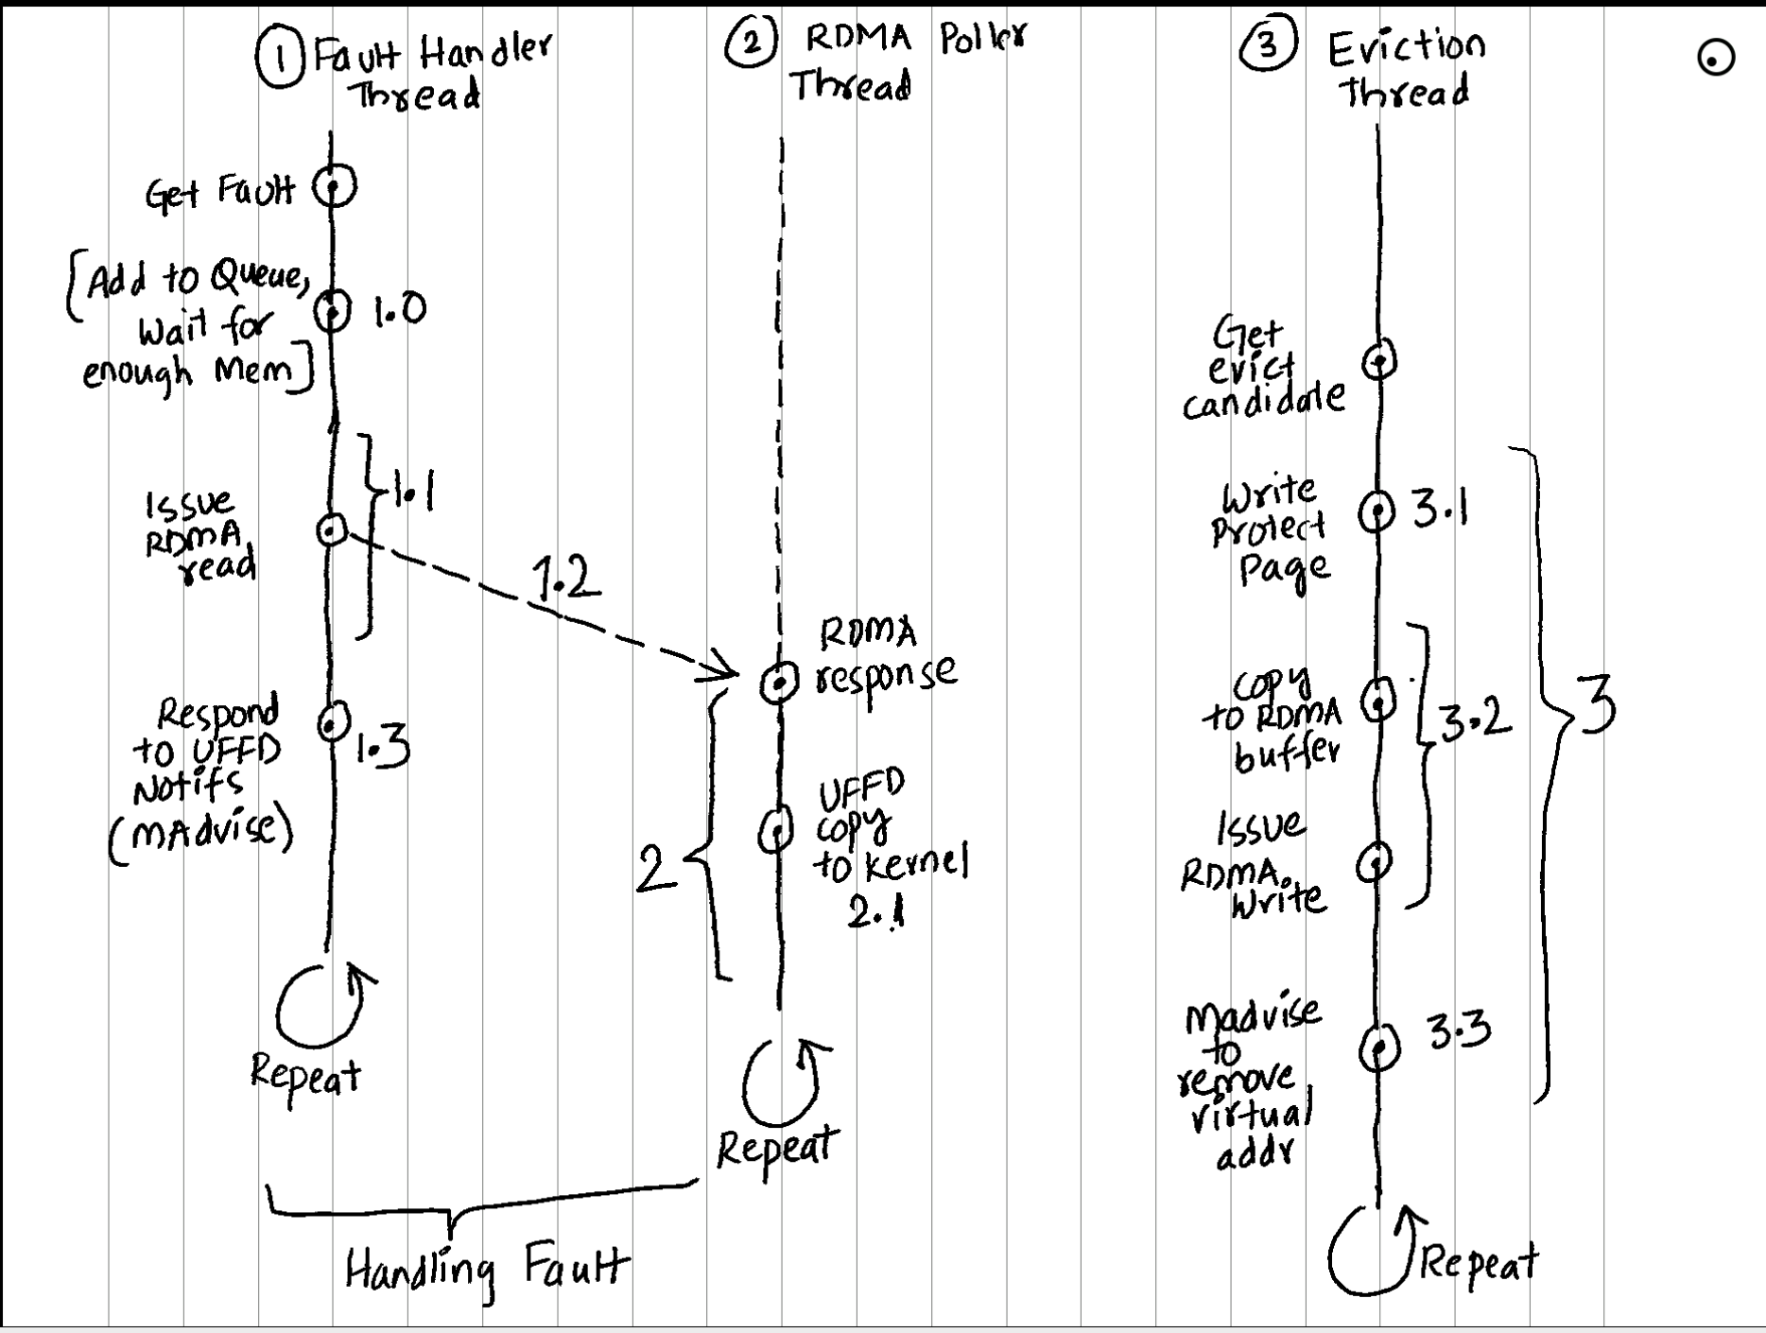
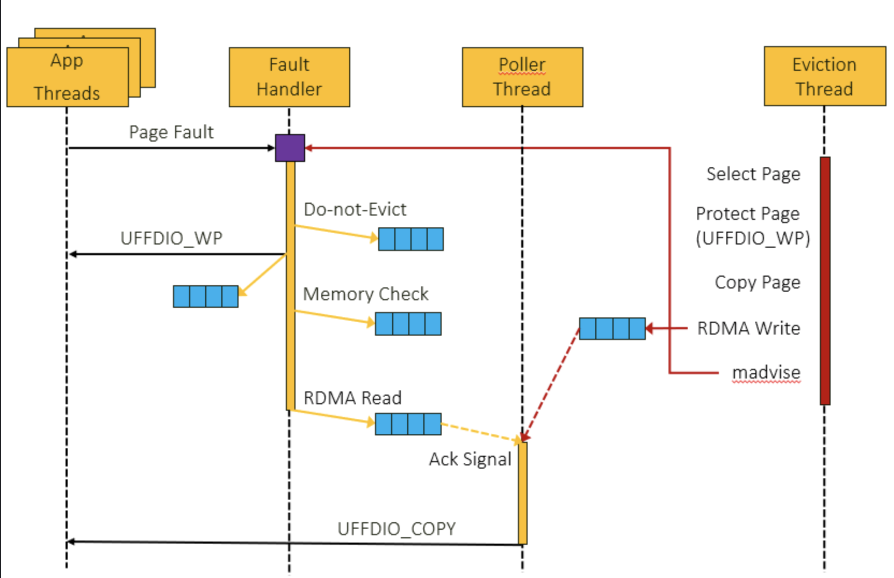
Kona Flowchart

