Slide 1
Status
Tested/benchmarked scheduler changes
Working on Memcached
App
Interface
Kona
Remote memory server
Scheduler
Kernel

Slide 2
Throughput Benchmark
Main thread spawns a batch of worker threads
Added to the ready queue on the main core
Can be stolen by other cores
Each worker thread raises a pagefault
Vanilla: no pagefault
Regular: kona pagefault
Apf-sync: Non-blocking page faults but synchronous
Apf-async: Non-blocking page faults, yield to the scheduler
Scheduler monitors responses during thread switches
Batch repeats

Slide 3
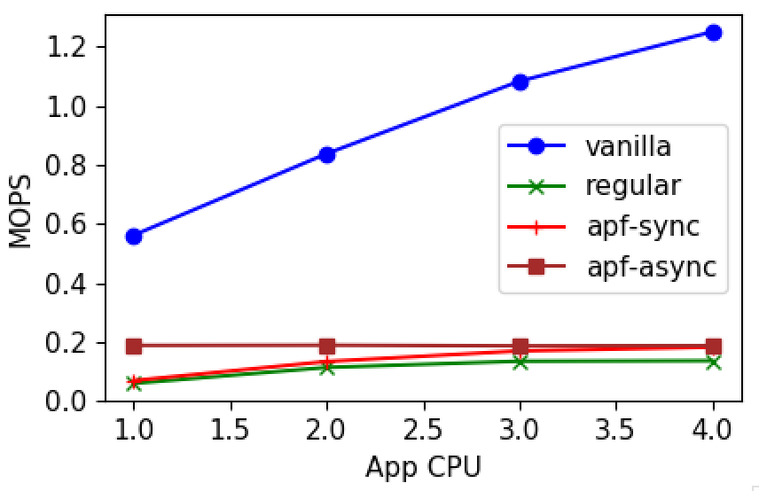
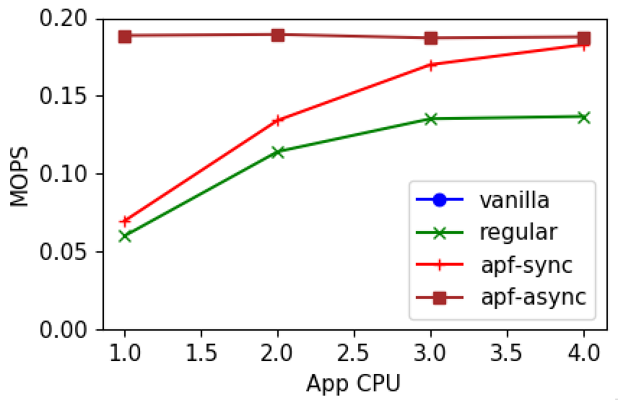
Throughput Benchmark

Slide 4
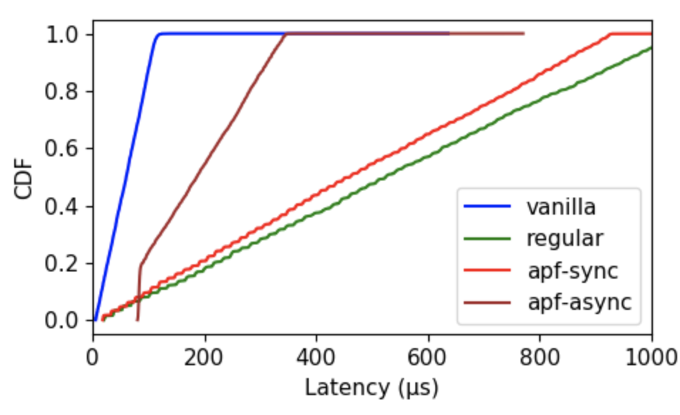
Latency
From thread spawn
1 core
Notes:
Why the tail?
Do we prioritize the returned page fault?

Slide 5
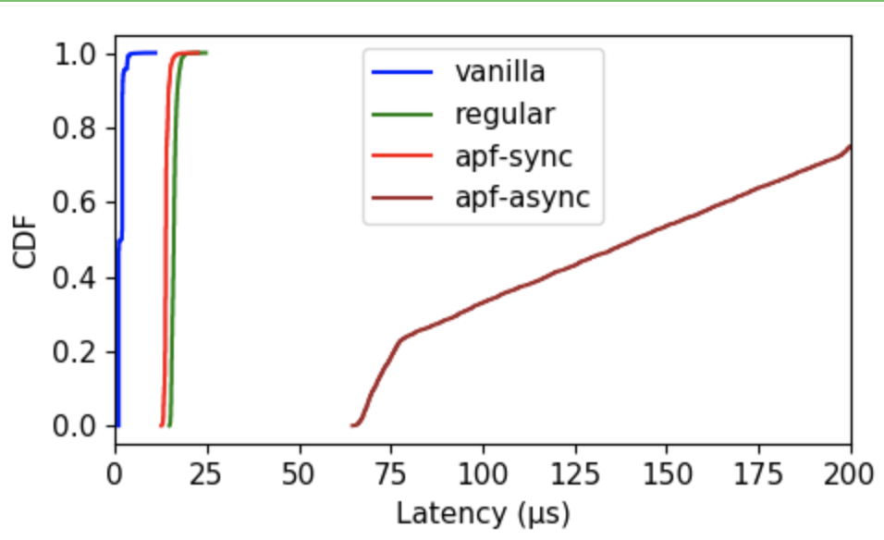
Latency
From thread start
1 core

Slide 6
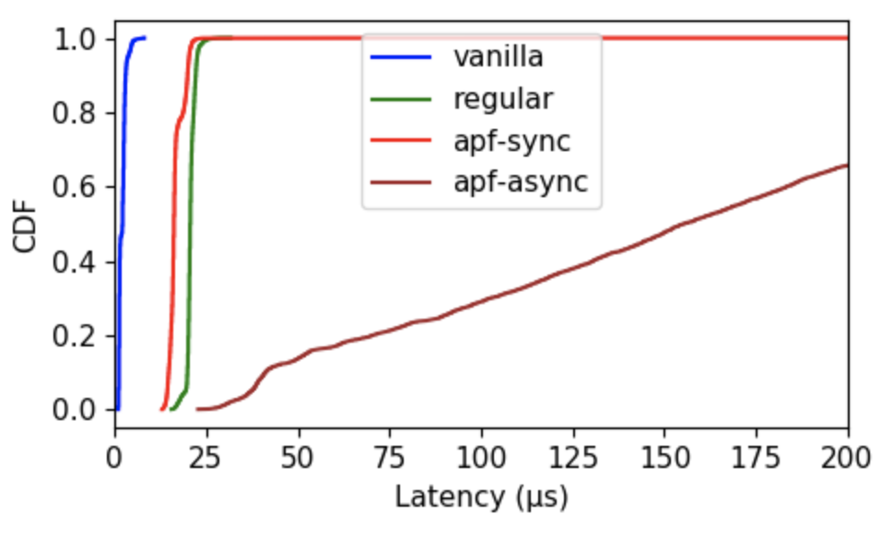
Latency
From thread start:
3 cores

Slide 7
Next
Annotating Memcached
Will report back EOW
Reschedule next few meetings

Slide 9
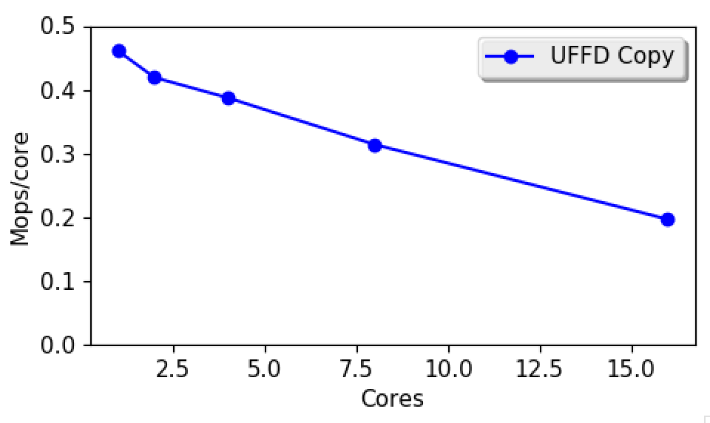
UFFD-copy scalability

