Slide 1
Topics
Fastswap – no progress
Application from AIFM paper – still setting up
Scaling Kona
Paper feedback

Slide 2
New application
Custom-written web service frontend
Hash table lookup + indexing into blob array + compression
Runs on Shenango Caladan
Fancier scheduling, RDMA net stack, etc.
Integrated into AIFM runtime
AIFM’s remoteable data structures & memory evacuation
No AIFM-less implementation –> (APP + AIFM + Shenango)
Borrow the idea/implementation?
Tease apart from AIFM runtime
Run with AIFM runtime at 100% local memory – setup troubles

Slide 4
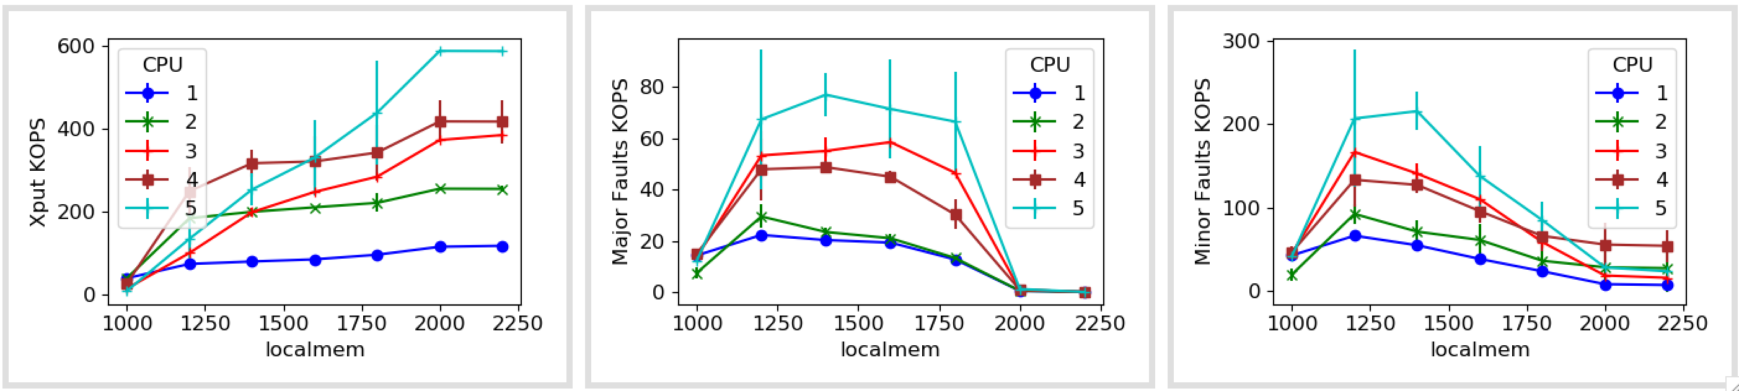
Fastswap with error bars
Notes:
Add more cores
Add more x-axis data points

Slide 5
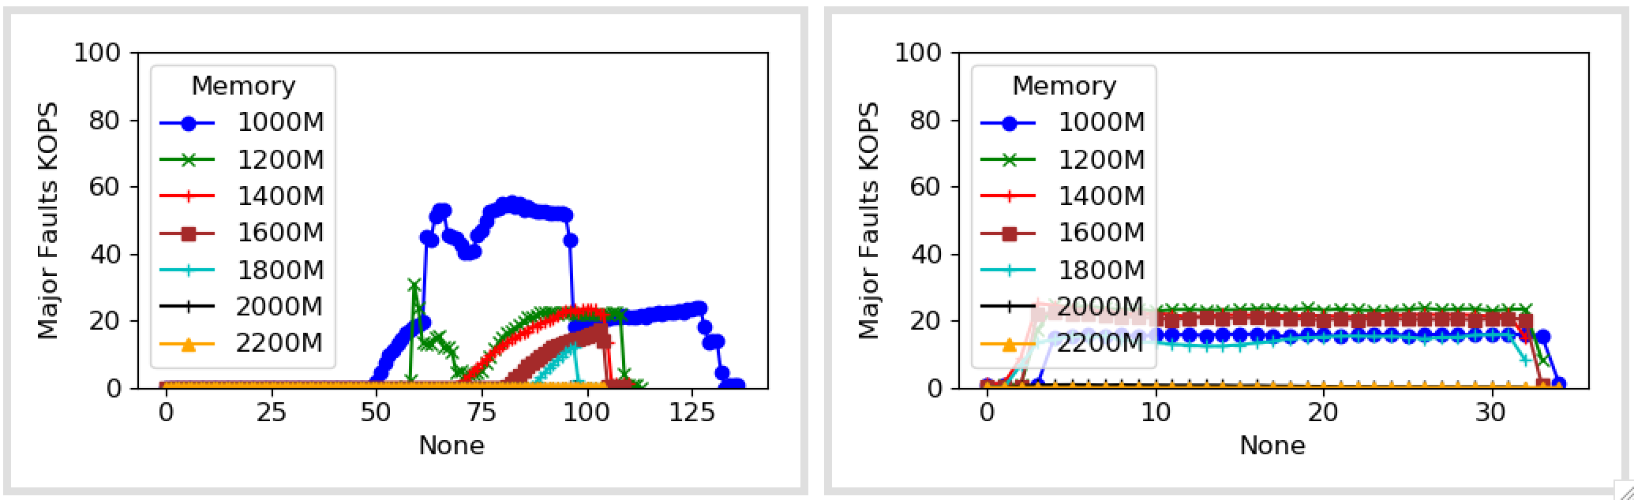
1 core

Slide 6
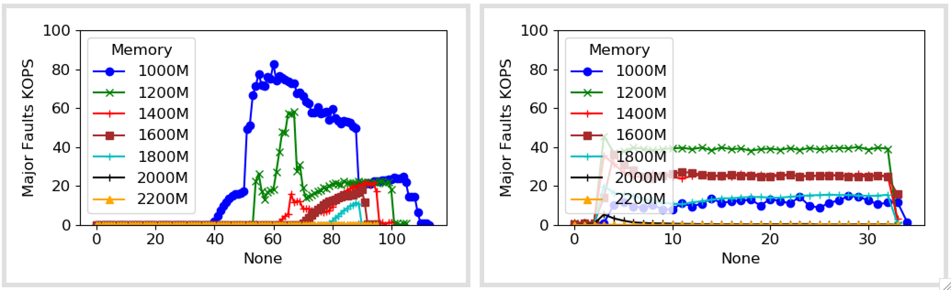
2 cores

Slide 7
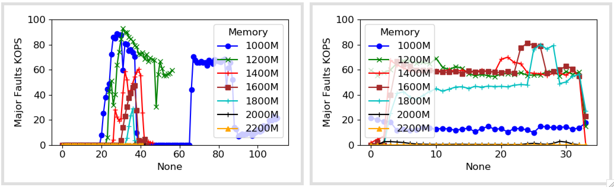
3 cores

Slide 8
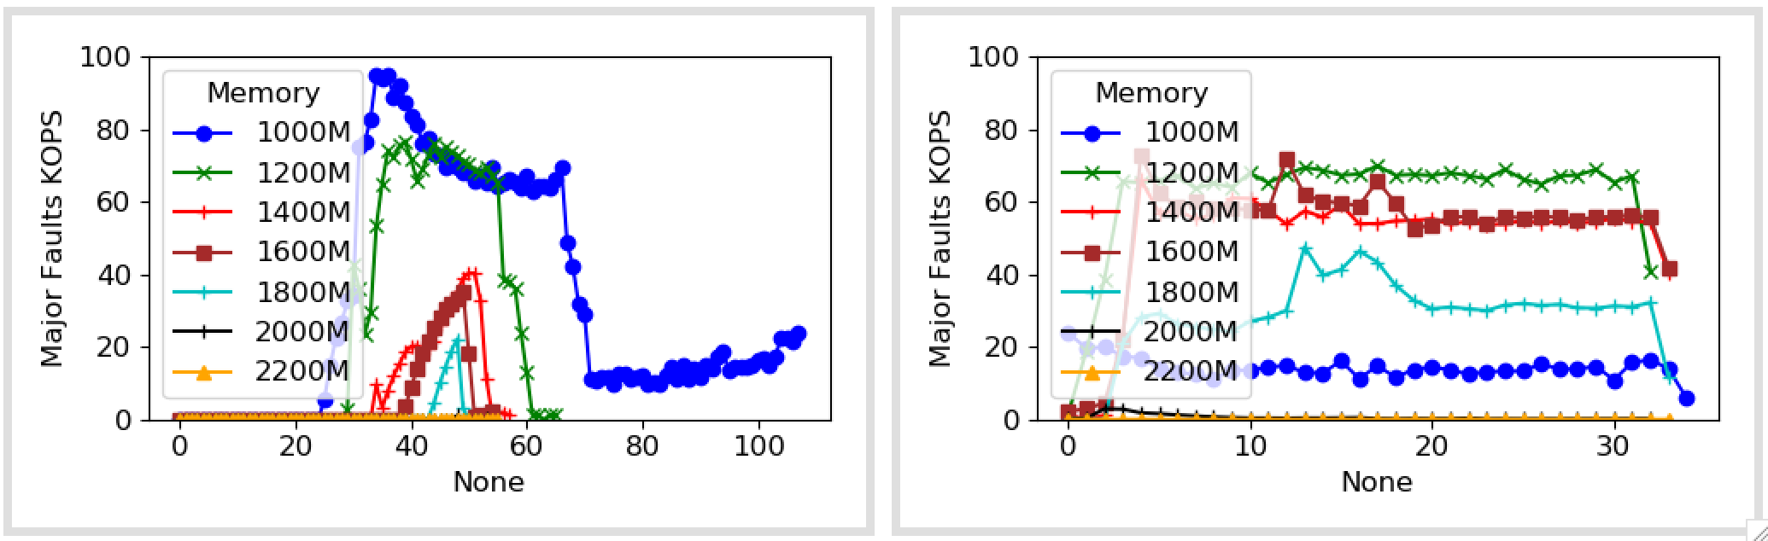
4 cores

Slide 9
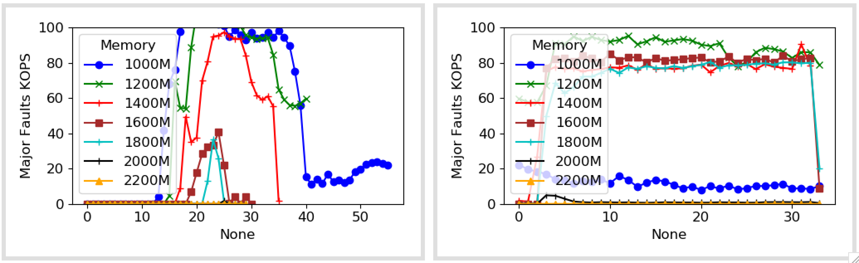
5 cores

Slide 11
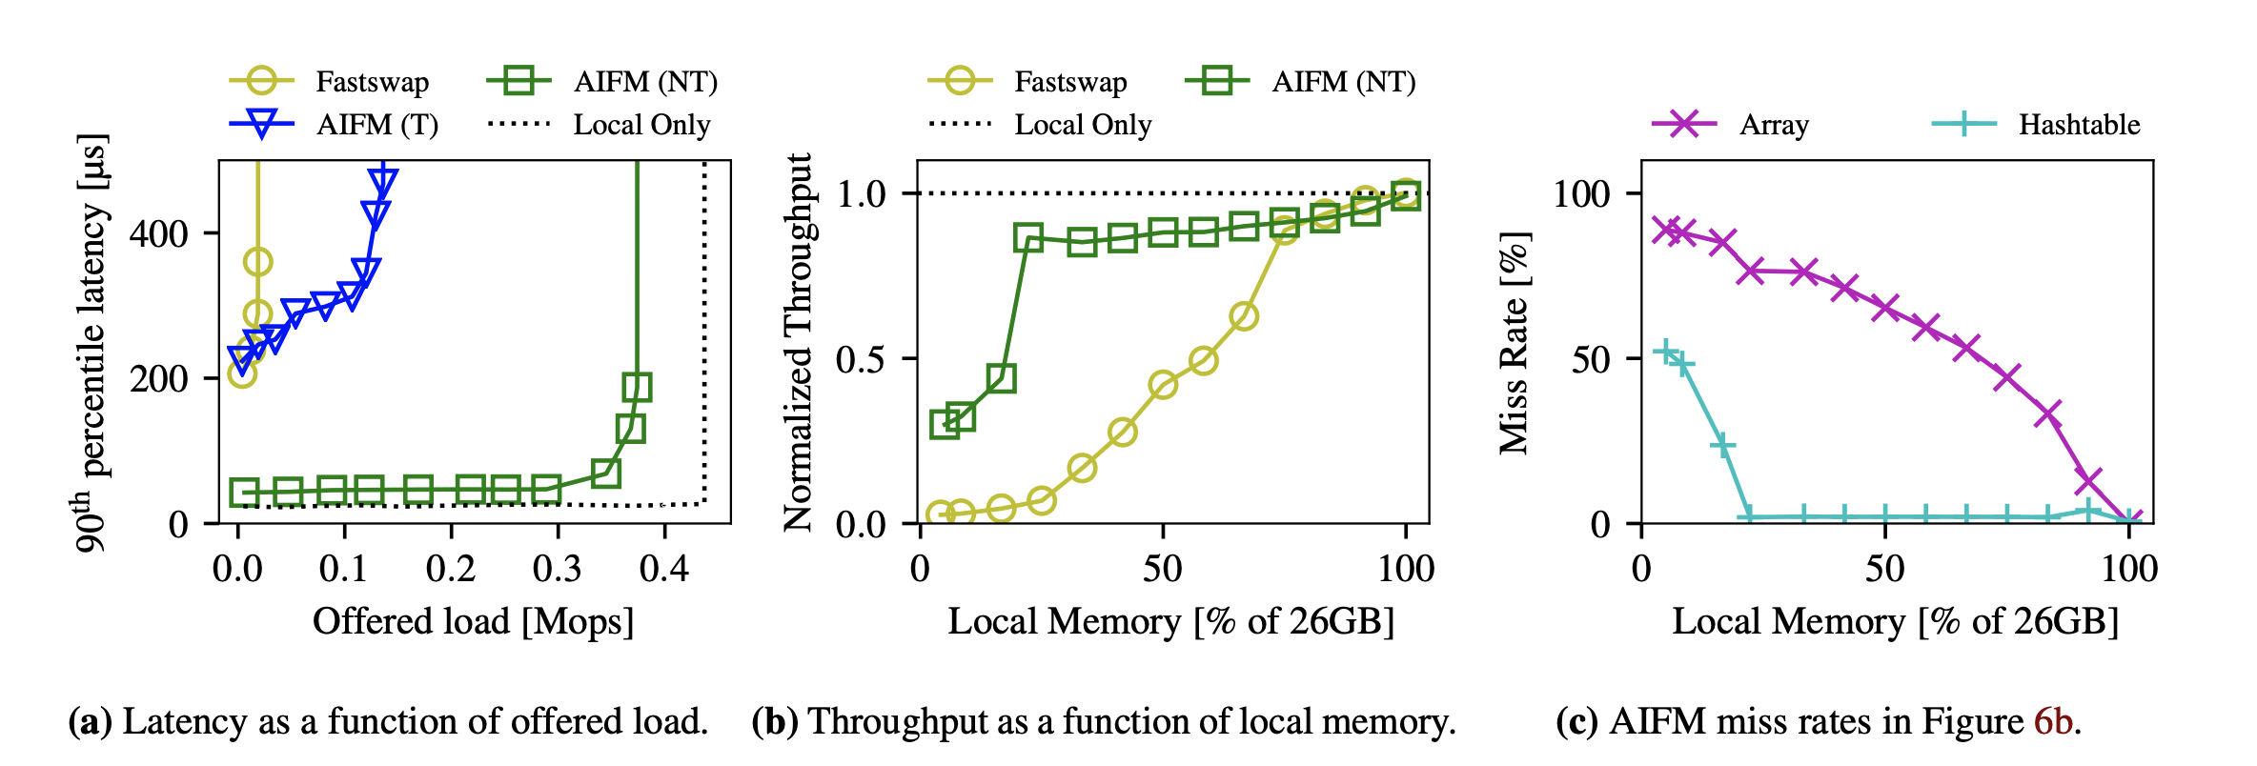
AIFM numbers
26GB total memory (10 GB hash table, 16 GB blob array)
5 GB local memory for (a), s = 0.8

Slide 12
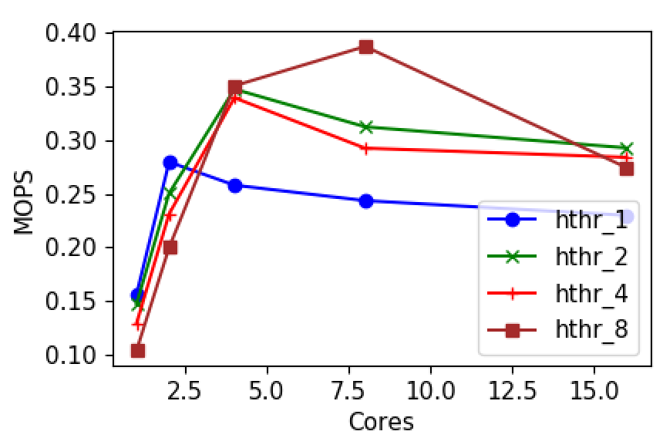
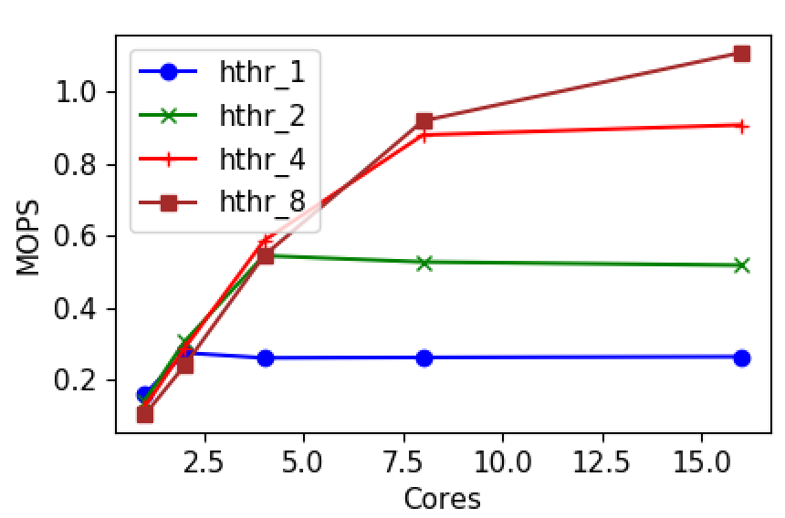
Userfaultfd Scalability
Fault handling overhead
One fd
Fds = Cores
Notes:
Notes: multiple fds scale better but multiple fds shard the memory region. We don’t need this though; we can use single fd enabling flexibility in scaling.
Use epoll – and run with 16 threads, look at logical core mapping

Slide 13
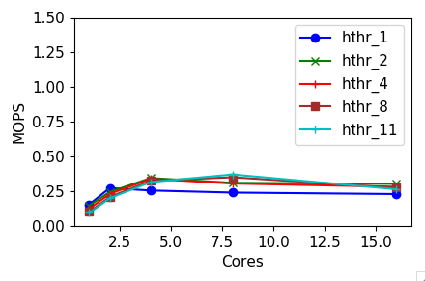
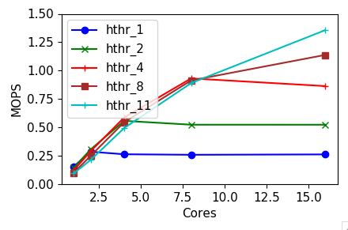
Userfaultfd Scalability
11 cores
One fd
Fds = Cores
Notes:
Notes: multiple fds scale better but multiple fds shard the memory region. We don’t need this though; we can use single fd enabling flexibility in scaling.
Use epoll – and run with 16 threads, look at logical core mapping

