Slide 1
Update
Synthetic benchmark numbers
With more compute intensity
New application: parallel sort
Characterizing baseline performance

Slide 2
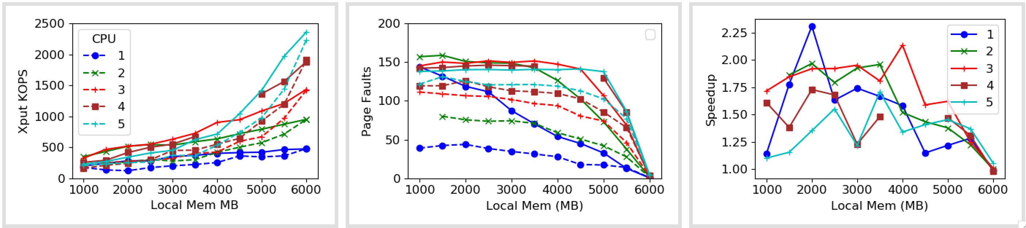
1x Zip

Slide 3
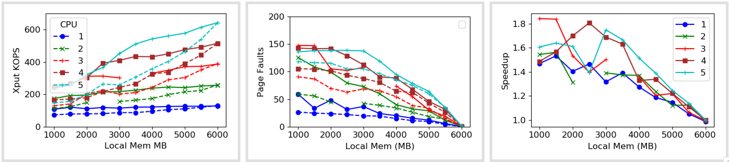
5x Zip

Slide 4
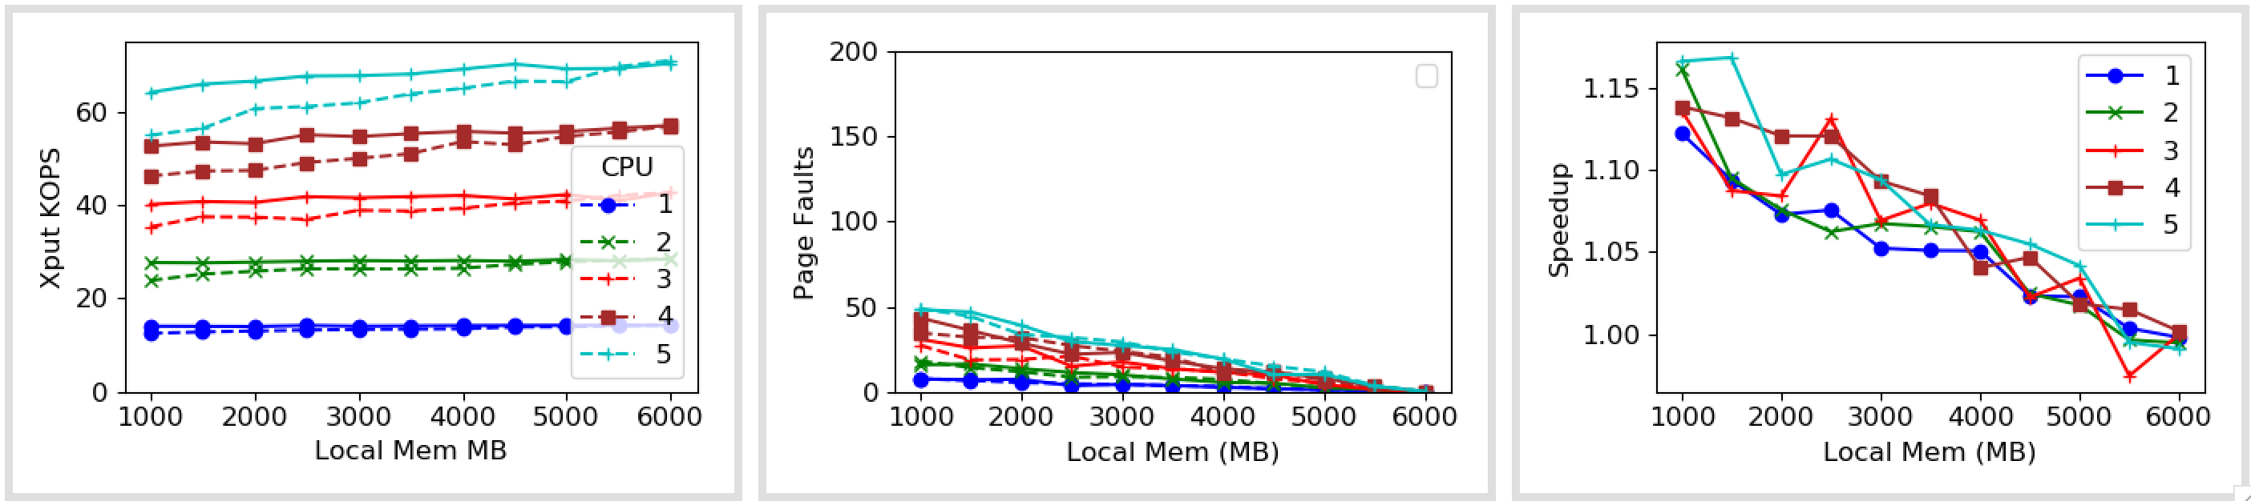
50x Zip

Slide 5
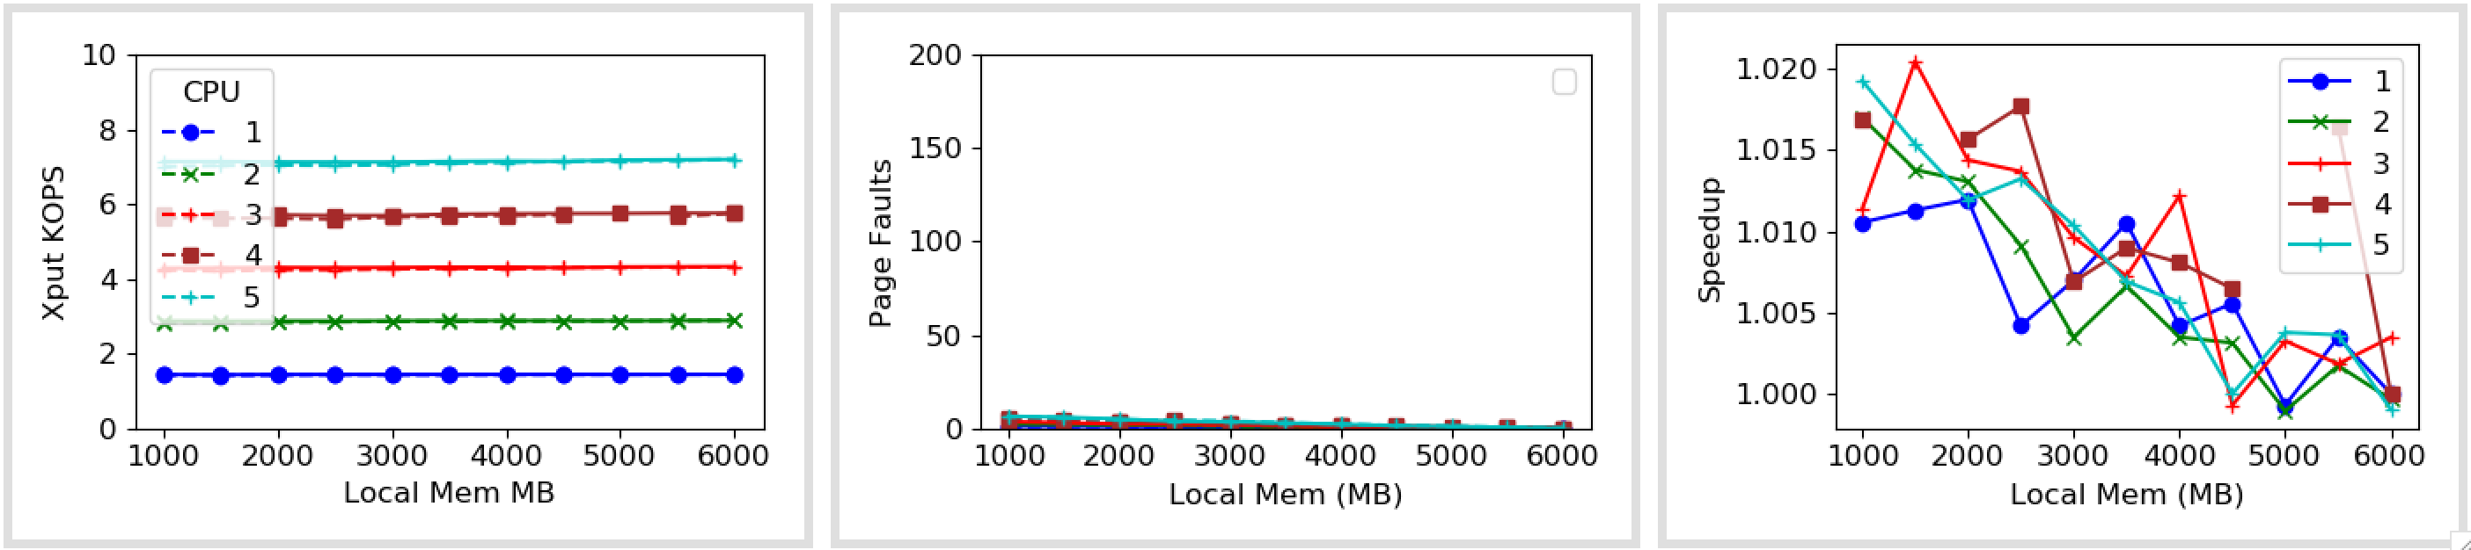
500x Zip
Notes:
TODO: Build Zipf into Memcached client as well

Slide 6
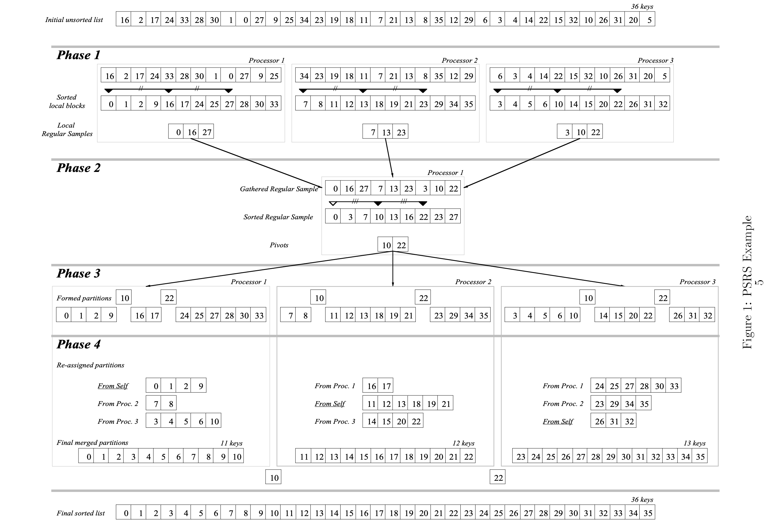
Sort
Parallel sort with regular sampling (PSRS)

Slide 7
PSRS Implementation
Found a kernel-thread Implementation
Integrated with Shenango threads & Kona memory
Baseline performance breakdown & scalability

Slide 8
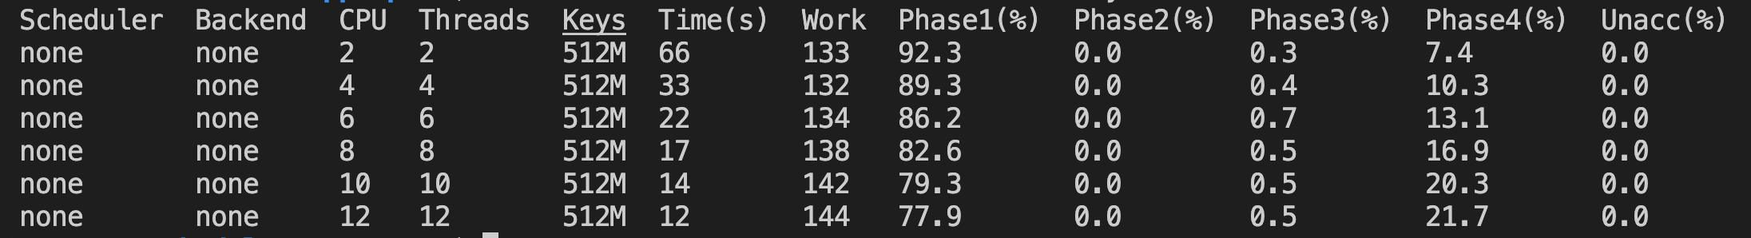
Performance (varying cores)
Notes:
Scales well. Probably because of the uniform/randomly distributed keys
Phases 1 & 4 significant.

Slide 9
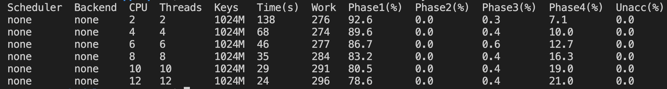
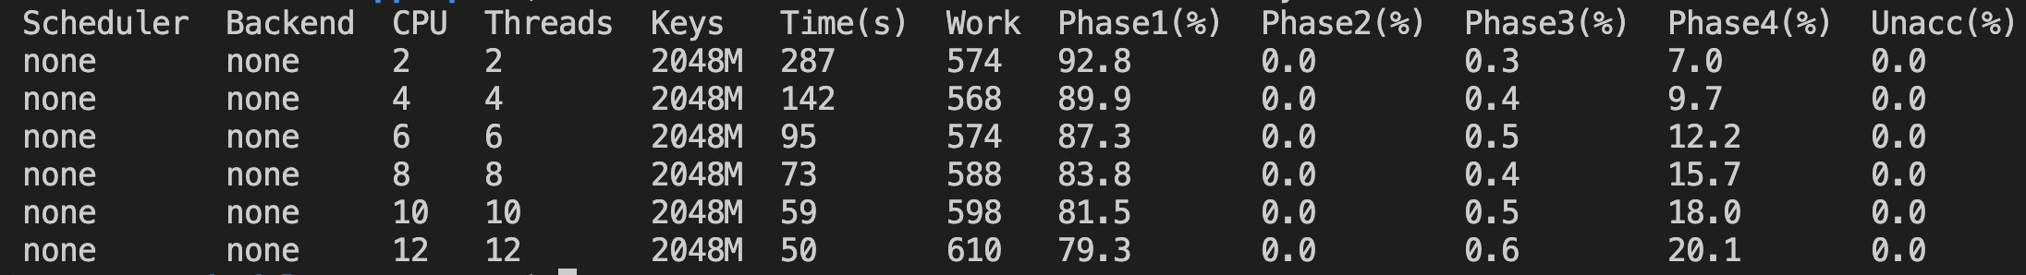
Performance (more keys)

Slide 10
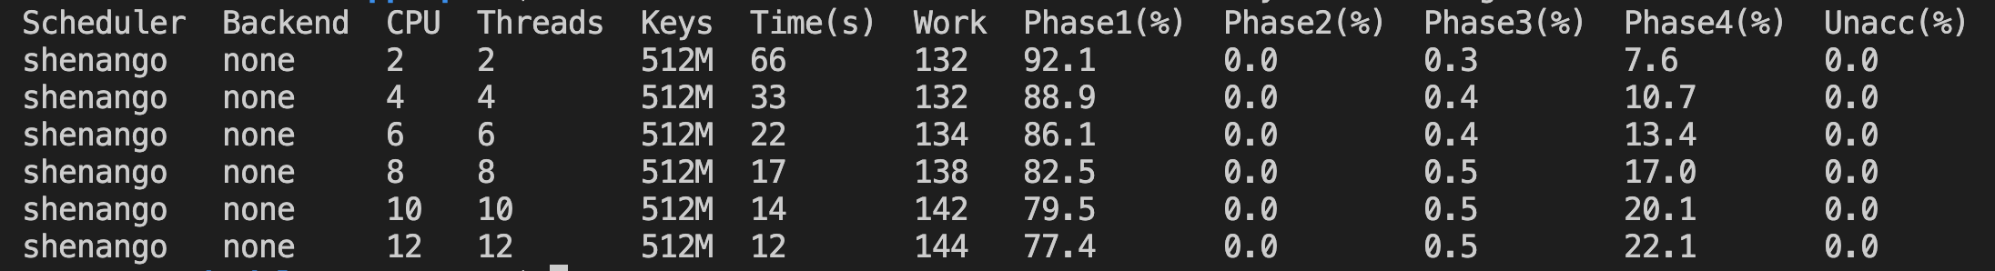
Performance with Shenango
Notes:
No difference, at least yet

Slide 11
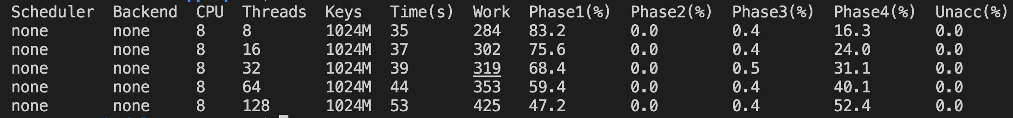
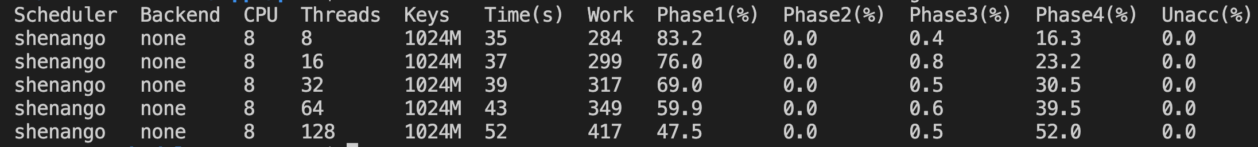
Performance (more threads per core)
Notes:
Overhead in the last phase – because of the thread factor. None of the thread “overheads” seem to matter at this point.
Overhead might not be this pure in a skewed case
We might be opening a trade-off between overhead introduced by concurrency and benefits of page faults enabled by it

Slide 12
Next
Sort
Page fault profiling
Adding annotations
Backlog
Zipf for Memcached
Explore page fault batching
Notes:
Multi-page annotations

