Slide 1
Agenda
Brainstorming potential directions.
Eden++ – improving current design
Eden** – exploring other points in the design space

Slide 2
Eden++
Locality-aware scheduling. Examples:
Addressing locality effect of induced concurrency e.g., Sort
Revisiting scheduling policies for locality
Run-to-completion is better
Work stealing is not? (The data locality of work stealing)
Scheduling related group of threads together – memory affinity labels on threads. E.g.,
“Thread Scheduling for Cache Locality”
OMP labels for NUMA-local scheduling
L3 cache focused. Can we extend it?
Notes:
Thread to page mapping – LRU based
Think of implications of differences on the previous work
Data placement is also an important dimension

Slide 3
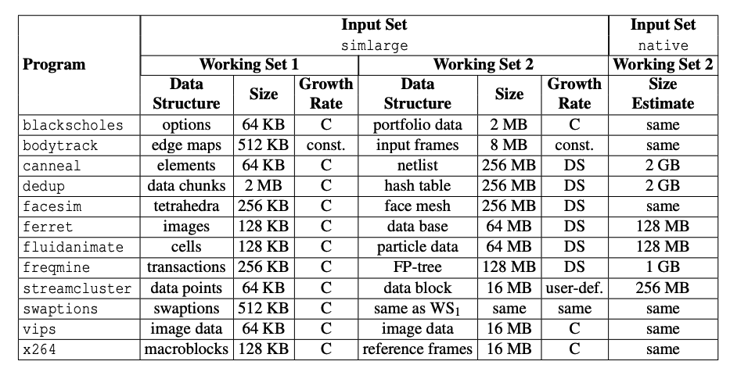
Eden++: Another application
PARSEC suite – already Shenango-ported
Many apps seem compute-intensive
Still working on getting memory footprint for all i.e., heap size
Hopeful on dedup/canneal
Notes:
Another candidate: Matric multiply, solving linear systems, LP solvers, ML training (Tensorflow?)

Slide 4
Eden**
Single node → Rack scale
Single application → More apps
Paging over Network → CXL
Remote Memory → NVM
Partial Disaggregation → Full

Slide 5
Exercise: Design space
 | Paging over Network | CXL
Single node
Rack scale
Partial
Partial
Full
Full
Partial
Partial
Full
Full

Slide 6
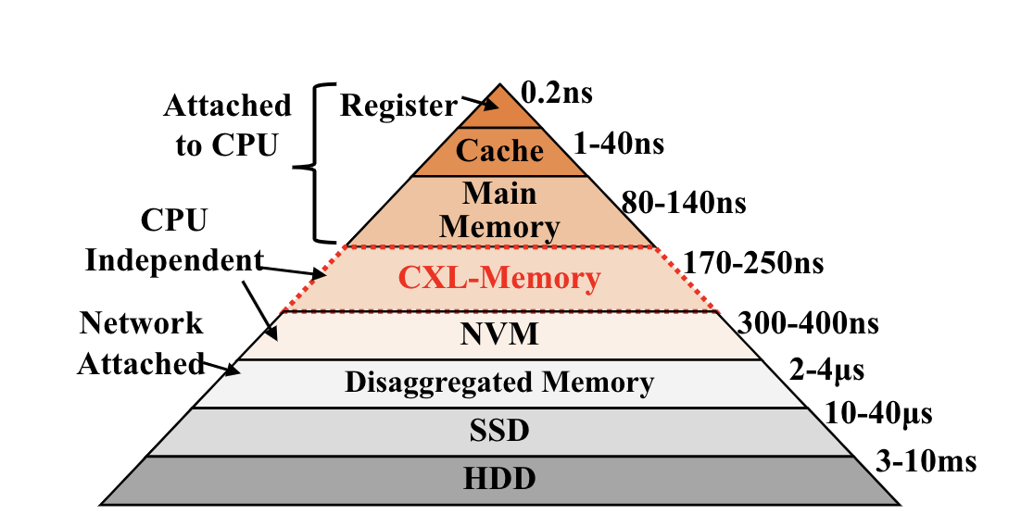
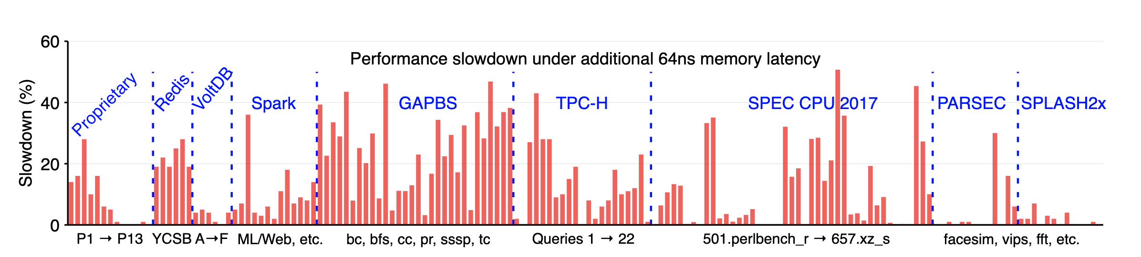
CXL Memory
Only 2-3 times slower
App degradation could be much lower
Is pure CXL-memory a possibility?
Notes:
CXL disaggregated memory – latencies are still debatable

Slide 7
Network vs. Pure CXL
5 µs or easily more CPU overhead of paging GBs of local cache size Fancy caching/prefetching | 250 µs No CPU overhead Smaller L3 cache No fancy prefetching

Slide 8
Partial vs Full Disaggregation
Network or CXL Ample* Local DRAM Minimizing remote latencies/perf degradation a priority Caching or Page promotion/demotion part of runtimes – applicable for both network and CXL E.g., all network-based systems and Microsoft, Facebook’s CXL systems | Only CXL? L3 cache Accepted perf degradation, and explore CX-specific opportunities. Like? E.g., None yet

Slide 9
Scheduling problem
 | Paging over Network | CXL
Single node
Rack scale
Partial
Eden++
Multiple apps – more efficiency, isolation
Partial
Eden is irrelevant – tight latencies, no primitive for asynchronous access
Eden++ (locality-aware scheduling) may still apply
Full
Not feasible
Full
No scheduling story?
Partial
Partial
Full
Full

Slide 10
Scheduling problem
 | Paging over Network | CXL
Single node
Rack scale
Partial
Eden++
Multiple apps – more efficiency, isolation
Partial
Eden is irrelevant – tight latencies, no primitive for asynchronous access
Eden++ (locality-aware scheduling) may still apply
Full
Not feasible
Full
No scheduling story?
Partial
Fastswap++
Cluster + node (Job + task) scheduling
New resources: local cache, remote bandwidth
Partial
Same as Fastswap++ but with CXL flavor
Microsoft paper schedules VMs but can do more fine-grained
Can abstract design for both technologies?
Full
Not feasible
Full
Is there a cluster scheduling story?
Shared but not coherent memory – what are the opportunities?

