Slide 1
Agenda
Brainstorming potential directions.
Eden++ – improving current design
Eden** – exploring other points in the design space

Slide 2
Eden**
Single node → Rack scale
Single application → More apps
Paging over Network → CXL
Remote Memory → NVM
Partial Disaggregation → Full

Slide 3
Exercise: Design space
 | Paging over Network | CXL
Single node
Rack scale
Partial
Partial
Full
Full
Partial
Partial
Full
Full

Slide 4
Setting: Network vs. CXL
5 µs or easily more Local memory – yes Page caching/swapping on path | 300 ns - 1 µs Local memory - yes Page migrations off-path
Both cases aim to avoid far memory
But runtime work/requirements more relaxed in case of CXL

Slide 5
Scheduling problem
 | Paging over Network | CXL
Single node
Rack scale
Eden++
Multiple apps – more efficiency, isolation
Eden is irrelevant – tight latencies, no primitive for asynchronous access
Eden++ (locality-aware scheduling) may still apply
Cluster + node (Job + task) scheduling
New resources: local cache, remote bandwidth
Fastswap++
Same as network but with CXL flavor
Microsoft paper schedules VMs but can do more fine-grained
Can abstract design for both technologies?

Slide 6
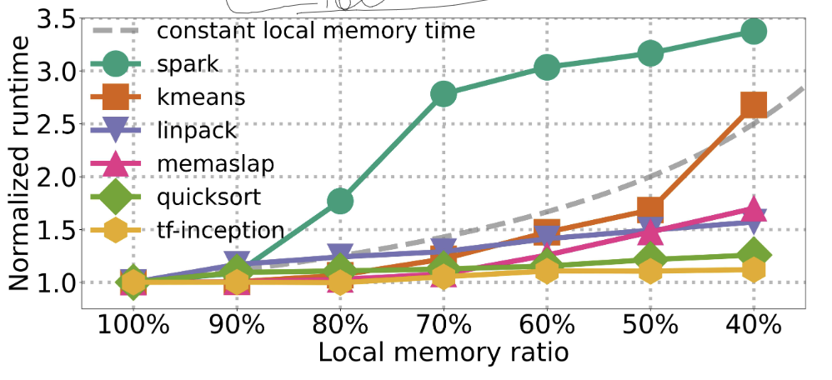
Fastswap
Far-memory aware cluster scheduler
Job degradation profiles: job time as f(local mem)
Optimize for local memorytime = allocated memory * runtime
Runtime goes up as local memory reduced
Maximize local memorytime savings / far memory usage
Independently for each node
Can rebalances allocations at runtime: but not sure when?
Simulations

Slide 7
Fastswap++ thoughts
Static job degradation profiles may not cut it
The cluster scheduler has no “control” over each job
Does not consider temporal memory-usage variations
No story for more dynamic, online scheduling
Questions:
Can two-level scheduling do more?
How does CXL affect this picture?

Slide 8
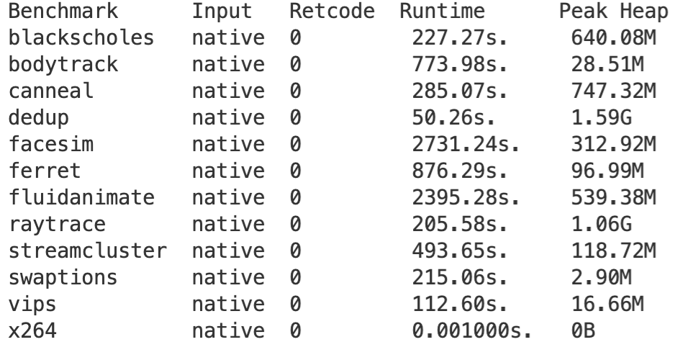
PARSEC Apps
Running with Kona
C/C++ apps – C++ requires some legwork
Started with dedup
2.4 GB alloc’d
Running at 1GB and 1.5GB produced very little read faults
Running at lower memory hangs, debugging.
Idea is to get Kona profiles for some apps

Slide 10
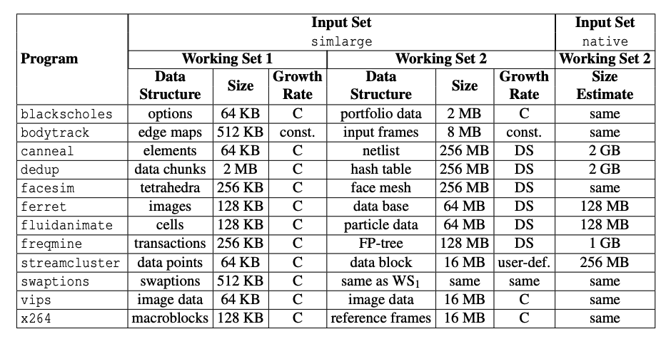
PARSEC apps
PARSEC suite – already Shenango-ported
Many apps seem compute-intensive
Still working on getting memory footprint for all i.e., heap size
Hopeful on dedup/canneal
Notes:
Another candidate: Matric multiply, solving linear systems, LP solvers, ML training (Tensorflow?)

Slide 11
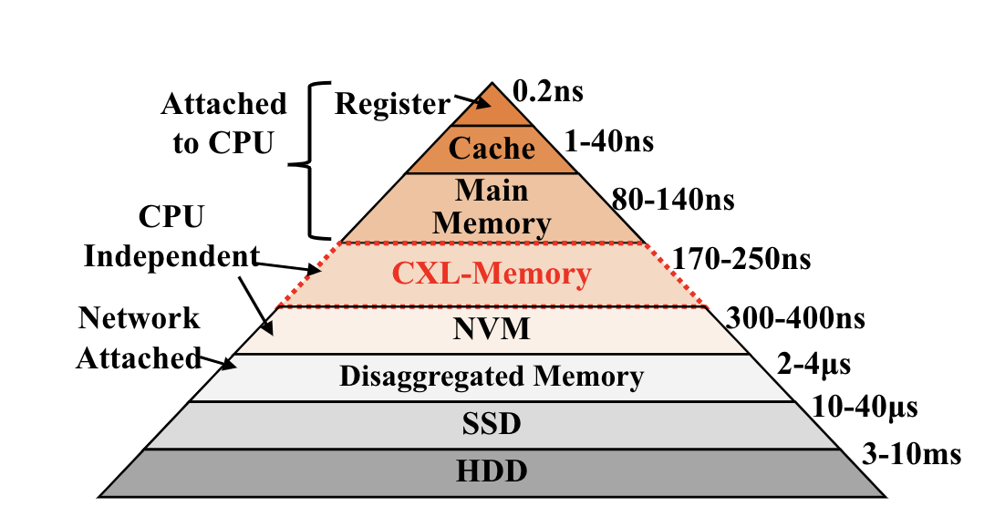
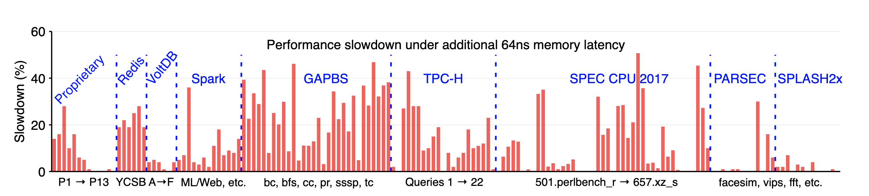
CXL Memory
Only 2-3 times slower
App degradation could be much lower
Is pure CXL-memory a possibility?
Notes:
CXL disaggregated memory – latencies are still debatable

Slide 12
Eden++
Locality-aware scheduling. Examples:
Addressing locality effect of induced concurrency e.g., Sort
Revisiting scheduling policies for locality
Run-to-completion is better
Work stealing is not? (The data locality of work stealing)
Scheduling related group of threads together – memory affinity labels on threads. E.g.,
“Thread Scheduling for Cache Locality”
OMP labels for NUMA-local scheduling
L3 cache focused. Can we extend it?
Notes:
Thread to page mapping – LRU based
Think of implications of differences on the previous work
Data placement is also an important dimension

Slide 13
Partial vs Full Disaggregation
Network or CXL Ample* Local DRAM Minimizing remote latencies/perf degradation a priority Caching or Page promotion/demotion part of runtimes – applicable for both network and CXL E.g., all network-based systems and Microsoft, Facebook’s CXL systems | Only CXL? L3 cache Accepted perf degradation, and explore CX-specific opportunities. Like? E.g., None yet

