Slide 1
User-level Thread Scheduling On Remote Memory
Anil Yelam
Mentors: Radhika Niranjan Mysore, Marcos K. Aguilera

Slide 2
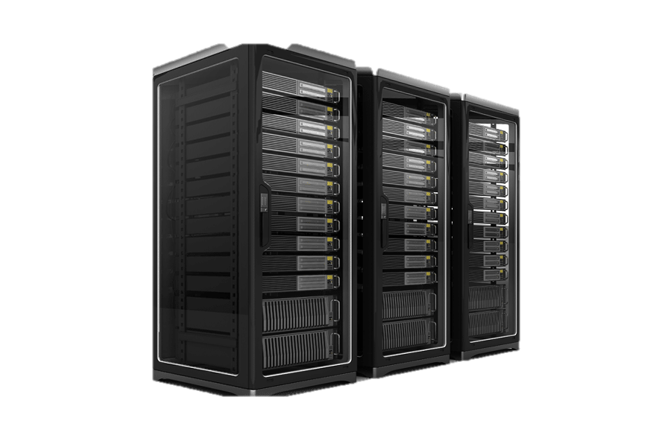
Racklette Effort
Redesigned software stack for Rack-scale applications
Simplified programming
Better/balanced resource utilization
Exploring CPU Scheduling, both on the rack-level and within each server
Notes:
Racklette which is one of recent rackscale computing efforts, driven to brand rack as a more integrated computing platform than a traditional distribued system
Driven by recent hardware trends like fast, low latency networks, CXL, and disaggregated memory, Rack resembles more and more like a multi-core server; and the goal is to exploit this to provide simplified programming models and better resource utilization through global decision making.
While there are many open questions on the design, an important one is how we are gonna do CPU scheduling, both across the rack and within each node

Slide 3
Racklette Effort
Redesigned software stack for Rack-scale applications
Simplified programming
Better/balanced resource utilization
Exploring CPU Scheduling, both on the rack-level and within each server
Notes:
Racklette which is one of recent rackscale computing efforts, driven to brand rack as a more integrated computing platform than a traditional distribued system
Driven by recent hardware trends like fast, low latency networks, CXL, and disaggregated memory, Rack resembles more and more like a multi-core server; and the goal is to exploit this to provide simplified programming models and better resource utilization through global decision making.
While there are many open questions on the design, an important one is how we are gonna do CPU scheduling, both across the rack and within each node

Slide 4
Assumptions
Disaggregated Compute & Memory (aka Remote Memory)
Run legacy applications: POSIX Threads and Virtual memory
Target applications: Recommender, Memcached
Notes:
To narrow down the problem, these are some choices/assumptions that we make

Slide 5
Question
What’s the best way to manage & schedule threads, in the context of Racklette and Remote Memory?
Ideally, these properties:
Lightweight
Flexible scheduling e.g., prioritizing threads based on signals
Co-scheduling opportunities e.g., network
Migratable (longer-term)
Notes:
Given that, the question comes down to:

Slide 6
Thread Management
Kernel is a suitable location but
Kernel threading primitives are expensive
User-level thread management (e.g., Arachne, Shenango, Caladan)
Separate thread scheduling from core allocation
Runtime provides locks and I/O etc. in userspace
Core allocation based on signals (co-design)
But can they be run out-of-the-box on remote memory?
Notes:
Goal is to explore this option.

Slide 7
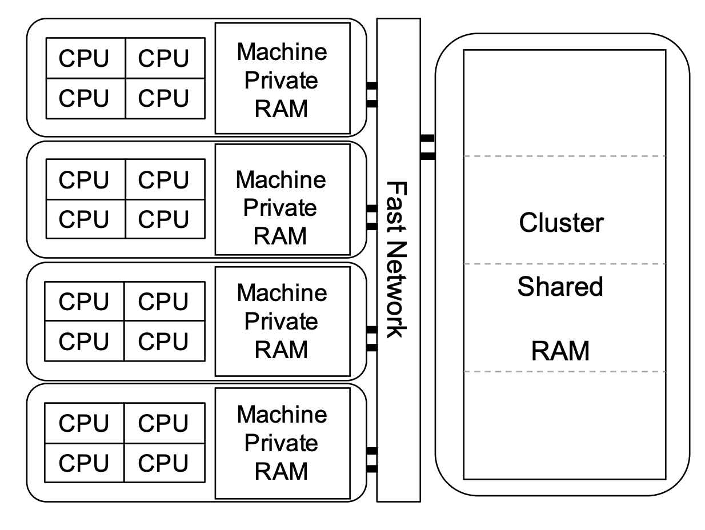
Remote/Disaggregated Memory
Pools of compute and memory, connected by low-latency network.

Slide 8
Paging-based Remote Memory
Presented as virtual memory and serviced through page faults
Pros:
Native memory interface
No app changes
But handled by the kernel.
Application
Virtual
Address
Space
Kernel
Pagefault Handler
Local Memory
Network
Transport
Remote Memory
Notes:
While there are different ways to provide remote memory…

Slide 9
Page faults are a problem
Today’s user-level schedulers use kernel thread as a proxy for cores (one thread per core).
e.g., Arachne, Shenango, Caladan, GOLANG.
But blocking kernel calls take the thread/core away.
Blocking calls – Sync I/O, System calls, Page faults
Multiple kernel threads per core not an option
Notes:
This presents a problem for user-level schedulers who want the kernel out of the picture.

Slide 10
Page faults are a problem
Various solutions, none of which work for page faults.
Custom I/O interfaces
Because Page faults trap in hardware.
All current schedulers ignore the issue
Not an option in a remote memory system
Concrete Goal: Demonstrate and quantify the performance effect of blocking due to page faults

Slide 11

Approach
Shenango – State-of-the-art user thread scheduler
Kona – State-of-the-art, in-house remote memory system
Run them together,
Benchmark with Memcached

Slide 12
Kona
Paging-based remote memory
Application
Virtual
Address
Space
Kernel
Pagefault Handler
Local Memory
Network
Transport
Remote Memory
Notes:
Just a few more details about the setup

Slide 13
Kona
Paging-based remote memory
Transparency introduces semantic gap so Kona handles page faults in userspace. Provides:
Choice of compatibility or co-design
Resource accounting
Easy to adopt
Application
Pagefault Handler
Virtual
Address
Space
Kernel
Local Memory
Network
Transport
Remote Memory
Notes:
Providing the application with native memory interface but giving it the control over how the local cache is managed.

Slide 14
Kona
Host
App
Kona Threads
Memory
Server
App Work
RDMA
Faults
Eviction
NIC
Notes:
Kona from a cpu allocation perspective

Slide 15
Kona + Shenango
Host
Memcached
User Threads
Kona Threads
Memory
Server
I/O Core
Poller
Faults
Eviction
Runtime
KV
Client
NIC
Notes:
Kona and shenango are core-isolated, with shenango managing rest of the threads. Has it own net stack, etc.
All working memory is local, only app heap goes on the remote memory.

Slide 16
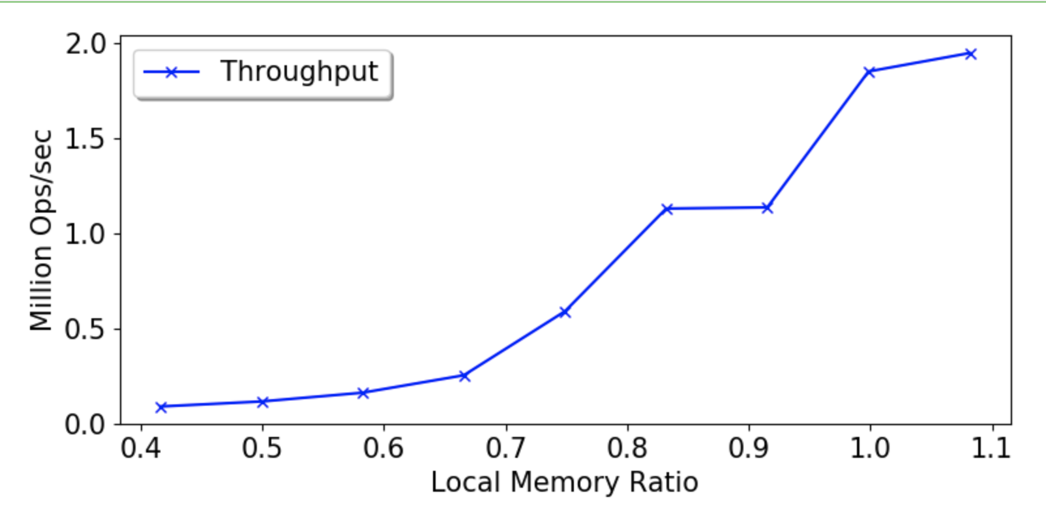
Memcached Throughput
Memcached
4 CPU cores
Offered load: 2 Mops
Mostly (>99%) Reads
Uniform key distribution
Notes:
Degradation as expected. Of course, the challenge is to separate the degradation due to hardware and due to system design. Only way to know is to figure out where the bottlenecks are coming from.

Slide 17
Memcached Throughput
Memcached
4 CPU cores
Offered load: 2 Mops
Mostly (>99%) Reads
Uniform key distribution
Notes:
Degradation as expected. Of course, the challenge is to separate the degradation due to hardware and due to system design. Only way to know is to figure out where the bottlenecks are coming from.

Slide 18
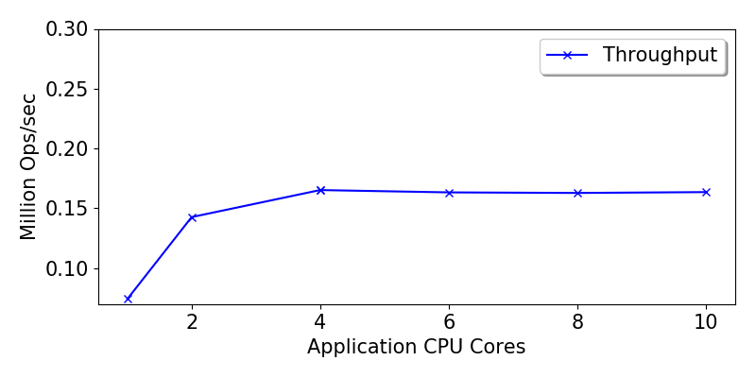
Throwing more CPU at it

Slide 19
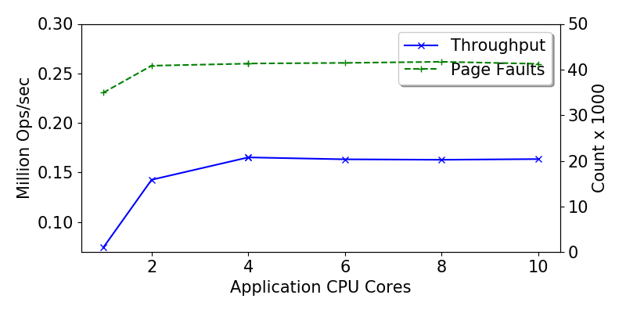
Throwing more CPU at it

Slide 20
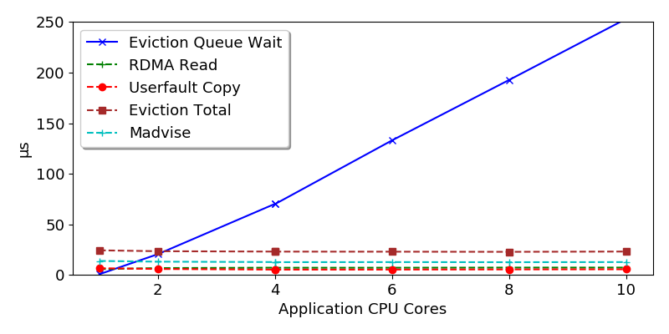
Throwing more CPU at it
Notes:
Kona, with its single core, is not able to keep up.

Slide 21
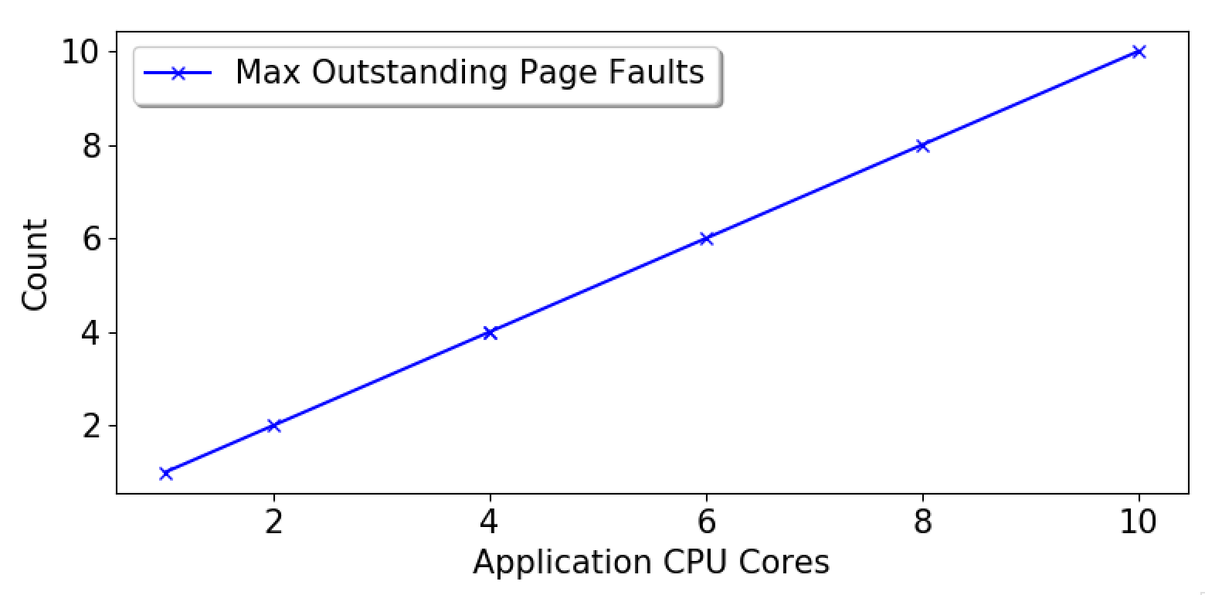
Well, what about page faults?
Perhaps the next bottleneck we’ll hit. But for a flavor…
Notes:
What this shows is that 1) page faults are synchronous and threads aren’t doing any other work, and 2) even after removing bottlenecks in Kona, you won’t be able to put more that 10 concurrent rdma in flight

Slide 22
Potential Solutions
Kona bottlenecks
Optimizing some kernel operations
Co-design with Shenango scheduler
Kona threads to User threads
Increase/decrease threads based on paging activity
Asynchronizing page faults
Upcalls à la scheduler activations
Notes:
Fortunately, as if by foresight, Kona already does its work in userspace

Slide 23
Going forward
Implementing these solutions
Exploring how this fits into rack-level scheduling

Slide 24
Conclusion
Investigated the user-level threading as a scheduling option for remote memory
Identified & demonstrated some perf challenges
Proposed potential solutions

Slide 25
Thanks & Questions

