Slide 1
Setup
b1640
Rack Controller
b1630 (Cores)
Memcached Process
Memory
Server
Shenango
IO Core
User Threads
Kona Threads
Poller
User faults
Eviction
Shenango Runtime
b1607
Memcached
Client
Shenango
NIC (DPDK +RDMA)

Slide 2
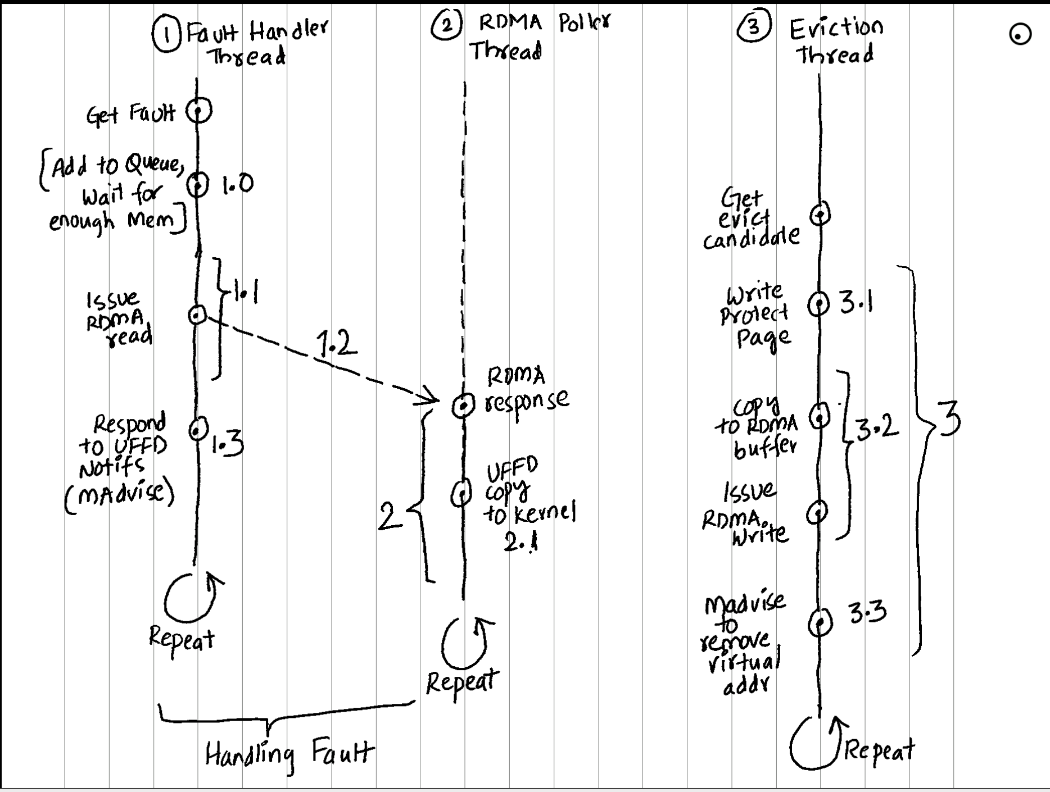
Changing server cores at 1500MB

Slide 3
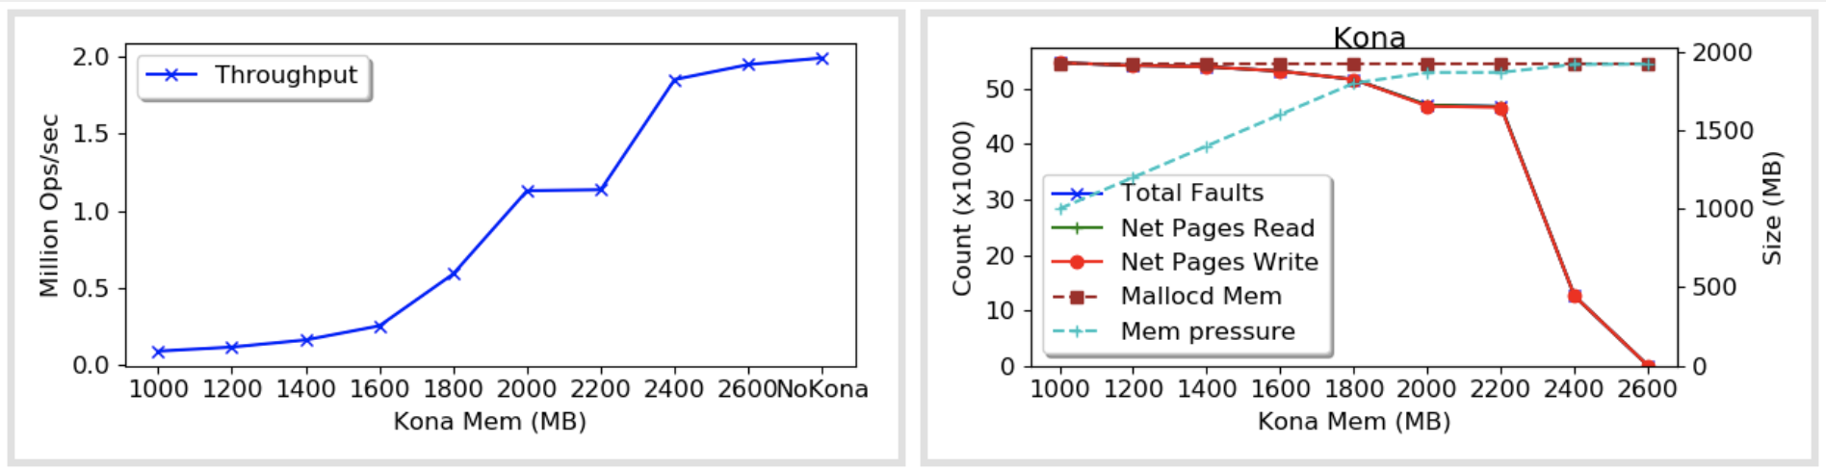
Changing Kona memory at 4 cores

Slide 4
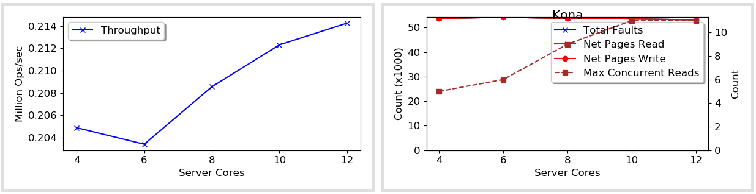
Changing server cores at 1500MB

Slide 5
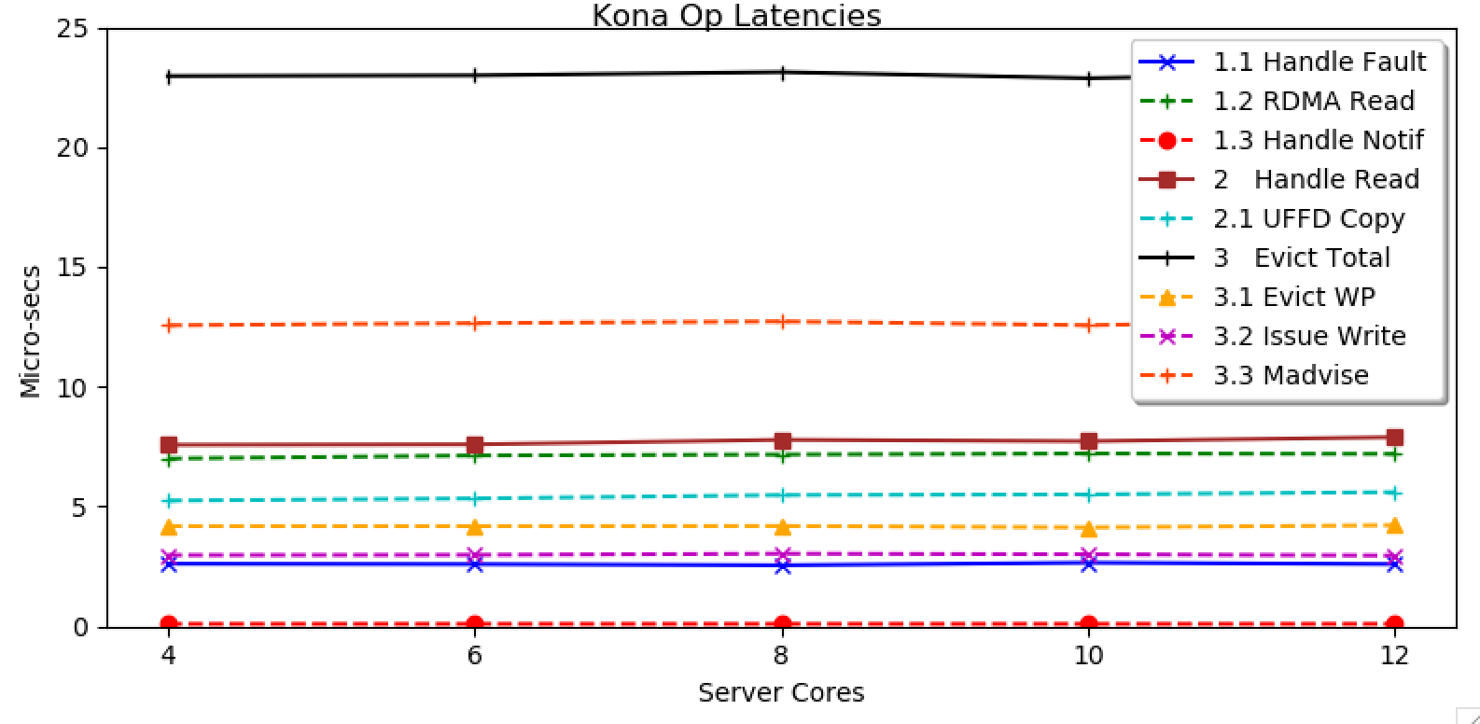
Changing server cores at 1500MB

Slide 6
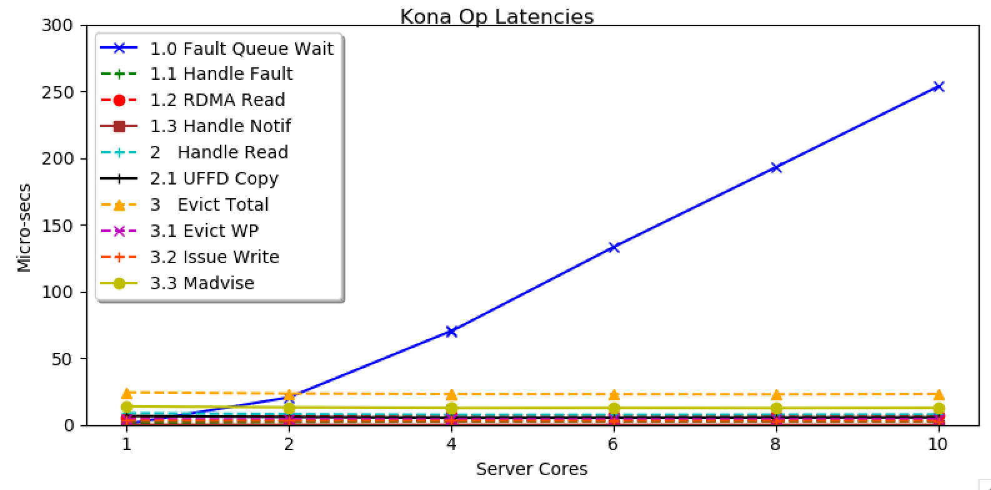
Changing server cores at 1500MB

Slide 7
Discussion
Can we convert them to user threads?
The rdma 12 error in eviction writes
Write protect

Slide 8
Misc

Slide 9
Argument for upcalls
We want userspace threading
M:N scheduling
Arachne – Better, fast scheduling to exploit cache locality
Shinjuku – preemption using signals
Shenango – use net stack to better estimate/respond to demand
Caladan – use other signals to minimize interference
GO scheduler – best in practice IMO
etc.
Blocking calls is an orthogonal issue

Slide 10
Argument for upcalls
Mitigations for blocking
I/O: Wrapping I/O in userspace and use async kernel interfaces
Syscalls: pad them compile time
Still lose the thread but at least you’ll know.
Maintain spare kernel threads, but at the cost of spinning E.g., GO
Work stealing – Shenango, Caladan, GO, etc.
With pagefaults, no knowledge of blocking.
None of the recent schedulers handle. But that’s okay!
Not for remote memory.

Slide 11
Argument for upcalls
Is upcalls a solution though?
How expensive is an upcall compare to e.g., page fault or kernel thread creation, etc
Depends on the answer.
My goal:
Estimate the CPU loss due to page faults
Emulate upcall by returning the same thread quickly after a page fault?
Estimate the cost of upcalls

Slide 12
Argument for Shenango?
Not a strong one, really.
Just happened to have what we’re looking for – a recent M:N scheduler with some ported applications
Controlling the net stack might come in handy!
No other threading libs with built-in upcalls

Slide 13
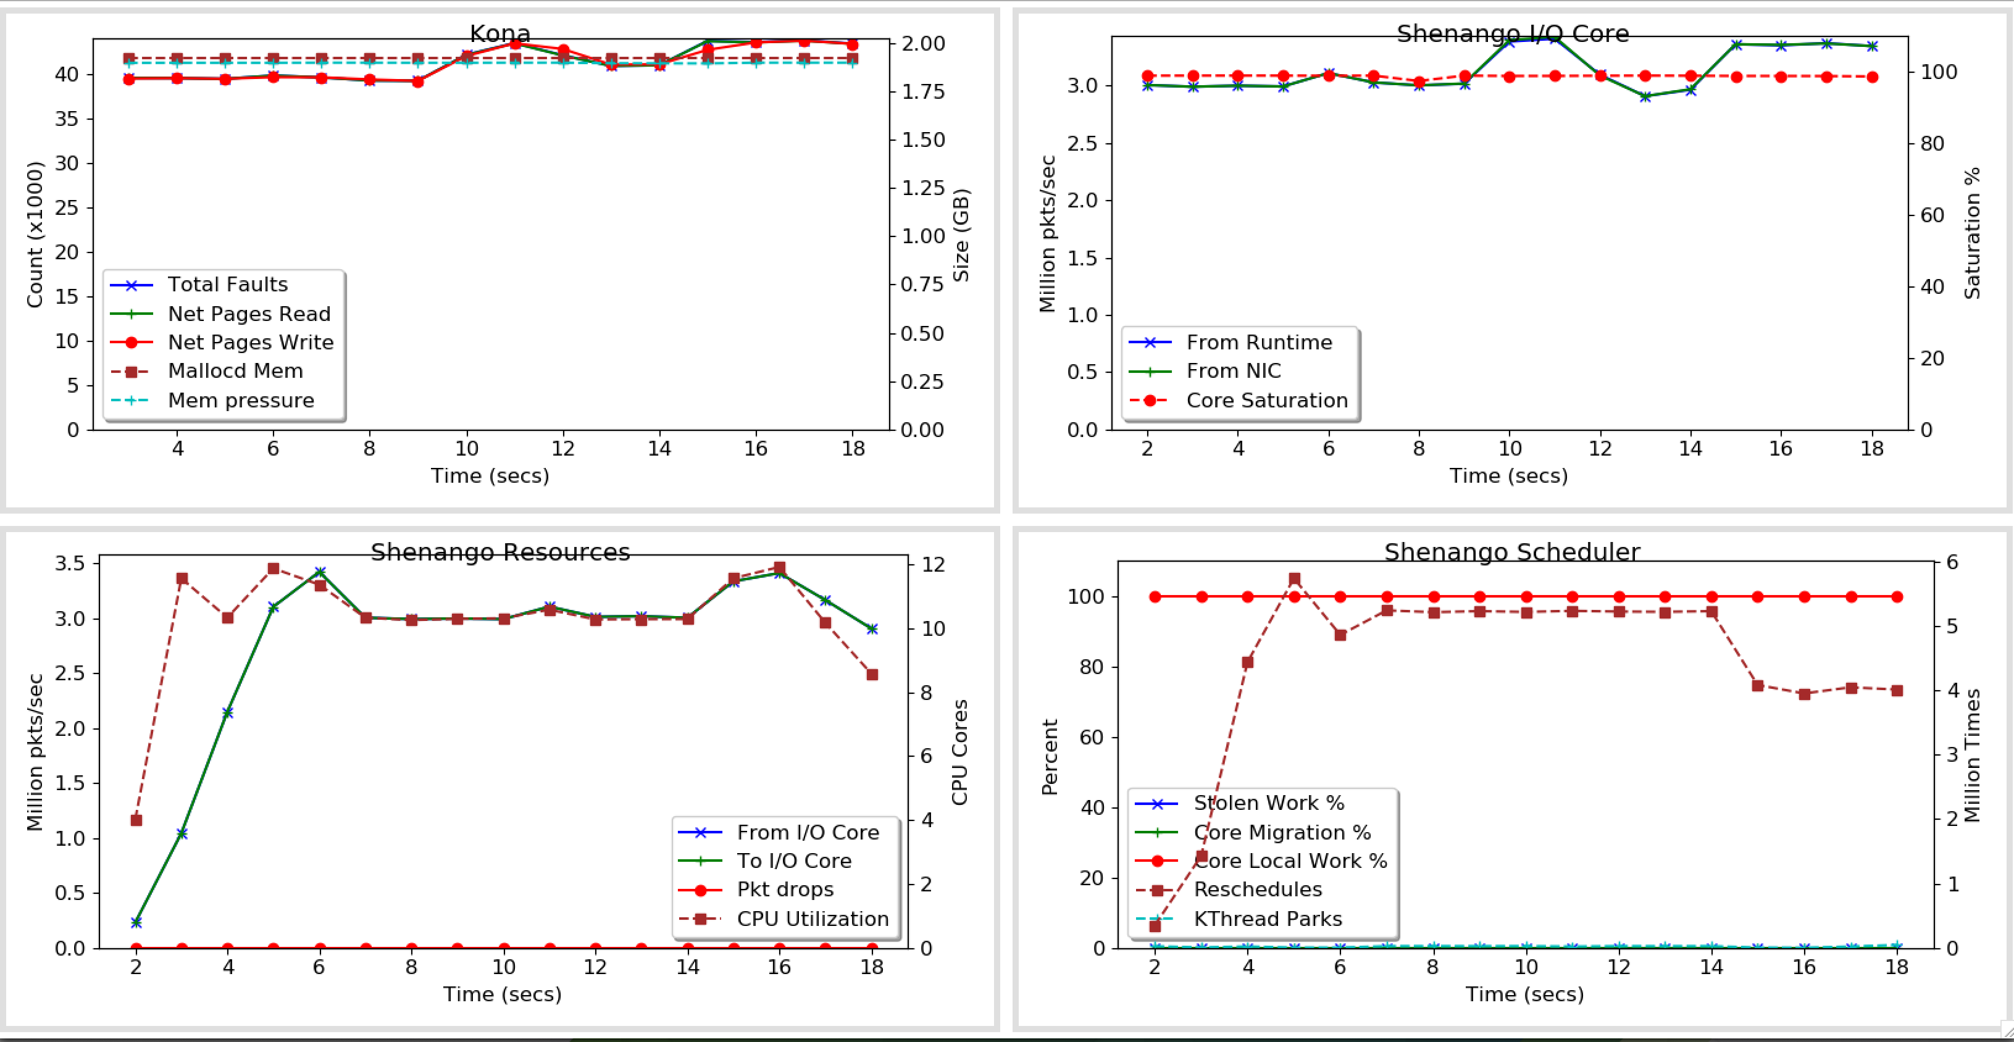
Status
Just bettering plots – adding more metrics
E.g.,

Slide 14
Next
Making it CPU bottlenecked:
Lower server cores so that we don’t see i/o core or RDMA bottlenecks
Zipfian distribution

Slide 15
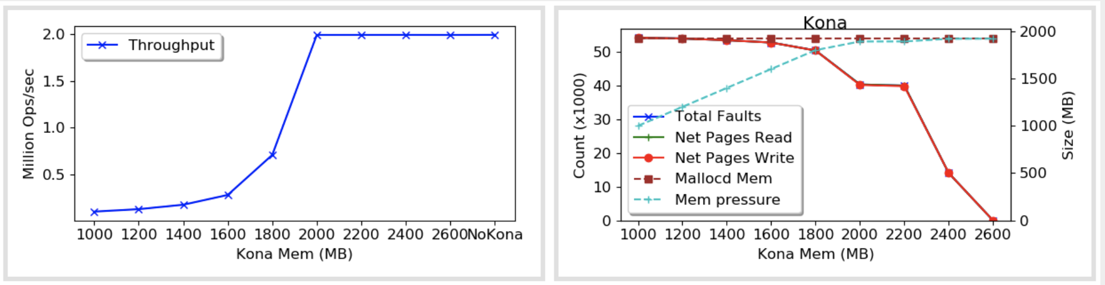

Slide 16
Misc

Slide 18
Discussion
If you add upcalls, how much would the performance improve?
How much does thrashing have to do with?
Emulating to get a lower/upper bound?
Some simulations?
From Racklette meeting:
No luck with Sched act code so far
M:N vs other scheduling

Slide 19
This Week
Prep for the talk – practice talk on Thu/Fri?
What should I shoot for, results-wise?
Signing the NDA stuff
Also, Alex wanted to talk

