Slide 1
Status
Done with handling concurrent app-faults
Testing the scheduler changes
App
Interface
Kona
Remote memory server
Scheduler
Kernel

Slide 2
How the whole thing works
Scheduler + App
Annotate potential locations with scheduler-provided fault calls
Check for page absence and post fault to Kona
Each core gets its separate cache-isolated channel from/to Kona
We place thread_t ptr in the fault
Yield thread
Schedulers polls for responses between threads
If found, sets thread to ready
Kona
Round-robins on all channels
Adds concurrent faults to wait_q, to be released when the current fault is done
Most of the handling is unchanged
When finished, extra-step of posting the response back
Can enforce a limit on max faults in progress per channel

Slide 3
Roadmap for NDSI, Apr 20th
Jan
Finish up work in the scheduler (almost done)
Replicate simulation results for Memcached (next week)
Feb
Unavailable for the most part
Perhaps a bit of writing
Mar
Another workload: GAP benchmark (Mar?)
Explore alternatives for Baseline (P0)
Memcached without shenango (lots of kernel threads)
Memcached with Shenango
Fastswap would just rule out backend/userfaults or eviction policy, etc as the cause of performance improvements
Brainstorm some ideas and discuss later
Filling the gaps

Slide 4
Next
Benchmarking Scheduler faults
Annotating Memcached
One issue: How to annotate write-protect faults?
Problem is we can’t write anything into memory
Taking in a 64-bit parameter into the vDSO call?

Slide 6
Long term plan/out of scope?
Local scheduling for multiple apps
Both Shenango and Nadav’s Kona can support multiple apps
Improving memory system
Kona can certainly be written better
Replacing Kona with Nadav’s Kona
Tight-coupling scheduler+memory systems
Basically, re-writing kernel in userspace?
Improving Kernel’s userfault API
Allows co-scheduling resources?

Slide 7
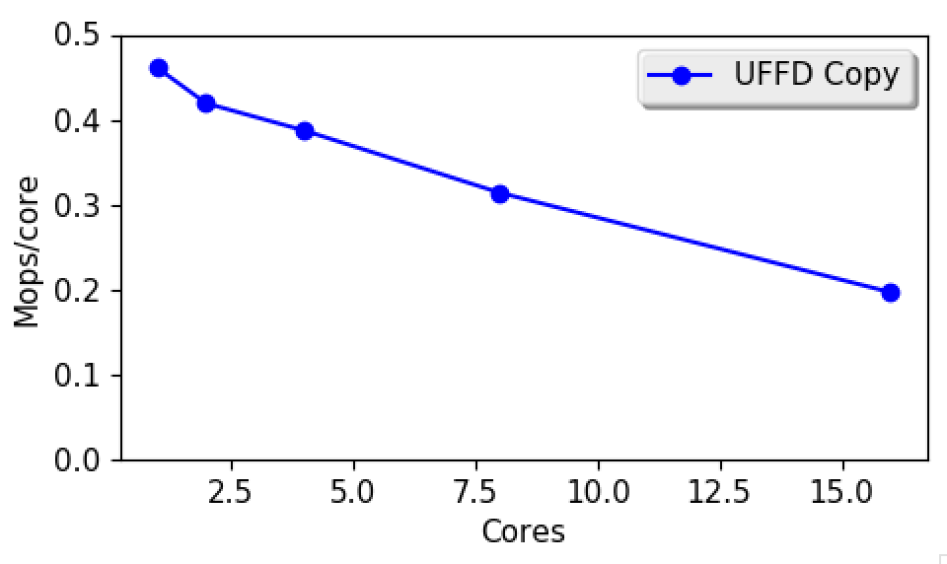
UFFD-copy scalability

