Slide 1
Update
Fastswap
Benchmark from AIFM paper
Scaling Kona
Paper feedback

Slide 2
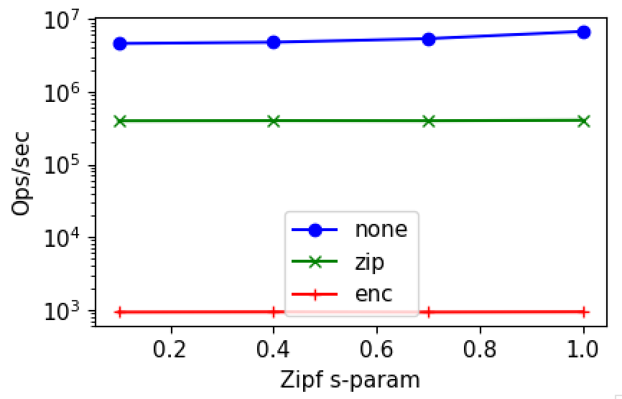
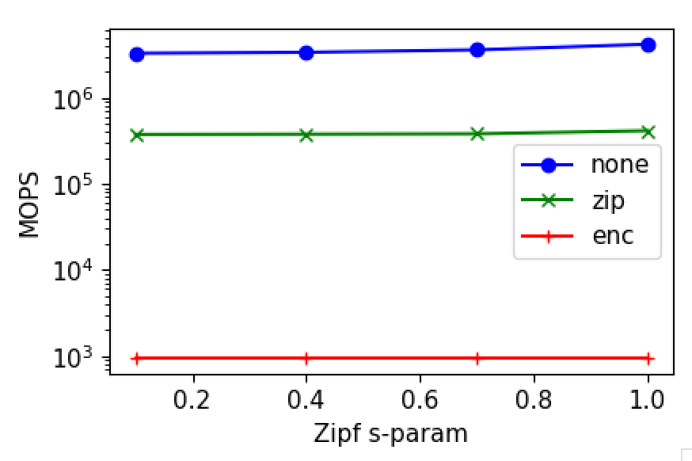
Rudimentary benchmark
Single core
No page faults yet
1M keys
8KB array items

Slide 3
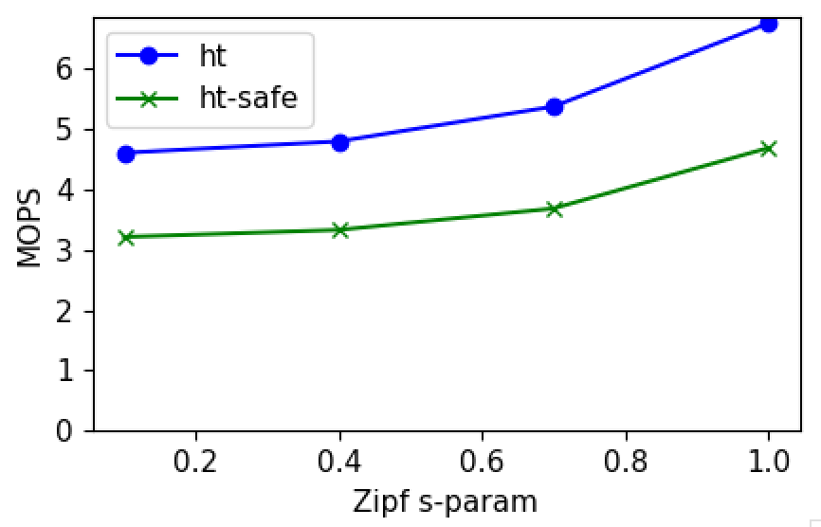
Cost of thread-safety

Slide 4
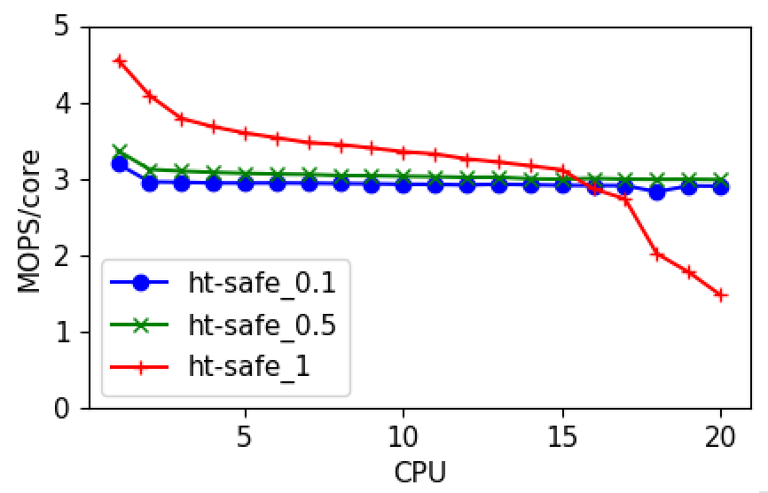
Hopscotch Scalability

Slide 5
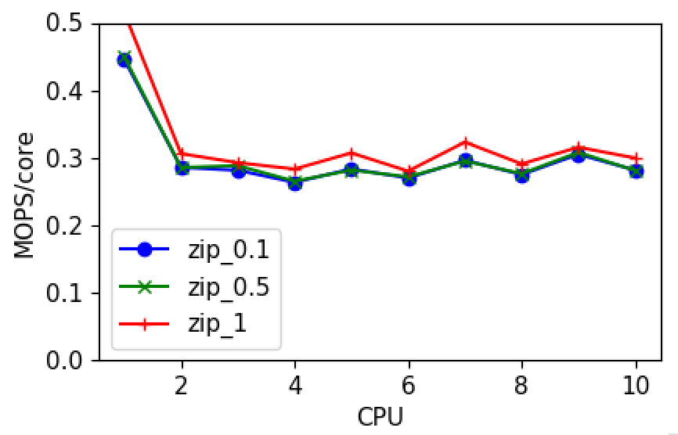
With Zip

Slide 6
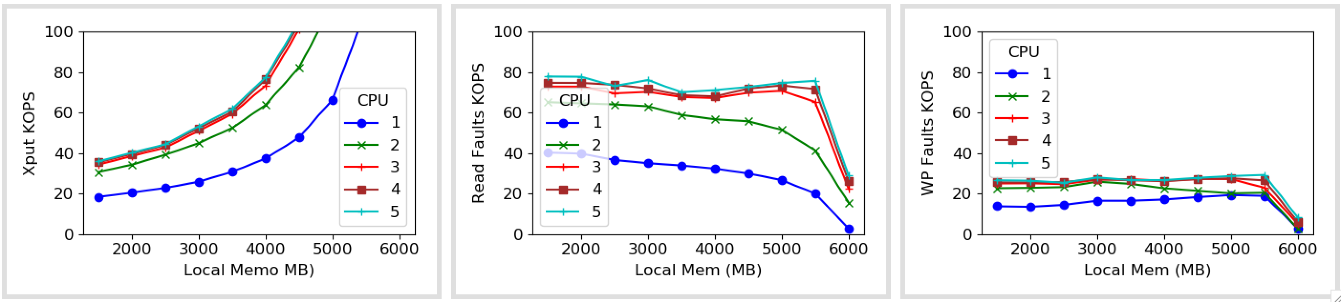
With Kona

Slide 7
Next
Running on remote memory (kona)
Got throughput numbers but getting other details as well
To find locations for page fault annotations, etc.

Slide 8
Changes
Hopscotch design
Removing WP faults – tradeoffs
Batch page faults

Slide 9
Breakdown (Single core, 1M keys)
176 Mops baseline ~ 12 cycles
57 Mops with rdtsc ~ 25 cycles
4.6 Mops with HT lookup ~ 450 cycles/200 ns
6.6 Mops with just hash ~ 300 cycles
3.2 Mops with safe GT lookup ~ 690 cycles
0.4 Mops with Zip ~ 6k cycles/3 µs
Cross-checked Zip outputs
Less-randomized zip input

Slide 10
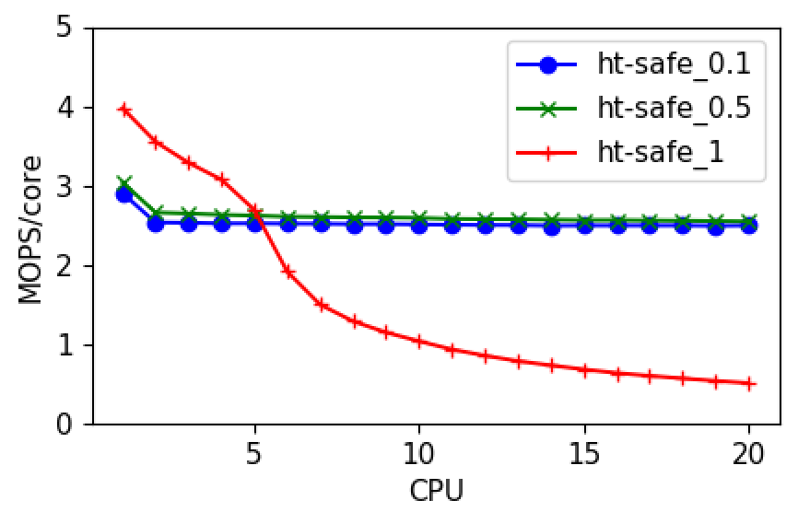
Hopscotch Scalability

Slide 11
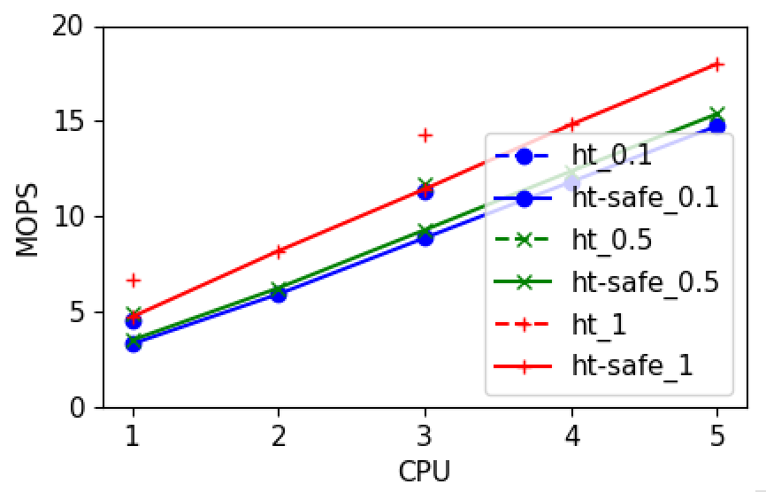
Cost of locking

Slide 12
Decoupling from Kona
Talked to Nadav
Umap as root
Umap scales with page fault load
Umap does proper LRU eviction
Provides baseline
We’re not using any of the Kona’s contributions

Slide 13
Decoupling from Kona
Feature | UMAP | Kona/Kailua | Nadav’s Kona (Future of Kailua)

Slide 14
Next
Another revision by end of the month
Will send out another version before the last week
Need to send out to Nadav as well
Another app that is not latency-sensitive

Slide 15
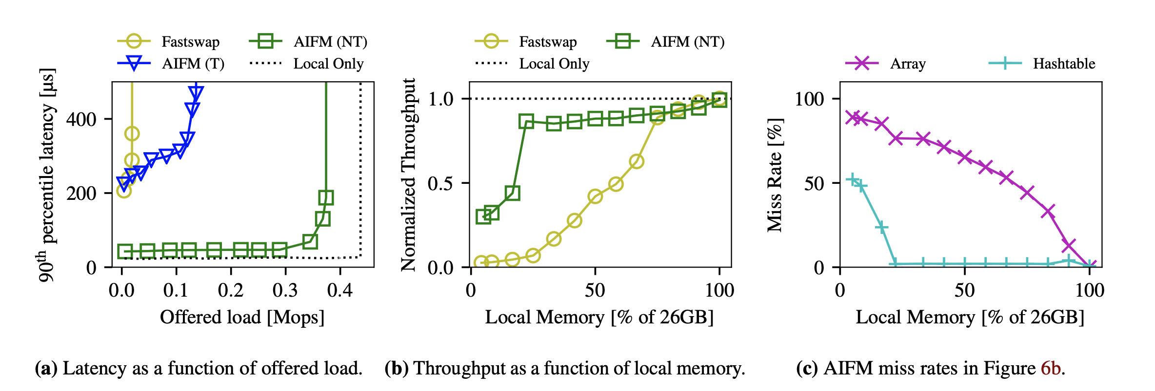
AIFM numbers
26GB total memory (10 GB hash table, 16 GB blob array)
5 GB local memory for (a), s = 0.8

Slide 16
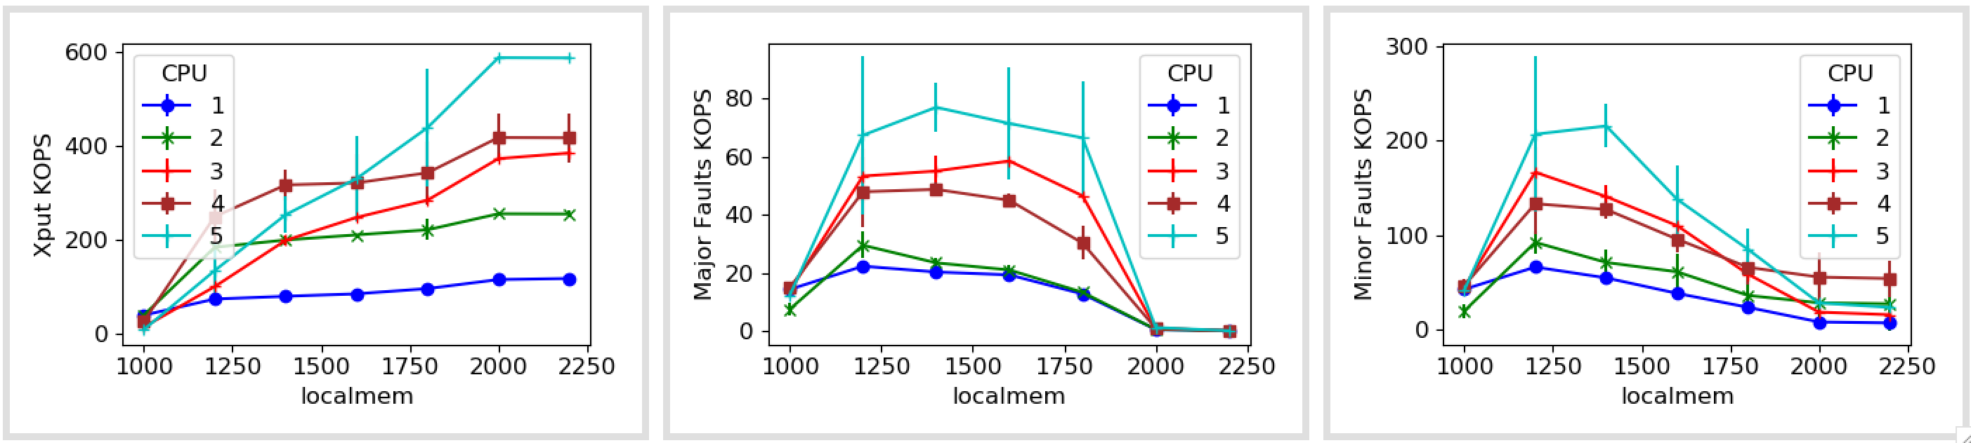
Fastswap with error bars
Notes:
Add more cores
Add more x-axis data points

Slide 17
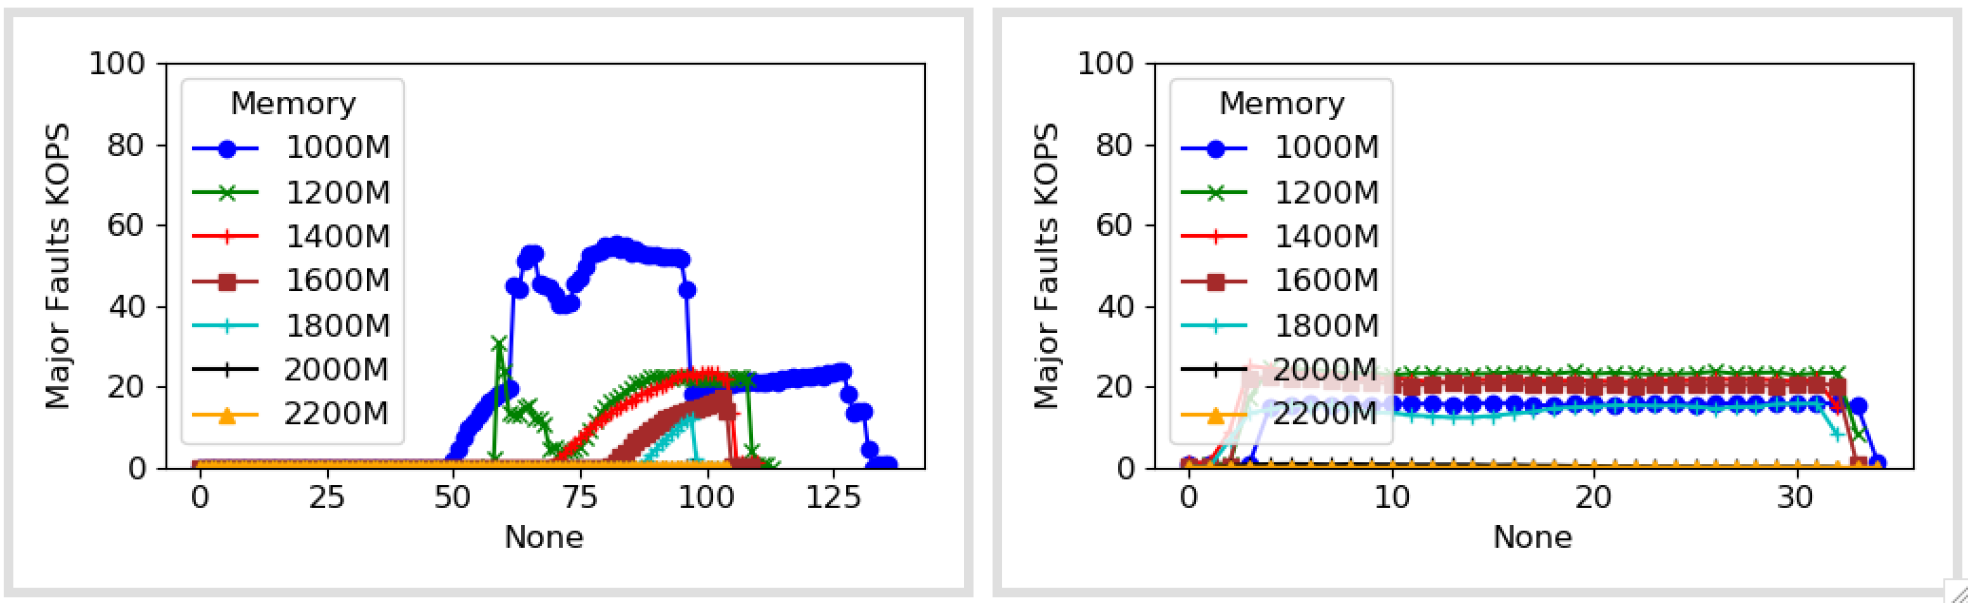
1 core

Slide 18
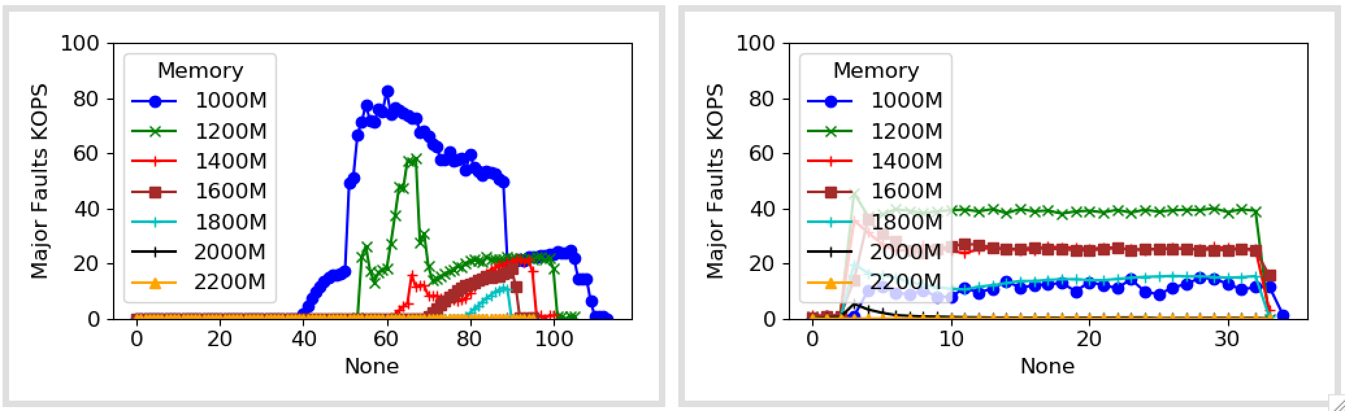
2 cores

Slide 19
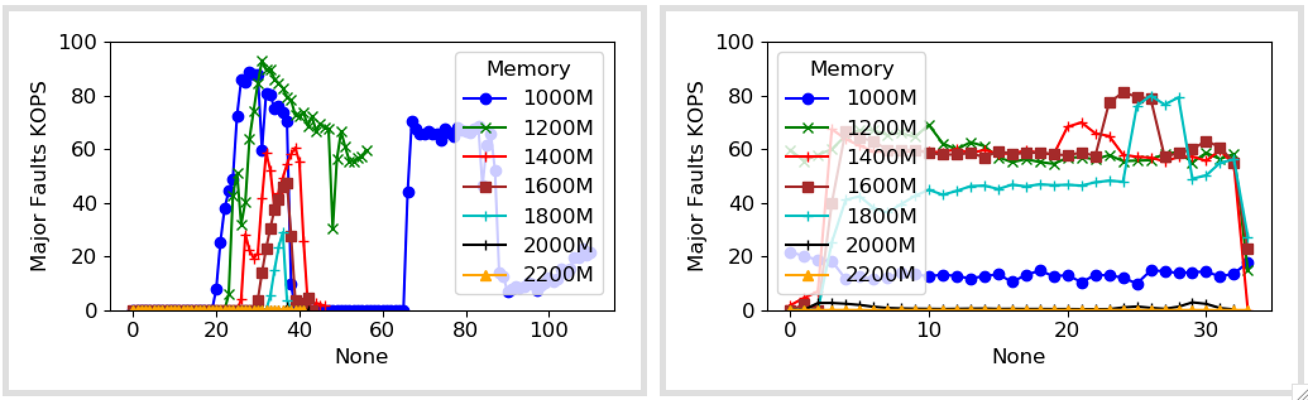
3 cores

Slide 20
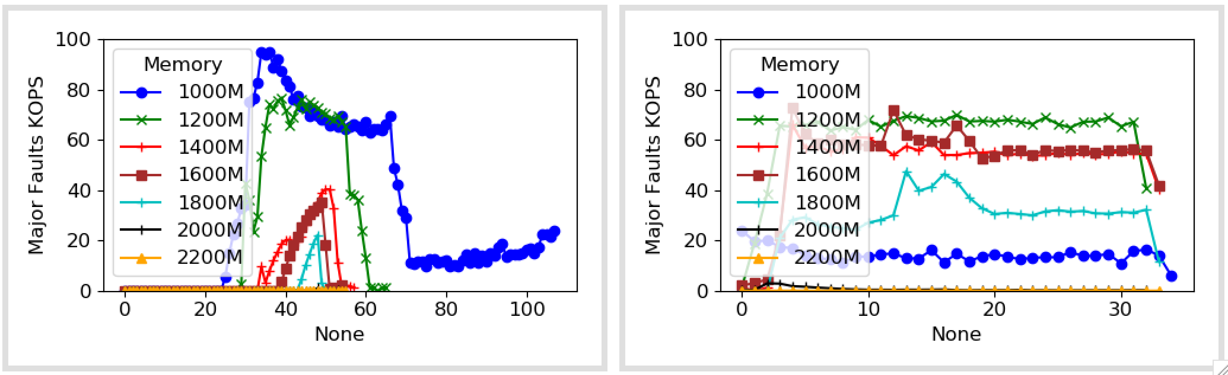
4 cores

Slide 21
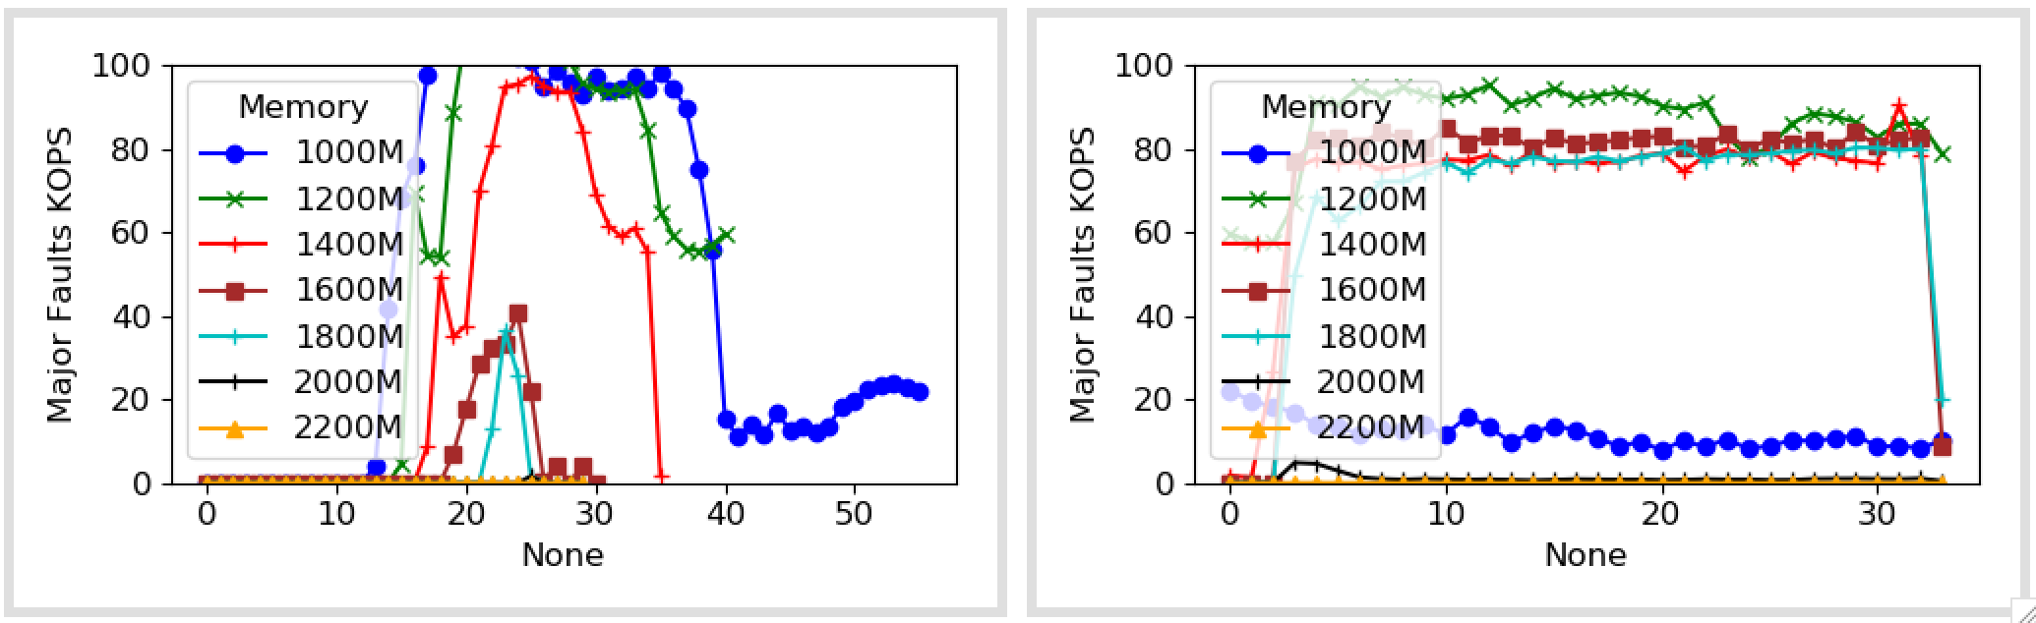
5 cores

