Slide 1
Update
More results for AIFM benchmark
Kailua discussion
Paper feedback

Slide 2
Feedback
CXL – not in this paper.
Would scheduling user threads make sense with CXL?
Would the idea of annotations carry over? Does CXL provide async primitives?
Extending our simulations for CXL
Contributions are not crisp – Kona (UMap) as the baseline/motivation
More apps – in progress
Contributions not enough – let’s evaluate this in the next revision

Slide 3
Kona, Kailua and UMap
Kailua
Contributions | UMap | Kona | Nadav’s | Our answer
Basic Userfaultfd (Kernel 5.9+) | ✅ | ✅ | ✅ | ✅
RDMA Backend | ❌ | ✅ | ❌ | ✅
Userfaultfd Improvements v1 Optional faulting thread polling Asynchronous page fault monitoring In-place page fault resolution Integration with io-uring Page preallocation and prefetch by faulting thread | ❌ | ✅ (but we don’t use them) | ✅ | ❌ Orthogonal Some of them contrast with user faults?
Advanced eviction policies (page access info) | ❌ | ❌ | ✅ | ❌
Userfaultfd Improvements v2 Vectored ops for madvise, uffd Advanced TLB stuff on these ops | ❌ | ❌ | ✅ | Same as v1
I/O decoupling (aka multiple fillers/evictors) | ✅ | ❌ | ❌ | ❓
API: User-controlled fetching, pinning, read-ahead, etc. | ✅ | ✅ | ✅ | ❓
Notes:
Disclaimer: As far as Anil knows
Takeaways
We shouldn’t have any problem in building conceptually on UMap in our paper

Slide 4
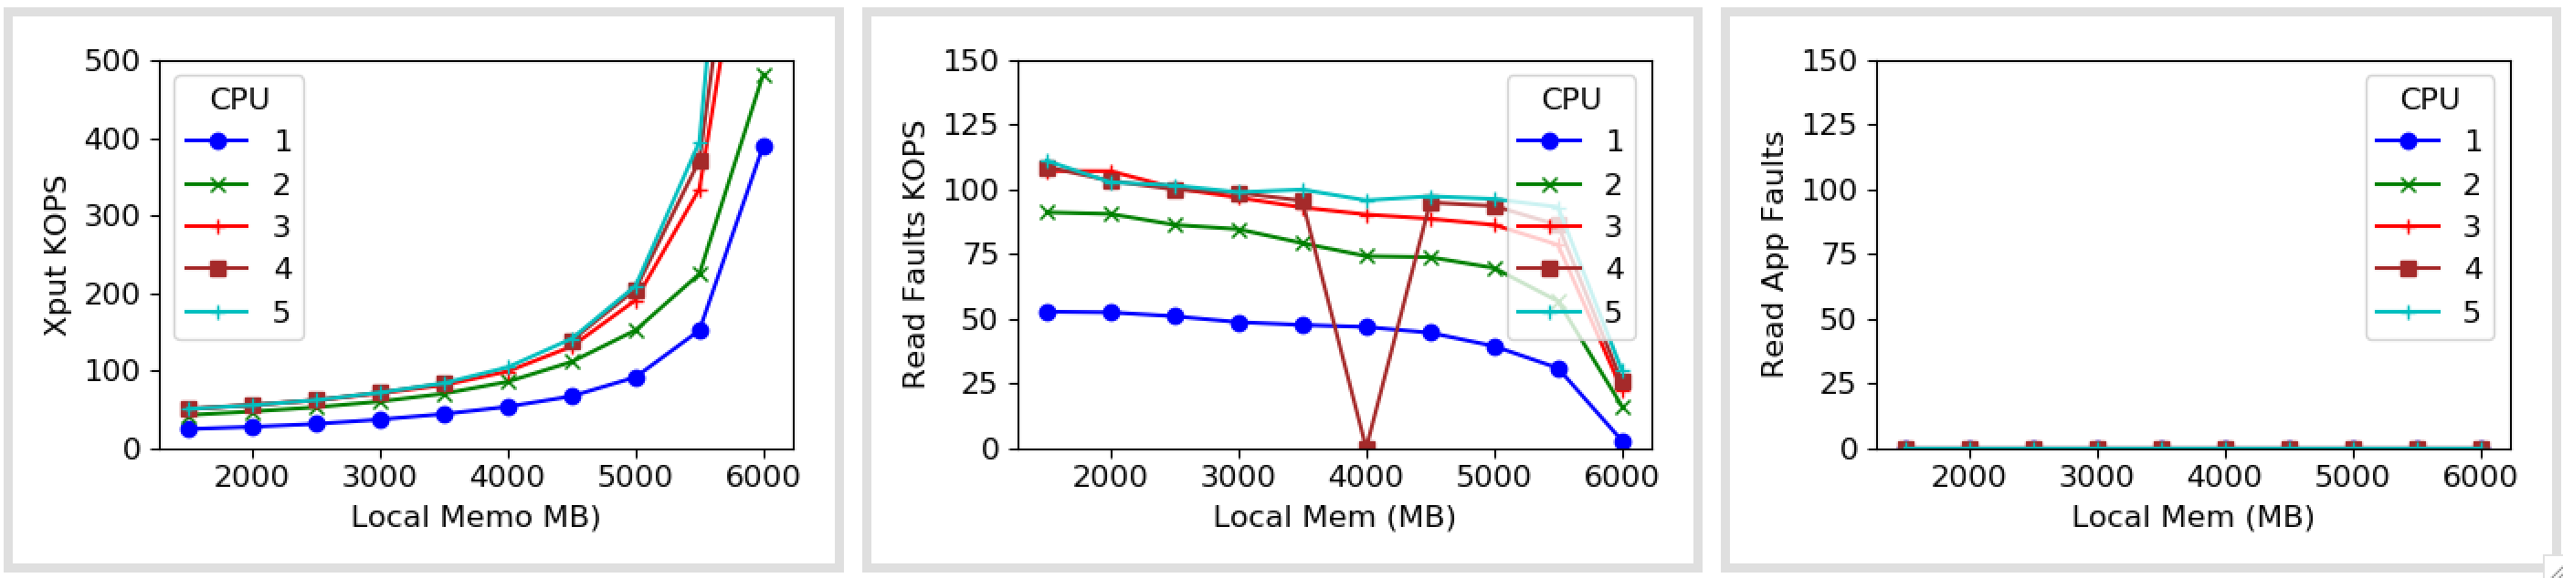
With Kona

Slide 5
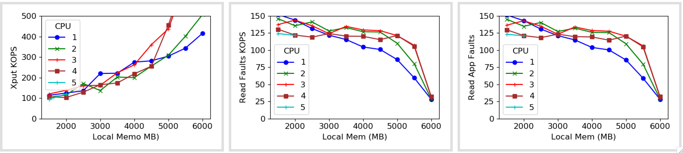
With upcalls

Slide 6
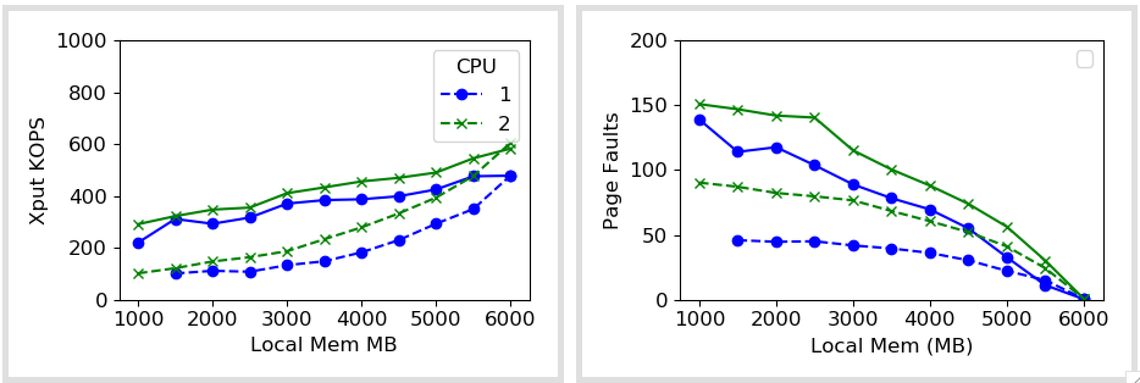
Zipfs: 1

Slide 7
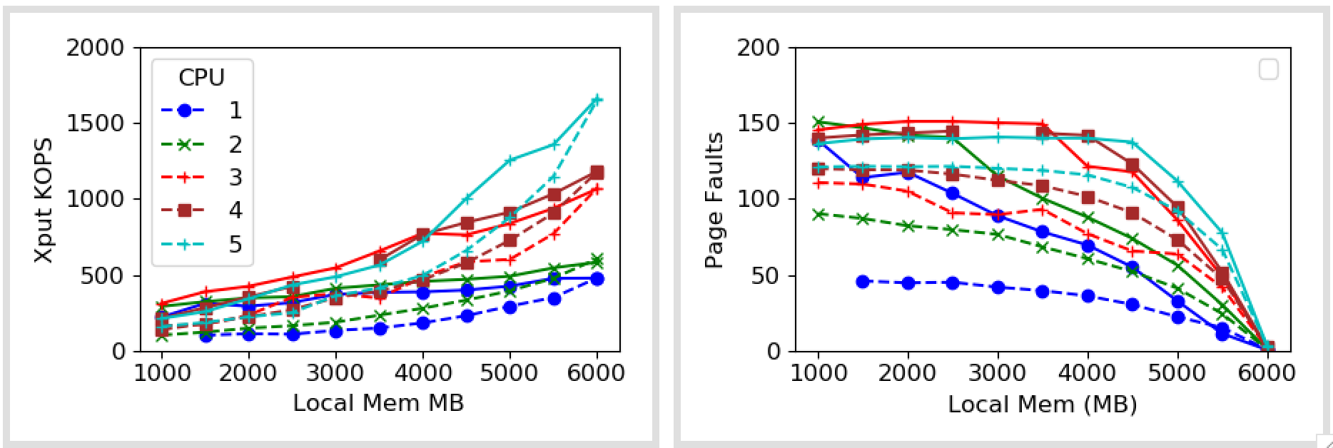
Zipfs: 1

Slide 8
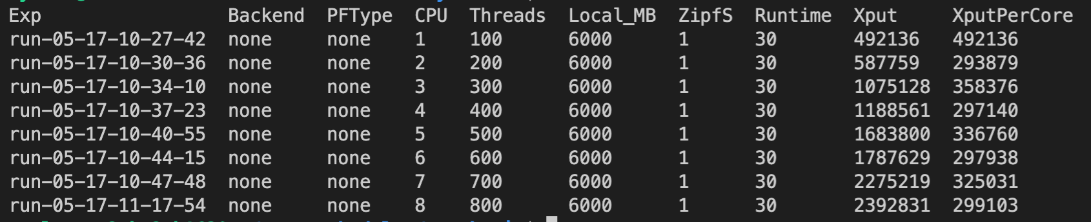
Snappy Performance

Slide 9
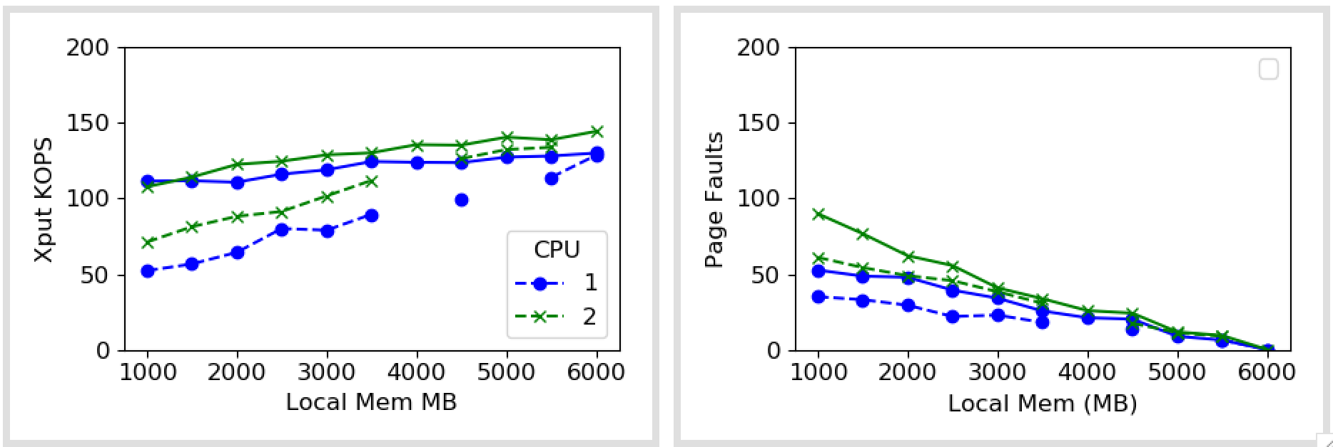
Zipfs: 1 (4*zip)

Slide 10
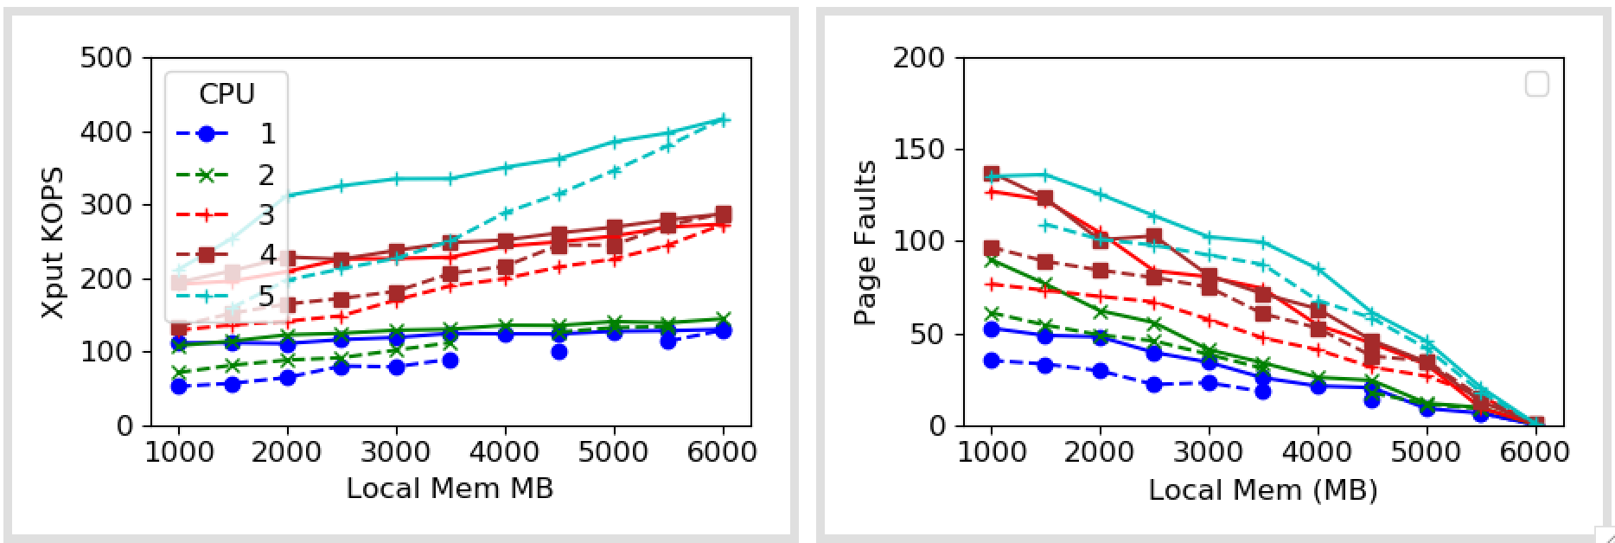
Zipfs: 1 (4*zip)
Notes:
Takeaways: 100 times or way more than that

Slide 11
Next
Next for AIFM app?
Paper feedback
In the queue
Batching – no support in Kona
Zipf for Memcached
Use benchmarks from UMap: Sort, Graph app, Asteroid detection
Comparison systems: Fastswap vs UMap

