Slide 1
Status
Paper
Fastswap
Kona scalability

Slide 3
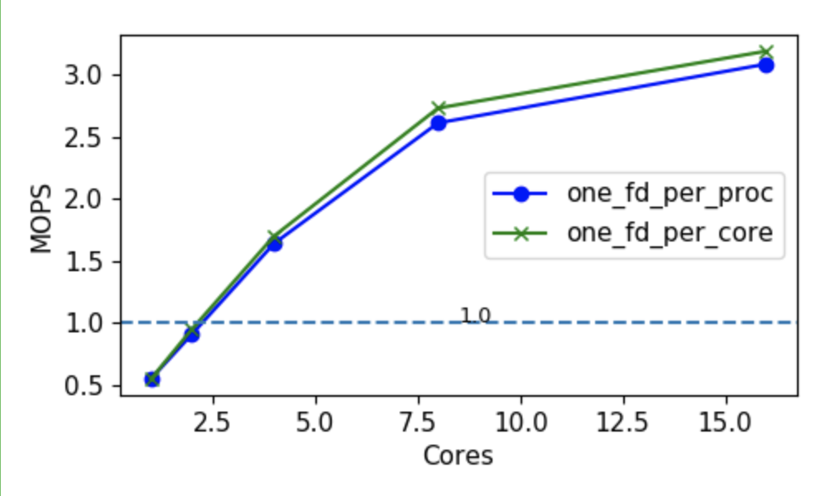
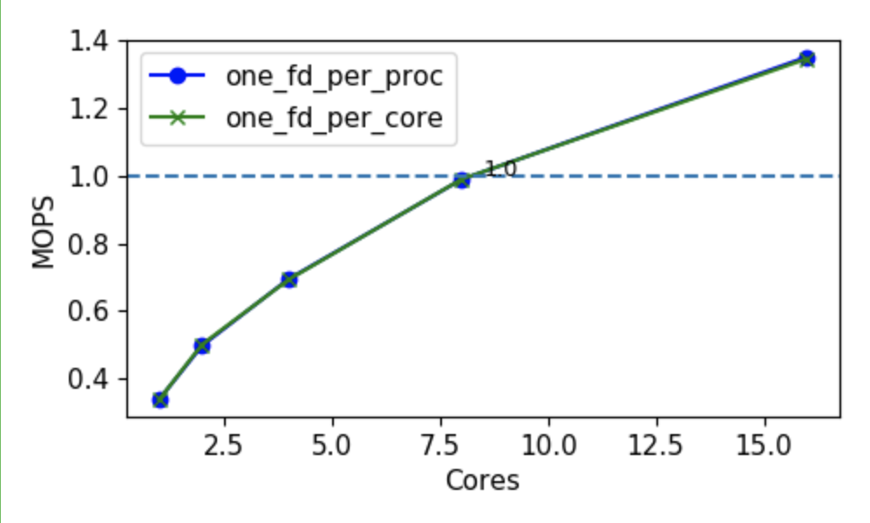
Kona scalability

