Slide 1
Exploiting Concurrency for Practical Memory Disaggregation
Anil Yelam, Nadav Amit, Radhika Niranjan Mysore, Marcos K. Aguilera, Alex C. Snoeren

Slide 2
Memory Disaggregation

Slide 3
Misc

Slide 4
In a nutshell
=
?
Traditional schedulers
Systems for Disaggregated Memory
Notes:
Involves two lines of research which I’ll talk about
In a nutshell though, I’m just combining these two and explaining performance

Slide 5
Outline
Background
What motivates this?
Performance challenges
Where I’m at

Slide 6
Background
=
?
Traditional schedulers
Systems for Disaggregated Memory
Notes:
Involves two lines of research which I’ll talk about
In a nutshell though, I’m just combining these two and explaining performance

Slide 7
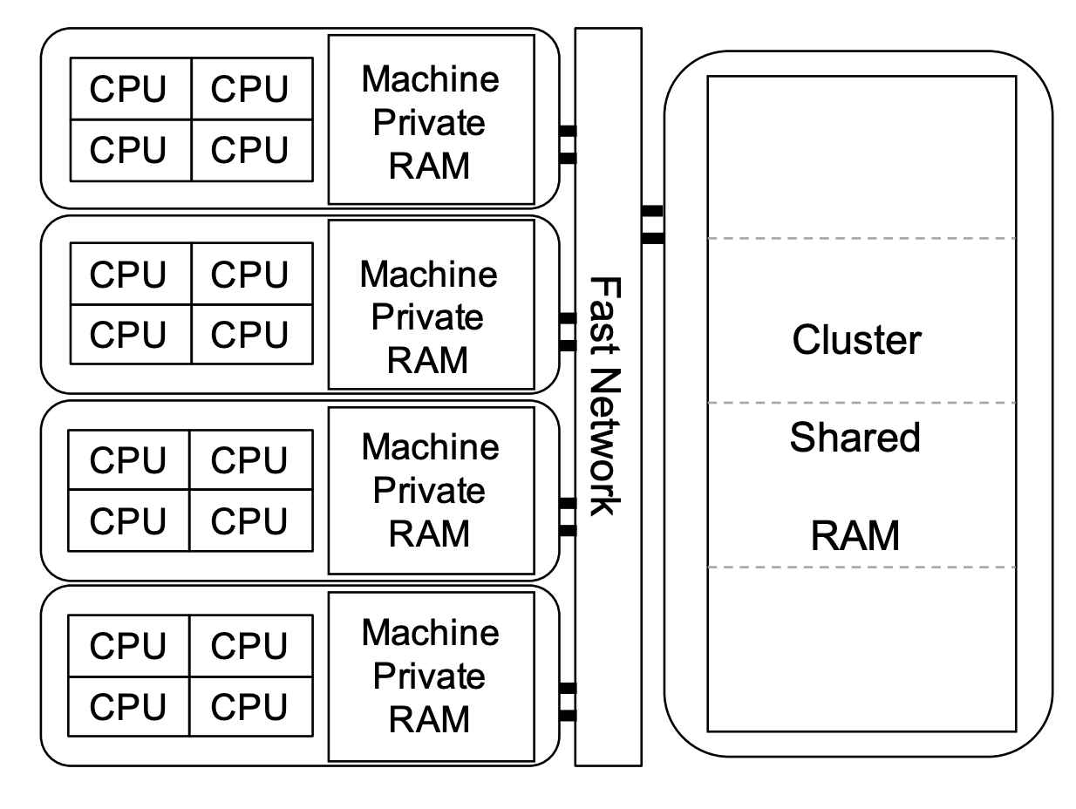
Remote/Disaggregated Memory
Pools of compute and memory, connected by low-latency network.
Benefits? Talk to Stew.
Challenge: Performance affect of remote memory accesses.
Common mitigation is to exploit locality.

Slide 8
How is the memory exposed?
Performance
Transparency
Native Apps
Low-level RDMA interface
No memory management
OS/Runtimes
Focus on transparency and ease of adoption
Common abstraction: virtual memory

Slide 9
Paging-based Remote Memory
Presented as virtual memory and serviced through page faults
Pros:
No application changes
Generality
e.g., Infiniswap, Fastswap, zSwap, LegoOS, Leap, Kona
Will be looking at such systems.
Application
Virtual
Address
Space
Kernel
Pagefault Handler
Local Memory
Network
Transport
Remote Memory
Notes:
While there are different ways to provide remote memory…

Slide 10
Background
=
?
Traditional schedulers
Systems for Disaggregated Memory
Notes:
Involves two lines of research which I’ll talk about
In a nutshell though, I’m just combining these two and explaining performance

Slide 11
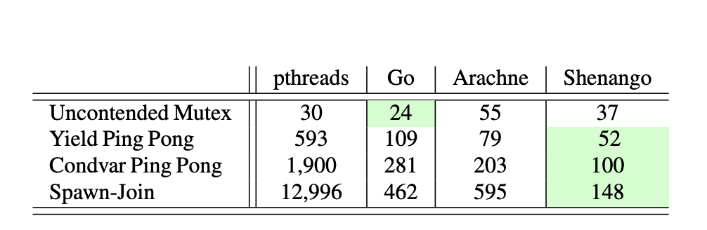
Scheduling: The usual way
Scheduling in Kernel
Kernel threads to express parallelism
But Kernel threading primitives are expensive!
Large number of threads not feasible
Hides parallelism from the scheduler
Notes:
on multi-core systems
Express parallelism through Kernel threads

Slide 12
User-space schedulers
Lightweight Threads scheduled in User-space
Separates thread scheduling from core allocation
Runtimes provides super-light locks and kernel-bypass I/O
Keep things in user-space!
Con
Cooperative scheduling
Coarse-granular core allocation
Can’t work well with Kernel
e.g., Arachne, Shenango, Caladan
Notes:
Goal is to explore this option.

Slide 13
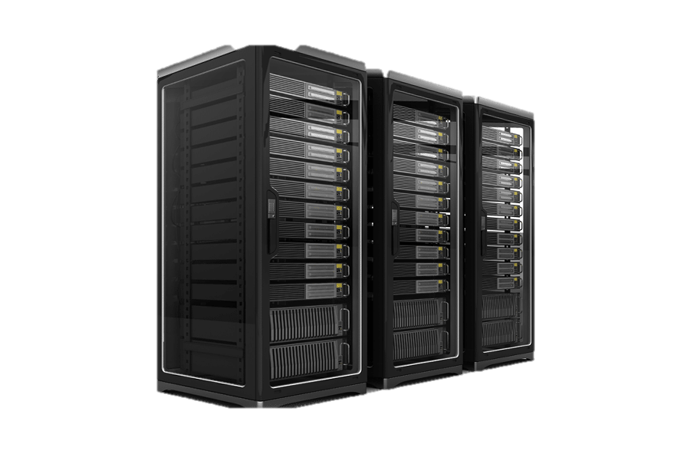
Why is this interesting?
Would state-of-the-art schedulers work on remote memory?
Exploit parallelism to hide remote latencies
A step towards rack-scale scheduling
Notes:
Explore other abstractions on the OSes

Slide 14
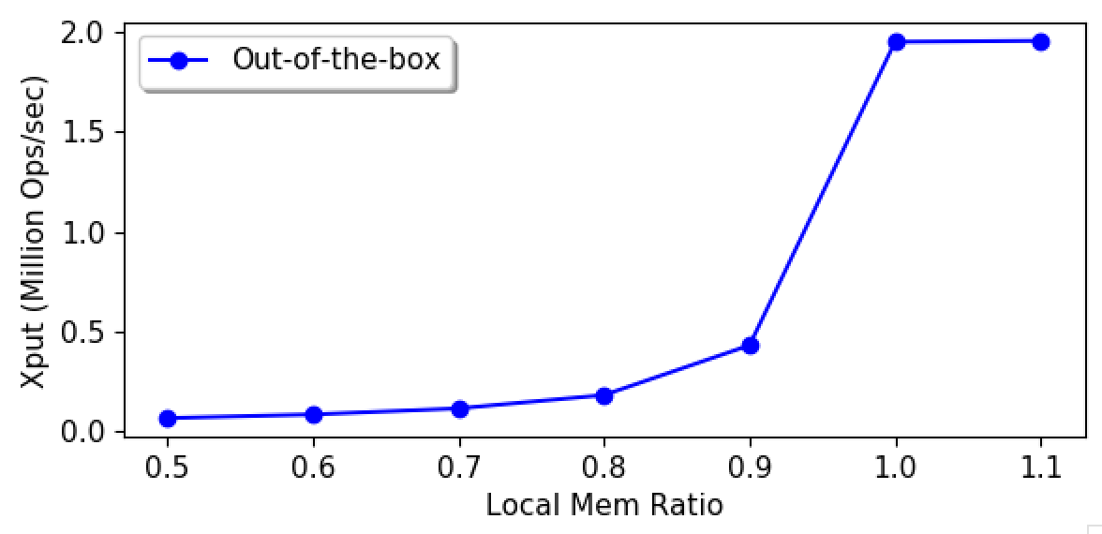
Out-of-the-box Performance
Goal: Characterize Performance
(Details shortly)

Slide 15
A suspect: Page faults
Gateway to remote memory in transparent systems.
Today’s user-space schedulers use kernel thread as a proxy for cores (one thread per core) – to avoid kernel scheduler.
Being blocking operations, they take the thread/core away
Limits page fault (remote access) concurrency
Notes:
This presents a problem for user-level schedulers who want the kernel out of the picture.

Slide 16
Asynchronizing Page faults
Some blocking kernel calls have been asynchronized
Custom I/O interfaces
But Page faults trap in hardware.
All current schedulers ignore the issue; not an option in a remote memory system
May require kernel upcalls like scheduler activations
Wait, show me that this is a real problem first!

Slide 17

Approach
Shenango – State-of-the-art user thread scheduler
Kona – State-of-the-art remote memory system
Run them together,
Benchmark with Memcached
Notes:
Ok let’s get real then.

Slide 18
Kona
Paging-based remote memory
Application
Virtual
Address
Space
Kernel
Pagefault Handler
Local Memory
Network
Transport
Remote Memory
Notes:
Just a few more details about the setup

Slide 19
Kona
Paging-based remote memory
Transparency introduces semantic gap so Kona handles page faults in userspace. Provides:
Choice of compatibility or co-design
Resource accounting
Easy to experiment
Shouldn’t make a difference in my case
Application
Pagefault Handler
Virtual
Address
Space
Kernel
Local Memory
Network
Transport
Remote Memory
Notes:
Providing the application with native memory interface but giving it the control over how the local cache is managed.

Slide 20
Kona
Host
App
Kona Threads
Memory
Server
App Work
RDMA
Faults
Eviction
NIC
Notes:
Kona from a cpu allocation perspective
Describe eviction and eviction threshold.

Slide 21
Kona + Shenango
Host
Memcached
User Threads
Kona Threads
Memory
Server
I/O Core
Poller
Faults
Eviction
Runtime
KV
Client
NIC
Notes:
Kona and shenango are core-isolated, with shenango managing rest of the threads. Has it own net stack, etc.
All working memory is local, only app heap goes on the remote memory.

Slide 22
Memcached Throughput
Memcached
4 CPU cores
Offered load: 2 Mops
Mostly (>99%) Reads
Uniform key distribution
Notes:
Out of the box performance
Took me whole internship

Slide 23
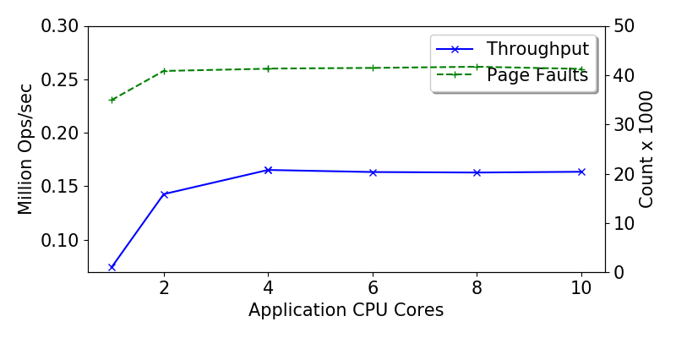
First in line: Kona Bottlenecks
Notes:
That was it, that was where my internship ended really.

Slide 24
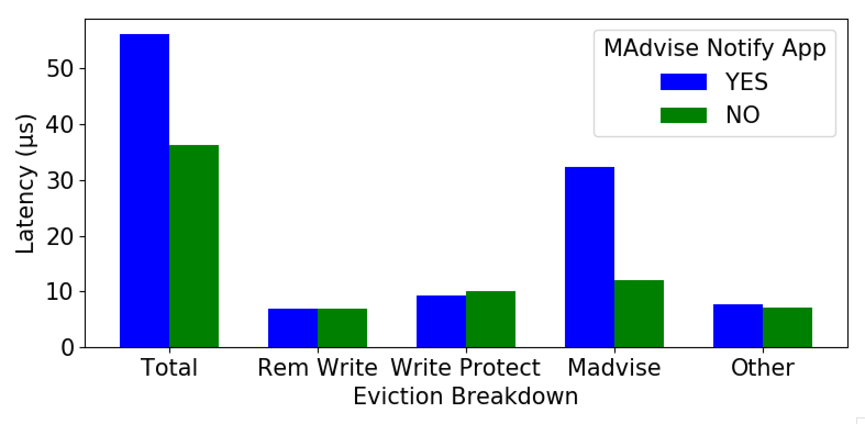
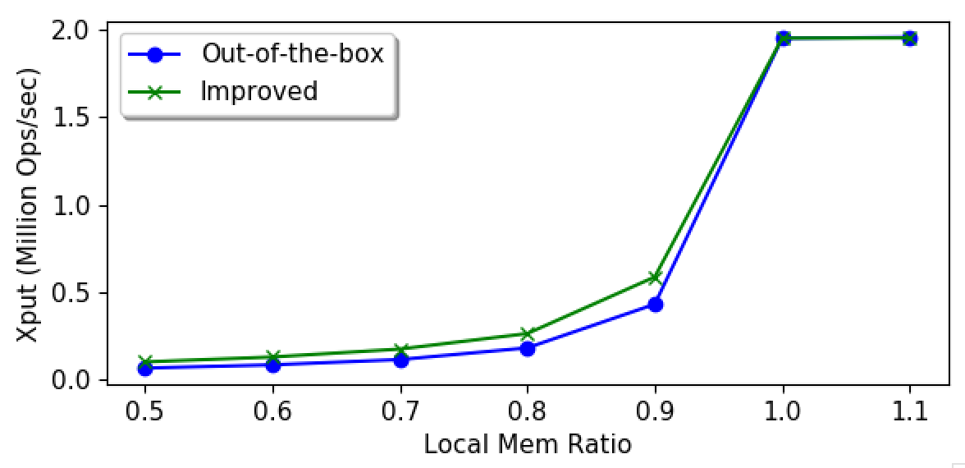
Eviction Bottleneck
Eviction Time ~ 35%

Slide 25
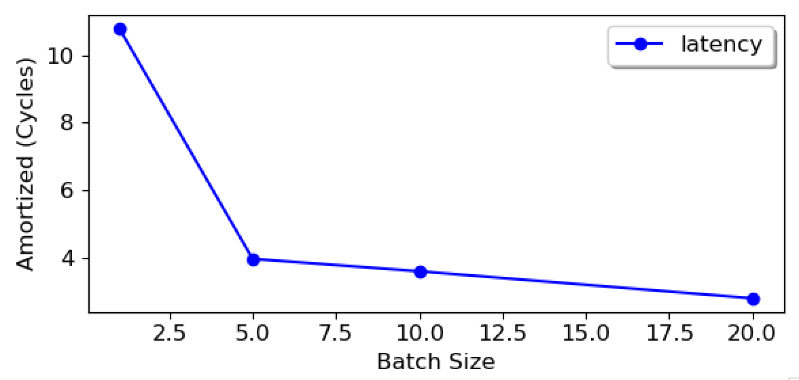
Eviction Bottleneck
Eviction Time ~ 35%
Eviction Batching ~ 10% (expected)

Slide 26
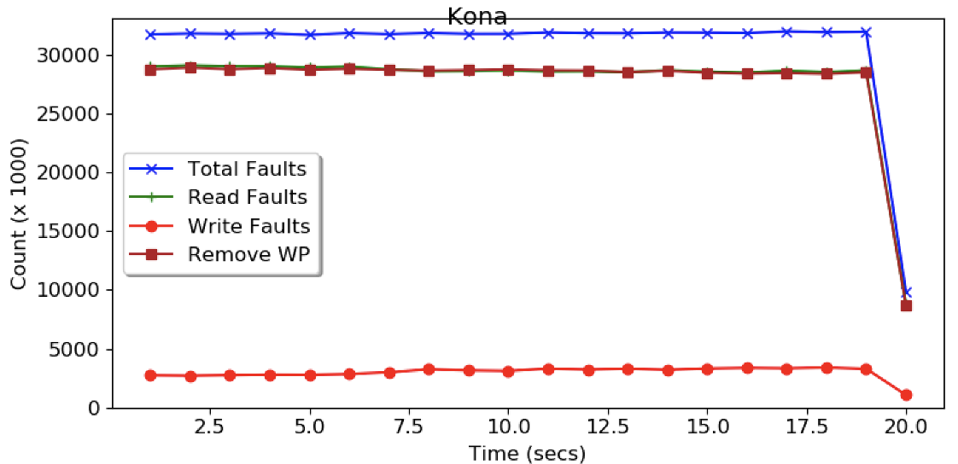
Eviction Bottleneck
Eviction Time ~ 35%
Eviction Batching ~ 10% (expected)
Memcached dirtying ~ 30% (expected)

Slide 27
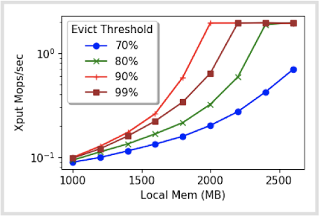
Eviction Bottleneck
Eviction Time ~ 35%
Eviction Batching ~ 10% (expected)
Memcached dirtying ~ 30% (expected)
Eviction threshold

Slide 28
First in line: Kona Bottlenecks
Working on improving eviction, but there might be others in Kona.
Expectation is that we’ll hit page fault concurrency after this.

Slide 29
Going forward
Keep exploring performance bottlenecks
Opportunities for scheduler-remote memory co-design
Longer-term
How could this fit into rack-scale scheduling?

Slide 30
Conclusion
Exploring user-space CPU scheduling for remote memory.
Sounds Interesting? Please reach out!

Slide 31
The end

Slide 32
Don’t go past this

Slide 33
Please stop!

Slide 34
Racklette Effort
Redesigned software stack for Rack-scale applications
Simplified programming
Better/balanced resource utilization
Exploring CPU Scheduling, both on the rack-level and within each server
Notes:
Racklette which is one of recent rackscale computing efforts, driven to brand rack as a more integrated computing platform than a traditional distribued system
Driven by recent hardware trends like fast, low latency networks, CXL, and disaggregated memory, Rack resembles more and more like a multi-core server; and the goal is to exploit this to provide simplified programming models and better resource utilization through global decision making.
While there are many open questions on the design, an important one is how we are gonna do CPU scheduling, both across the rack and within each node

Slide 35
Assumptions
Disaggregated Compute & Memory (aka Remote Memory)
Run legacy applications: POSIX Threads and Virtual memory
Target applications: Recommender, Memcached
Notes:
To narrow down the problem, these are some choices/assumptions that we make

Slide 36
Question
What’s the best way to manage & schedule threads, in the context of Racklette and Remote Memory?
Ideally, these properties:
Lightweight
Flexible scheduling e.g., prioritizing threads based on signals
Co-scheduling opportunities e.g., network
Migratable (longer-term)
Notes:
Given that, the question comes down to:

Slide 37
Thread Management
Kernel is a suitable location but
Kernel threading primitives are expensive
User-level thread management (e.g., Arachne, Shenango, Caladan)
Separate thread scheduling from core allocation
Runtime provides locks and I/O etc. in userspace
Core allocation based on signals (co-design)
But can they be run out-of-the-box on remote memory?
Notes:
Goal is to explore this option.

Slide 38
Remote/Disaggregated Memory
Pools of compute and memory, connected by low-latency network.

Slide 39
Paging-based Remote Memory
Presented as virtual memory and serviced through page faults
Pros:
Native memory interface
No app changes
But handled by the kernel.
Application
Virtual
Address
Space
Kernel
Pagefault Handler
Local Memory
Network
Transport
Remote Memory
Notes:
While there are different ways to provide remote memory…

Slide 40
Page faults are a problem
Today’s user-level schedulers use kernel thread as a proxy for cores (one thread per core).
e.g., Arachne, Shenango, Caladan, GOLANG.
But blocking kernel calls take the thread/core away.
Blocking calls – Sync I/O, System calls, Page faults
Multiple kernel threads per core not an option
Notes:
This presents a problem for user-level schedulers who want the kernel out of the picture.

Slide 41
Page faults are a problem
Various solutions, none of which work for page faults.
Custom I/O interfaces
Because Page faults trap in hardware.
All current schedulers ignore the issue
Not an option in a remote memory system
Concrete Goal: Demonstrate and quantify the performance effect of blocking due to page faults

Slide 42
Approach
Shenango – State-of-the-art user thread scheduler
Kona – State-of-the-art, in-house remote memory system
Run them together,
Benchmark with Memcached

Slide 43
Kona
Paging-based remote memory
Application
Virtual
Address
Space
Kernel
Pagefault Handler
Local Memory
Network
Transport
Remote Memory
Notes:
Just a few more details about the setup

Slide 44
Kona
Paging-based remote memory
Transparency introduces semantic gap so Kona handles page faults in userspace. Provides:
Choice of compatibility or co-design
Resource accounting
Easy to adopt
Application
Pagefault Handler
Virtual
Address
Space
Kernel
Local Memory
Network
Transport
Remote Memory
Notes:
Providing the application with native memory interface but giving it the control over how the local cache is managed.

Slide 45
Kona
Host
App
Kona Threads
Memory
Server
App Work
RDMA
Faults
Eviction
NIC
Notes:
Kona from a cpu allocation perspective

Slide 46
Kona + Shenango
Host
Memcached
User Threads
Kona Threads
Memory
Server
I/O Core
Poller
Faults
Eviction
Runtime
KV
Client
NIC
Notes:
Kona and shenango are core-isolated, with shenango managing rest of the threads. Has it own net stack, etc.
All working memory is local, only app heap goes on the remote memory.

Slide 47
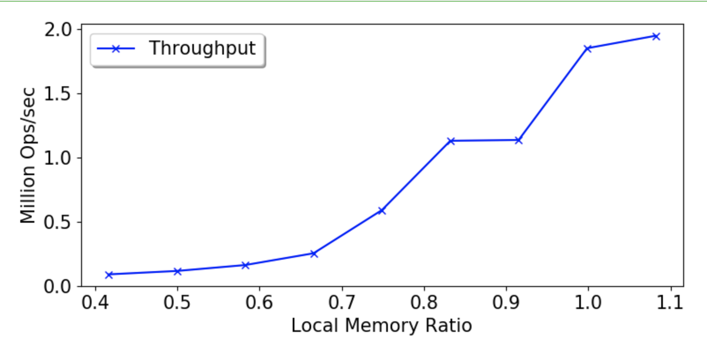
Memcached Throughput
Memcached
4 CPU cores
Offered load: 2 Mops
Mostly (>99%) Reads
Uniform key distribution
Notes:
Degradation as expected. Of course, the challenge is to separate the degradation due to hardware and due to system design. Only way to know is to figure out where the bottlenecks are coming from.

Slide 48
Memcached Throughput
Memcached
4 CPU cores
Offered load: 2 Mops
Mostly (>99%) Reads
Uniform key distribution
Notes:
Degradation as expected. Of course, the challenge is to separate the degradation due to hardware and due to system design. Only way to know is to figure out where the bottlenecks are coming from.

Slide 49
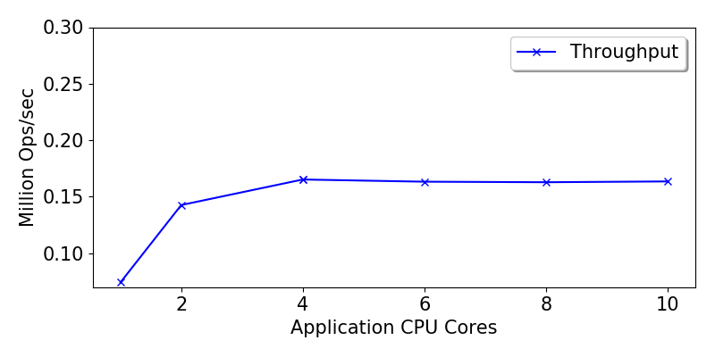
Throwing more CPU at it

Slide 50
Throwing more CPU at it

Slide 51
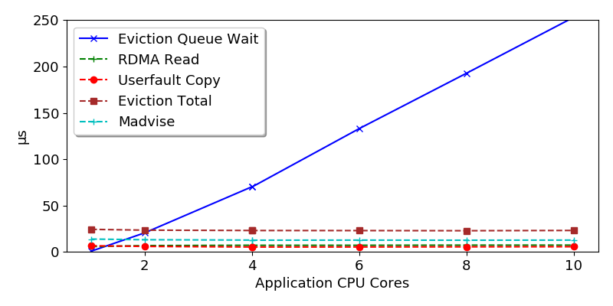
Throwing more CPU at it
Notes:
Kona, with its single core, is not able to keep up.

Slide 52
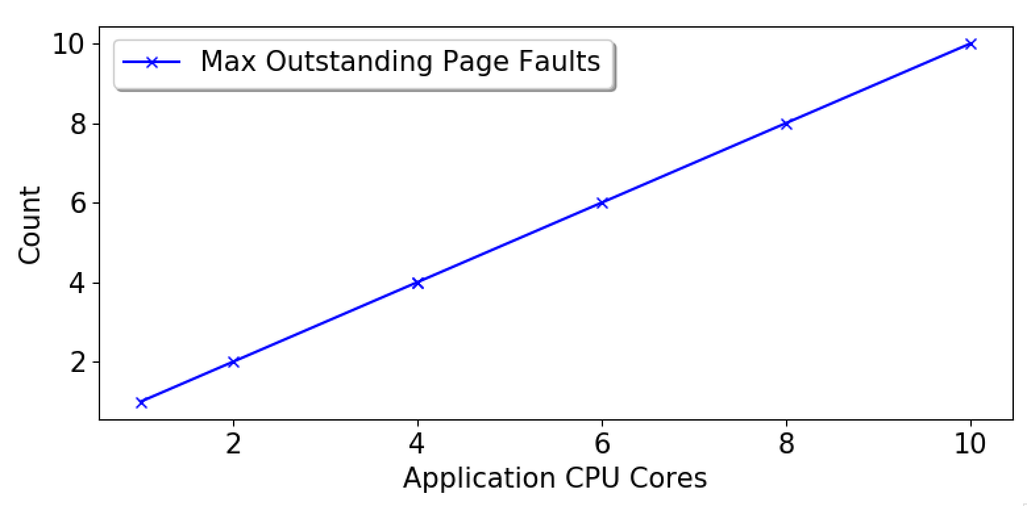
Well, what about page faults?
Perhaps the next bottleneck we’ll hit. But for a flavor…
Notes:
What this shows is that 1) page faults are synchronous and threads aren’t doing any other work, and 2) even after removing bottlenecks in Kona, you won’t be able to put more that 10 concurrent rdma in flight

Slide 53
Potential Solutions
Kona bottlenecks
Optimizing some kernel operations
Co-design with Shenango scheduler
Kona threads to User threads
Increase/decrease threads based on paging activity
Asynchronizing page faults
Upcalls à la scheduler activations
Notes:
Fortunately, as if by foresight, Kona already does its work in userspace

Slide 54
Going forward
Implementing these solutions
Exploring how this fits into rack-level scheduling

Slide 55
Conclusion
Investigated the user-level threading as a scheduling option for remote memory
Identified & demonstrated some perf challenges
Proposed potential solutions

Slide 56
Thanks & Questions

Slide 57

Where I’m at
An Amazing Scheduler
For Remote Memory
Expectation
Reality

