Slide 1
Exploiting Concurrency for Practical Memory Disaggregation

Slide 2
Background
Memory Disaggregation
Paging-based Remote Memory (not CXL)
Infiniswap, Fastswap, Leap
App-controlled Page Management
With Linux Userfaultfd
Benefits: App-managed prefetching, Read-ahead, Custom eviction
UMap, HeMem, Kona/Kailua

Slide 3
Motivation
Hiding the remote memory latencies
e.g., RDMA takes up to 6 µs in my case
Obvious solution is better caching/eviction policy
We chose to (and make it easier to) exploit concurrency
But with minimal application changes
Keep virtual memory (but no CXL yet) – hence the focus on paging
But full transparency may not be an option – hence Userfaultfd
Notes:
How much concurrency do I need per application? Can we quantify it?
Comments:
Say: traditional solution
Convenience of virtual memory but with some additional control

Slide 4
We start here
Page fault: 17 µs*
RDMA read: 6 µs
(*no Kailua optimizations)
Process (Userspace)
App work
Remote Paging Handler
API
Userfaultfd
Remote memory
Kernel
Notes:
TODO: Get the perfect breakdown?

Slide 5
Problem
To hide latencies, app must use kernel threads.
Switching expensive ~ O(µs)
Limited parallelism exposed to the (kernel) scheduler
Process (Userspace)
App work
Remote Paging Handler
API
Userfaultfd
Remote memory
Kernel
Notes:
NOTE: I don’t have some numbers to support this argument in the paper
Fastswap forgoes switching threads altogether because it didn’t deem the cost worth it
Comment: current approach is OS threads (not must)
Comment: The term “kernel thread” is overloaded; maybe not use it? Just use threads vs user threads

Slide 6
Solution
User threads & userspace scheduler e.g., Shenango
Switching expensive ~ O(µs)
Limited parallelism exposed to the (kernel) scheduler
Process (Userspace)
App work
Remote Paging Handler
POSIX-like API
API
Scheduler
Userfaultfd
Remote memory
Kernel

Slide 7
Challenge with User Threads
Page faults are synchronous
Process (Userspace)
App work
Remote Paging Handler
POSIX-like API
API
Scheduler
Userfaultfd
Remote memory
Kernel

Slide 8
Solution: Sched faults (Scheduler-mediated userfaults)
Make them asynchronous
e.g., scheduler activations.
Process (Userspace)
App work
Remote Paging Handler
POSIX-like API
API
Scheduler
Userfaultfd
Remote memory
Kernel

Slide 9
Solution: Sched faults
Make them asynchronous
e.g., scheduler activations.
Instead:
Return empty-handed from the fault (upcall) into the scheduler
Process (Userspace)
App work
Remote Paging Handler
POSIX-like API
API
Scheduler
Userfaultfd
Remote memory
Kernel

Slide 10
Solution: Sched faults
Make them asynchronous
e.g., scheduler activations.
Instead:
Return empty-handed from the fault (upcall) into the scheduler
Fault communication in userland
Avoids an extra kernel-user trip
Avoids an additional kernel upcall
Performs slightly better
Process (Userspace)
App work
Remote Paging Handler
POSIX-like API
Extended API
Scheduler
Userfaultfd
Remote memory
Kernel

Slide 11
Application-managed Sched faults
Sched faults are entirely* transparent to the application
But we also provide them as API calls for app to annotate at fault locations e.g., for batching page faults
Simplified implementation but finding fault locations was easy
(*in an ideal implementation)
Process (Userspace)
POSIX-like API (Extended)
App work
Remote Paging Handler
Extended API
Scheduler
Userfaultfd
Remote memory
Kernel
Notes:
What does it take to implement kernel

Slide 12
Application-managed Sched faults
Sched faults are entirely* transparent to the application
But we also provide them as API calls for app to annotate at fault locations e.g., for batching page faults
Simplified implementation but need to find fault locations
(*in an ideal implementation)
Process (Userspace)
POSIX-like API (Extended)
App work
Remote Paging Handler
Extended API
Scheduler
Userfaultfd
Remote memory
Kernel
Notes:
What does it take to implement kernel

Slide 13
Questions on the Design
Why the scheduler? Why not let the app manage it entirely?
Simple thread abstraction to extract concurrency
Reduces the burden of placing prefetch calls
Enables future (scheduling) optimizations without changing apps

Slide 14
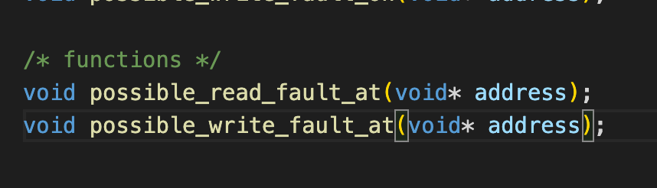
Implementation
Kona for Remote Memory Handler
No Kailua Optimizations
Like UMap but with an RDMA backend
Extended to accept faults from scheduler
Shenango for user-thread scheduler
On receiving control after a fault,
Place thread aside
Send fault to Kona
Run another thread
Poll fault responses as soft interrupts and set threads runnable
Scheduler-provided fault API

Slide 15
Implementation
How to get to scheduler on a fault?
We use Nadav’s vDSO call to check for page existence
Hit time: 20 ns
Miss time: 1.66 µs (overhead)
Notes:
Although, why not ask Kona?
Restartable sequences in the Kernel
Miss time should be lower: maybe kernel mitigations?

Slide 16
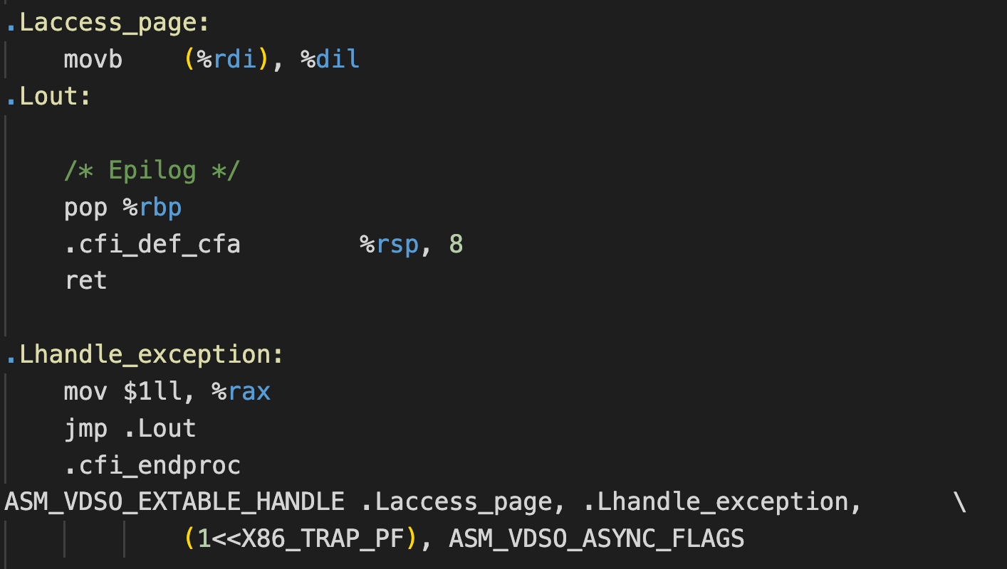
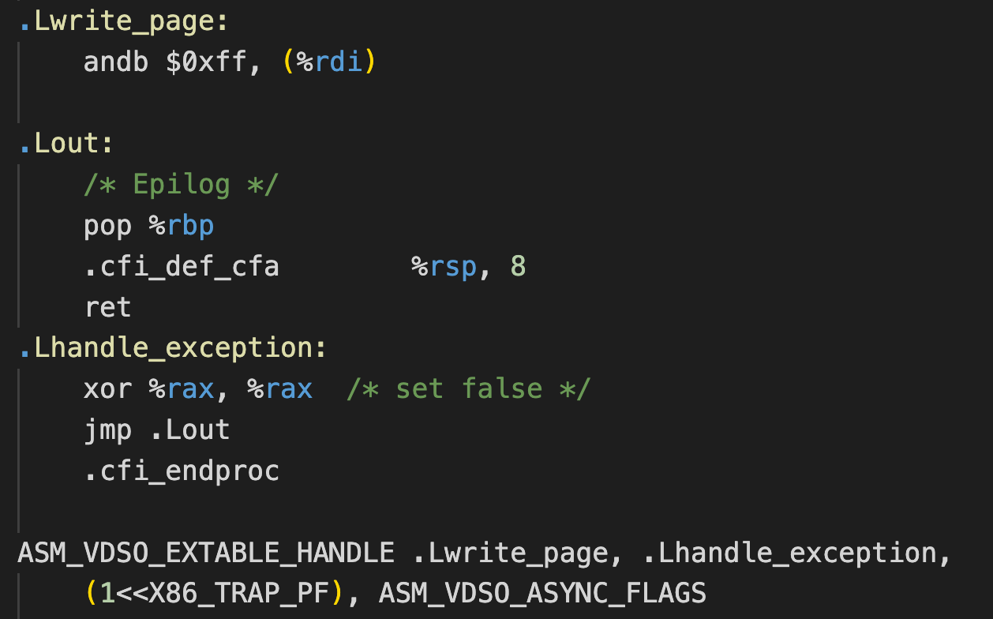
vDSO Calls
Page mapped check
Page write-protected check

Slide 17
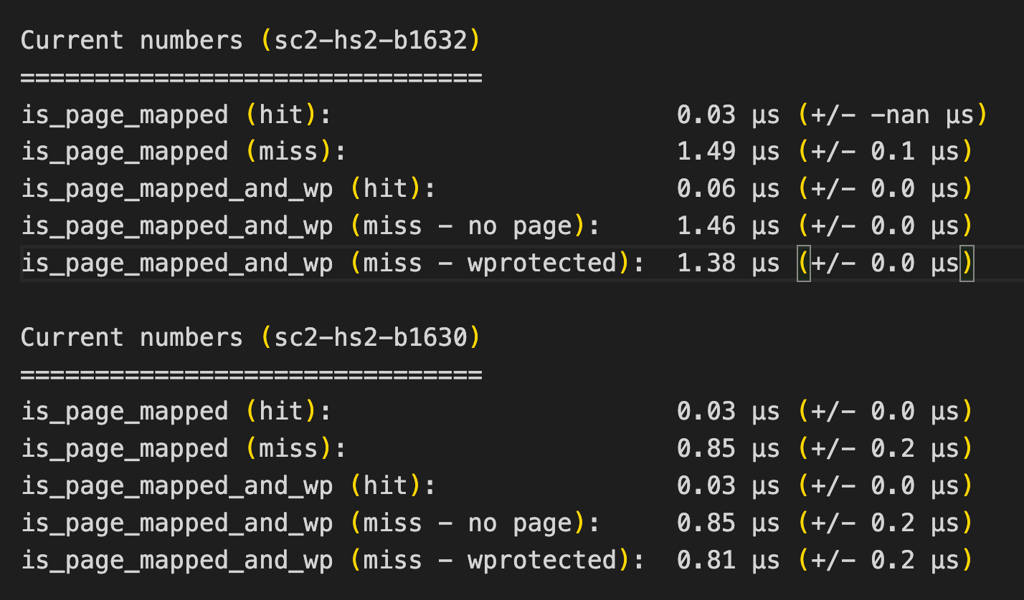
vDSO Calls

Slide 18
Discussion
How would I go about writing transparent upcalls?
Notes:
Although, why not ask Kona?
Restartable sequences in the Kernel
Miss time should be lower: maybe kernel mitigations?

Slide 19
Finding fault Locations
(Kernel) Included IP register in the UFFD messages
Turn off PIE/ASLR
addr2line prints out code location!
Added random fault sampling in Kona

Slide 20
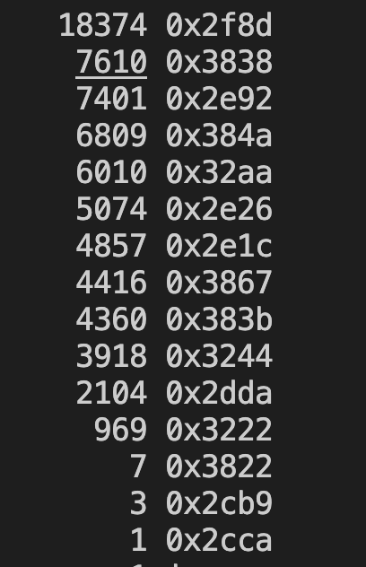
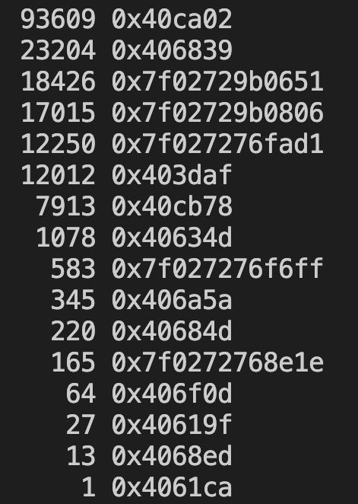
Fault Location Frequency
Sort
Synthetic
Memcached

Slide 21
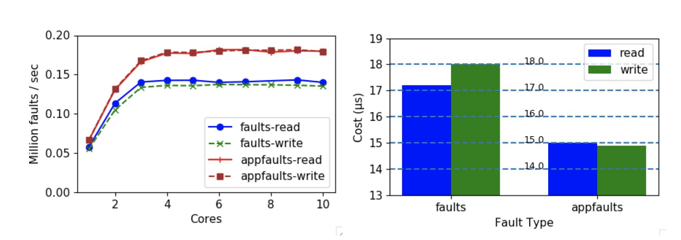
Micro: App-faults vs Userfaults
Why the gap?

Slide 22
Results Overview
Synthetic and Memcached apps
Remote memory-friendly changes
Avoid dirtying on reads
Concentrate locks at one place

Slide 23
Results: Synthetic app
Custom-written web service frontend
On each request:
Looks up hash table for blob index
Compresses the blob (8 KB)
50M kv pairs, 400k blobs –> 6 GB
Skewed request distribution (zipfs = 1)

Slide 24
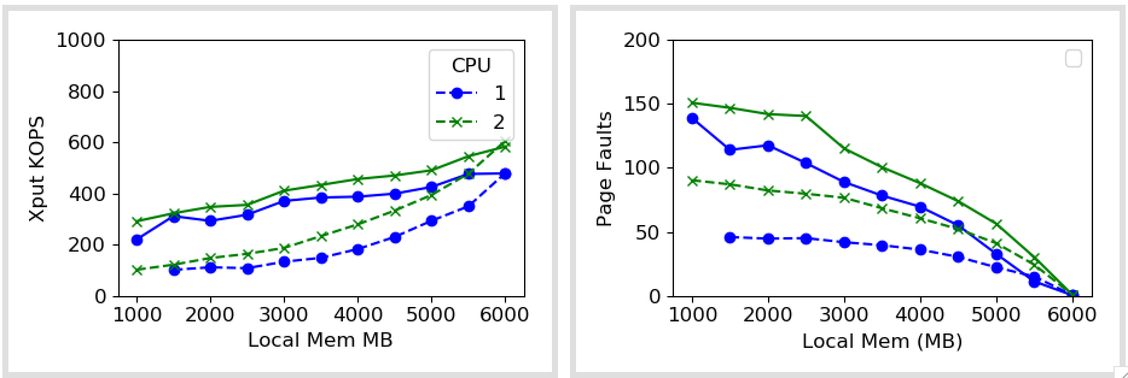
Results: Synthetic app

Slide 25
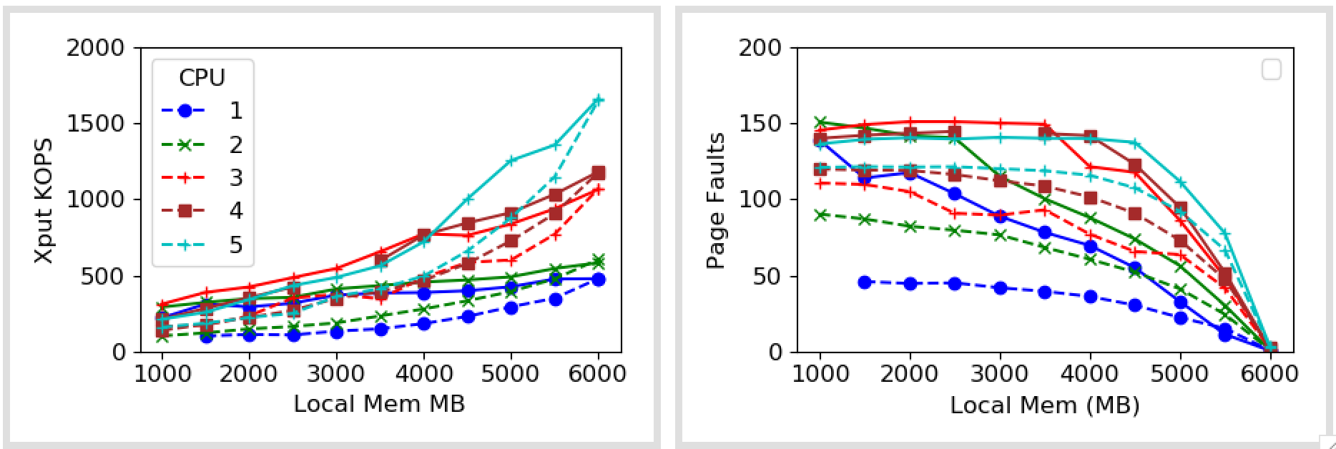
Results: Synthetic app

Slide 26
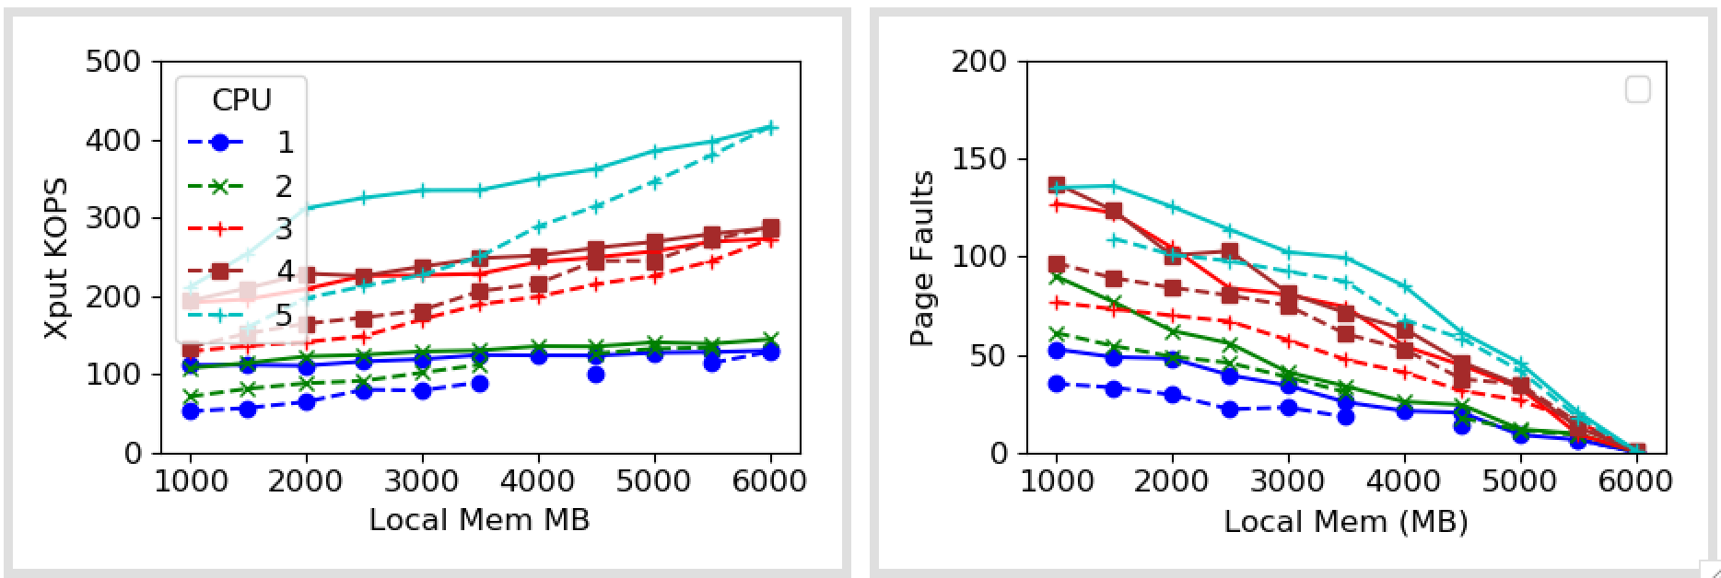
Results: Synthetic app
(more compute intensive)

Slide 27
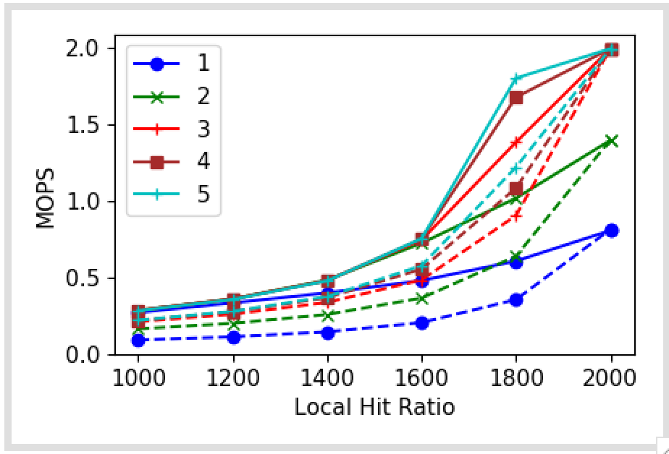
Results: Memcached
10M pairs
100B key-value size
2GB total memory
Uniform distribution
Yet to try more skewed workloads

Slide 28
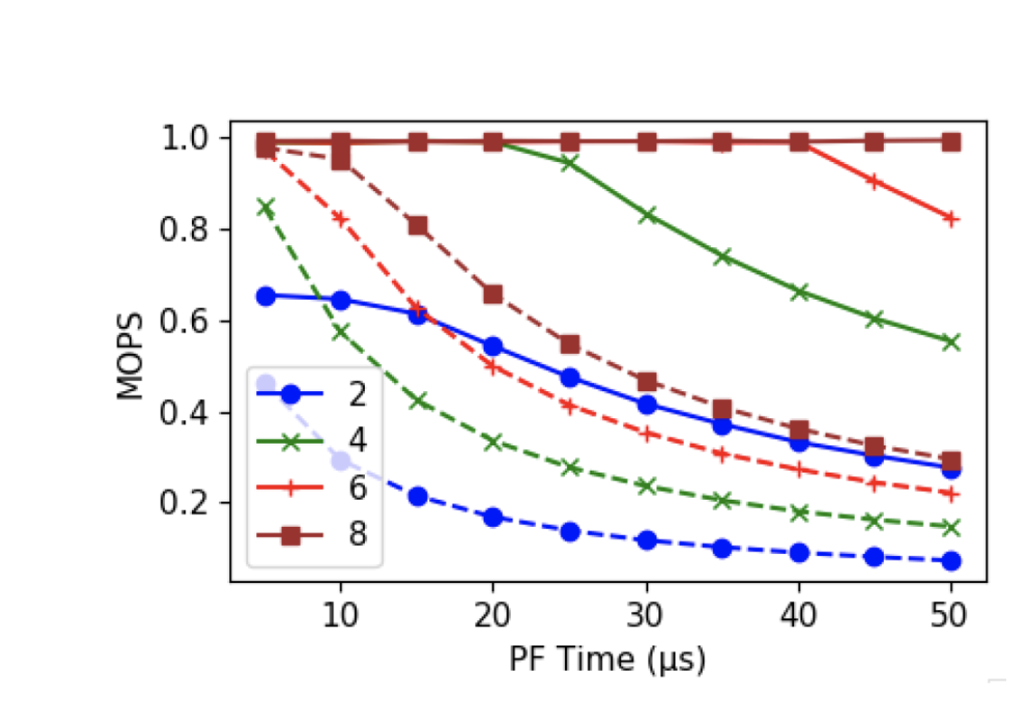
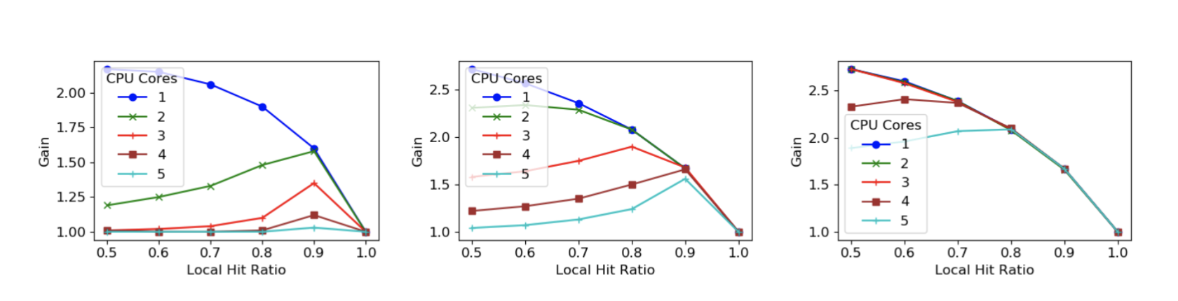
Simulations
Studied effect of various factors like page fault bandwidth, compute-to-faulting ratio, page fault latency, etc.

Slide 29
In Progress
Other apps: sort, matmul
Comparison with other systems: Fastswap, Umap

Slide 30
For Nadav
Comparison with Kailua
Including the vDSO trick towards my narrative

Slide 31
Comparison with Kailua
Kailua
Contributions | UMap | Kona | Nadav’s | Our system
Basic Userfaultfd (Kernel 5.9+) | ✅ | ✅ | ✅ | ✅
RDMA Backend | ❌ | ✅ | ❌ | ✅
Userfaultfd Improvements v1 Optional faulting thread polling Asynchronous page fault monitoring In-place page fault resolution Integration with io-uring Page preallocation and prefetch by faulting thread | ❌ | ✅ (but I don’t use them) | ✅ | ❌ Orthogonal Some of them contrast with user faults?
Userfaultfd Improvements v2 Vectored ops for madvise, uffd Advanced TLB stuff on these ops | ❌ | ❌ | ✅ | ’’
Advanced eviction policies (page access info) | ❌ | ❌ | ✅ | ❌
I/O decoupling (aka multiple fillers/evictors) | ✅ | ❌ | ❌ | ❌ (But possible)
API: User-controlled fetching, pinning, read-ahead, etc. | ✅ | ✅ | ✅ | ✅ (Only read-ahead but integrated into annotations)
Notes:
Disclaimer: As far as Anil knows

Slide 32
Misc

