Slide 1
Status
Got some results with Memcached
Finished an early draft of paper
Working with Fastswap now

Slide 2
Bugs
‘Biting more than I can chew’
Bug 1: Deadlock in Kona – throttle scheduler faults in Kona
Bug 2: Deadlock (in Kernel?) – throttle RX to limit waiting threads
App
Interface
Kona
Remote memory server
Scheduler
Kernel

Slide 3
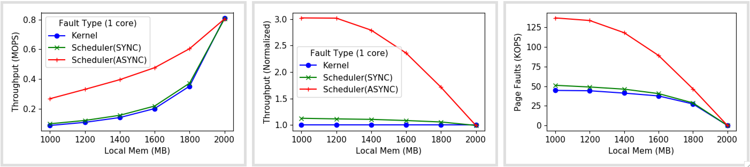
Perf gain (1 core)

Slide 4
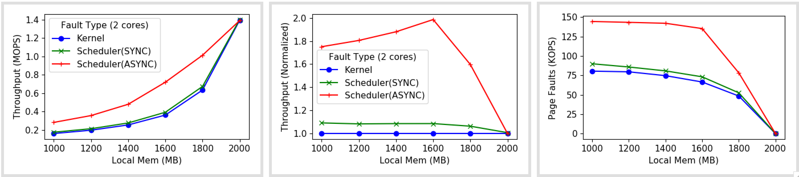
Perf gain (2 cores)

Slide 5
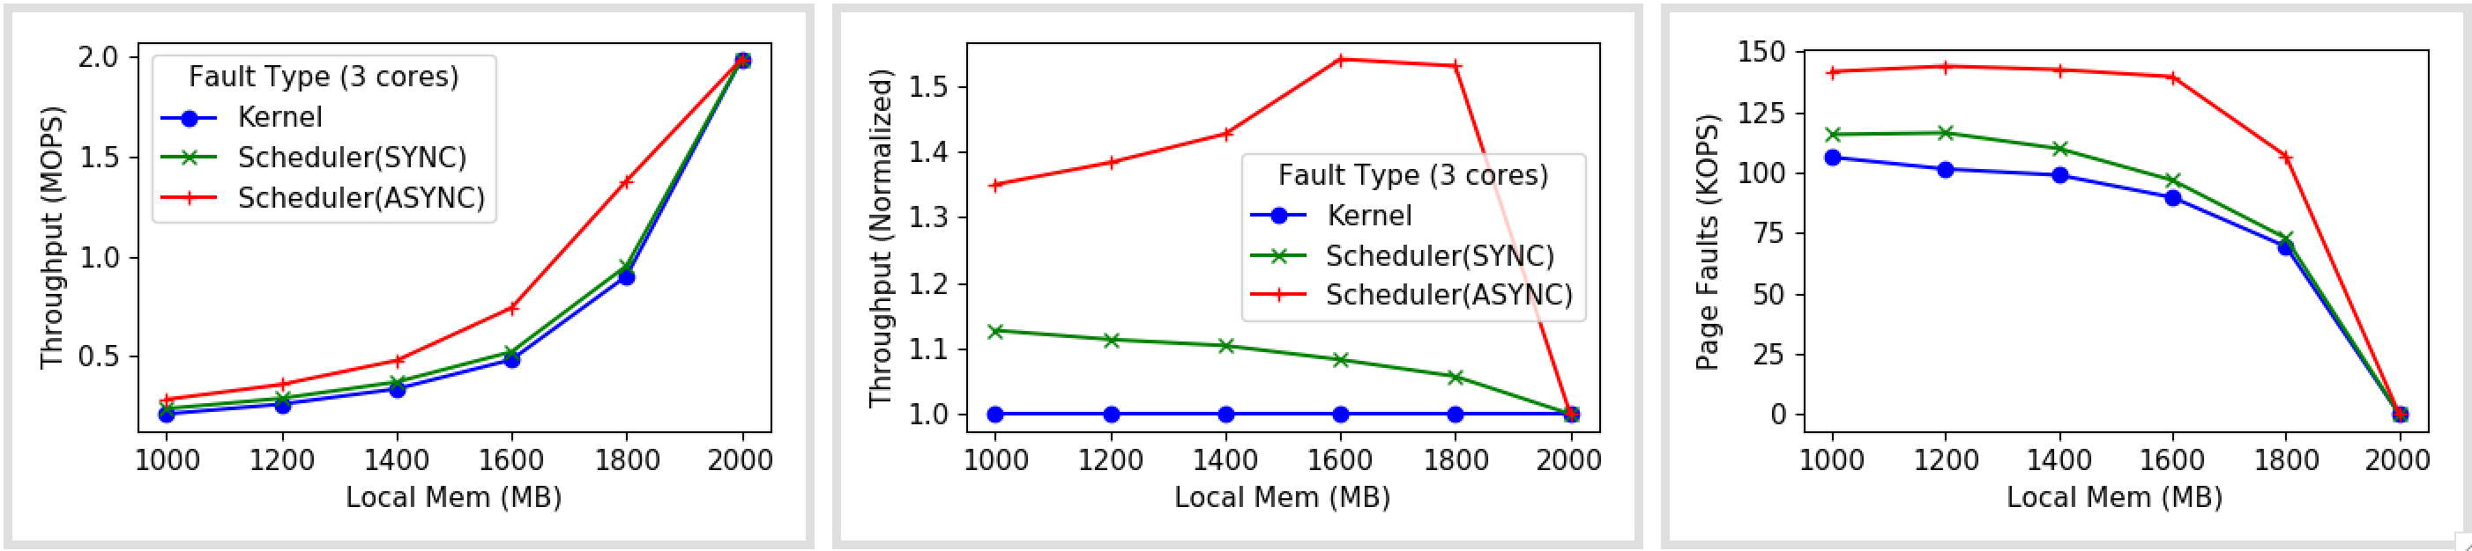
Perf gain (3 cores)

Slide 6
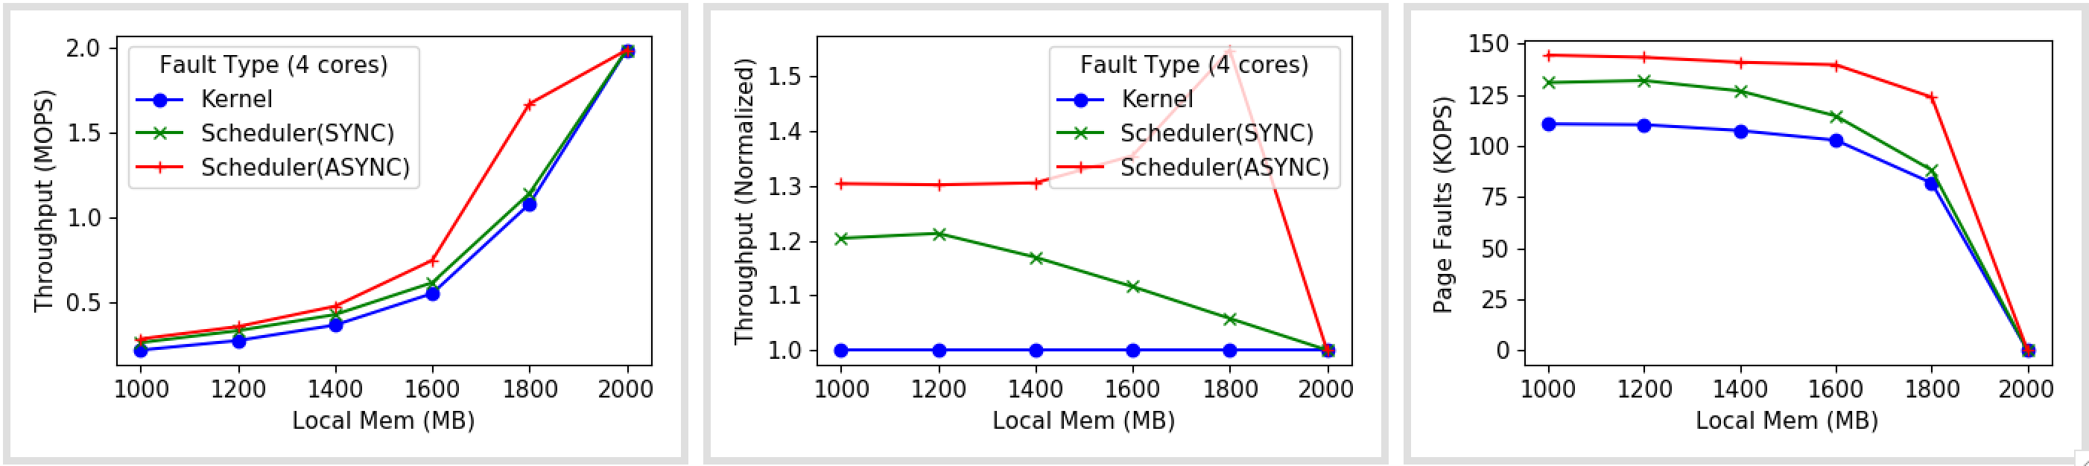
Perf gain (4 cores)

Slide 7
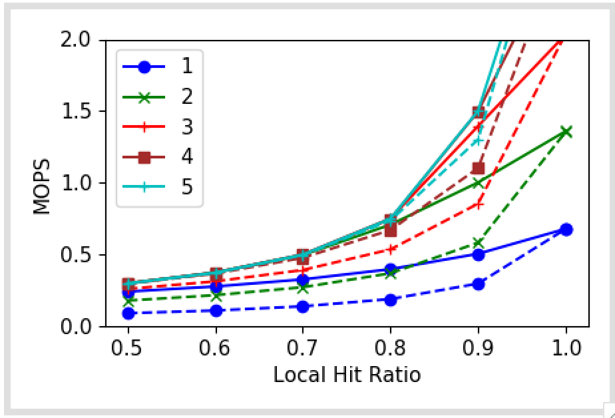
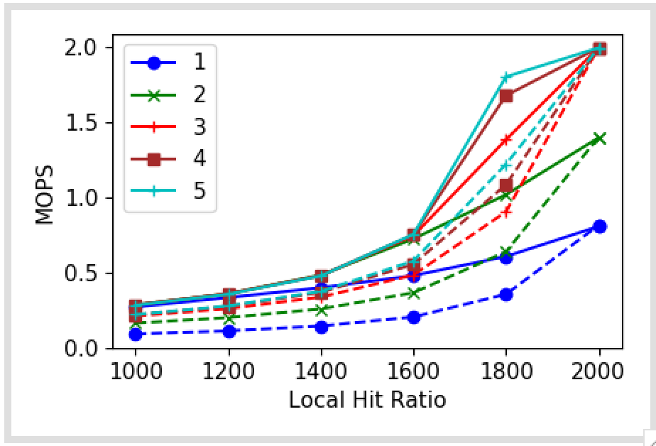
Notes
Agrees with simulations
Sim
Real

Slide 8
Next
Finishing first draft
Fastswap setup

Slide 10
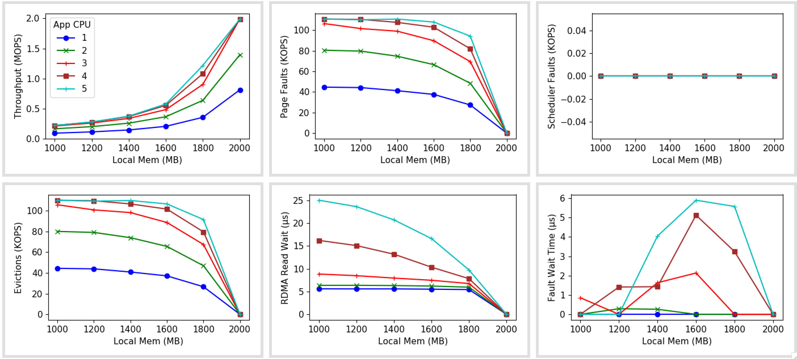
Kernel faults

Slide 11
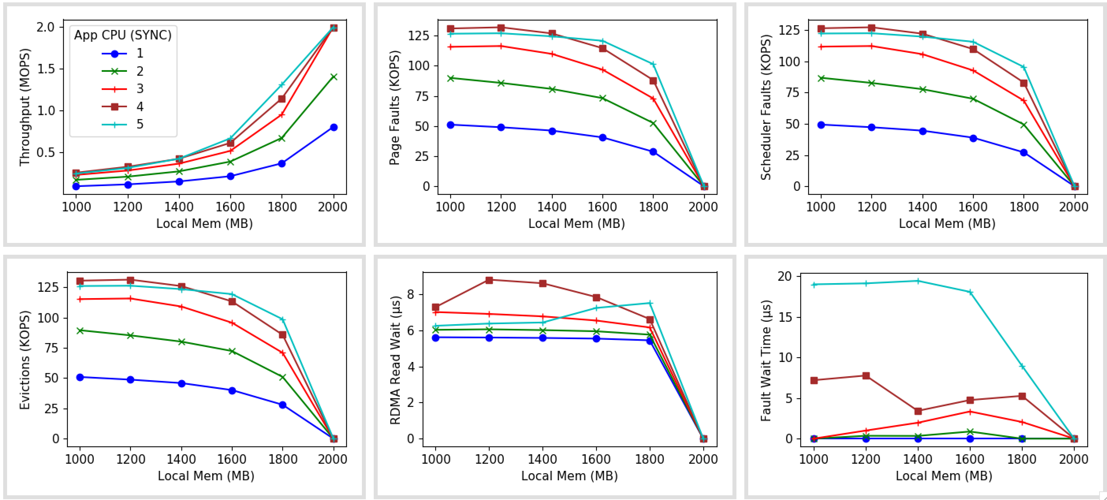
Scheduler faults: SYNC

Slide 12
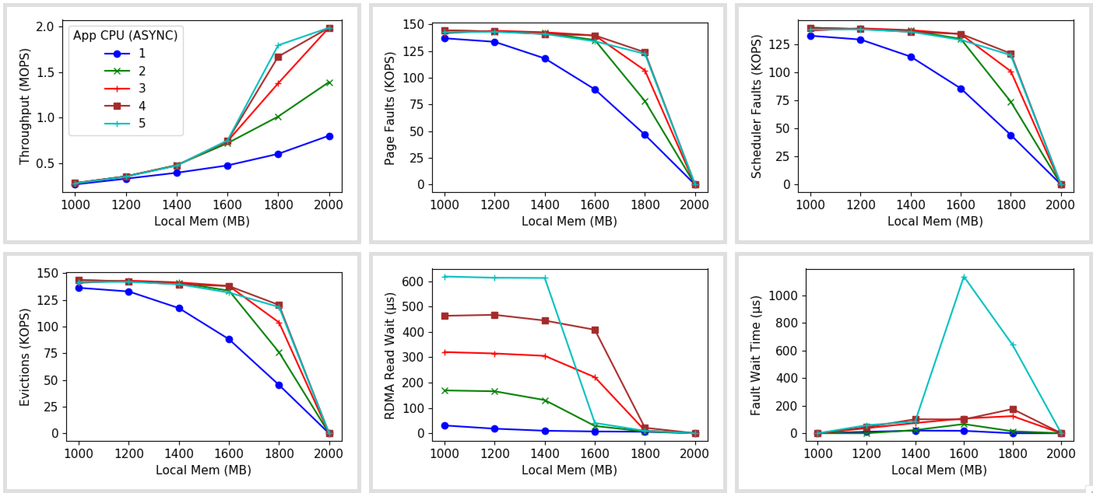
Scheduler faults: ASYNC

Slide 13
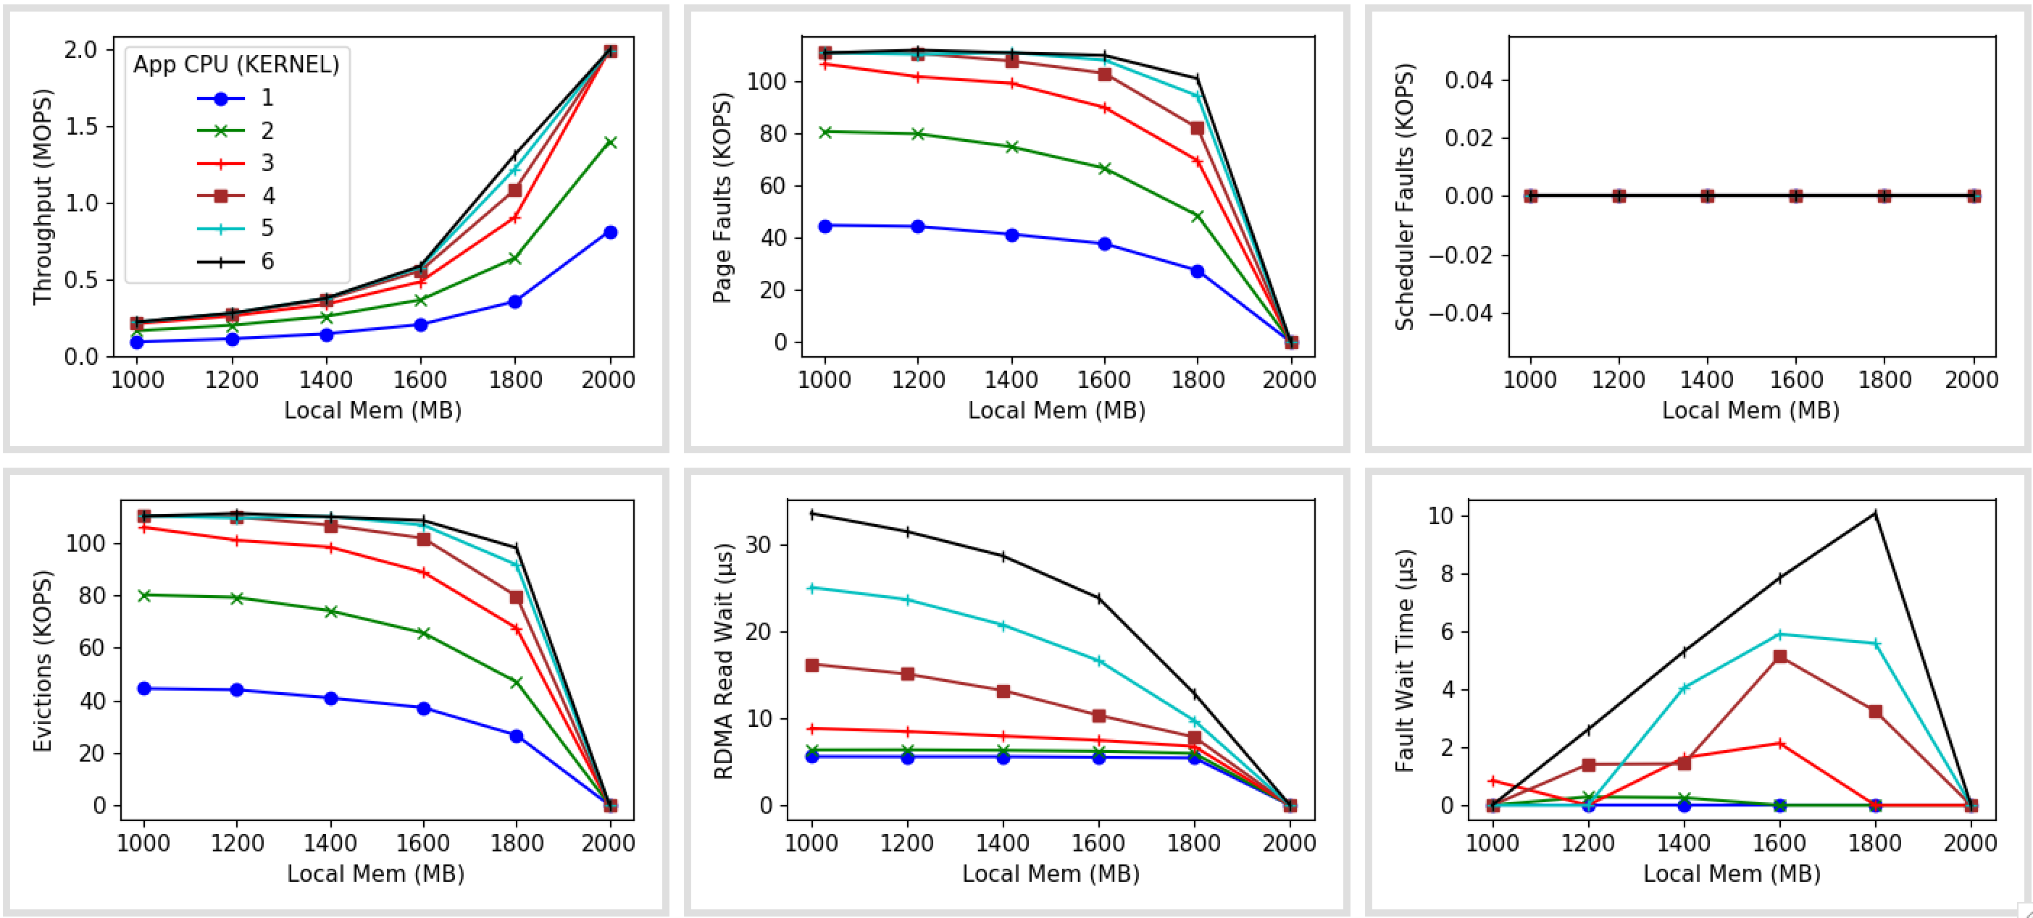
Kernel faults

Slide 14
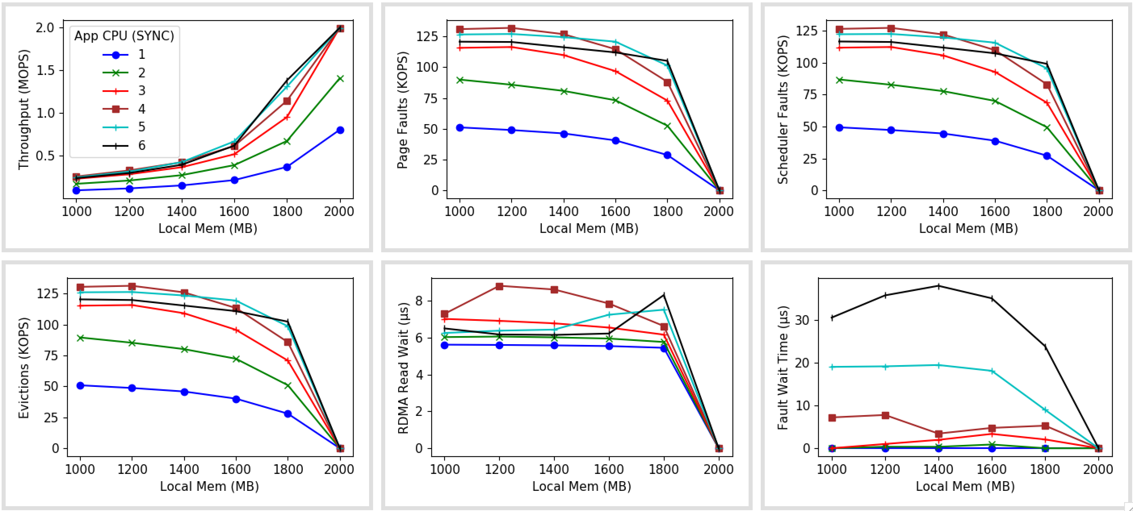
Scheduler faults: SYNC

Slide 15
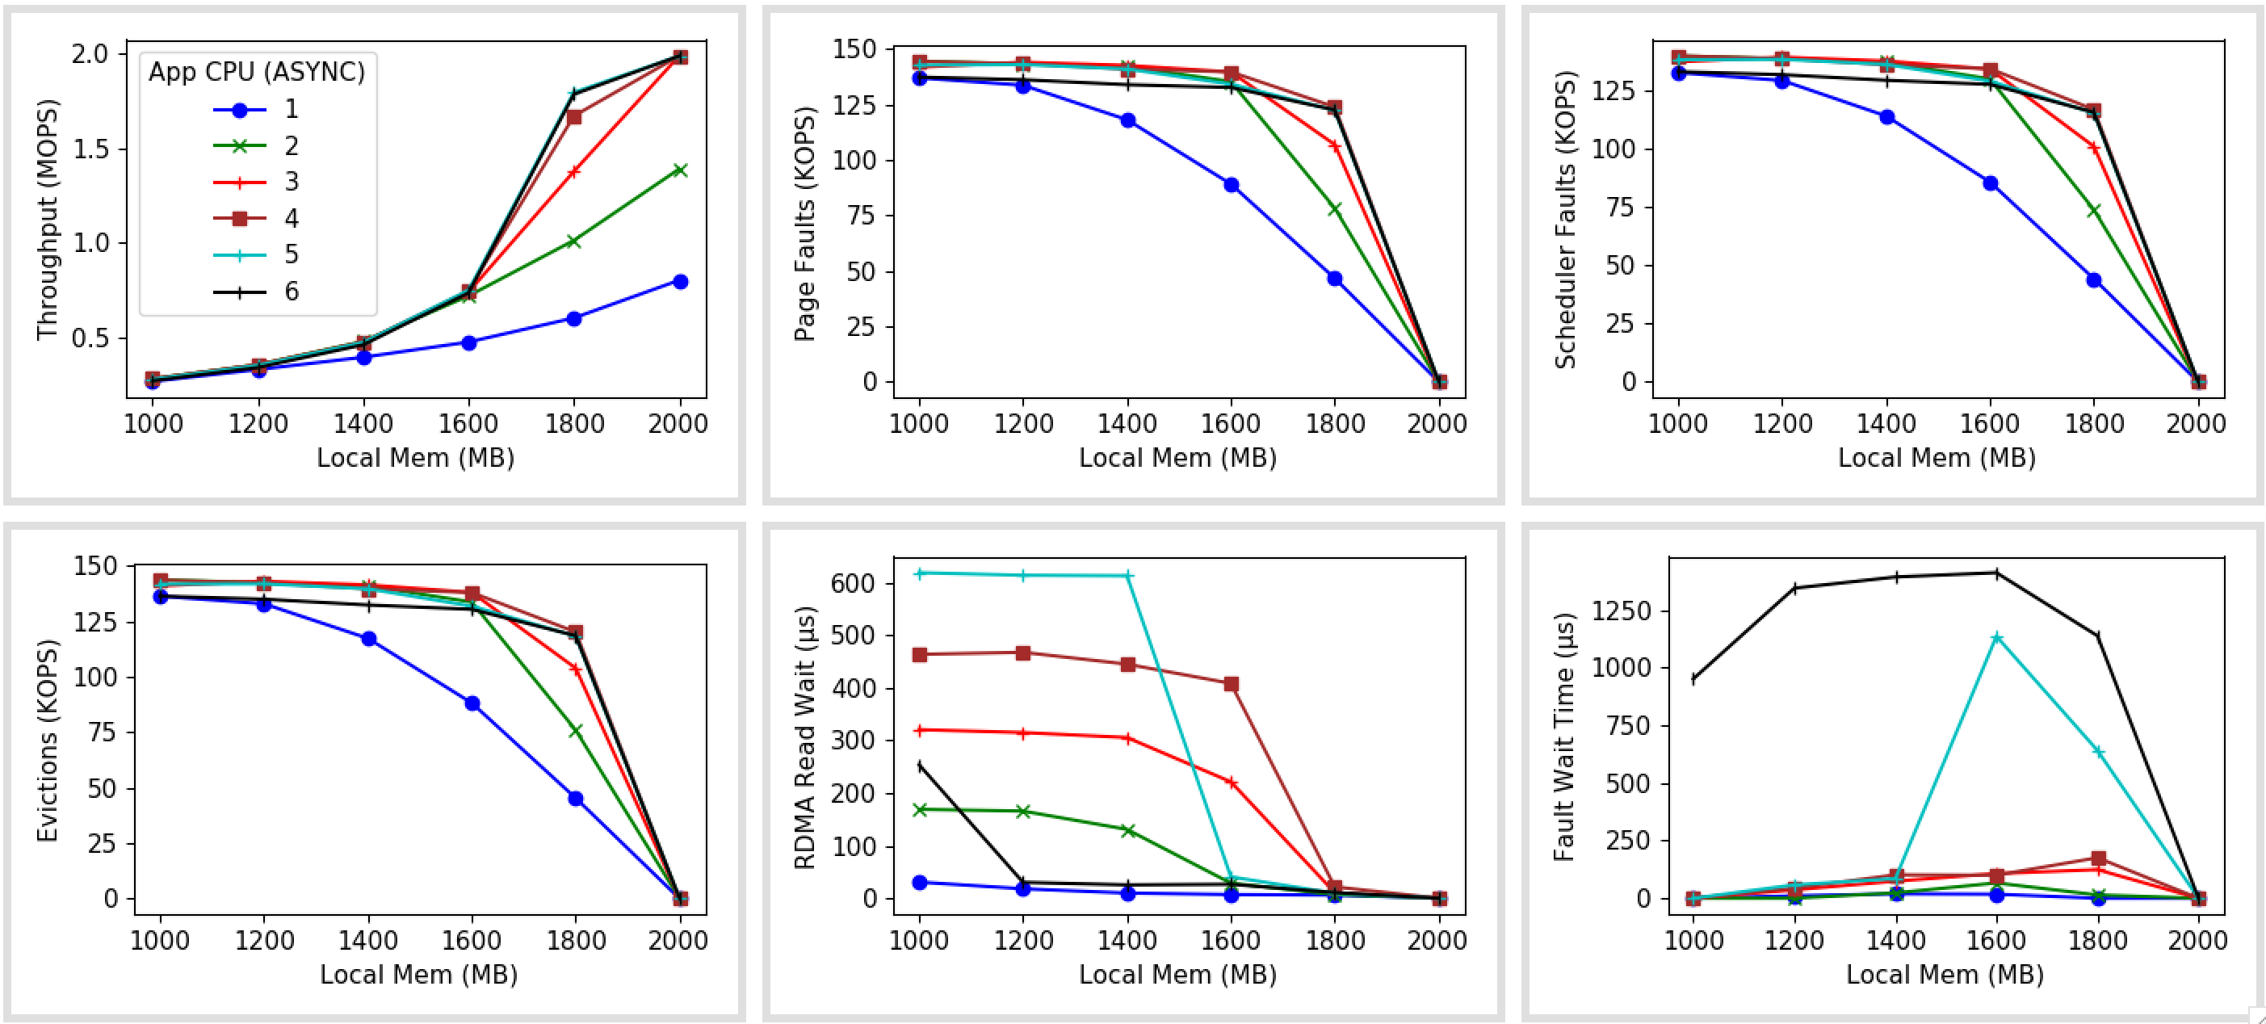
Scheduler faults: ASYNC

Slide 18
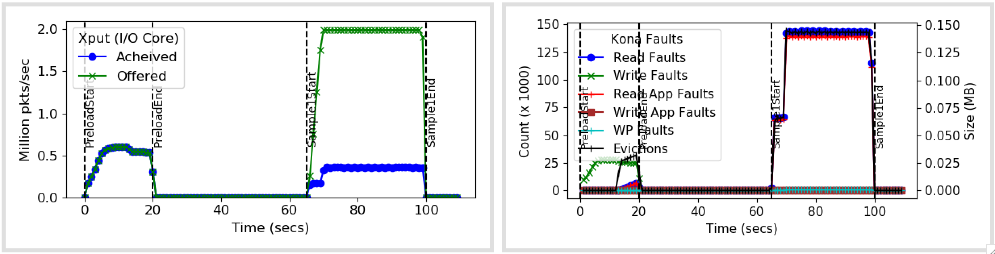
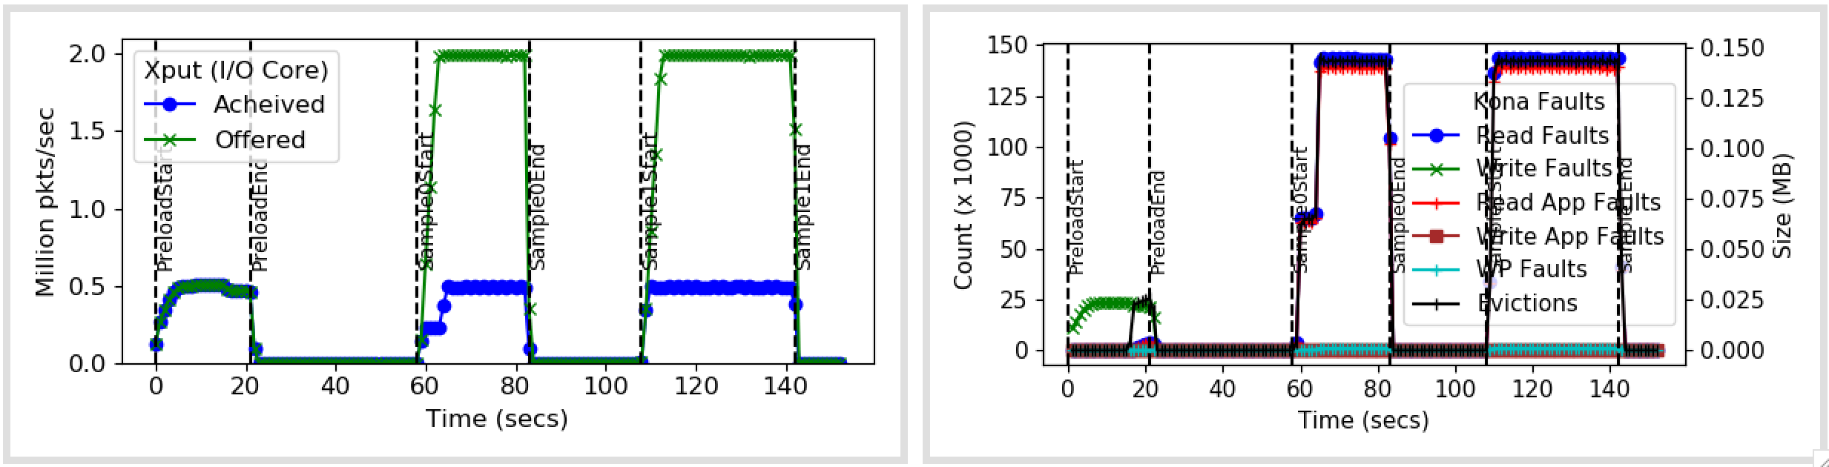
Run without/with warmup

