Slide 1
Overview
Parallel Sort
Baseline performance
Concurrency overhead
Page fault profile
Adding annotations – finding fault locations and resulting performance
Started writing again
Plan for ASPLOS

Slide 2
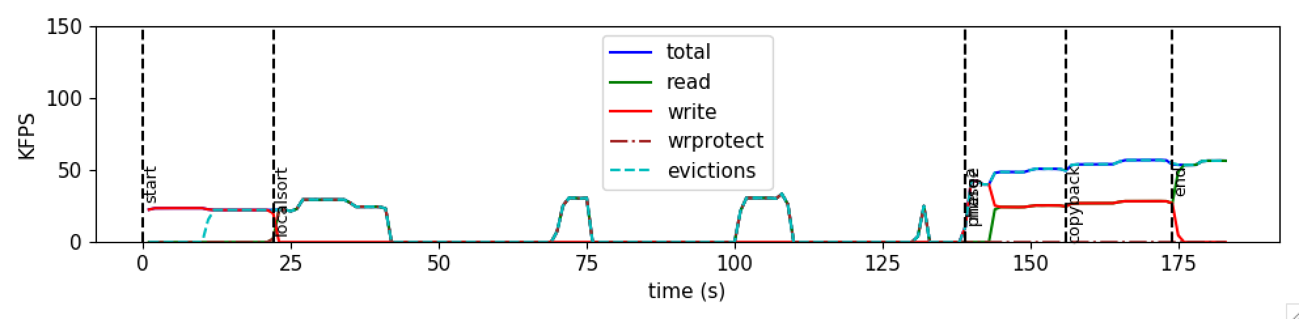
Sort Fault Profile (Custom QSort)
1 core
512M keys ~ 2GB
1GB Local
Notes:
PSRS

Slide 3
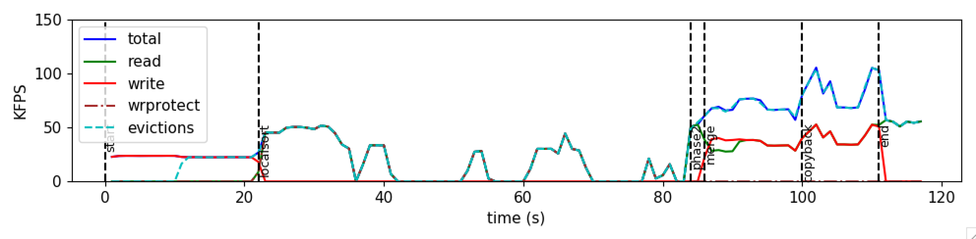
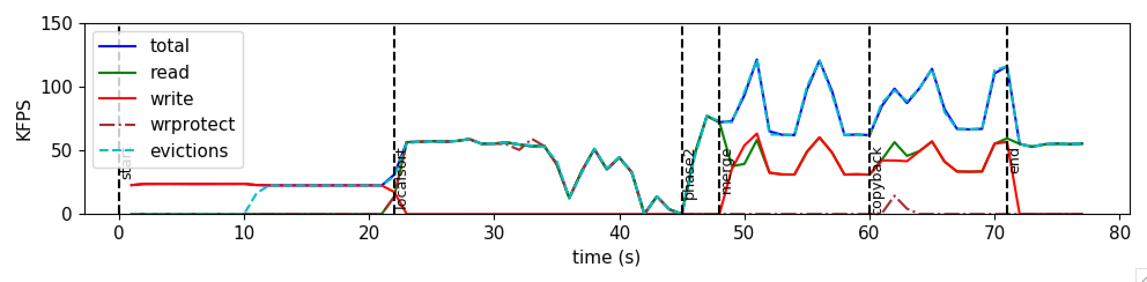
Custom QSort
1/2/4 cores
512M keys ~ 2GB
1GB Local

Slide 4
Finding fault Locations
[Kernel] Included IP reg in the UFFD messages
Turn off PIE/ASLR
addr2line prints out code location!
Randomly sample faults in Kona

Slide 5
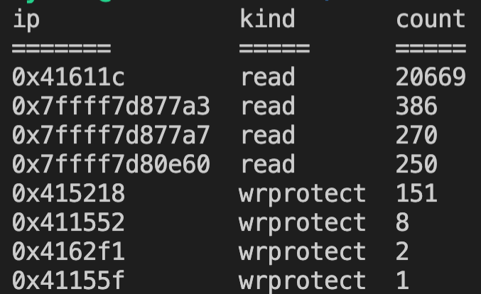
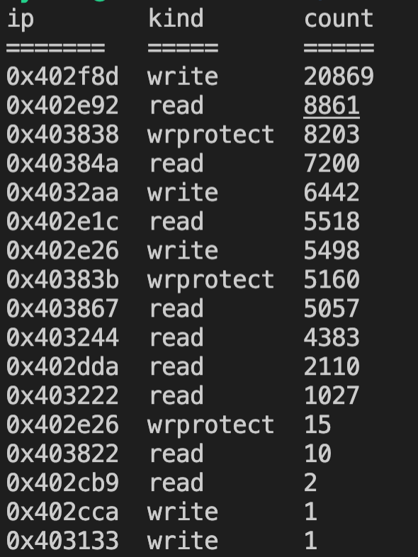
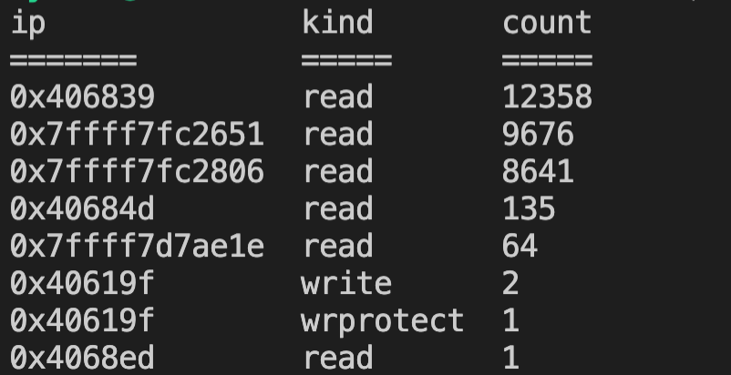
Fault Locations
Sort
Memcached
Synthetic
Notes:
TODO: see if the proportion matches

Slide 6
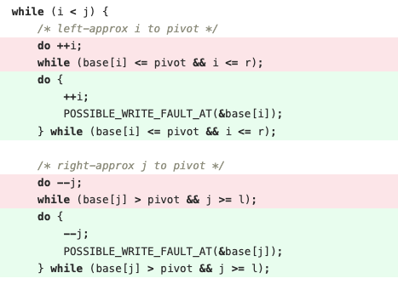
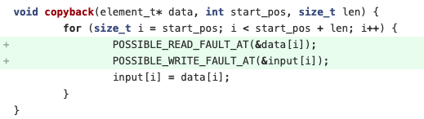
Sort Annotations
8 annotations
1 at generating input
2 in quicksort
3 at merging
2 at copyback
Mostly straight-forward

Slide 7
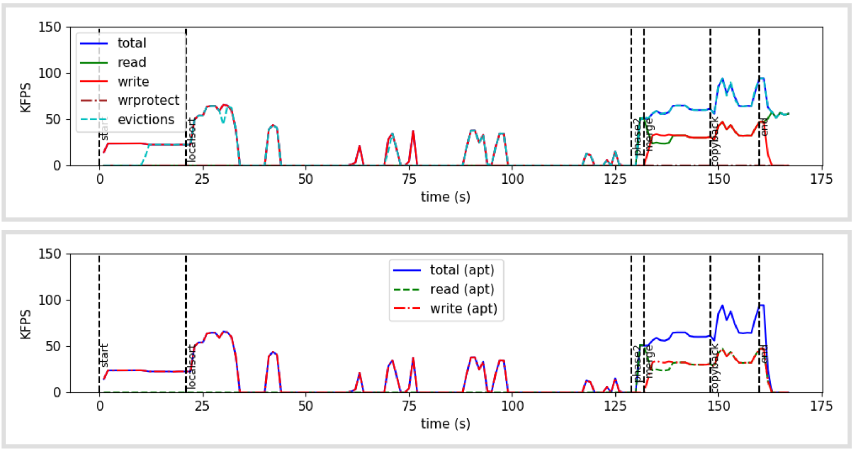
Sort Annotations
Covers most (~93%) faults.

Slide 8
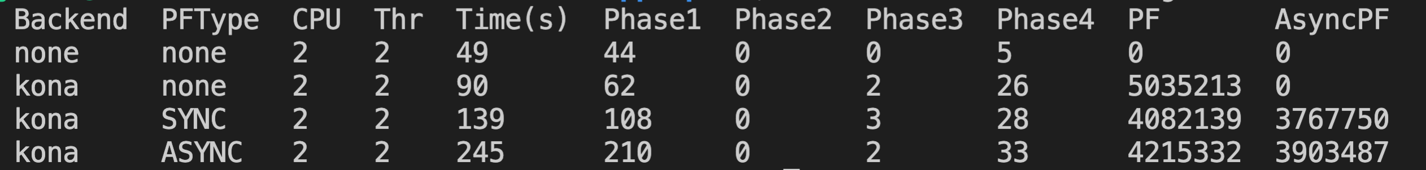
Sort Annotations: Performance

Slide 9
Sort Annotations: Performance
Annotate only on page boundaries
With enough local memory for no faults
Notes:
TODO More coverage with annotations
TODO Use the same random seed
TODO Incremental annotations – does it improve performance or not?
TODO Extend microbenchmark to cover the overhead of ASYNC at no concurrency?
TODO Extend profiling
TODO Run two threads on 1 core – does it improve ASYNC?

Slide 10
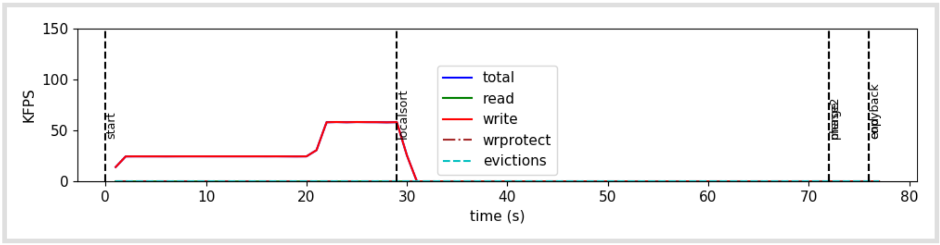
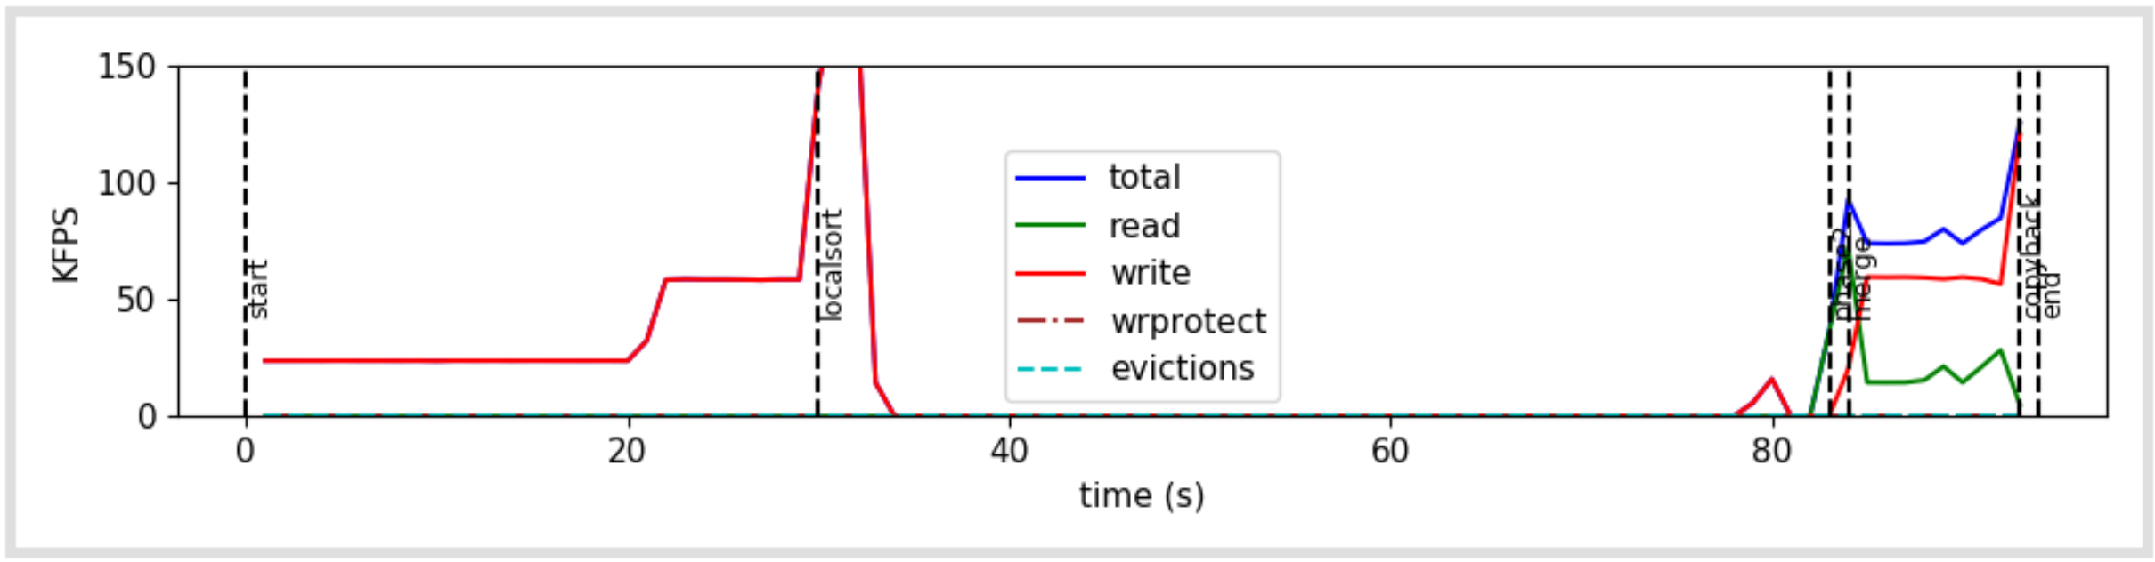
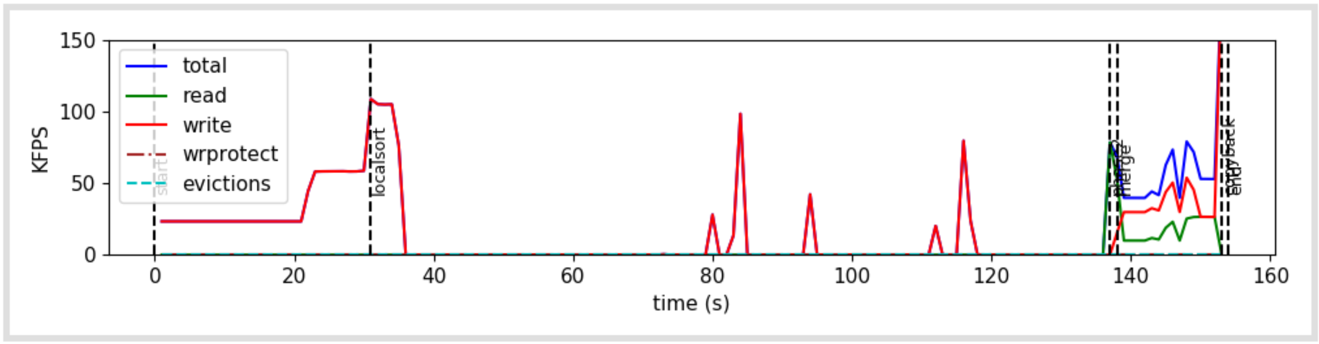
Kona
Annotations
SYNC
Annotations
ASYNC
Notes:
Everything to the right of “localsort” line are annotated page faults.
Spurious page faults
Even with the spurious page faults, ASYNC is twice as long.

Slide 11
Next
Sort
Why is ASYNC doing worse in the base case?
Why does merge/copyback scale badly? (from last time)
ASPLOS
Writing – another revision by Monday
Deadline: Jun 30/July 7

Slide 12
Misc

Slide 13
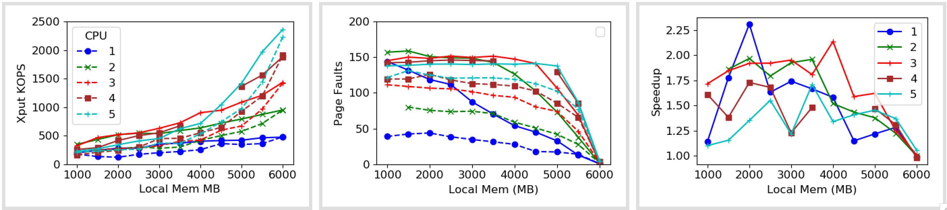
1x Zip

Slide 14
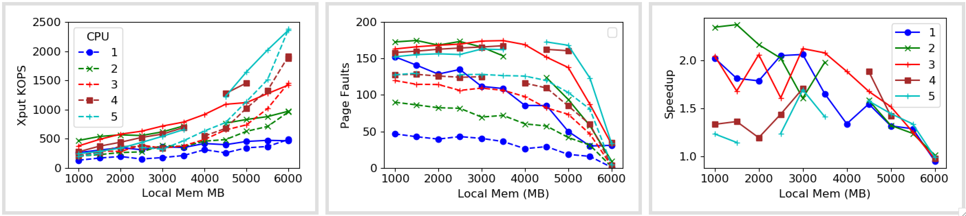
1x Zip (vDSO)

Slide 15
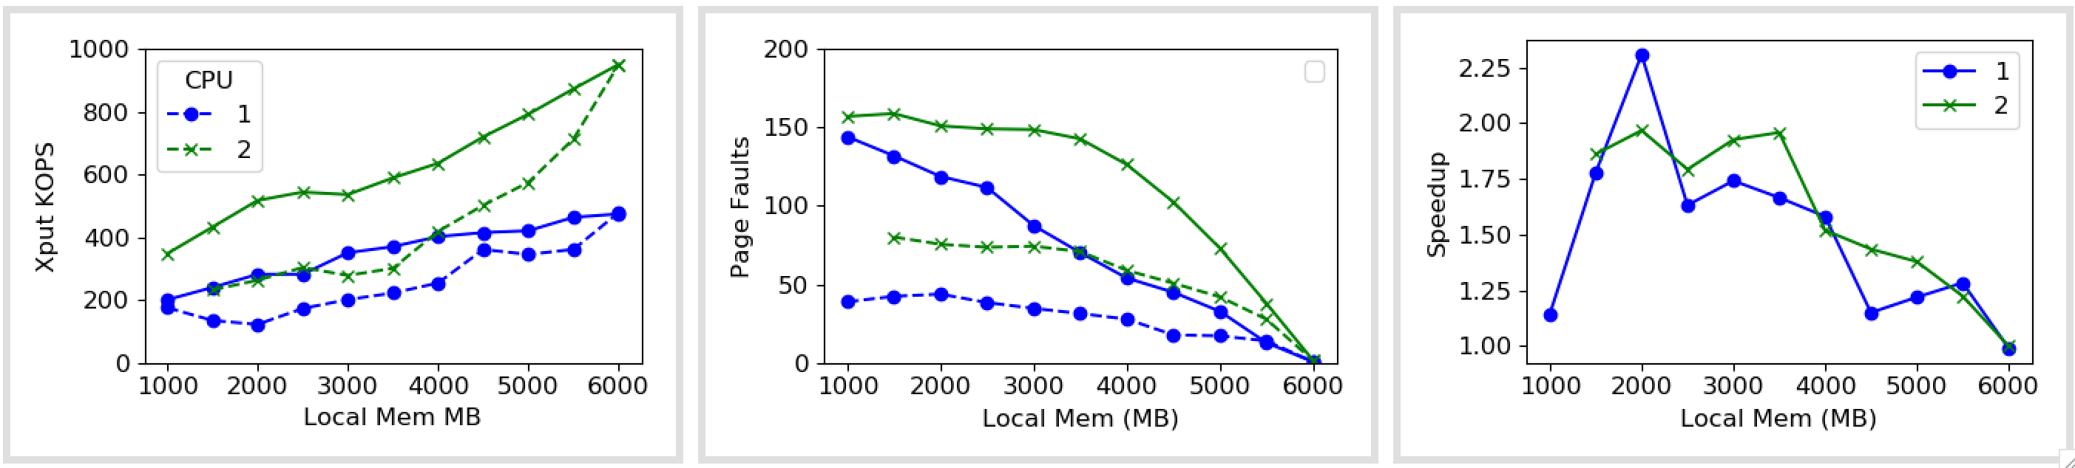
1x Zip

Slide 16
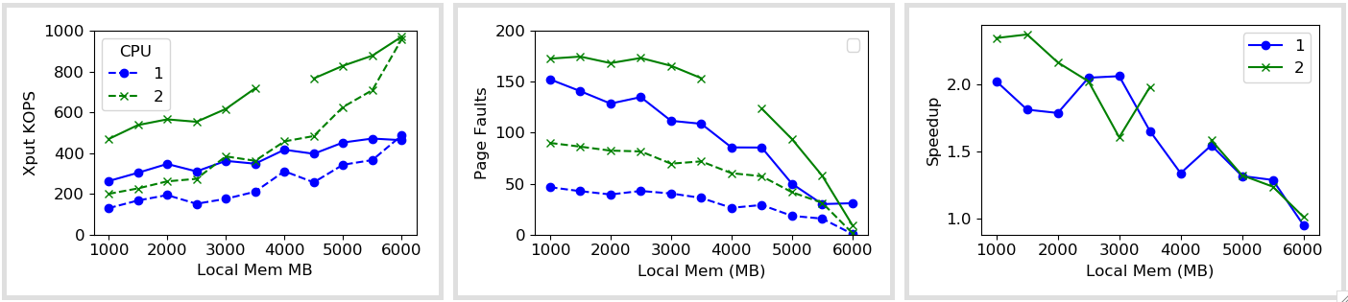
1x Zip (vDSO)

Slide 17
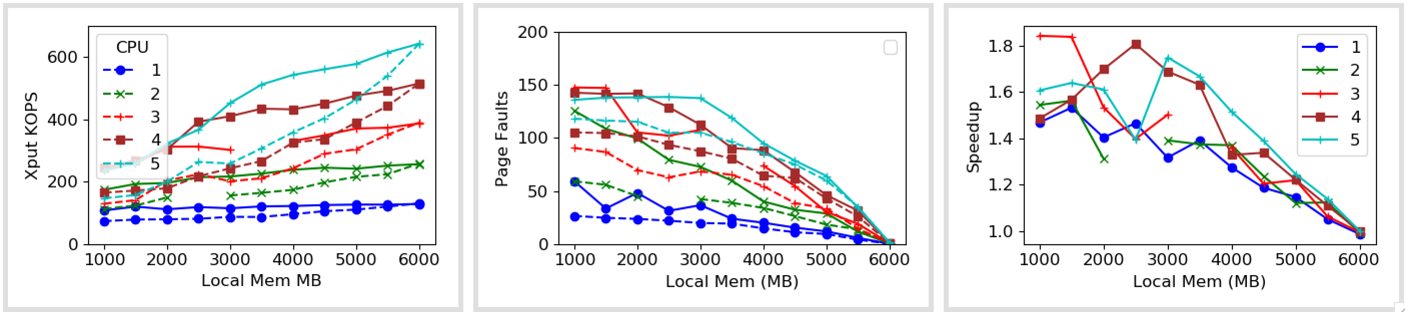
5x Zip

Slide 18
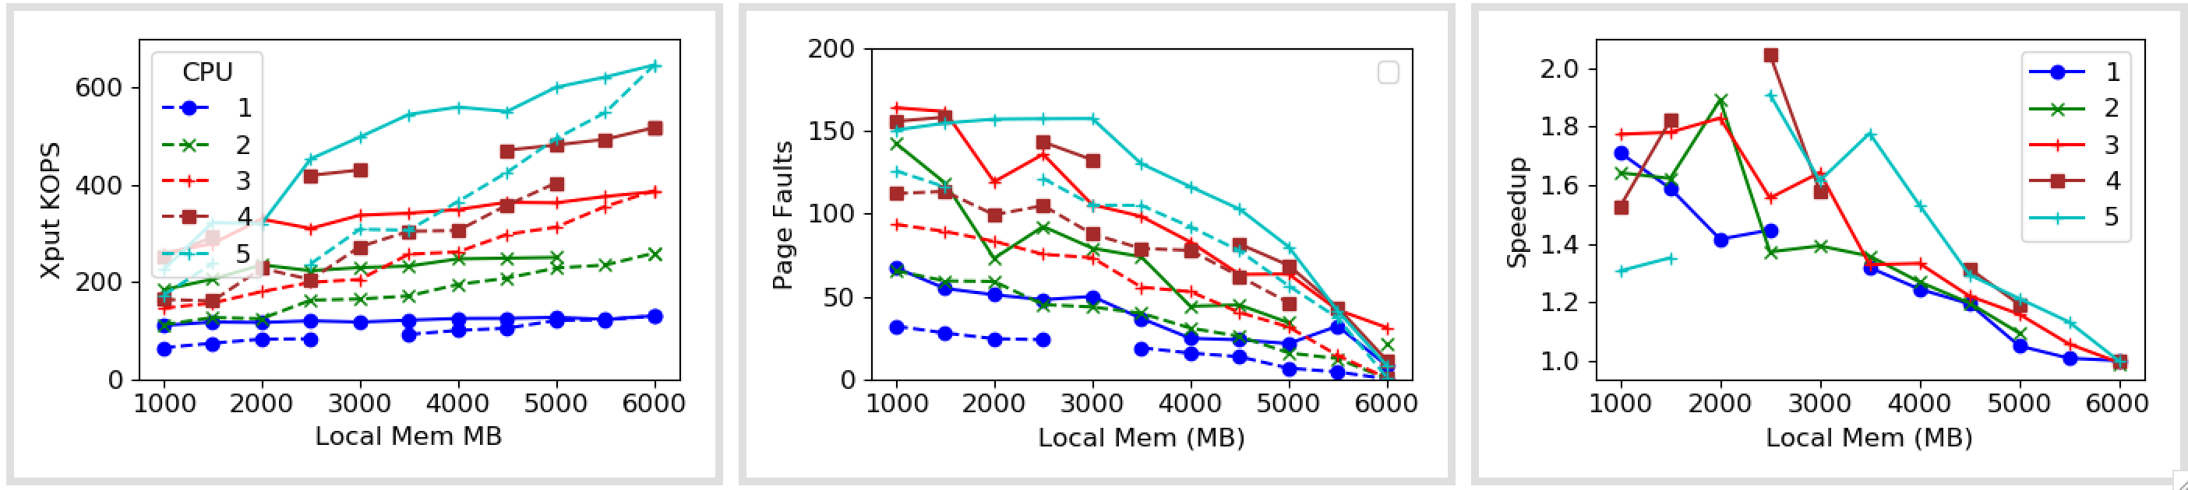
5x Zip (vDSO)

Slide 19
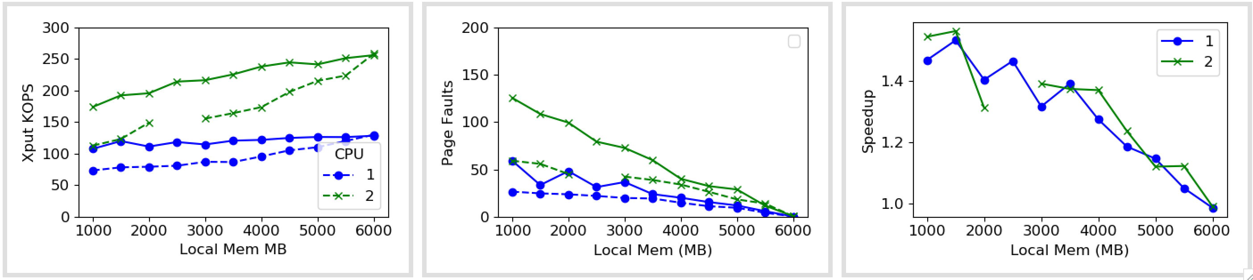
5x Zip

Slide 20
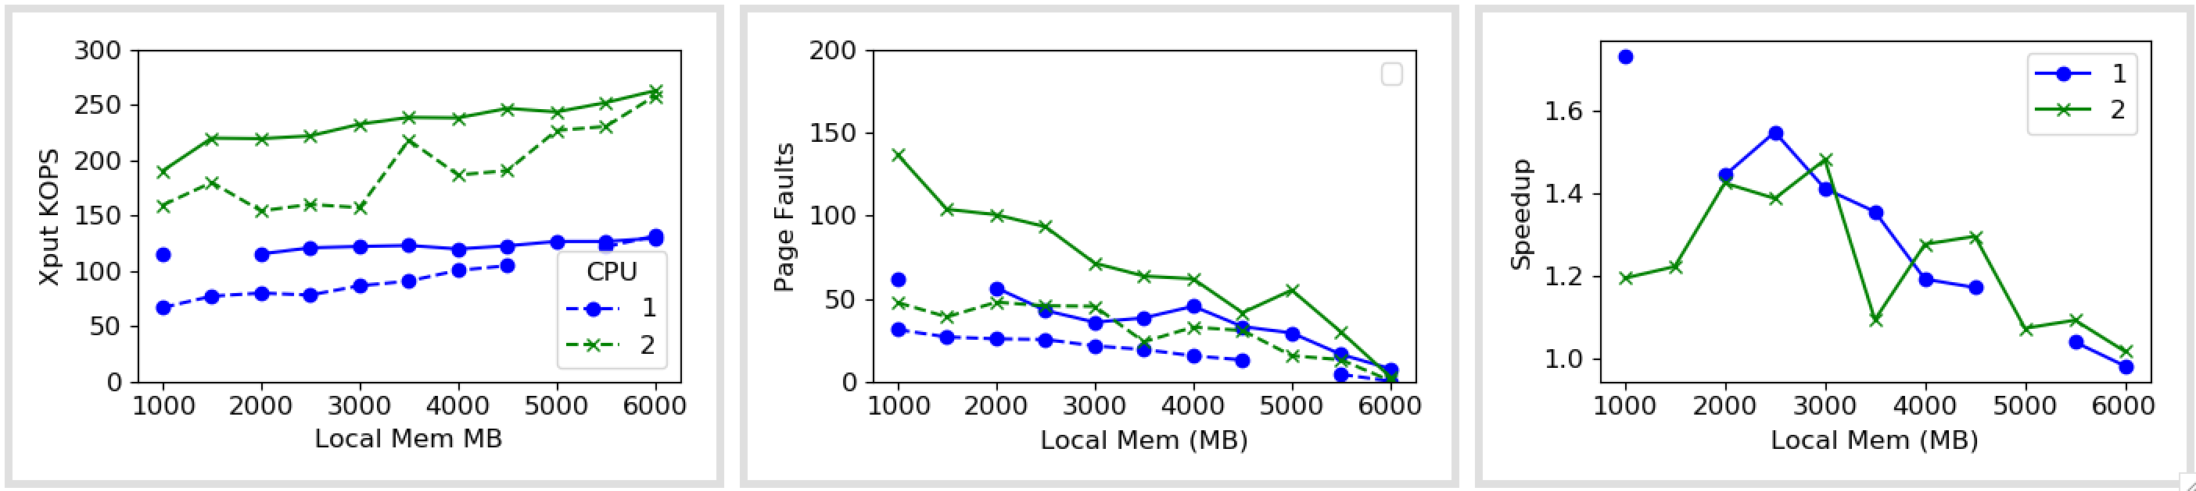
5x Zip (vDSO)

