Slide 1
Exploiting Concurrency for Practical Memory Disaggregation
Anil Yelam, Nadav Amit, Radhika Niranjan Mysore, Marcos K. Aguilera, Alex C. Snoeren

Slide 2
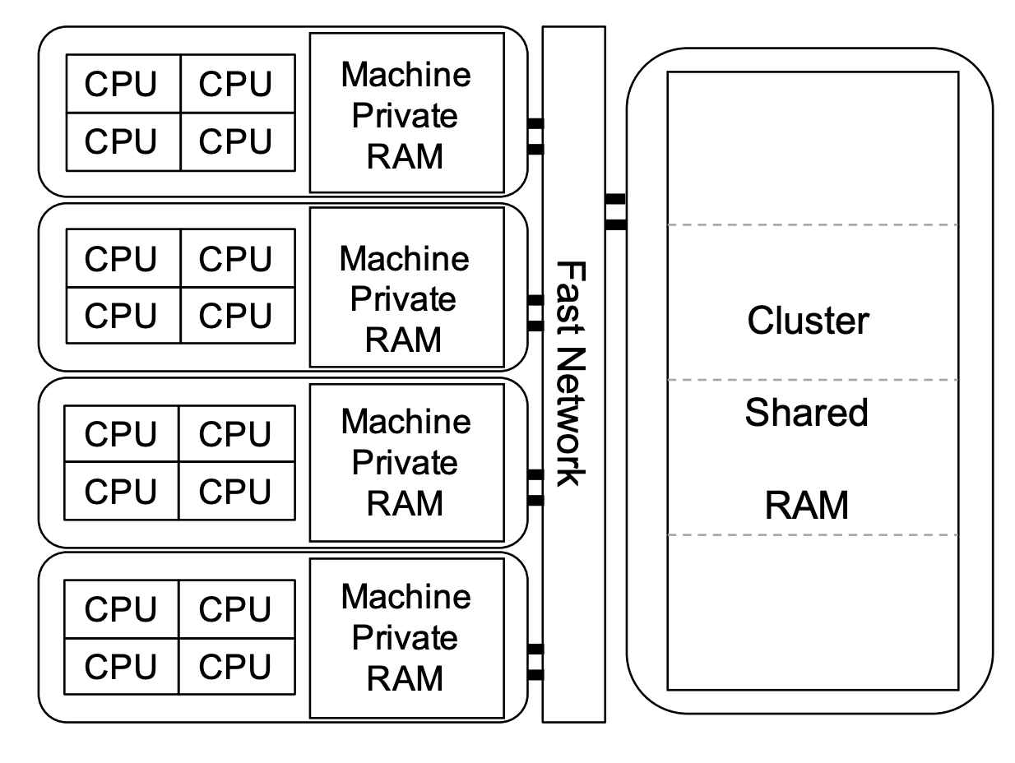
Remote/Disaggregated Memory
Decoupled pools of compute and memory connected by a low-latency network
+
–
Memory efficiency and scale-out benefits
Performance penalty of the slower remote memory accesses

Slide 3
Retaining native performance
Usual go to: Minimize remote accesses with caching
Another approach: hide remote accesses
Efficiently expose parallelism within the application e.g., Threads
Hide the remote accesses with other (runnable) threads
Complements caching – more so with less locality

Slide 4
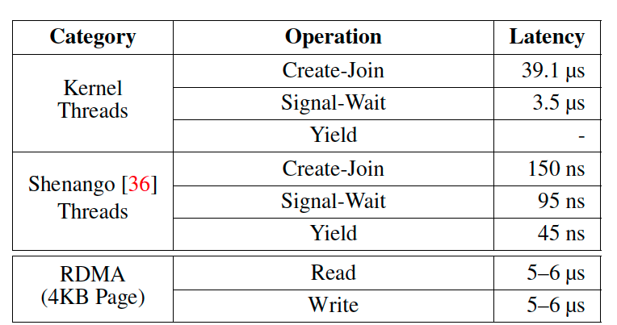
Existing solutions
TODO get a simple bar chart
Solution | No application porting | Concurrency friendly
Kernel Paging-based Systems General, low-level virtual memory interface Schedule kernel threads on page misses Example: Infiniswap | ✅ | ❌
Userspace Systems Custom object-based, language-specific interface Schedule lightweight “green threads” Example: AIFM | ❌ | ✅

Slide 5
A better solution
TODO get a simple bar chart
Solution | No application porting | Concurrency friendly
Kernel Paging-based Systems General, low-level virtual memory interface Schedule kernel threads on page misses Example: Infiniswap | ✅ | ❌
Userspace Systems Custom object-based, language-specific interface Schedule lightweight “green threads” Example: AIFM | ❌ | ✅
Eden | ✅ | ✅

Slide 6
Eden: Idea
User-level Threads
+
Paging-based Remote Memory
Application
Scheduler
Virtual Memory Interface
Local Memory
Kernel
Paging Handler
But simply combining existing systems doesn’t work due to the transparent & blocking page fault interface
Network
Transport
Remote Memory

Slide 7
Asynchronous Page Faults
With kernel upcalls, like Scheduler Activations
+
–
–
Application
1
2
4
Maintains transparency (to the application)
Scheduler
Virtual Memory Interface
Local Memory
Kernel
Paging Handler
Restrictive interface
Dumb scheduler – ignorant of page handling policies
3
Network
Transport
Remote Memory

Slide 8
Asynchronous Page Faults
Eden’s approach: Two key design choices
Preempt kernel page faults with user-provided hints
Service pages (i.e., remote memory handling) from userspace
Application
1
Scheduler
Paging Handler
2
4
Virtual Memory Interface
Local Memory
Kernel
3
Network
Transport
Remote Memory

Slide 9
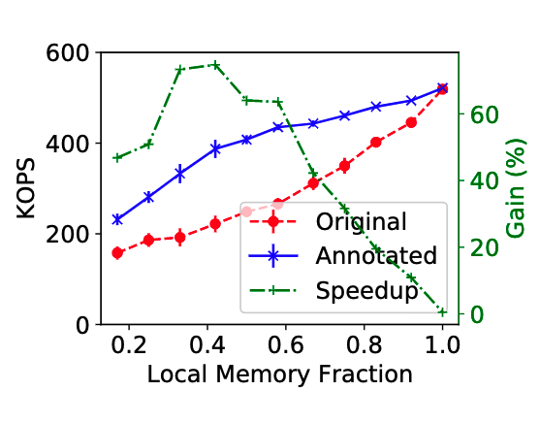
Eden’s contributions
A user-level remote memory design that provides light-weight scheduling and a familiar memory interface.
Developed API and tools for easy, low-overhead hinting
Integrated Shenango with an userfaultfd remote memory manager for page fault-aware scheduling
Evaluated with three applications, showing 12-75% gain in realistic settings
Todo: labels to with/without Eden

Slide 10
Userfaultfd Primer
App Threads
App Threads
App Threads
Kernel
UFFD Handler
Page faults routed to and serviced in userspace
Supports write-protecting and removing pages as well
Latency overhead: ~3µs*
fd = Userfaultfd()
malloc()/rmalloc()
UFFDIO_REGISTER(fd)
Page fault
poll(fd)
Thread wake
UFFDIO_COPY(fd)
UFFDIO_WRITEPROTECT(fd)
madvise(DONT_NEED)

Slide 11
Eden’s Remote Memory Handler
App Threads
App Threads
App Threads
Kernel
UFFD Handler
fd = Userfaultfd()
malloc()/rmalloc()
Back UFFD regions with remote memory
UFFDIO_REGISTER(fd)
Page fault
Remote Memory
poll(fd)
Fetch pages using RDMA
Thread wake
UFFDIO_COPY(fd)
UFFDIO_WRITEPROTECT(fd)
Write pages back during eviction
madvise(DONT_NEED)
Notes:
Other implementational details:
Only heap goes in remote memory. LD_PRELOADing would make it transparent
Simple eviction policy, threshold at 99%
Static design with 3 threads/cores

Slide 12
Eden’s Scheduler
User-level thread library
We build on Shenango:
Threads scheduled locally on each core
Run to completion
Load balancing through work stealing
POSIX–like threading & synchronization API
Our additions:
Fault annotations (hints) API
Fault-aware scheduling
Application
Scheduler
POSIX API
Fault Hints API
Kernel

Slide 13
Fault annotations

Slide 14
Eden Scheduler
Application
Typical
Paging Handler
Virtual Memory Interface
Local Memory
Kernel
3
Network
Transport
Remote Memory

Slide 15
Annotations
API

Slide 16
Annotations
Low overhead vDSO checks
Tool to assist in hints

Slide 17
Annotations: Examples
Overhead and examples

Slide 18
Fault-aware scheduling

Slide 19
Evaluation
Synthetic benchmark from AIFM
Memcached
Parallel Sort

Slide 20
Synthetic
What it does
What annotations added & how
Setup

Slide 21
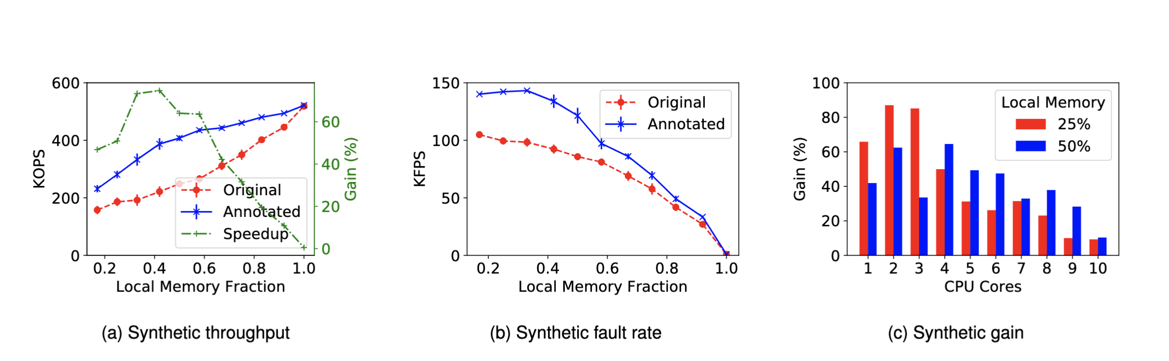
Synthetic

Slide 22
Memcached
More real
Remote memory changes
Annotations
Setup

Slide 23
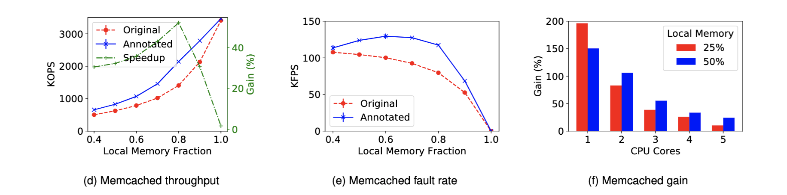
Memcached

Slide 24
Parallel Sort
A different kind, more complicated
Concurrency & working set
Setup

Slide 26
Misc

Slide 27
In a nutshell
=
?
Traditional schedulers
Systems for Disaggregated Memory
Notes:
Involves two lines of research which I’ll talk about
In a nutshell though, I’m just combining these two and explaining performance

Slide 28
Outline
Background
What motivates this?
Performance challenges
Where I’m at

Slide 29
Background
=
?
Traditional schedulers
Systems for Disaggregated Memory
Notes:
Involves two lines of research which I’ll talk about
In a nutshell though, I’m just combining these two and explaining performance

Slide 30
How is the memory exposed?
Performance
Transparency
Native Apps
Low-level RDMA interface
No memory management
OS/Runtimes
Focus on transparency and ease of adoption
Common abstraction: virtual memory

Slide 31
Background
=
?
Traditional schedulers
Systems for Disaggregated Memory
Notes:
Involves two lines of research which I’ll talk about
In a nutshell though, I’m just combining these two and explaining performance

Slide 32
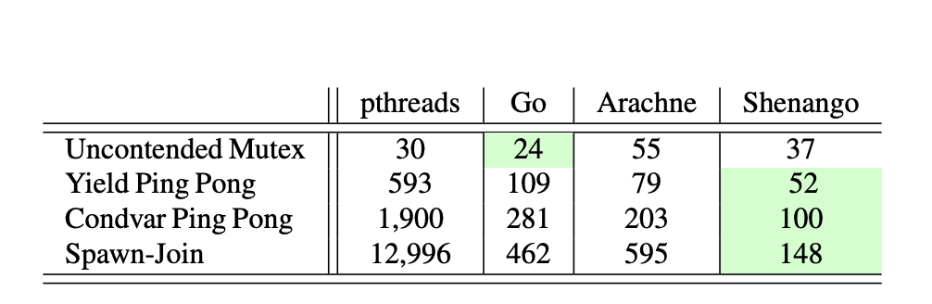
Scheduling: The usual way
Scheduling in Kernel
Kernel threads to express parallelism
But Kernel threading primitives are expensive!
Large number of threads not feasible
Hides parallelism from the scheduler
Notes:
on multi-core systems
Express parallelism through Kernel threads

Slide 33
User-space schedulers
Lightweight Threads scheduled in User-space
Separates thread scheduling from core allocation
Runtimes provides super-light locks and kernel-bypass I/O
Keep things in user-space!
Con
Cooperative scheduling
Coarse-granular core allocation
Can’t work well with Kernel
e.g., Arachne, Shenango, Caladan
Notes:
Goal is to explore this option.

Slide 34
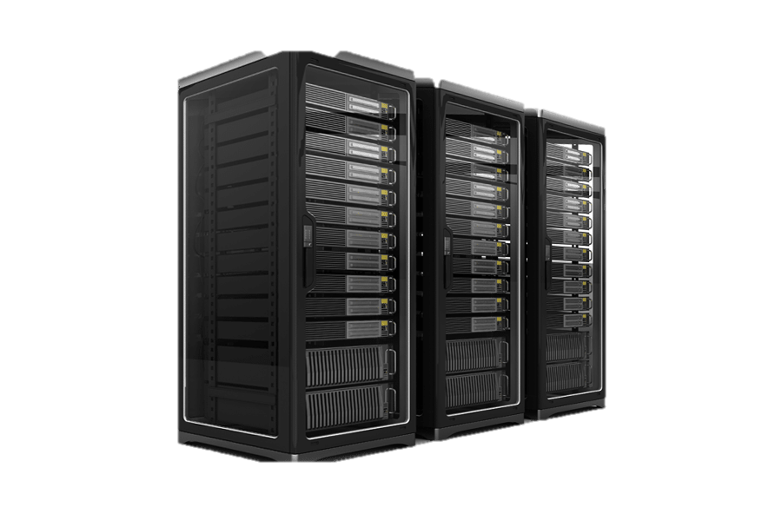
Why is this interesting?
Would state-of-the-art schedulers work on remote memory?
Exploit parallelism to hide remote latencies
A step towards rack-scale scheduling
Notes:
Explore other abstractions on the OSes

Slide 35
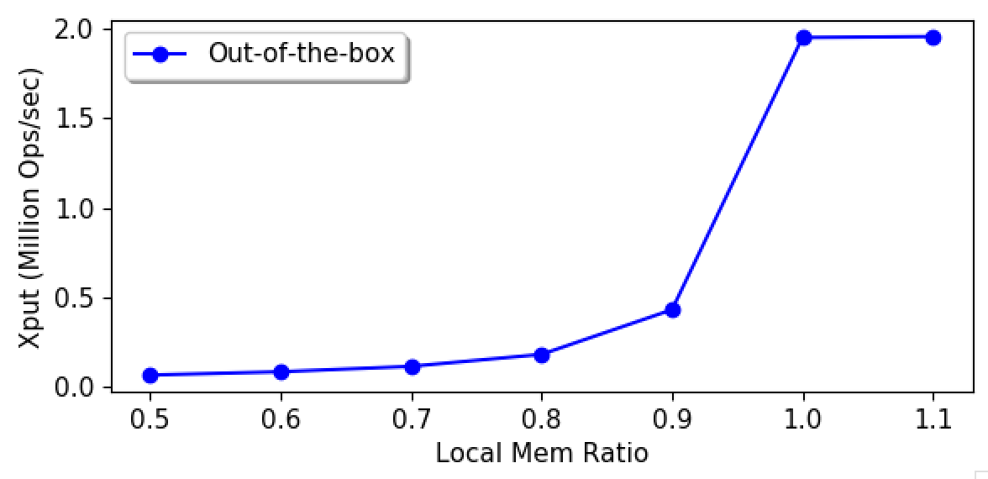
Out-of-the-box Performance
Goal: Characterize Performance
(Details shortly)

Slide 36
A suspect: Page faults
Gateway to remote memory in transparent systems.
Today’s user-space schedulers use kernel thread as a proxy for cores (one thread per core) – to avoid kernel scheduler.
Being blocking operations, they take the thread/core away
Limits page fault (remote access) concurrency
Notes:
This presents a problem for user-level schedulers who want the kernel out of the picture.

Slide 37
Asynchronizing Page faults
Some blocking kernel calls have been asynchronized
Custom I/O interfaces
But Page faults trap in hardware.
All current schedulers ignore the issue; not an option in a remote memory system
May require kernel upcalls like scheduler activations
Wait, show me that this is a real problem first!

Slide 38

Approach
Shenango – State-of-the-art user thread scheduler
Kona – State-of-the-art remote memory system
Run them together,
Benchmark with Memcached
Notes:
Ok let’s get real then.

Slide 39
Kona
Paging-based remote memory
Application
Virtual
Address
Space
Kernel
Pagefault Handler
Local Memory
Network
Transport
Remote Memory
Notes:
Just a few more details about the setup

Slide 40
Kona
Paging-based remote memory
Transparency introduces semantic gap so Kona handles page faults in userspace. Provides:
Choice of compatibility or co-design
Resource accounting
Easy to experiment
Shouldn’t make a difference in my case
Application
Pagefault Handler
Virtual
Address
Space
Kernel
Local Memory
Network
Transport
Remote Memory
Notes:
Providing the application with native memory interface but giving it the control over how the local cache is managed.

Slide 41
Kona
Host
App
Kona Threads
Memory
Server
App Work
RDMA
Faults
Eviction
NIC
Notes:
Kona from a cpu allocation perspective
Describe eviction and eviction threshold.

Slide 42
Kona + Shenango
Host
Memcached
User Threads
Kona Threads
Memory
Server
I/O Core
Poller
Faults
Eviction
Runtime
KV
Client
NIC
Notes:
Kona and shenango are core-isolated, with shenango managing rest of the threads. Has it own net stack, etc.
All working memory is local, only app heap goes on the remote memory.

Slide 43
Memcached Throughput
Memcached
4 CPU cores
Offered load: 2 Mops
Mostly (>99%) Reads
Uniform key distribution
Notes:
Out of the box performance
Took me whole internship

Slide 44
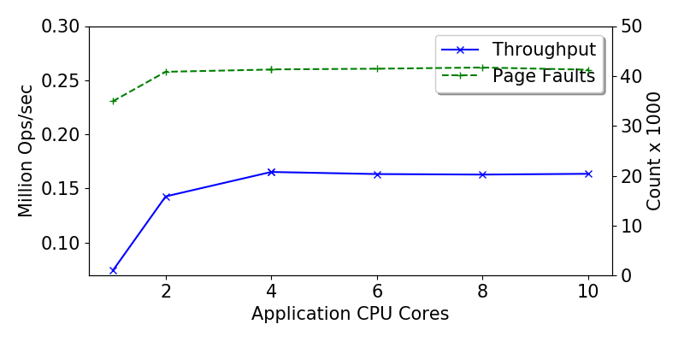
First in line: Kona Bottlenecks
Notes:
That was it, that was where my internship ended really.

Slide 45
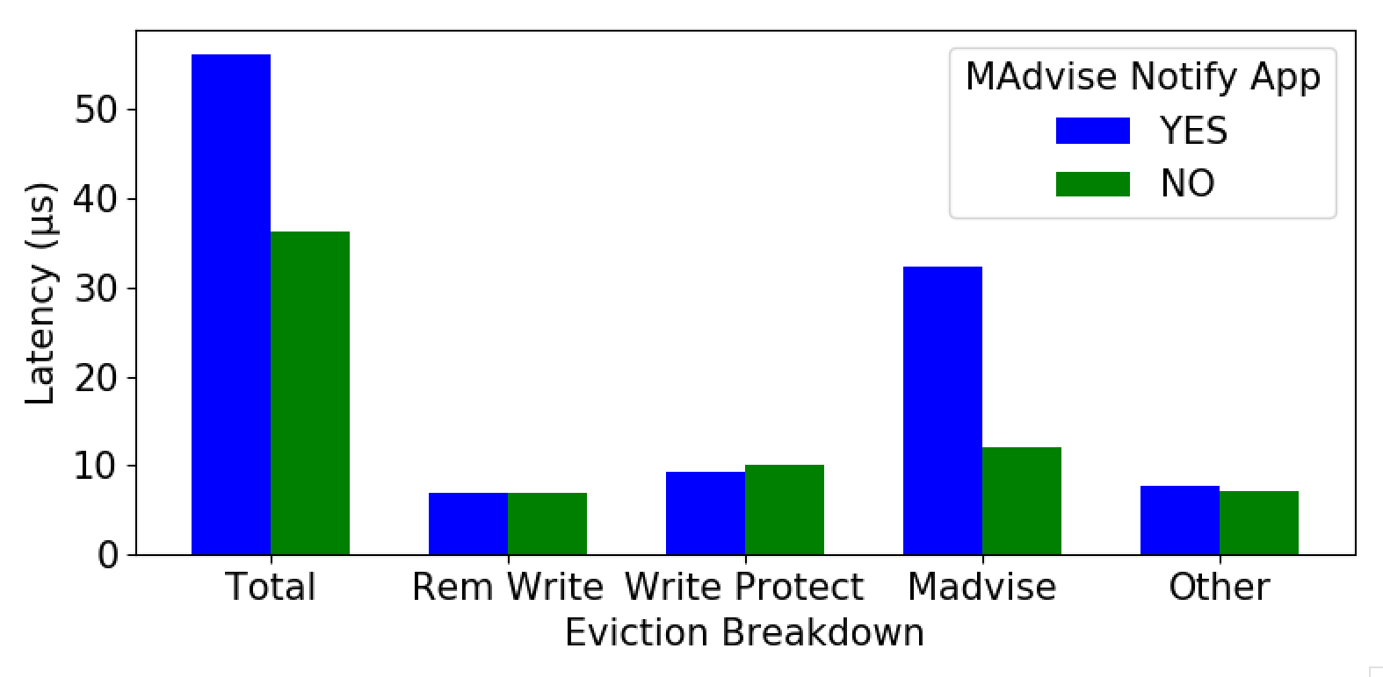
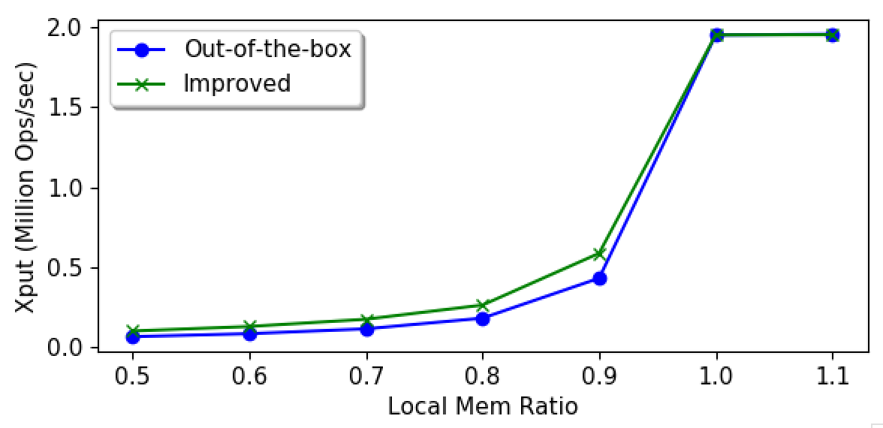
Eviction Bottleneck
Eviction Time ~ 35%

Slide 46
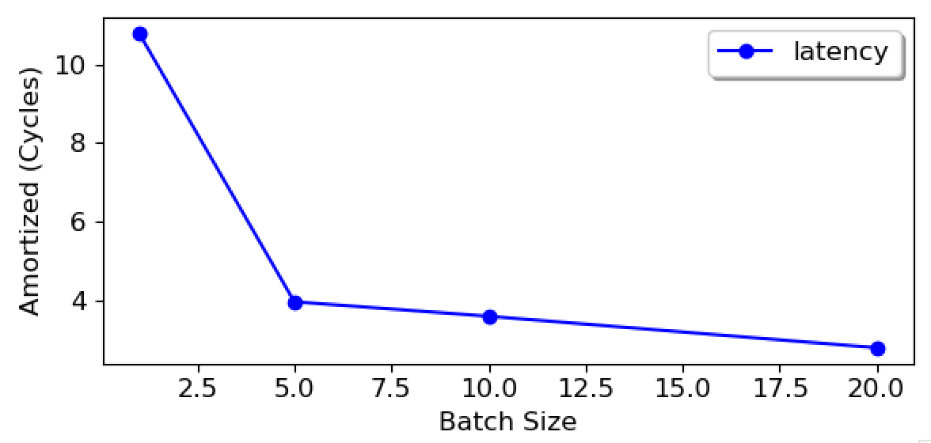
Eviction Bottleneck
Eviction Time ~ 35%
Eviction Batching ~ 10% (expected)

Slide 47
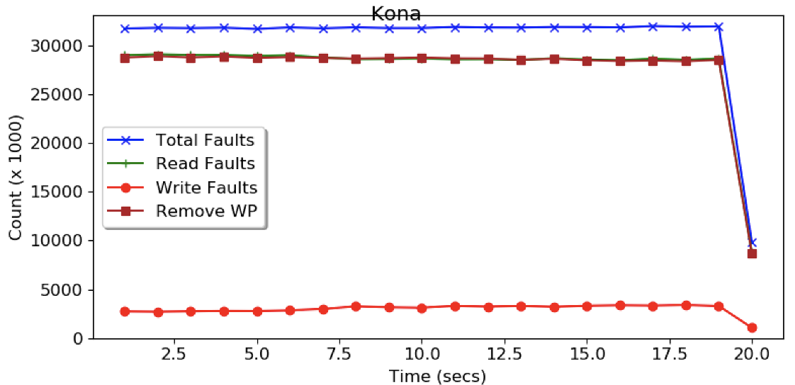
Eviction Bottleneck
Eviction Time ~ 35%
Eviction Batching ~ 10% (expected)
Memcached dirtying ~ 30% (expected)

Slide 48
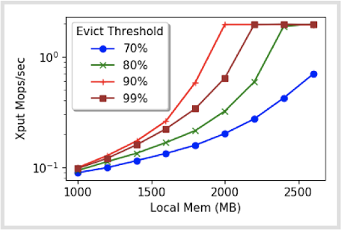
Eviction Bottleneck
Eviction Time ~ 35%
Eviction Batching ~ 10% (expected)
Memcached dirtying ~ 30% (expected)
Eviction threshold

Slide 49
First in line: Kona Bottlenecks
Working on improving eviction, but there might be others in Kona.
Expectation is that we’ll hit page fault concurrency after this.

Slide 50
Going forward
Keep exploring performance bottlenecks
Opportunities for scheduler-remote memory co-design
Longer-term
How could this fit into rack-scale scheduling?

Slide 51
Conclusion
Exploring user-space CPU scheduling for remote memory.
Sounds Interesting? Please reach out!

Slide 52
The end

Slide 53
Don’t go past this

Slide 54
Please stop!

Slide 55
Racklette Effort
Redesigned software stack for Rack-scale applications
Simplified programming
Better/balanced resource utilization
Exploring CPU Scheduling, both on the rack-level and within each server
Notes:
Racklette which is one of recent rackscale computing efforts, driven to brand rack as a more integrated computing platform than a traditional distribued system
Driven by recent hardware trends like fast, low latency networks, CXL, and disaggregated memory, Rack resembles more and more like a multi-core server; and the goal is to exploit this to provide simplified programming models and better resource utilization through global decision making.
While there are many open questions on the design, an important one is how we are gonna do CPU scheduling, both across the rack and within each node

Slide 56
Assumptions
Disaggregated Compute & Memory (aka Remote Memory)
Run legacy applications: POSIX Threads and Virtual memory
Target applications: Recommender, Memcached
Notes:
To narrow down the problem, these are some choices/assumptions that we make

Slide 57
Question
What’s the best way to manage & schedule threads, in the context of Racklette and Remote Memory?
Ideally, these properties:
Lightweight
Flexible scheduling e.g., prioritizing threads based on signals
Co-scheduling opportunities e.g., network
Migratable (longer-term)
Notes:
Given that, the question comes down to:

Slide 58
Thread Management
Kernel is a suitable location but
Kernel threading primitives are expensive
User-level thread management (e.g., Arachne, Shenango, Caladan)
Separate thread scheduling from core allocation
Runtime provides locks and I/O etc. in userspace
Core allocation based on signals (co-design)
But can they be run out-of-the-box on remote memory?
Notes:
Goal is to explore this option.

Slide 59
Remote/Disaggregated Memory
Pools of compute and memory, connected by low-latency network.

Slide 60
Paging-based Remote Memory
Presented as virtual memory and serviced through page faults
Pros:
Native memory interface
No app changes
But handled by the kernel.
Application
Virtual
Address
Space
Kernel
Pagefault Handler
Local Memory
Network
Transport
Remote Memory
Notes:
While there are different ways to provide remote memory…

Slide 61
Page faults are a problem
Today’s user-level schedulers use kernel thread as a proxy for cores (one thread per core).
e.g., Arachne, Shenango, Caladan, GOLANG.
But blocking kernel calls take the thread/core away.
Blocking calls – Sync I/O, System calls, Page faults
Multiple kernel threads per core not an option
Notes:
This presents a problem for user-level schedulers who want the kernel out of the picture.

Slide 62
Page faults are a problem
Various solutions, none of which work for page faults.
Custom I/O interfaces
Because Page faults trap in hardware.
All current schedulers ignore the issue
Not an option in a remote memory system
Concrete Goal: Demonstrate and quantify the performance effect of blocking due to page faults

Slide 63
Approach
Shenango – State-of-the-art user thread scheduler
Kona – State-of-the-art, in-house remote memory system
Run them together,
Benchmark with Memcached

Slide 64
Kona
Paging-based remote memory
Application
Virtual
Address
Space
Kernel
Pagefault Handler
Local Memory
Network
Transport
Remote Memory
Notes:
Just a few more details about the setup

Slide 65
Kona
Paging-based remote memory
Transparency introduces semantic gap so Kona handles page faults in userspace. Provides:
Choice of compatibility or co-design
Resource accounting
Easy to adopt
Application
Pagefault Handler
Virtual
Address
Space
Kernel
Local Memory
Network
Transport
Remote Memory
Notes:
Providing the application with native memory interface but giving it the control over how the local cache is managed.

Slide 66
Kona
Host
App
Kona Threads
Memory
Server
App Work
RDMA
Faults
Eviction
NIC
Notes:
Kona from a cpu allocation perspective

Slide 67
Kona + Shenango
Host
Memcached
User Threads
Kona Threads
Memory
Server
I/O Core
Poller
Faults
Eviction
Runtime
KV
Client
NIC
Notes:
Kona and shenango are core-isolated, with shenango managing rest of the threads. Has it own net stack, etc.
All working memory is local, only app heap goes on the remote memory.

Slide 68
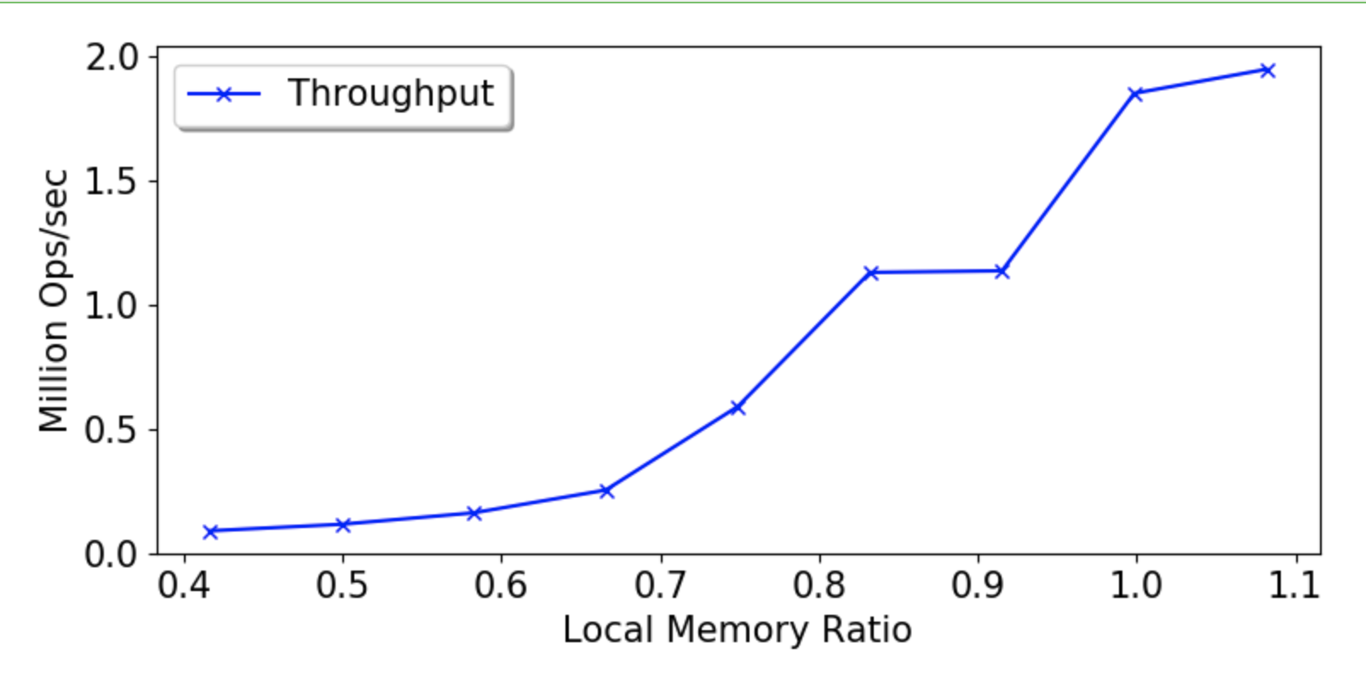
Memcached Throughput
Memcached
4 CPU cores
Offered load: 2 Mops
Mostly (>99%) Reads
Uniform key distribution
Notes:
Degradation as expected. Of course, the challenge is to separate the degradation due to hardware and due to system design. Only way to know is to figure out where the bottlenecks are coming from.

Slide 69
Memcached Throughput
Memcached
4 CPU cores
Offered load: 2 Mops
Mostly (>99%) Reads
Uniform key distribution
Notes:
Degradation as expected. Of course, the challenge is to separate the degradation due to hardware and due to system design. Only way to know is to figure out where the bottlenecks are coming from.

Slide 70
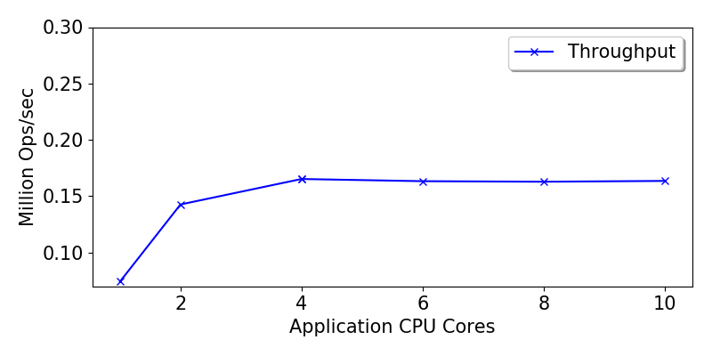
Throwing more CPU at it

Slide 71
Throwing more CPU at it

Slide 72
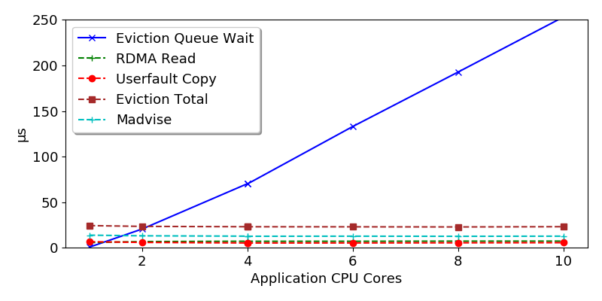
Throwing more CPU at it
Notes:
Kona, with its single core, is not able to keep up.

Slide 73
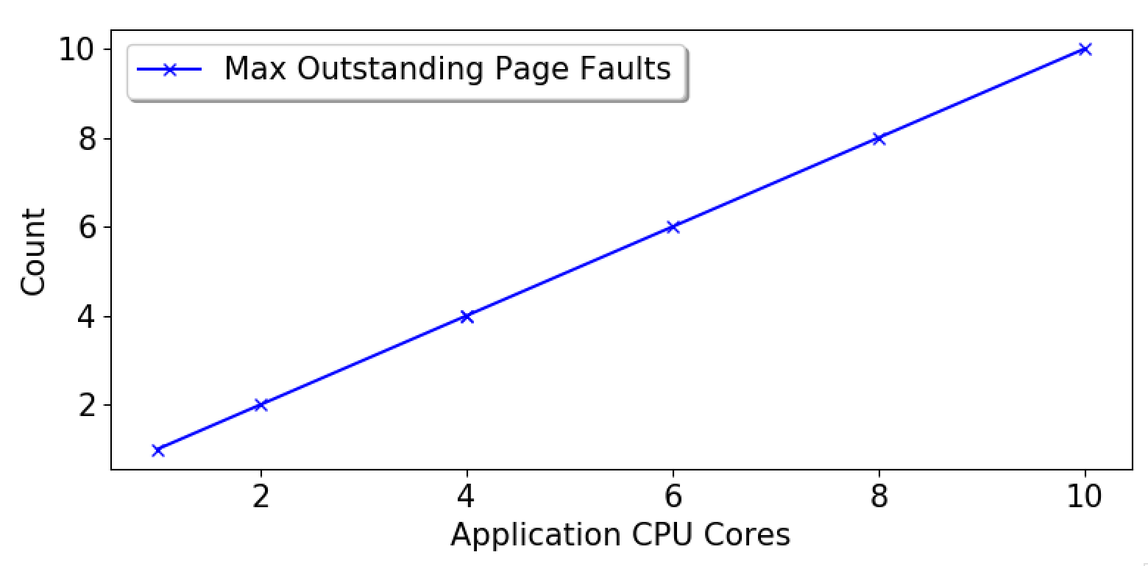
Well, what about page faults?
Perhaps the next bottleneck we’ll hit. But for a flavor…
Notes:
What this shows is that 1) page faults are synchronous and threads aren’t doing any other work, and 2) even after removing bottlenecks in Kona, you won’t be able to put more that 10 concurrent rdma in flight

Slide 74
Potential Solutions
Kona bottlenecks
Optimizing some kernel operations
Co-design with Shenango scheduler
Kona threads to User threads
Increase/decrease threads based on paging activity
Asynchronizing page faults
Upcalls à la scheduler activations
Notes:
Fortunately, as if by foresight, Kona already does its work in userspace

Slide 75
Going forward
Implementing these solutions
Exploring how this fits into rack-level scheduling

Slide 76
Conclusion
Investigated the user-level threading as a scheduling option for remote memory
Identified & demonstrated some perf challenges
Proposed potential solutions

Slide 77
Thanks & Questions

Slide 78

Where I’m at
An Amazing Scheduler
For Remote Memory
Expectation
Reality

