Slide 1
Local Scheduler for Racklette
Racklette opens new challenges/opportunities for CPU scheduling.
Performance – with disaggregated memory
Co-scheduling with other resources e.g., Network
First step: Exploring intra-node scheduling options in the disaggregated setting

Slide 2
Local Scheduler for Racklette
Goal
Studying performance of traditional schedulers on disaggregated memory
Our picks (to start with):
Shenango – user-space scheduler
Kona – user-managed disaggregated memory
Memcached – benchmarking application

Slide 3
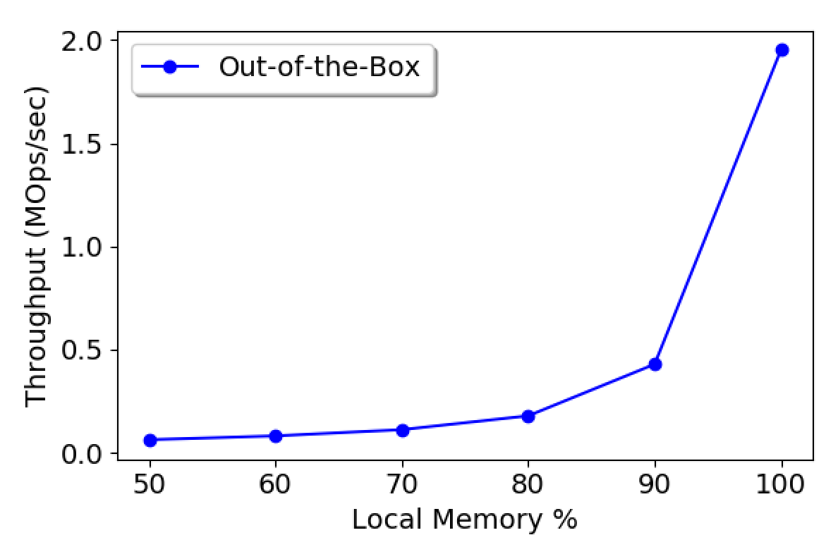
Out of the Box Performance
Breaking down performance degradation:
Expected scheduling-related bottlenecks due to Page faults
But we hit other issues first
(4 CPU cores, 2 Mops load, Mostly Read, Uniform Key Hits)

Slide 4
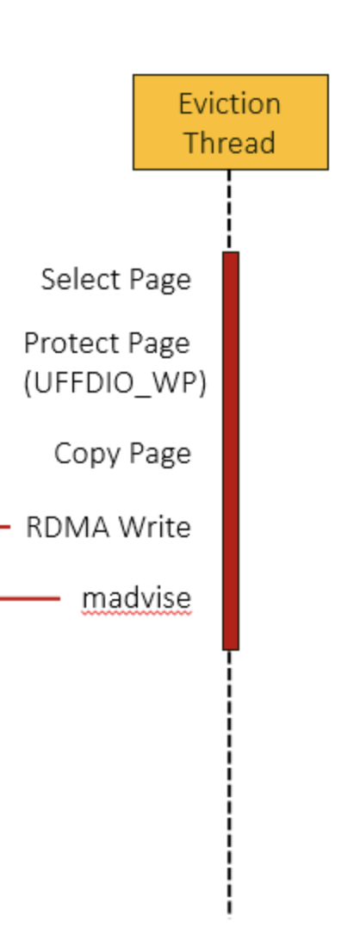
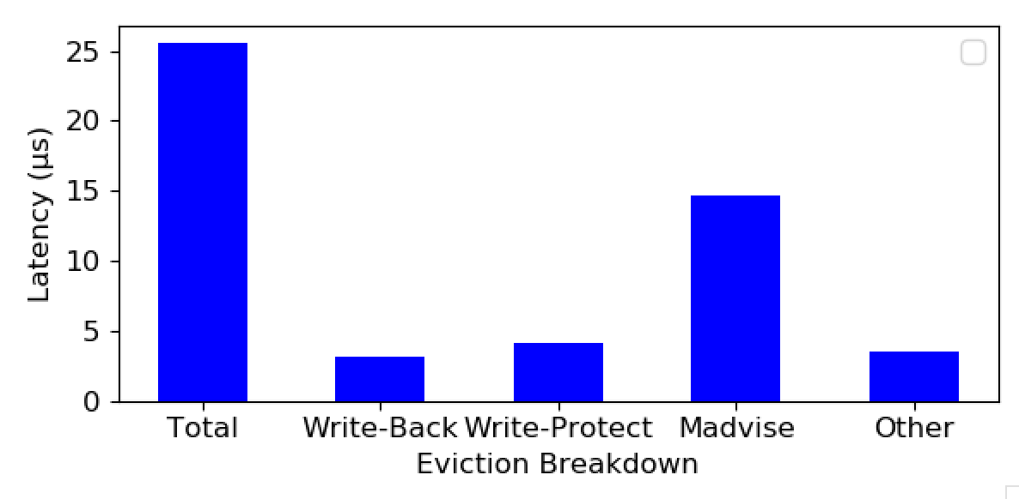
Performance Bottlenecks
1. Kona Eviction bandwidth
Runs on 1 core
Significant cost per page e.g., Madvise

Slide 5
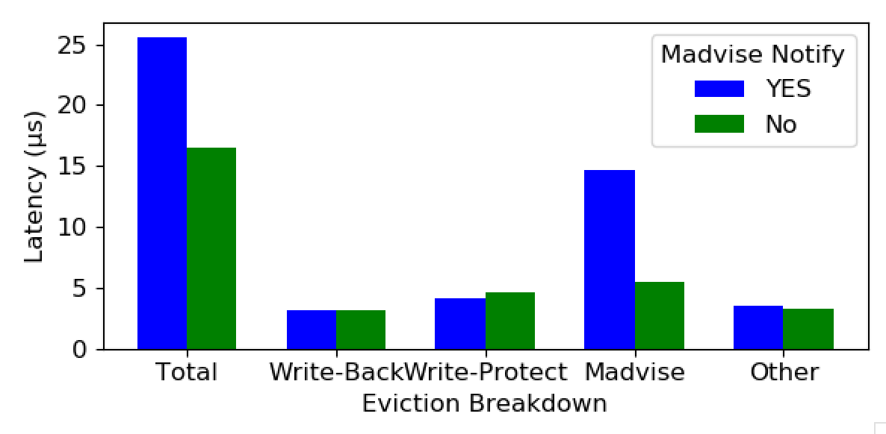
Performance Bottlenecks
1. Kona Eviction bandwidth
Runs on 1 core
Significant cost per page e.g., Madvise

Slide 6
Performance Bottlenecks
1. Kona Eviction bandwidth
Runs on 1 core
Significant cost per page e.g., Madvise
2. Write cost for every page
Memcached dirties every item

Slide 7
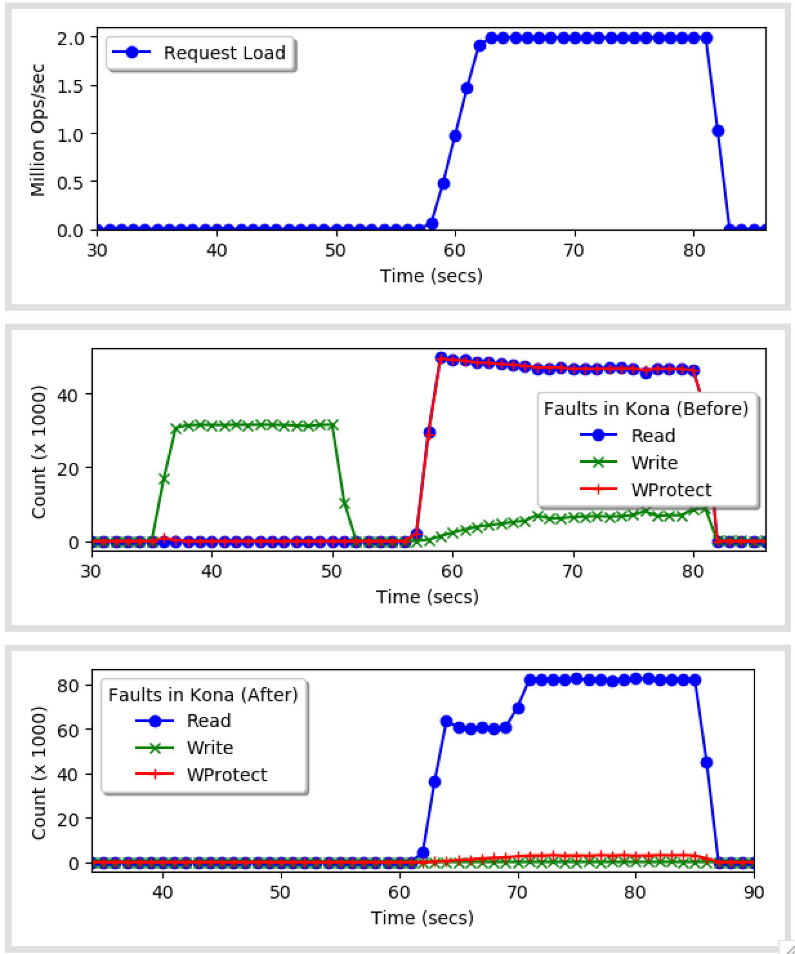
Memcached Dirtying
LRU maintenance both while serving the requests and in background
+
Consolidated KV item with data & metadata.
Turning off the maintenance removes all dirtying.
(to understand the performance effect)

Slide 8
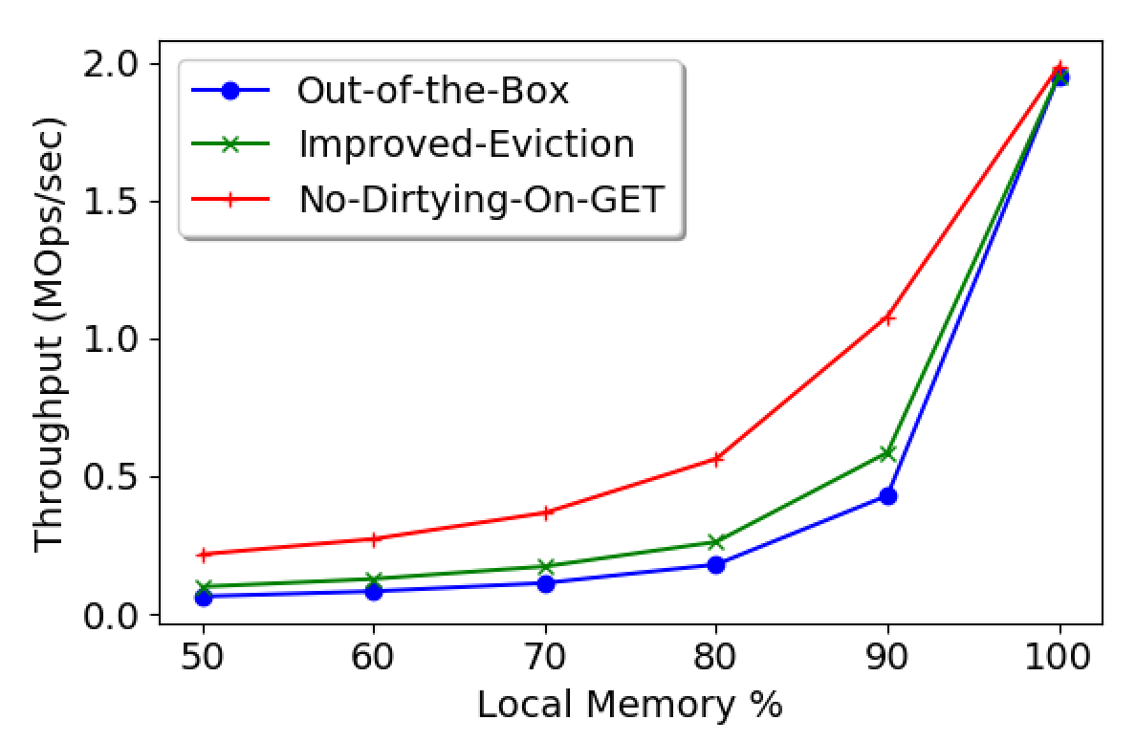
Effect on Overall Performance
1. Kona Eviction bandwidth
Runs on 1 core
Significant cost per page e.g., Madvise
2. Write cost for every page
Memcached dirties every item
(4 CPU cores, 2 Mops load, Mostly Read, Uniform Key Hits)

Slide 9
Takeaways so far
For Kona
that there are overheads we need to address
But not our goal
For Memcached (& apps in general)
that some programming/data placement choices need to be revisited when porting apps to disaggregated memory
Something we’d like to explore
Didn’t get to the scheduling yet

Slide 10
Going forward
On to the next bottleneck i.e., keep teasing out performance factors
We quantified the effect of some factors but how to address them? – Open questions.
Scheduler-Kona Co-design

