Slide 1
Scaling up Kona
1. Reducing cost of some operations
Nadav’s patches for madvise, wprotect – 30-40% improvement
Using IO_uring
Some general overall improvement?
For Nadav’s patch when UFFD copy becomes bottleneck

Slide 2
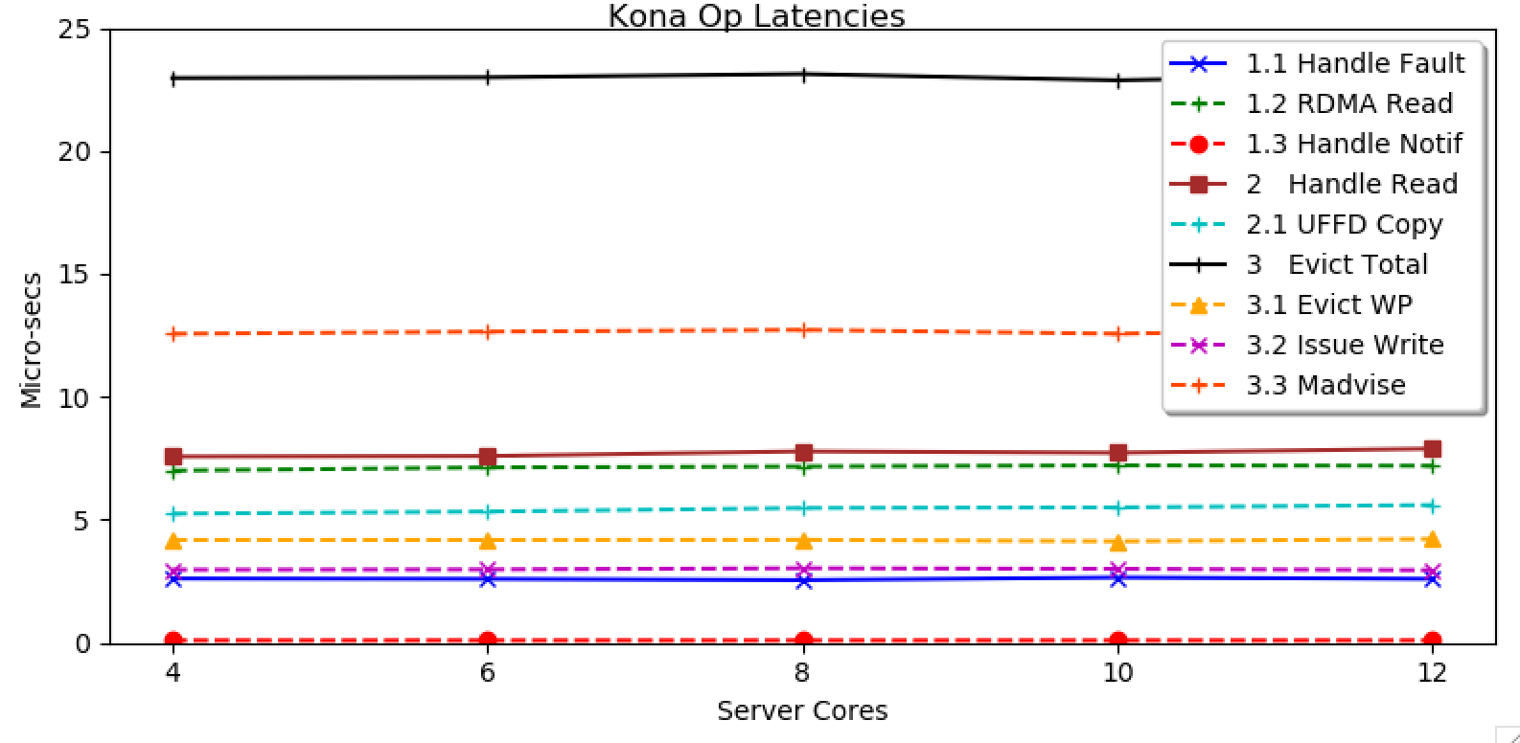
Breakdown of Kona latencies

Slide 3
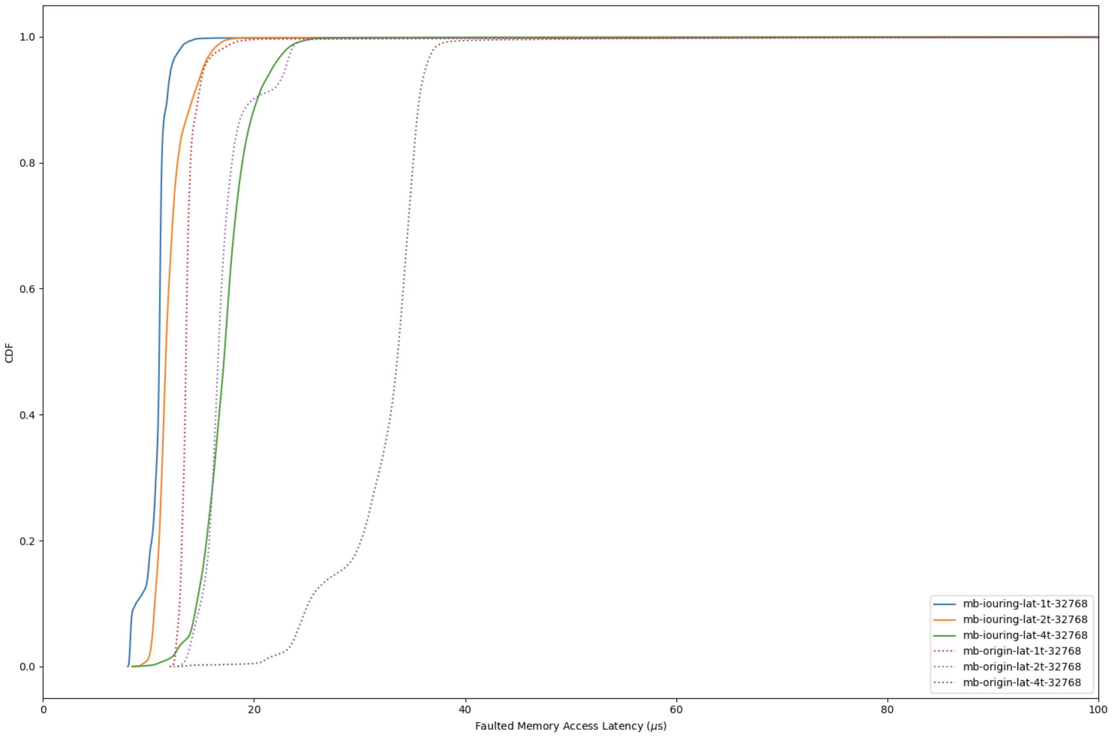
I/O Uring Jiacheng’s result

Slide 4
Scaling up Kona
2. Reducing page faults in general – is it too many?
Do we want to optimize for uniform distribution?
Worst case for number of page faults
Improve eviction algorithm – Leap, at least?
Especially for eviction, why are there so many write faults with .2% SETs?

Slide 5
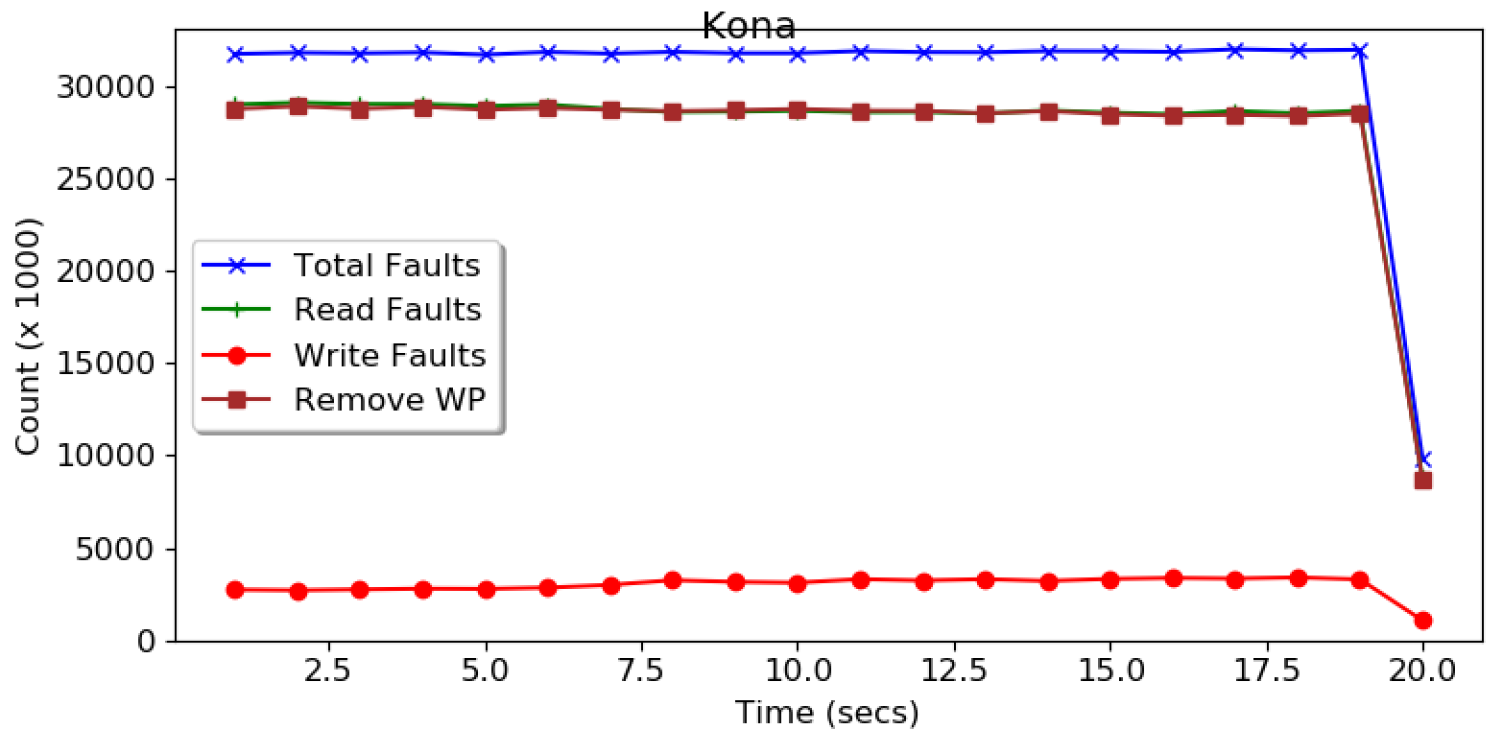
Kona Write_Protect Mode
Track dirty pages and only write back these pages
Has Performance overhead
Even the GETs are dirtying all the pages they touch.

Slide 6
Scaling up Kona
2. Reducing page faults in general – is it too many?
Do we want to optimize for uniform distribution?
Worst case for number of page faults
Improve eviction algorithm – Leap, at least?
Especially for eviction, why are there so many write faults with .2% SETs?
But… we may hit the limit anyway as we scale up

Slide 7
Scaling up Kona
3. Can we dynamically scale Kona’s work
Rethink Kona’s design with the scheduler
Parts of page fault handling as a user-threads per fault?
Most costly ops are syscalls – ok with user threads?
While thread-safe, we may kick off kernel’s locking mechanisms
Sets a new direction for the project

Slide 8
Misc

Slide 9
Setup
b1640
Rack Controller
b1630 (Cores)
Memcached Process
Memory
Server
Shenango
IO Core
User Threads
Kona Threads
Poller
User faults
Eviction
Shenango Runtime
b1607
Memcached
Client
Shenango
NIC (DPDK +RDMA)

Slide 10
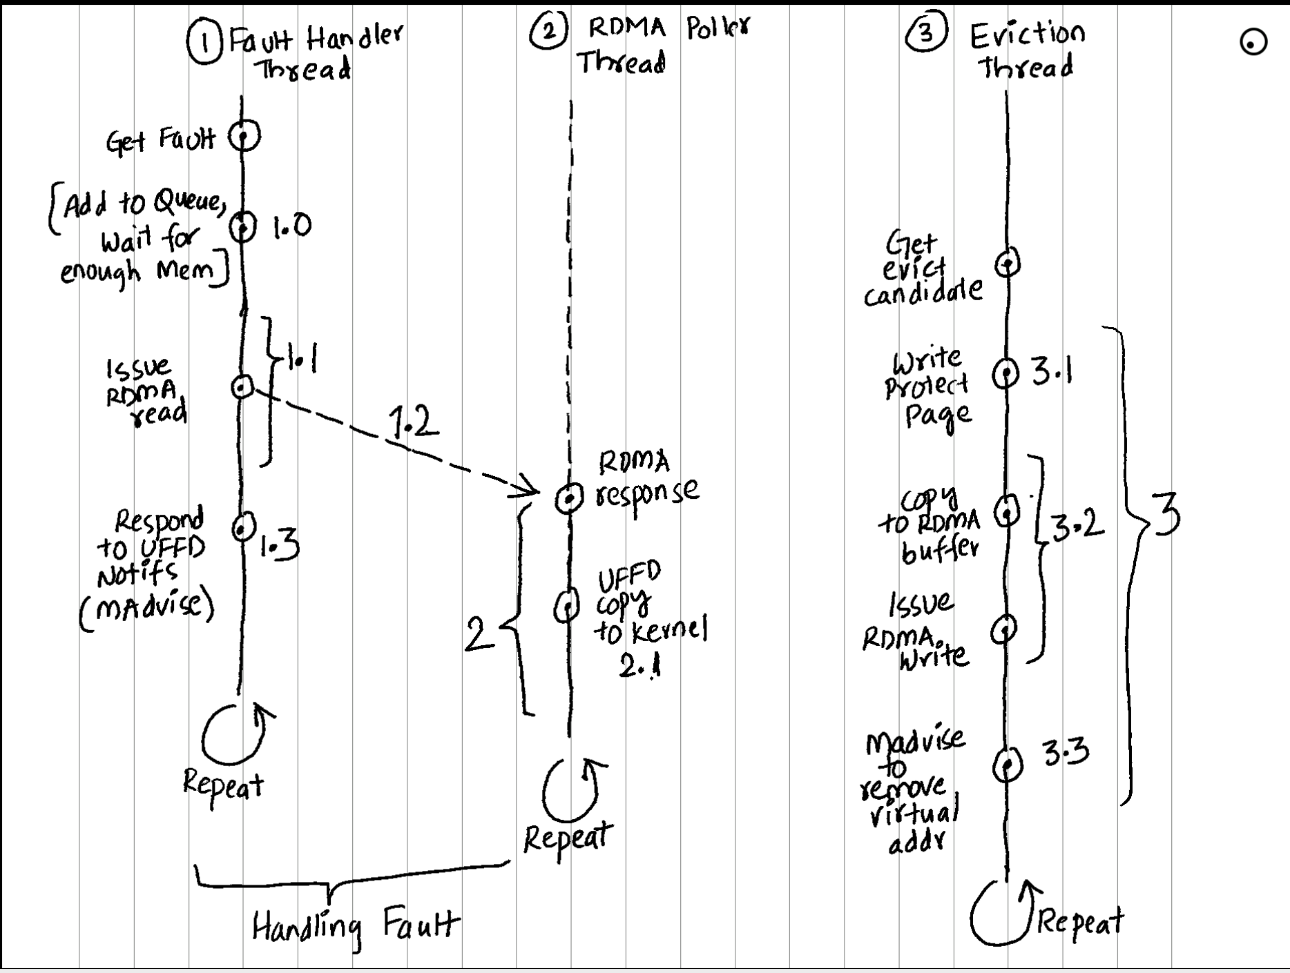
Flowchart

Slide 11
Discussion
What’s the best way forward
Plan for the rest of the week
Talk again on Friday
Alex wanted to say hi

Slide 12
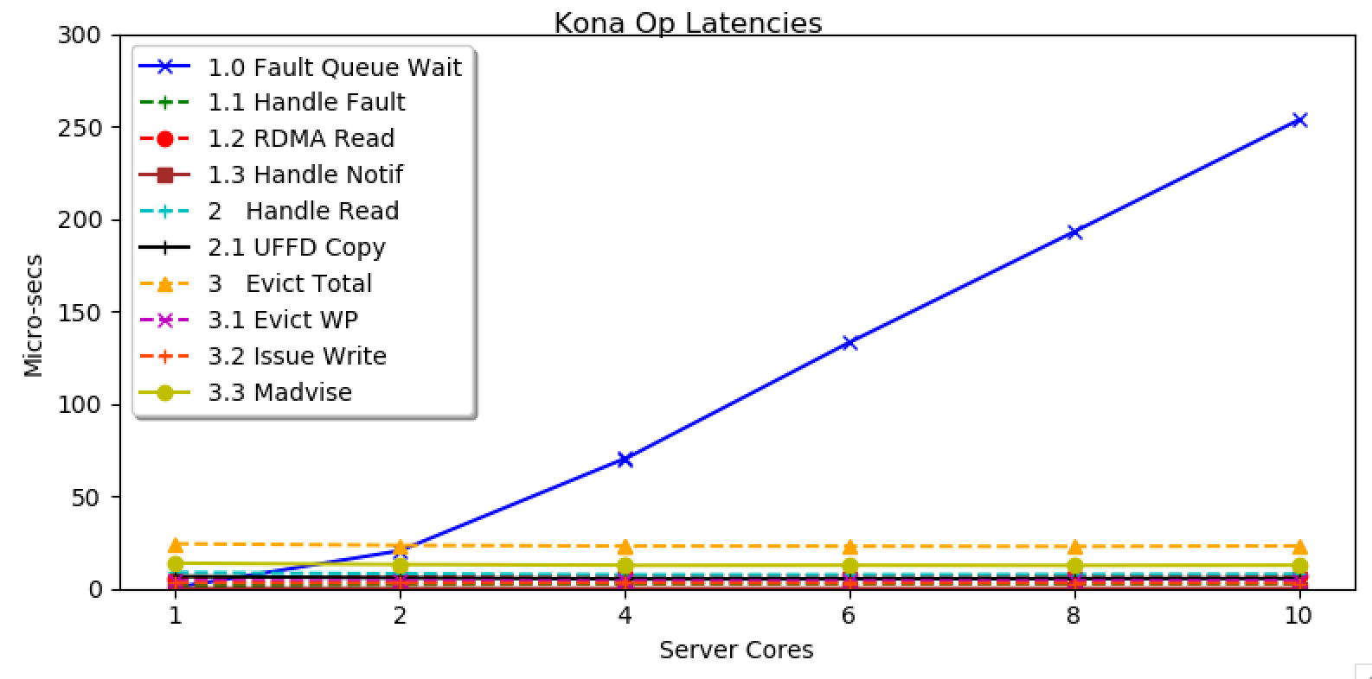
Eviction not able to keep up

Slide 13
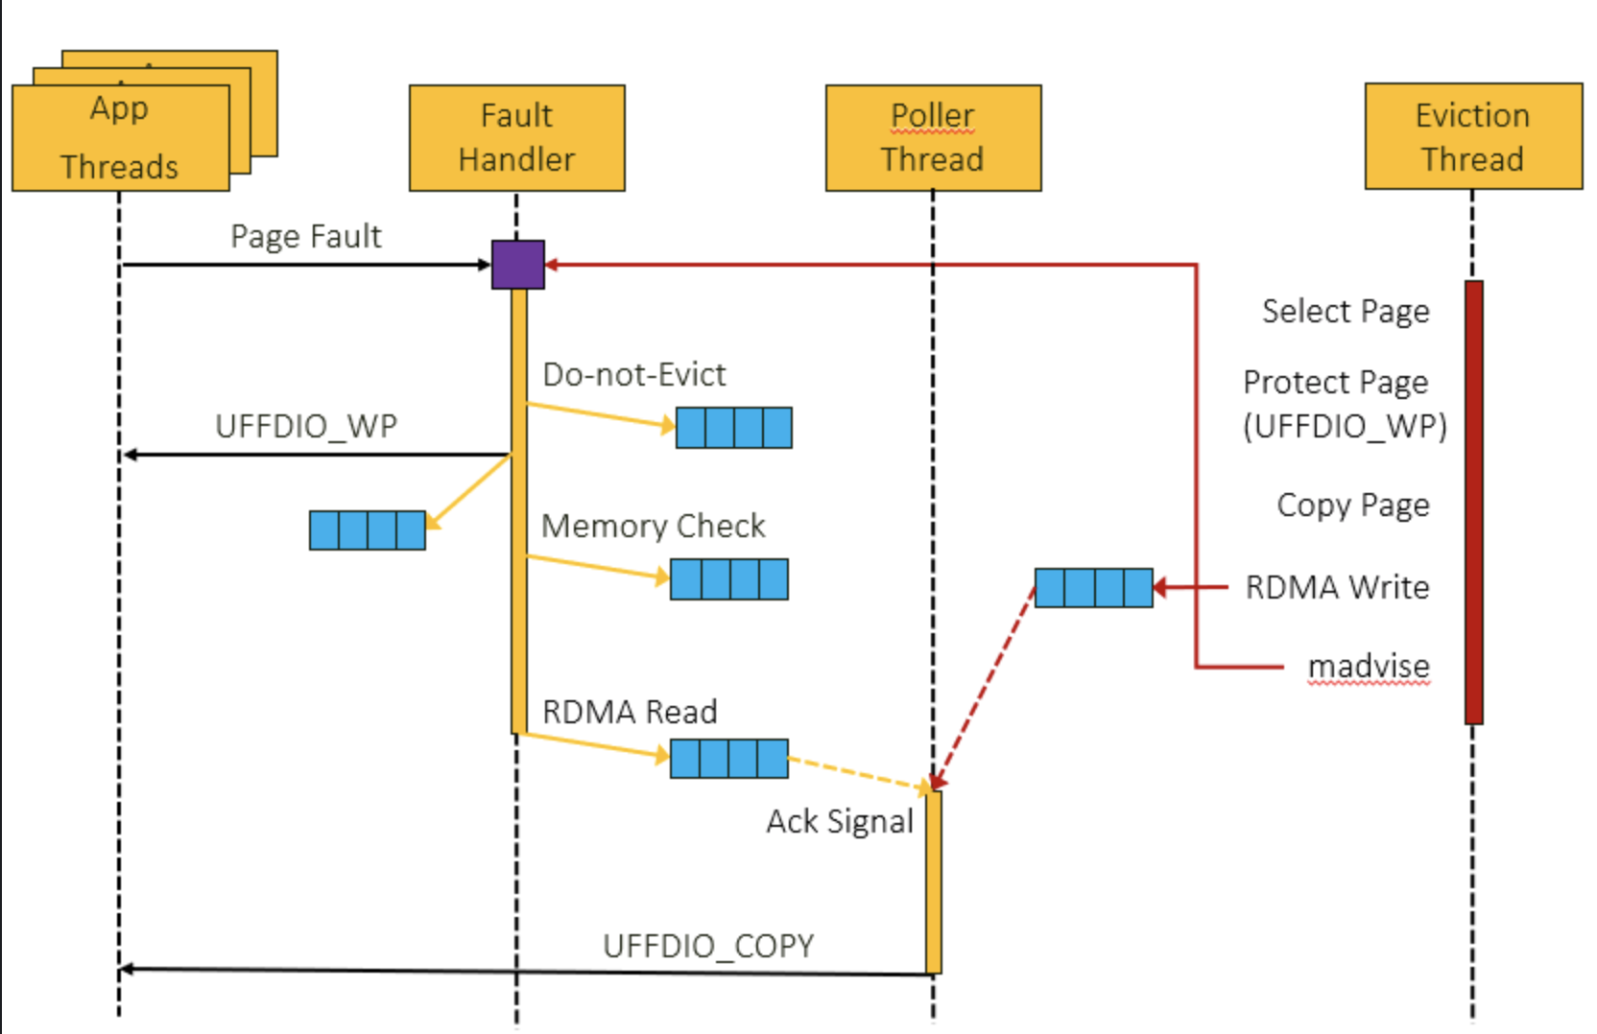
Flowchart

