Slide 1
Update
Wrote a simulator
Plan for emulating upcalls

Slide 2
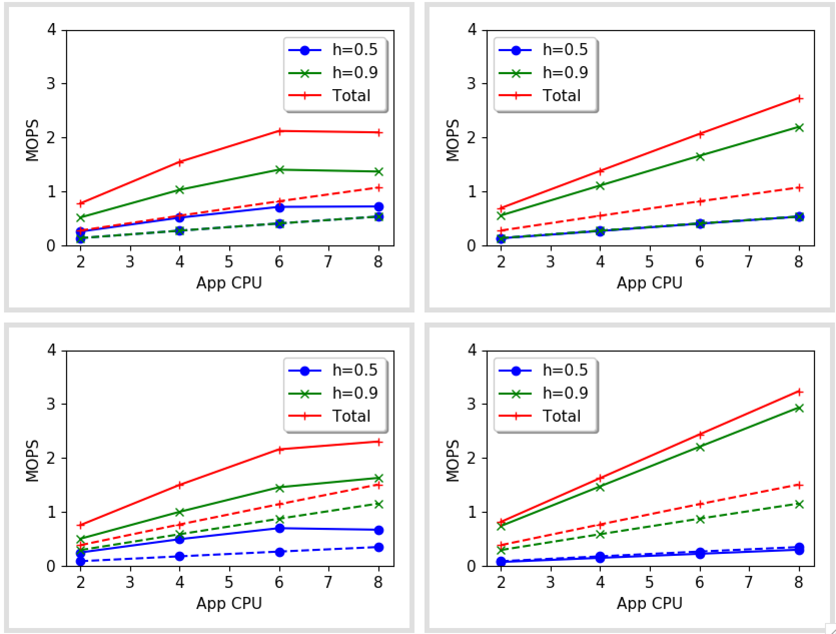
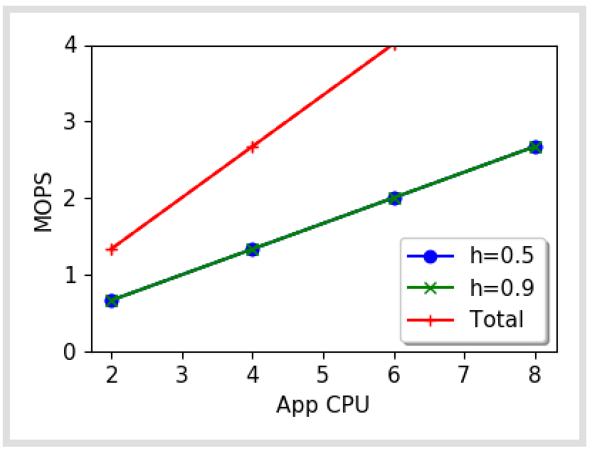
Kona = 500k
Split NO YES
Switch NO YES

Slide 3
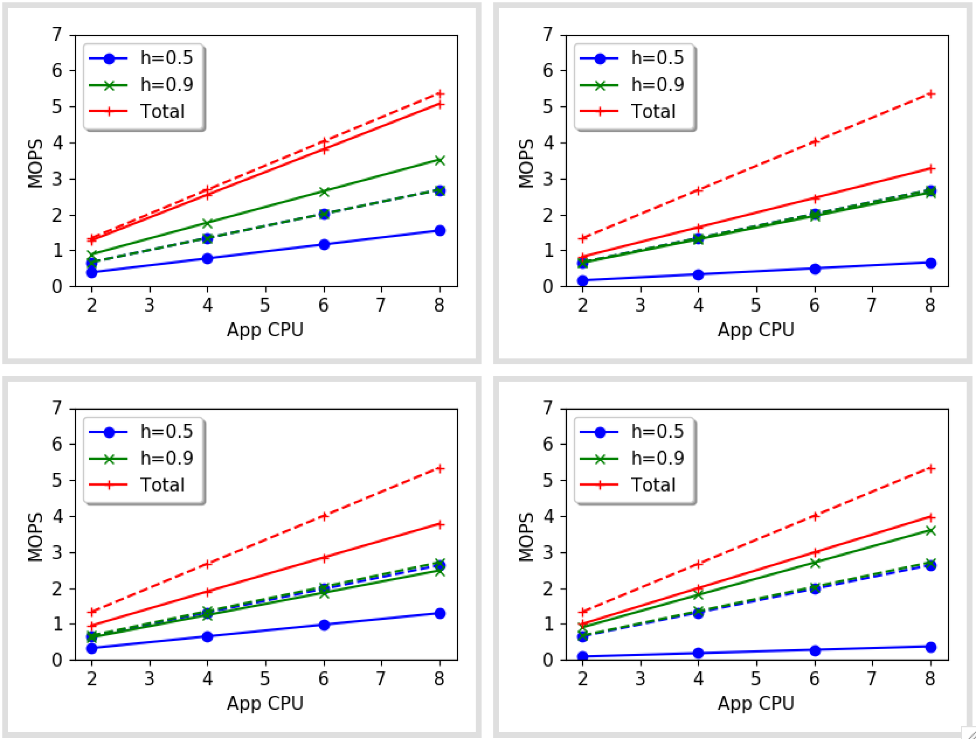
Kona = 500k
Upcall overhead = 0
Split NO YES
Switch NO YES

Slide 4
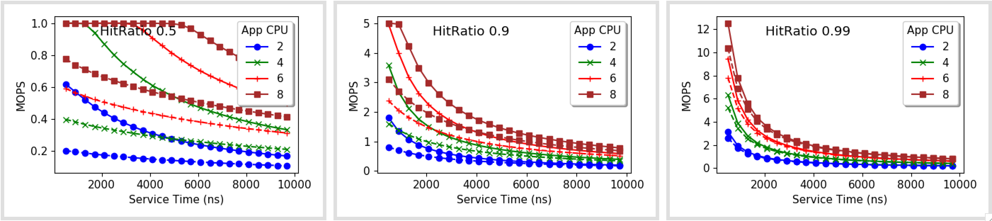
Varying request service time

