Slide 1
Topics
Fixed a deadlock in Kona
Fixed with gdb’s help
Runs successfully – but only sometimes.
Next: deadlock in the Kernel
Intel PT

Slide 2
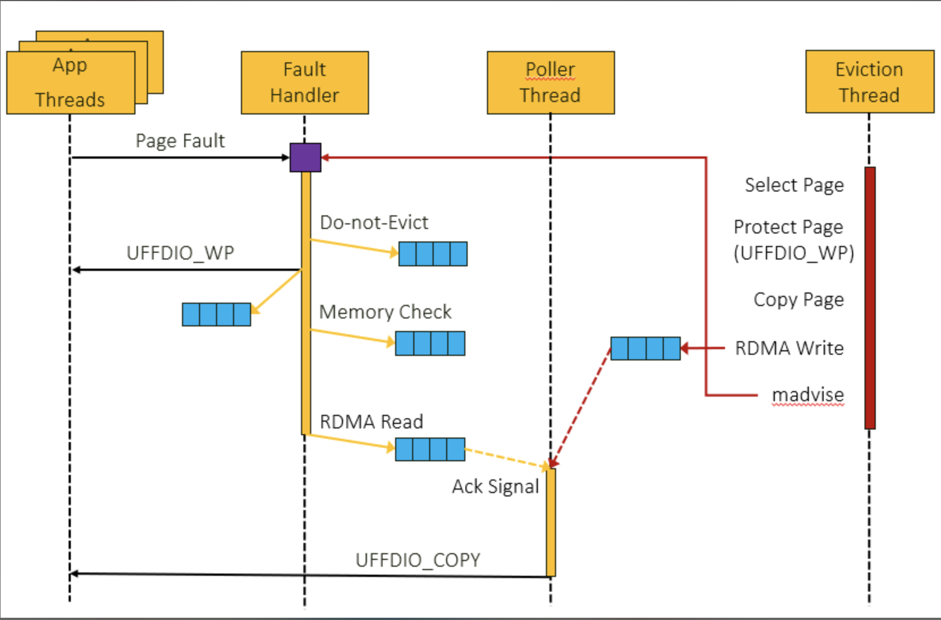
Kona

Slide 3
Kona

Slide 4
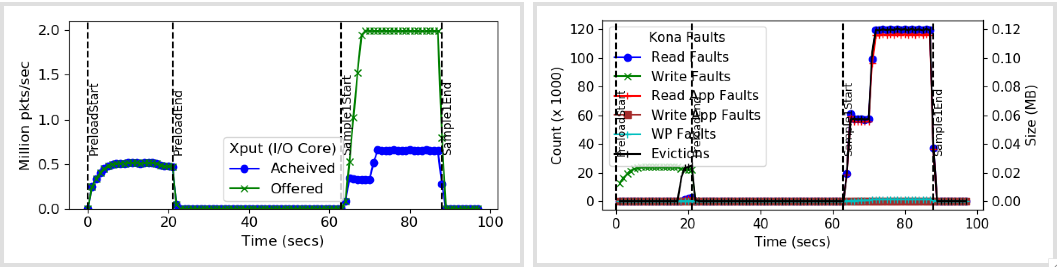
SYNC app faults

Slide 5
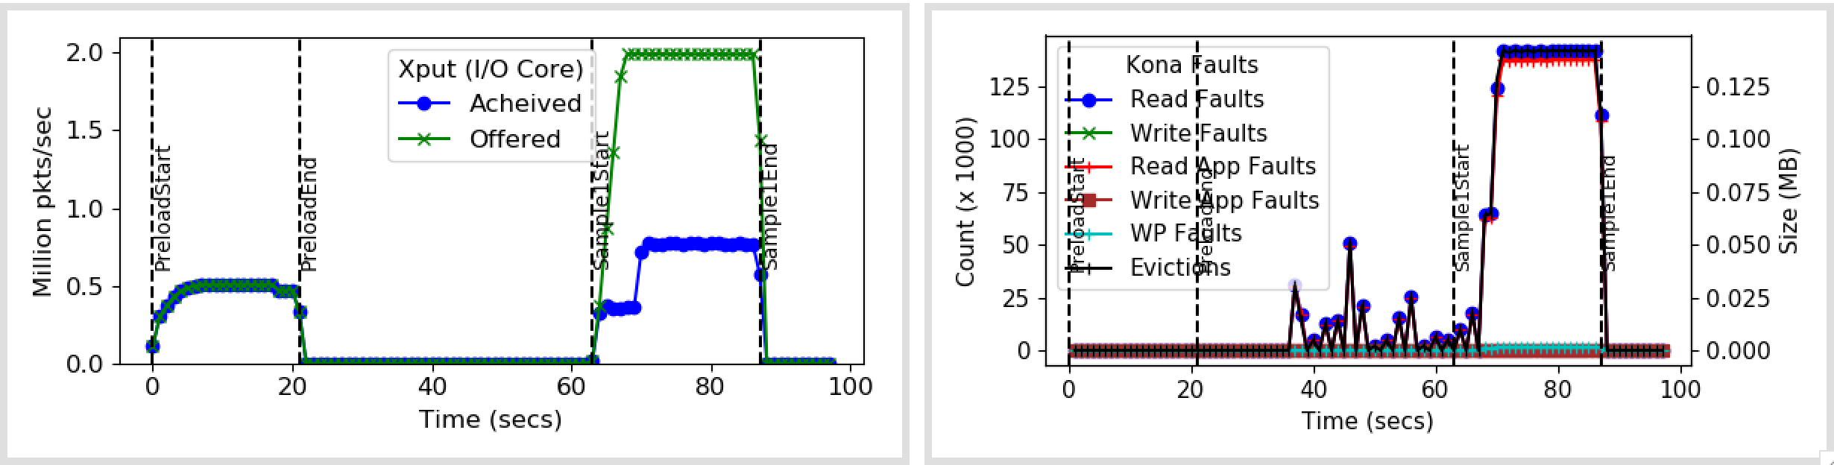
ASYNC app faults

Slide 6
Deadlock in Kernel
Breaks Kernel – so gdb doesn’t work too
Little debugging information
Trying a few things:
Kona doesn’t not hold any outstanding faults
Tracing Kona in more detail

Slide 8
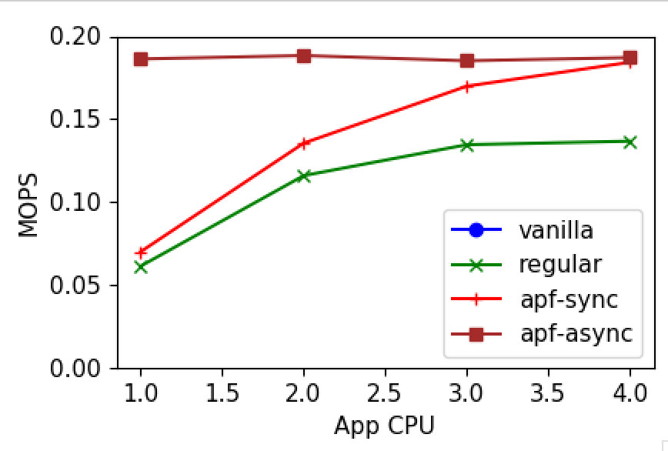
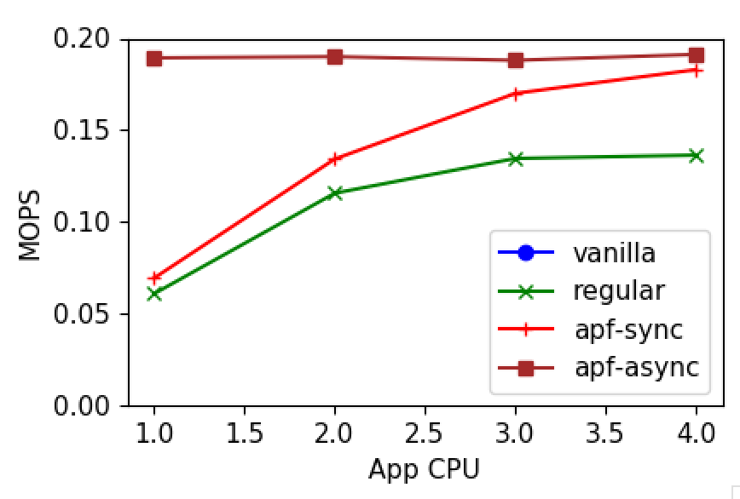
No affect on performance?

Slide 9
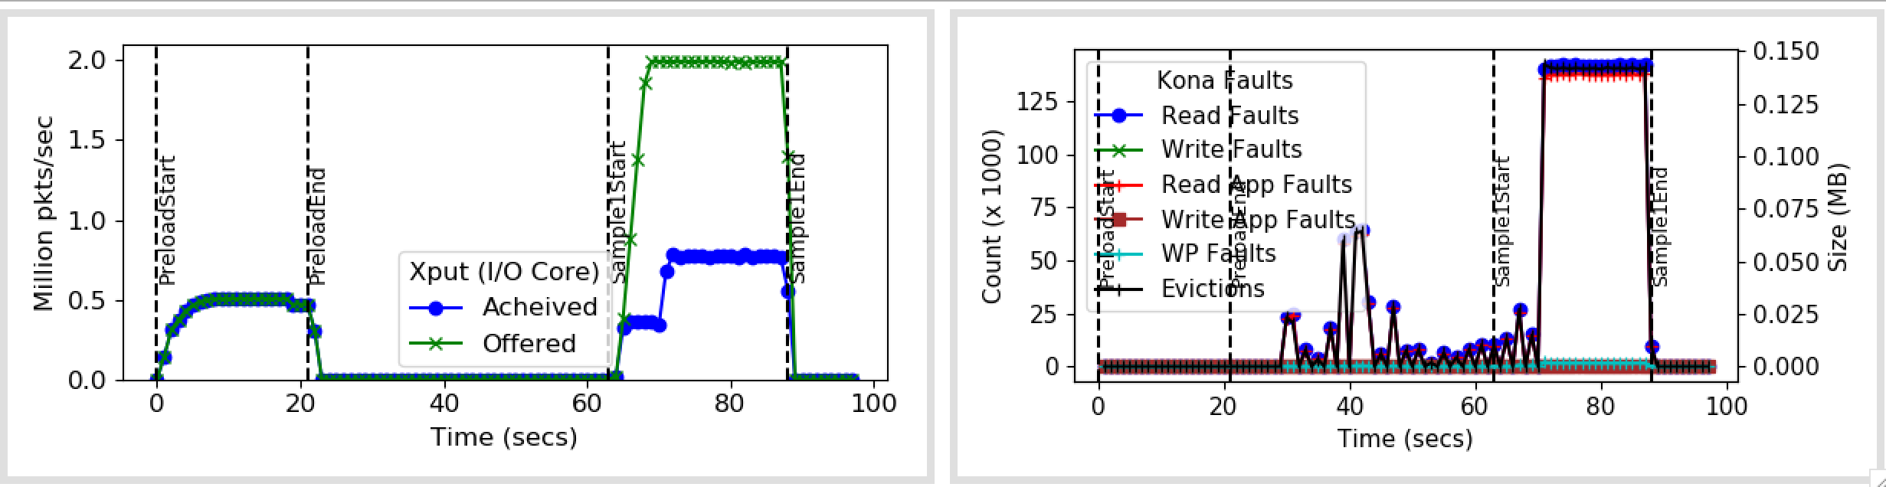
At least running with 2M now…

