Slide 1
Topics
Week (ASPLOS–12)
Fastswap – no progress
Paper feedback – updated Intro
Scaling Kona – as a contribution
Another application – more throughput-focused

Slide 2
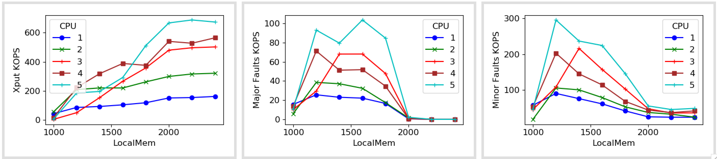
Fastswap

Slide 3
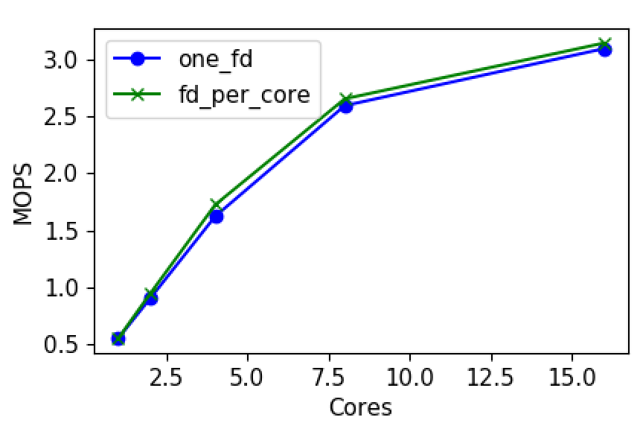
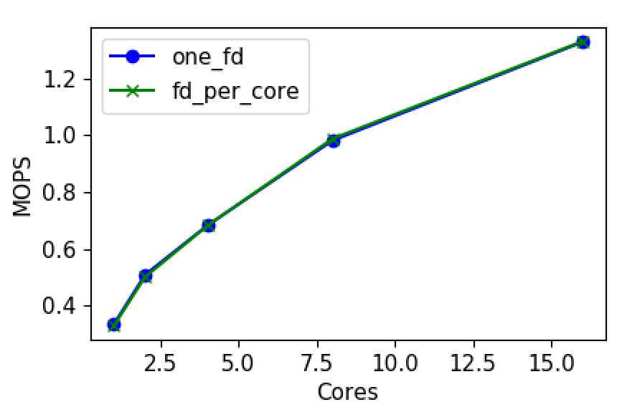
Userfaultfd Scalability
Map page: UFFD Copy
Unmap page: Madvise DONT_NEED

Slide 4
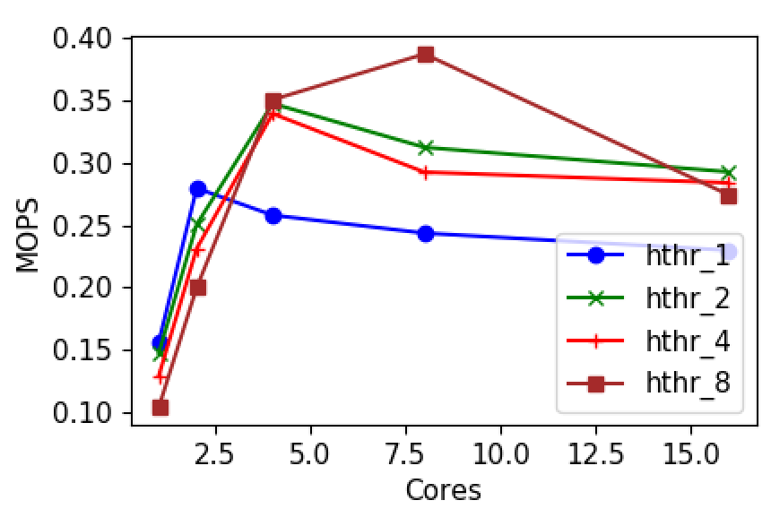
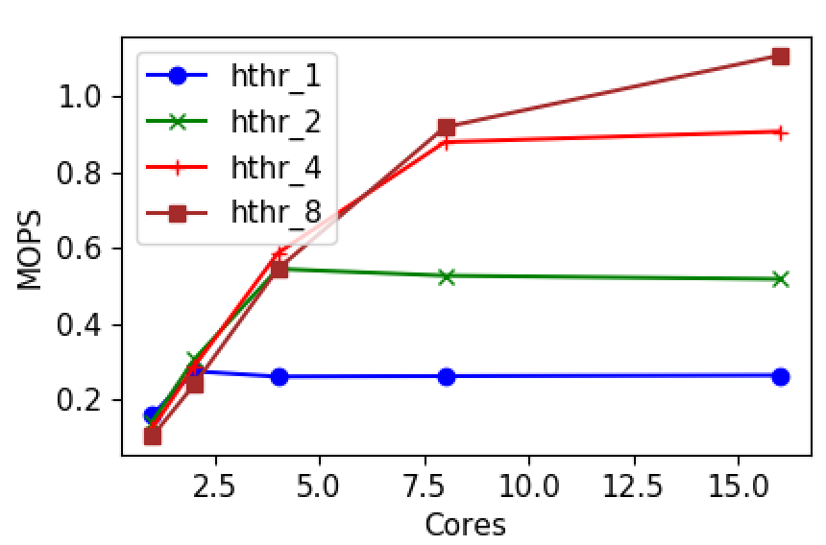
Userfaultfd Scalability
Fault handling overhead
One fd
Fds = Cores
Notes:
Notes: multiple fds scale better but multiple fds shard the memory region. We don’t need this though; we can use single fd enabling flexibility in scaling.

Slide 5
Changes to Kona
Add/remove cores by Shenango
Don’t partition cores by work; each fault handled by one core
RDMA qp per core
Eviction on path – maybe one dedicated thread
Batched eviction

Slide 6
Main items

Slide 7
Fastswap setup
Fastswap
Plugs in as a swap device; all process memory remote
Changes to local using cgroups
Dedicated eviction core; but switches to all core-eviction (benchmarks, thresholds?)
Vanilla Memcached
From shenango’s branch; similar options
No “page dirtying” changes yet
Memaslap client
Similar sized workload: 20B key, 80B val, 10M kv pairs
Uniform access: sectioned into windows, random access for each
Lot of concurrency (i.e., connections)

Slide 8
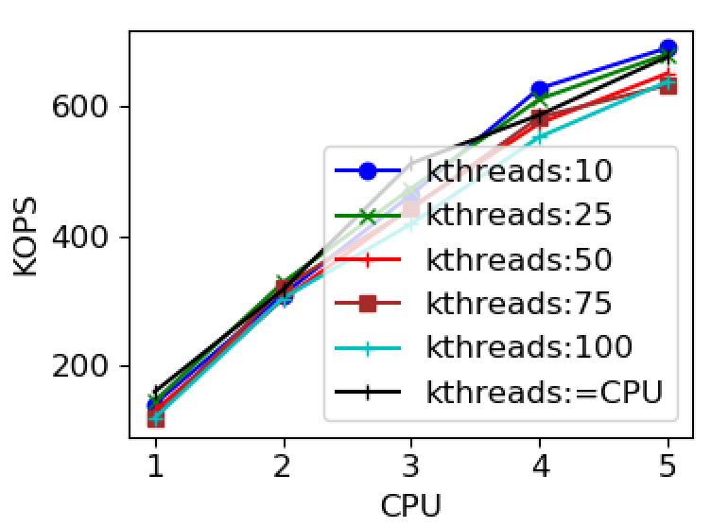
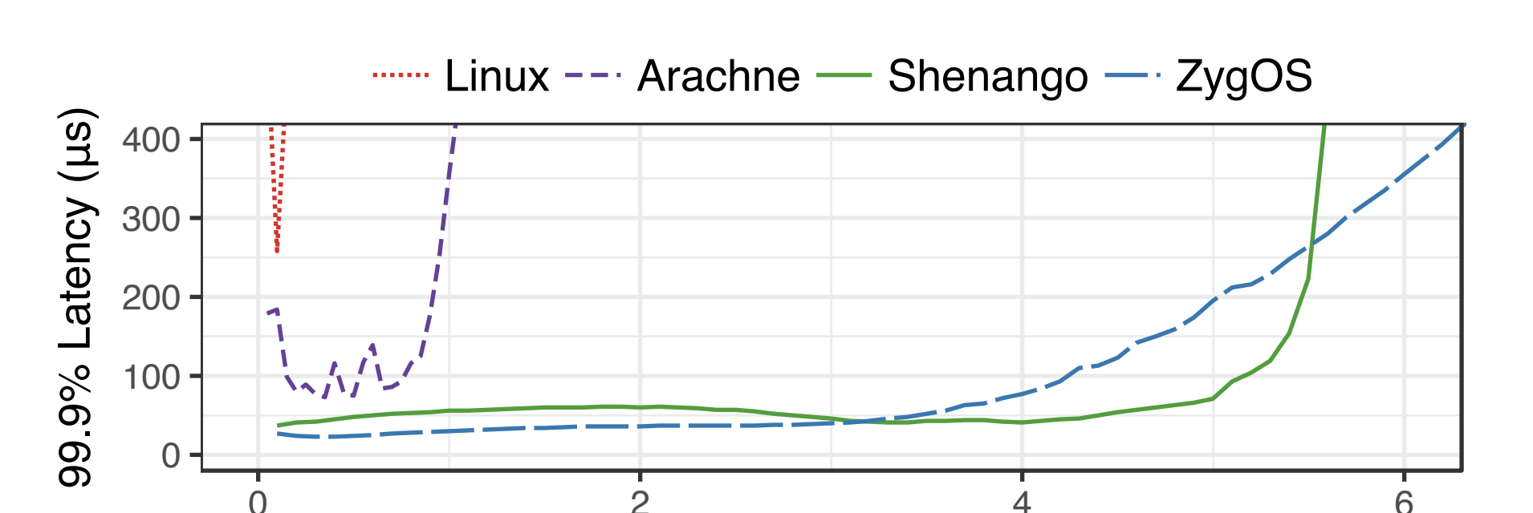
Native performance

Slide 9
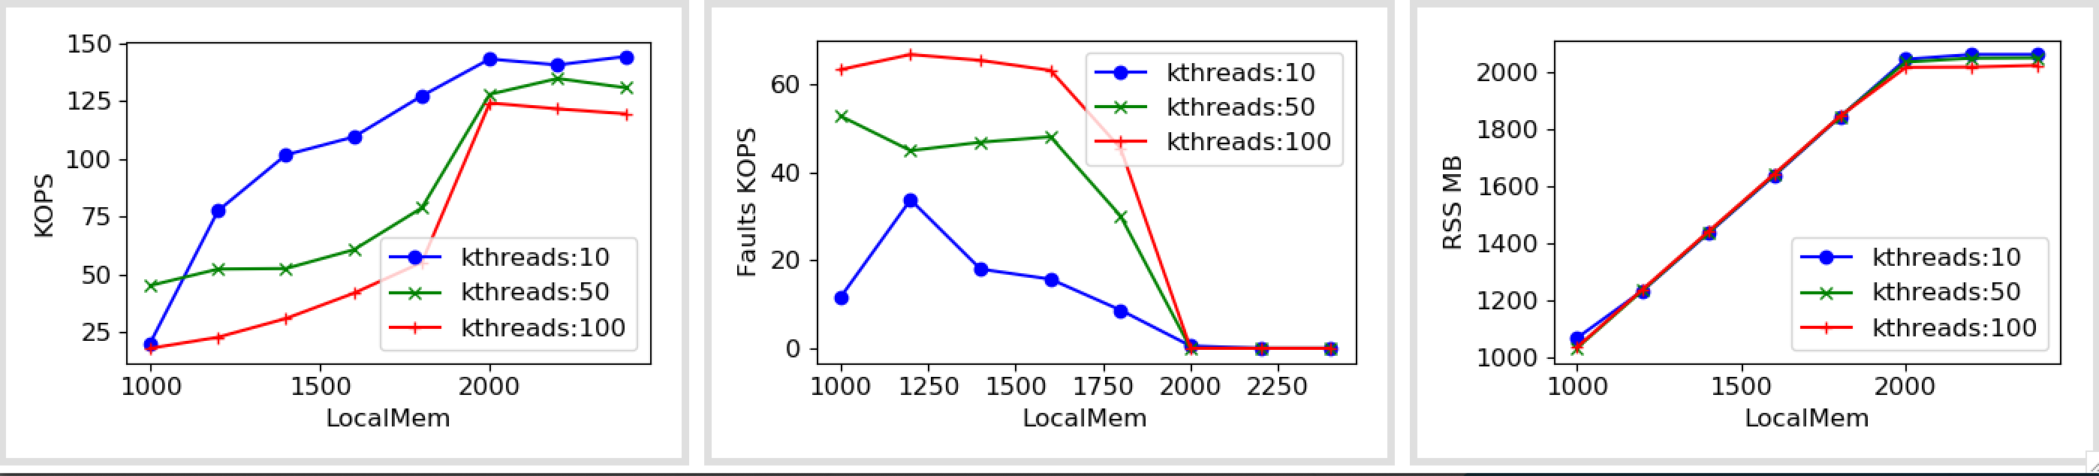
Fastswap (1 core)

Slide 10
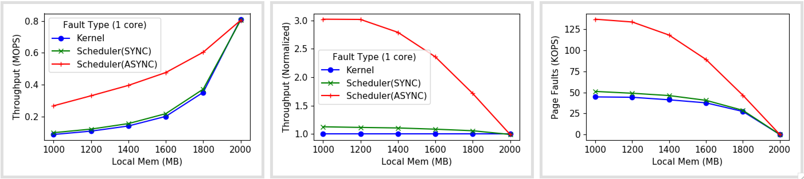
Shenango + Kona (1 core)

Slide 11
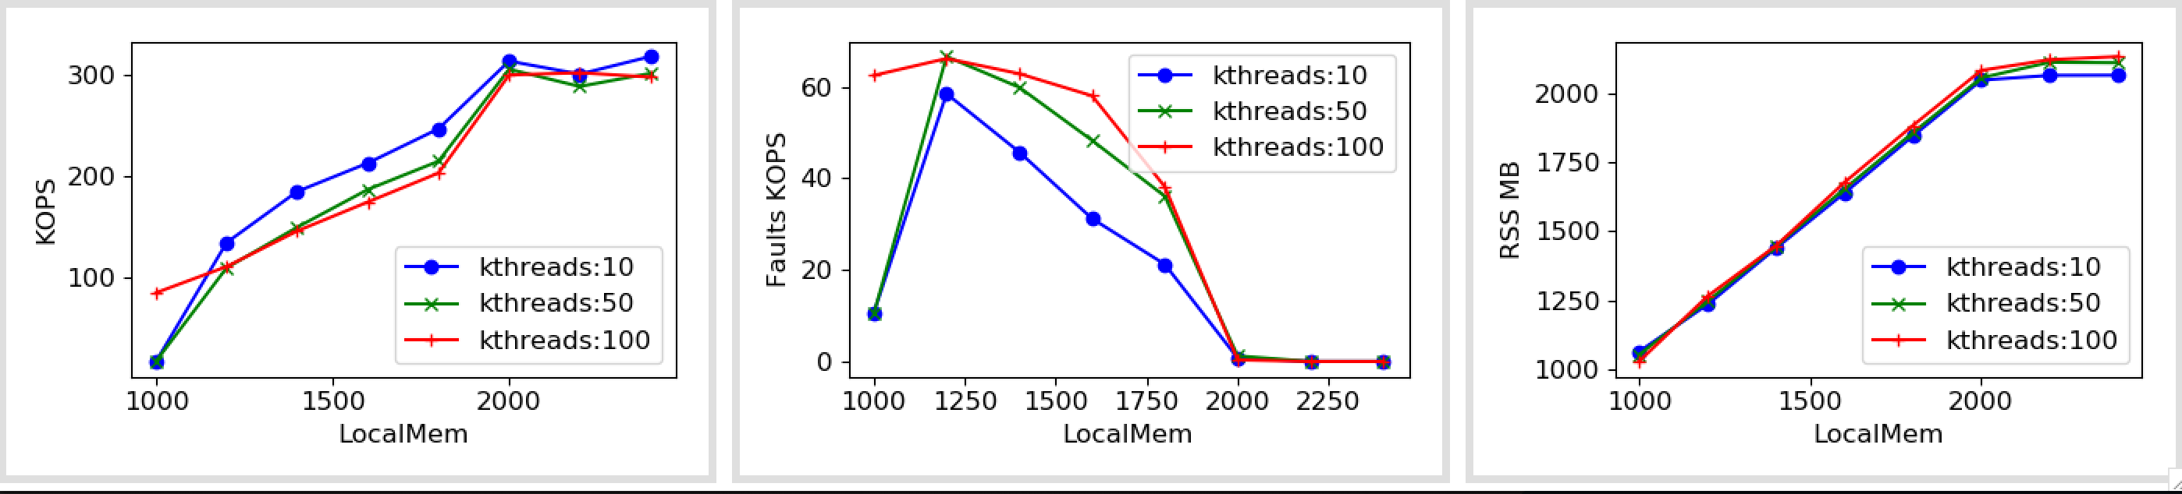
Fastswap (2 core)

Slide 12
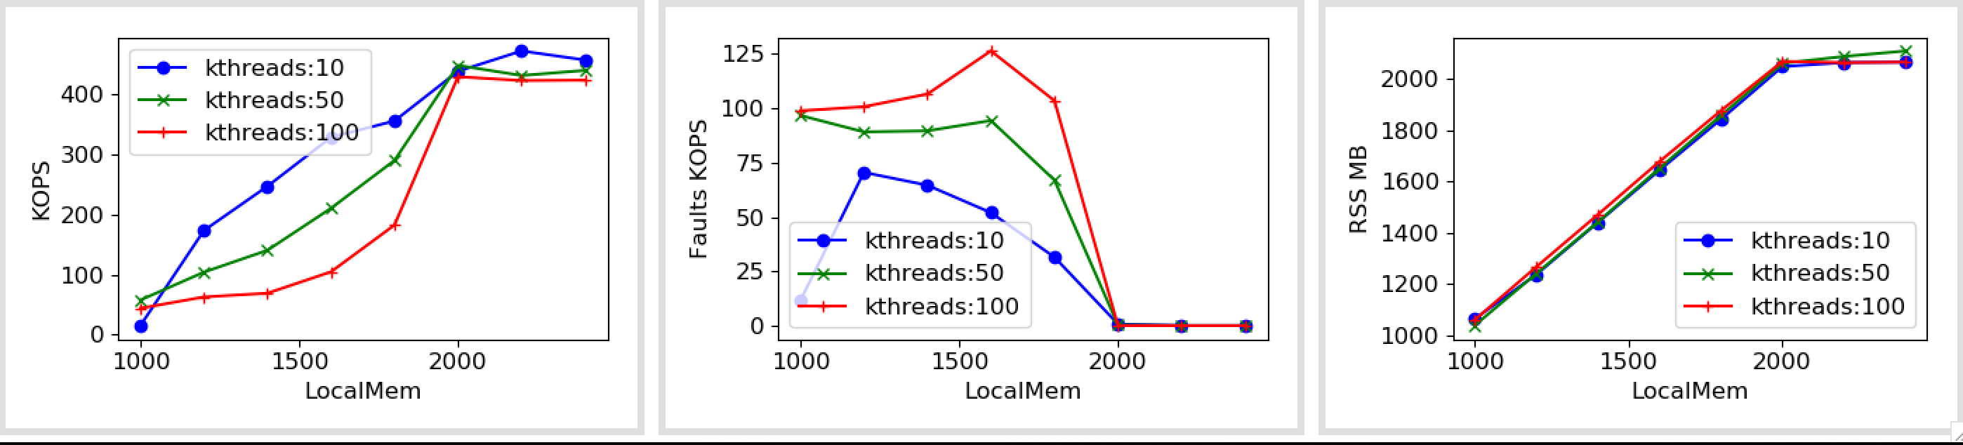
Fastswap (3 core)

Slide 13
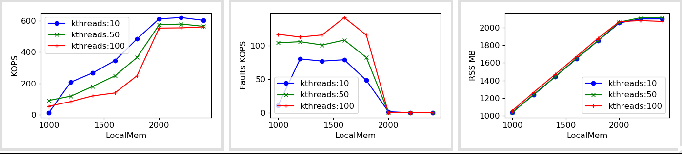
Fastswap (4 core)

Slide 14
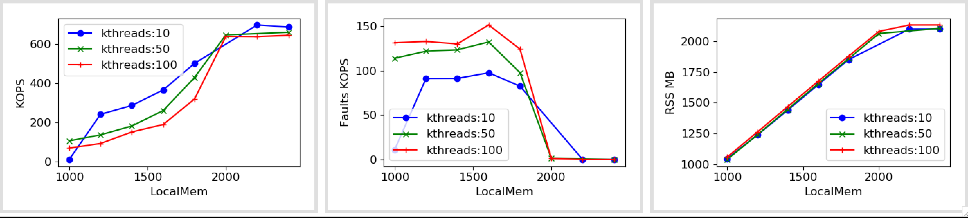
Fastswap (5 core)

Slide 15
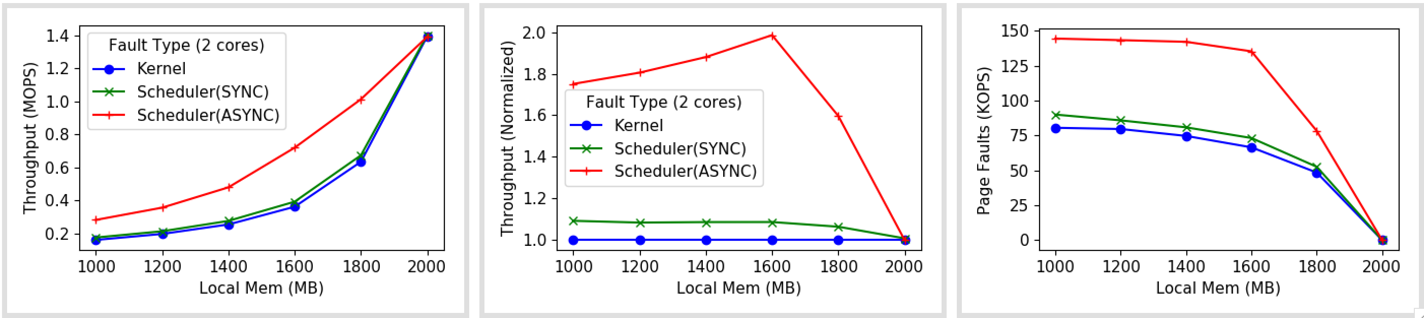
Shenango (2 cores)

Slide 16
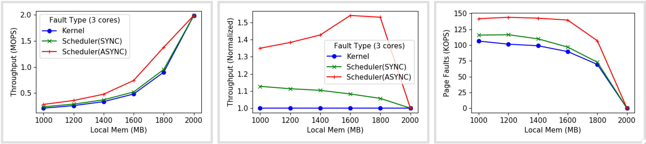
Shenango (3 cores)

Slide 17
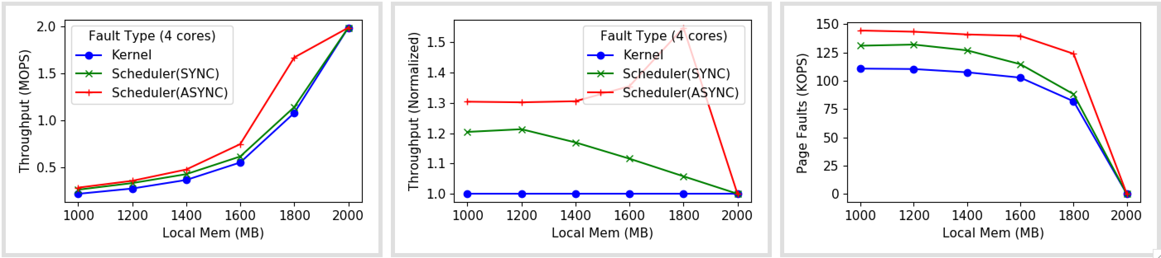
Shenango (4 cores)

