Slide 1
Update
Synthetic benchmark numbers
With multi-page annotations
Improvements in vDSO checks
New application: parallel sort
Concurrency overhead
Page fault profile
Adding annotations

Slide 2
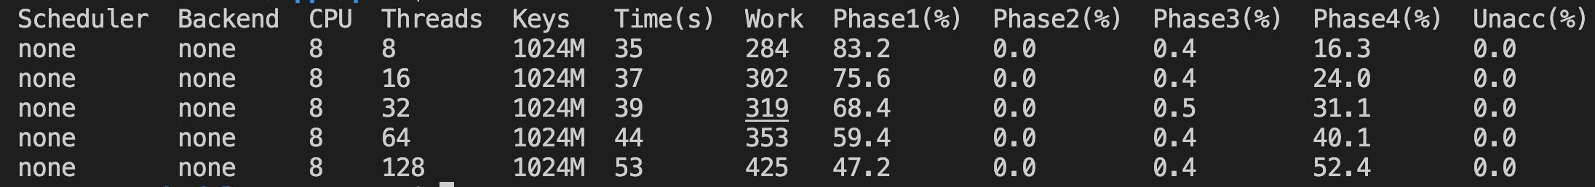
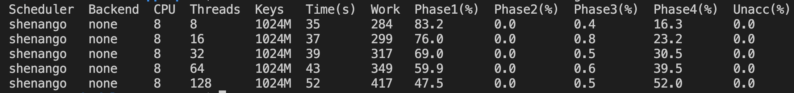
Concurrency overhead
Notes:
Overhead in the last phase – because of the thread factor. None of the thread “overheads” seem to matter at this point.
Overhead might not be this pure in a skewed case
We might be opening a trade-off between overhead introduced by concurrency and benefits of page faults enabled by it

Slide 3
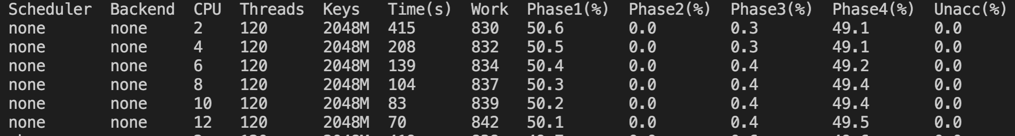
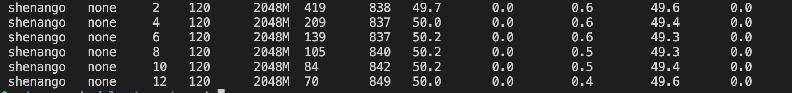
Concurrency overhead
Notes:
Overhead in the last phase – because of the thread factor. None of the thread “overheads” seem to matter at this point.
Overhead might not be this pure in a skewed case
We might be opening a trade-off between overhead introduced by concurrency and benefits of page faults enabled by it

Slide 4
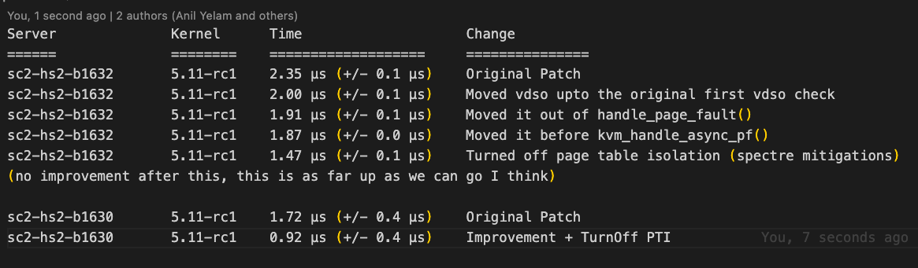
vDSO Improvements
Moved return closer to the start of the fault handler
Turned off PTI

Slide 5
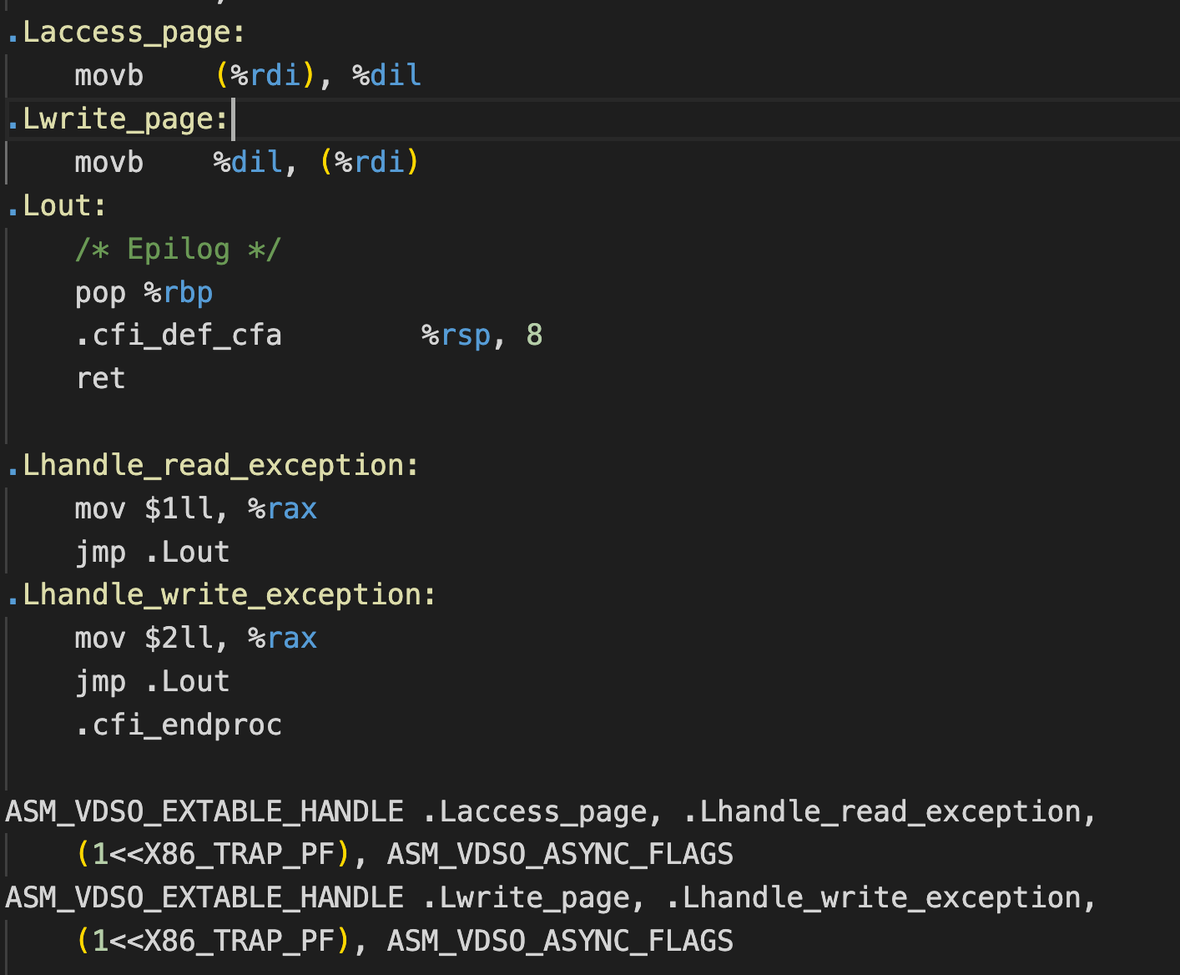
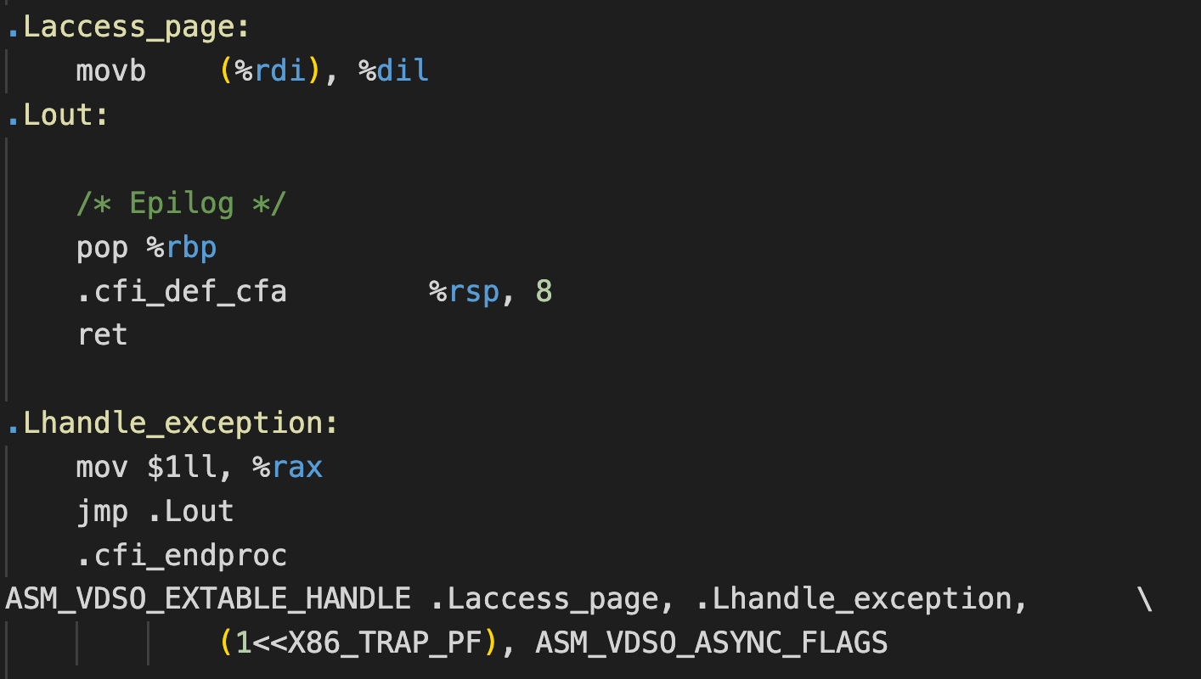
vDSO Improvements
Have a plan for write-protect checks
Seems to be working…
Page mapped check
Page write-protected check

Slide 7
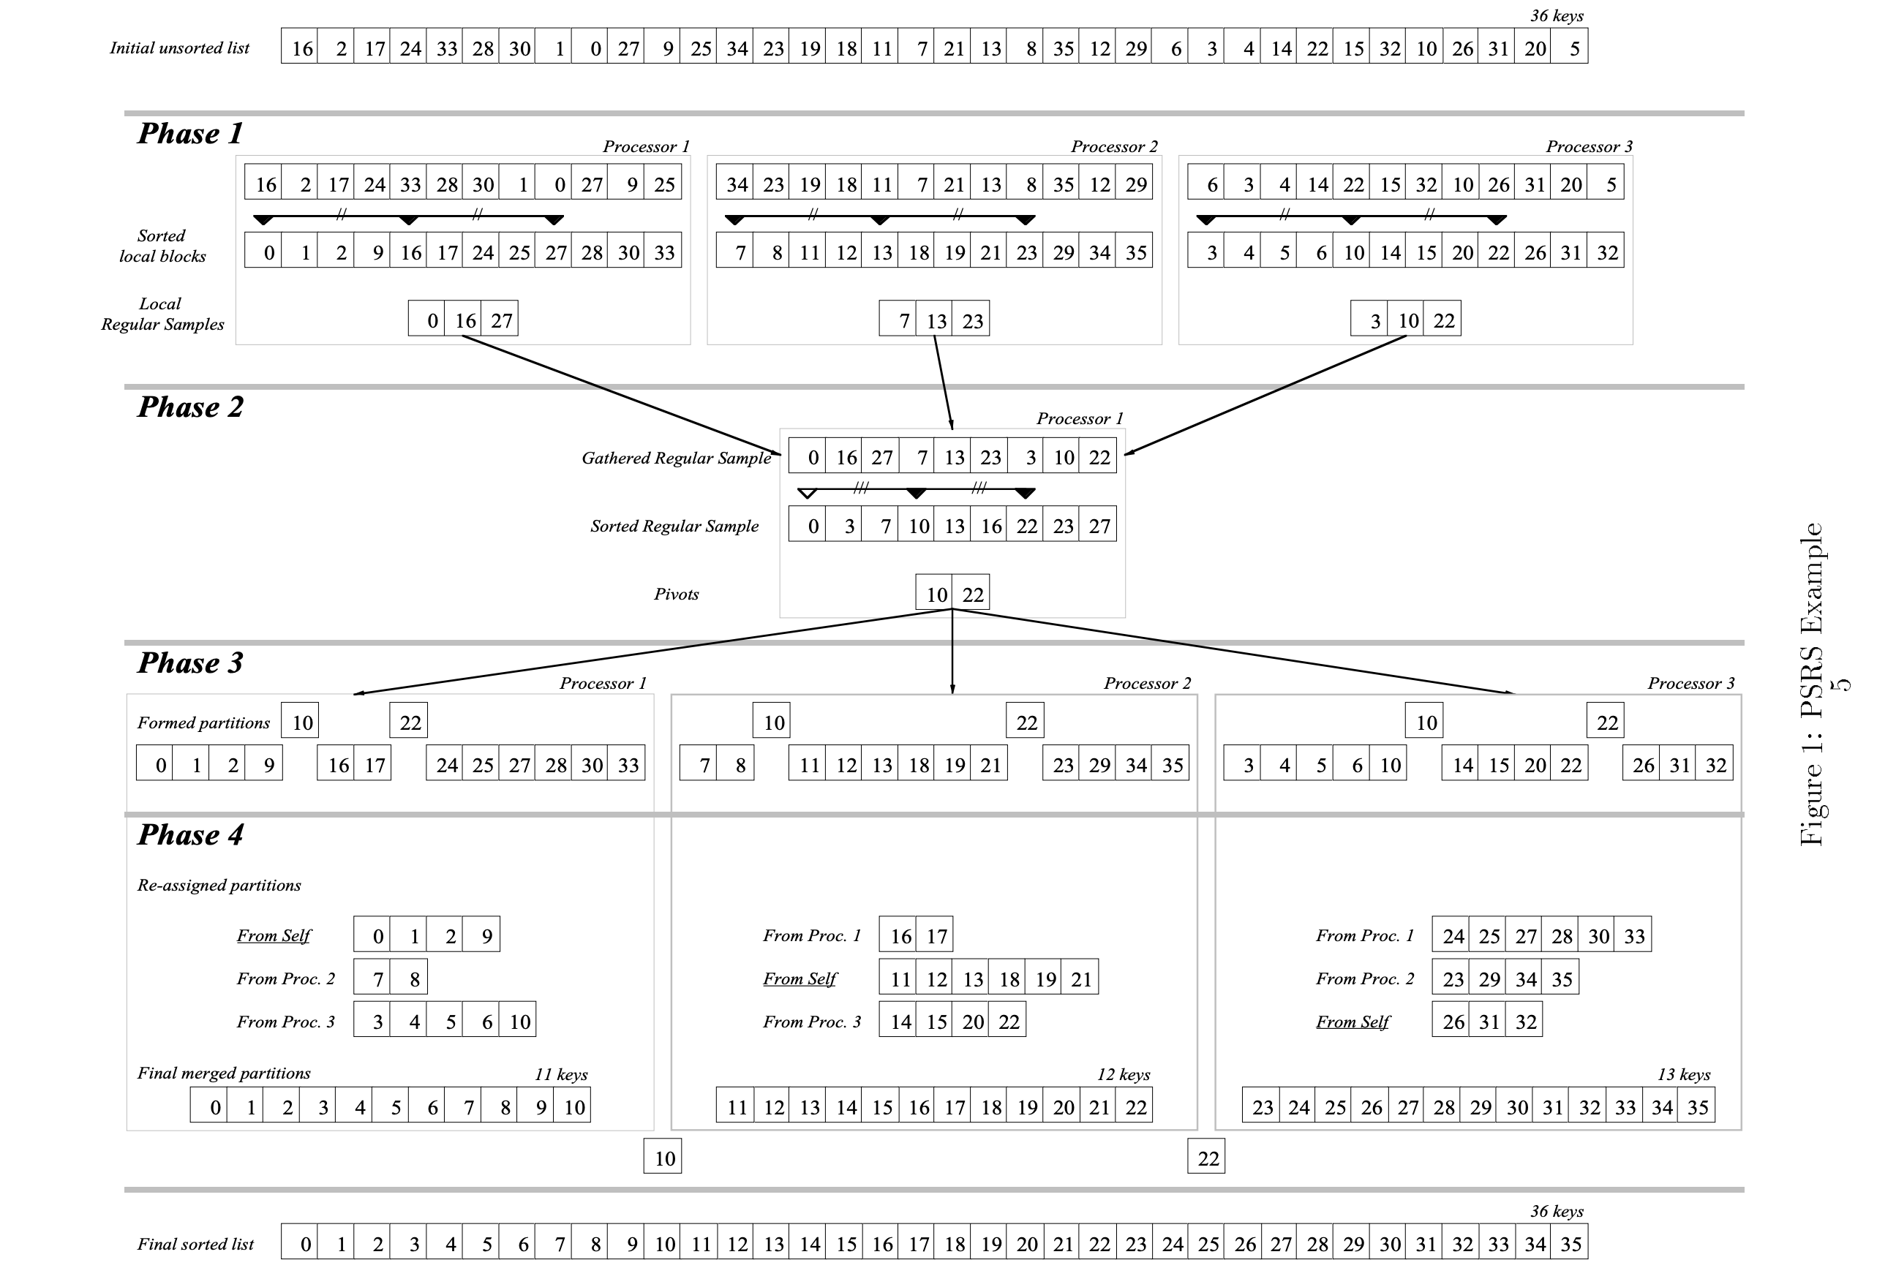
Sort
Parallel sort with regular sampling (PSRS)

