Slide 1
Agenda
PARSEC with Kona
Directions being explored:
(single node) Scheduling app threads for locality/cache performance
(single node) Applicability of NUMA data placement/scheduling works
(rack scale) Fastswap-like task scheduling
Use case discussion

Slide 2
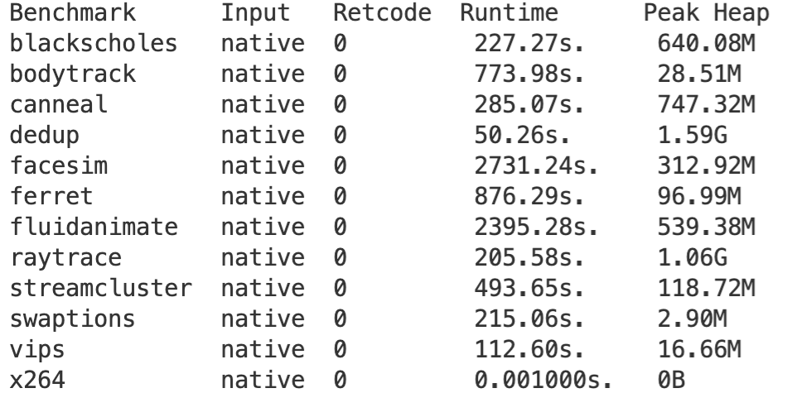
PARSEC Apps
Memory footprints
Compute-intensive
C/C++ apps – C++ requires some legwork
Ran Dedup with Kona
Notes:
TODO Get memory footprint for more threads

Slide 3
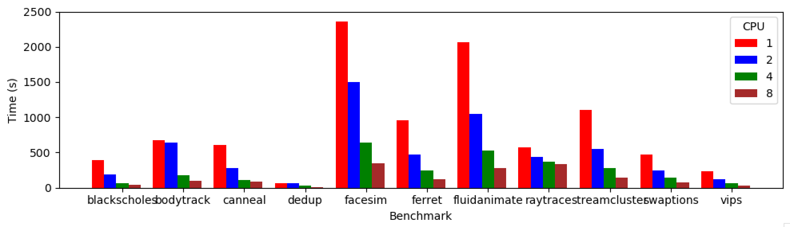
PARSEC Performance
1 pthread/core

Slide 4
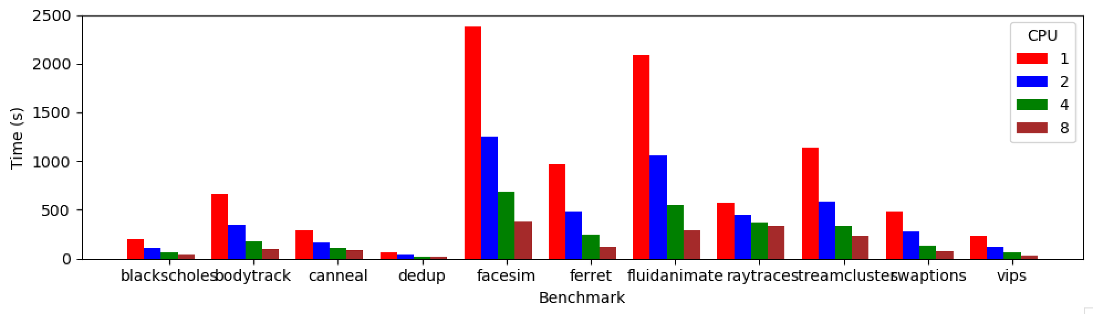
PARSEC Performance
1 pthread/core
4 pthreads/core

Slide 5
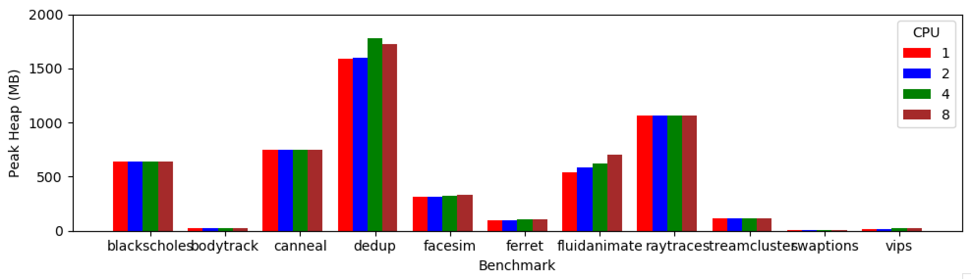
Memory footprint

Slide 6
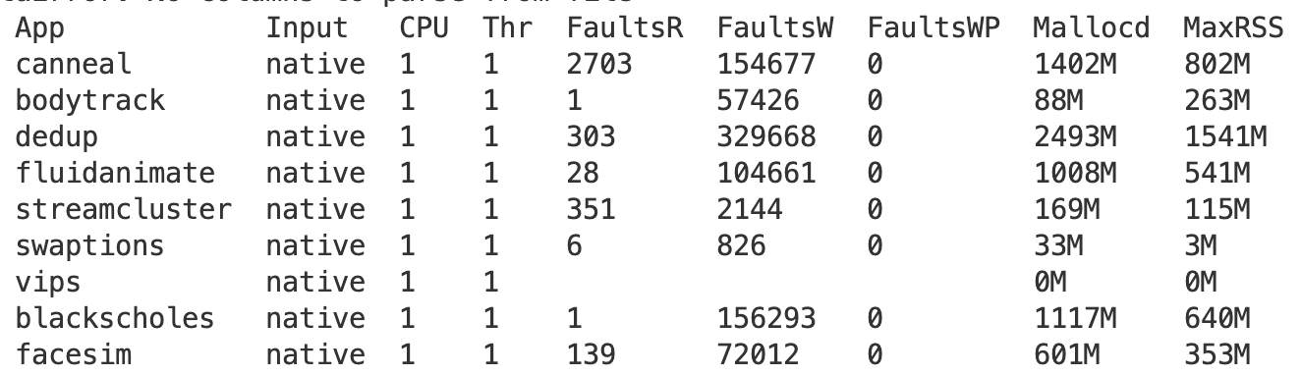
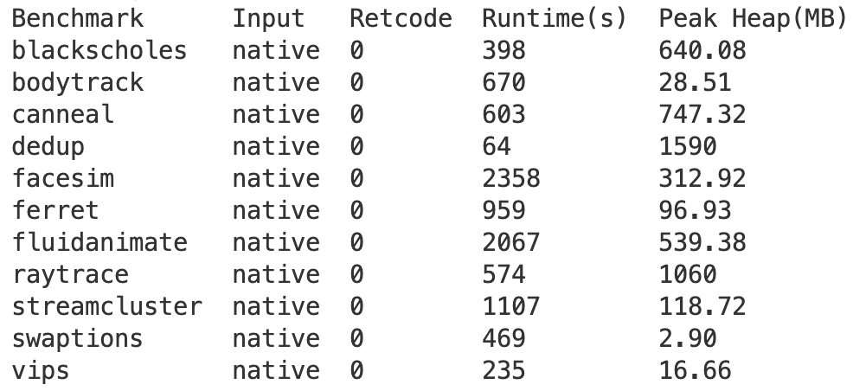
Most memory captured with Kona
Kona

Slide 7
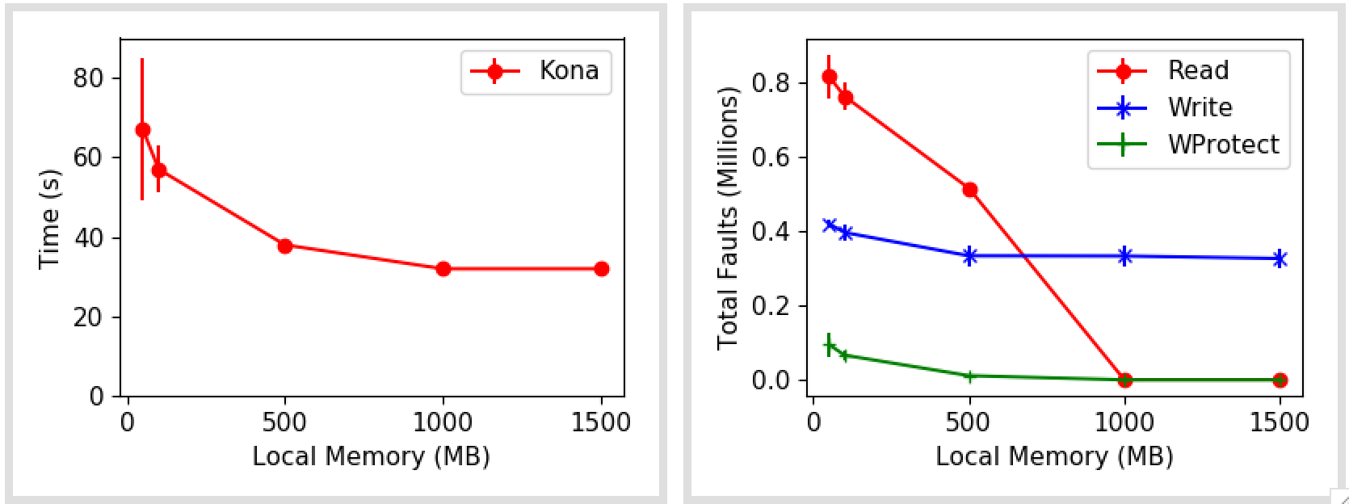
Dedup
Preloads whole file
Pipeline: Refine (x T) → dedup (x T) → compress (x T)
Biggest input size: 700 MB
Notes:
Small sliding window of a working set.
More threads might mean a bigger working set
But is 100 MB / core working set a natural app for disaggregation? More generally, are streaming apps a good fit? Probably not.

Slide 8
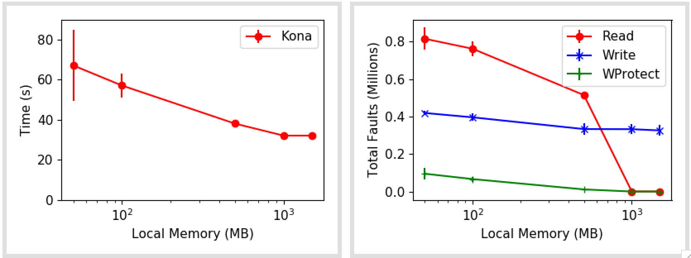
Dedup
Preloads whole file
Pipeline: Refine (x T) → dedup (x T) → compress (x T)
Biggest input size: 700 MB

Slide 9
Next
PARSEC: Kona profiles for every app
Use cases: look at some in-memory/graph processing databases
Keep reading some past literature

Slide 10
Misc

Slide 11
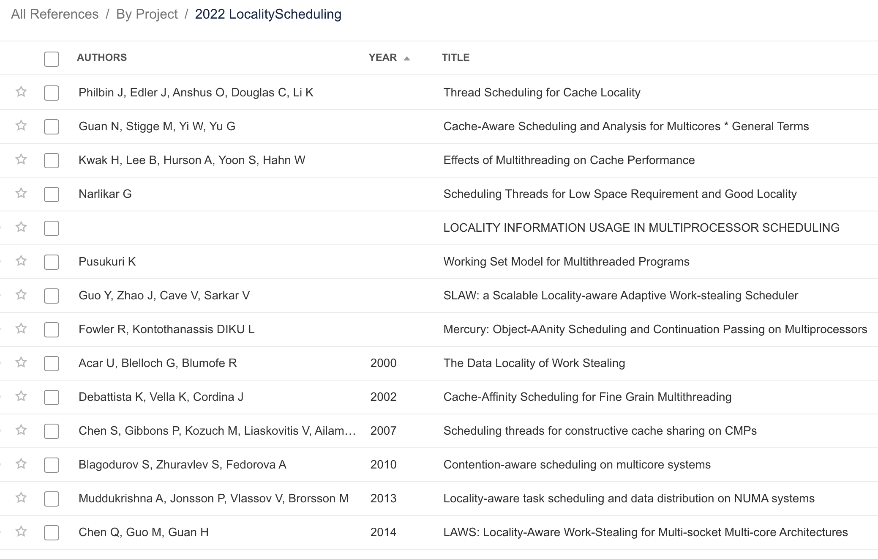
Scheduling for cache performance

