Slide 1
Agenda
Hints performance
All bugs fixed!
Local backend done
Eviction

Slide 2
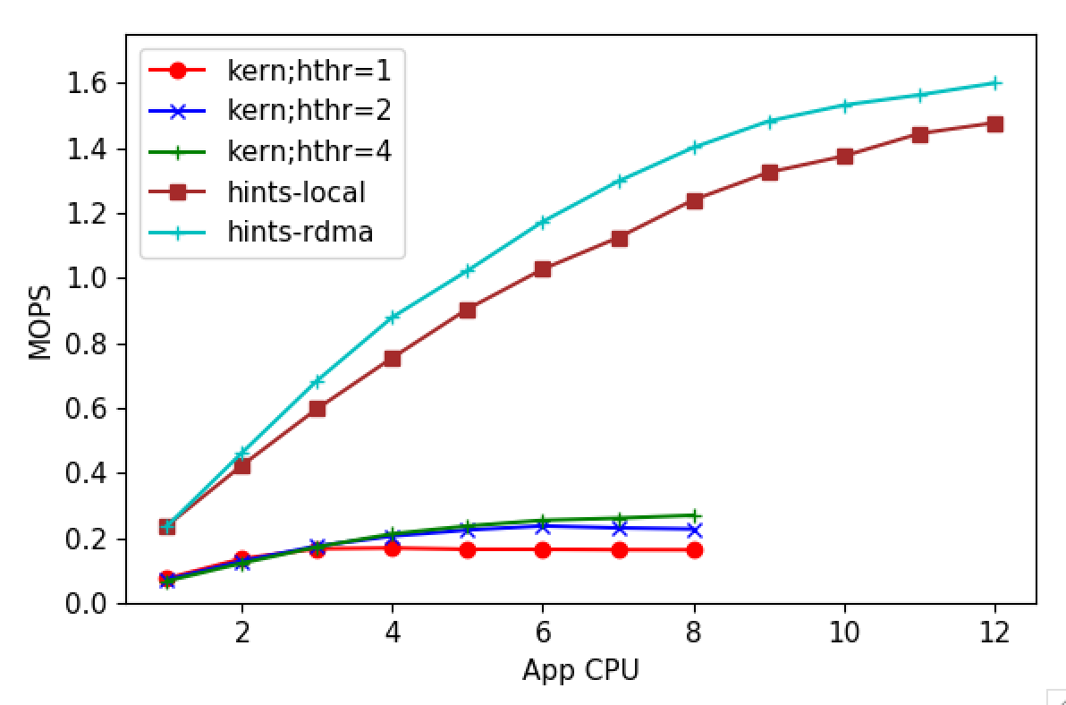
Fault performance

Slide 3
Eviction
Basic eviction
Clocking through the registered region
Atomically incrementing offset by each evictor core
Performance drops slowly after two cores
Too much time finding candidates

Slide 4
Eviction: LRU Lists
Page_node_t for each locally present page
Juggled around LRU lists
e.g., Hot, Warm, Cold like Memcached
Using hot bits set by hints
Memory Overhead
Saving index to the page node in page metadata
32-bit page metadata: 8 bits flags + 24 bits index
x MB metadata overhead for x GB registered memory
64GB local memory, no caps on registered memory
16M * 16B = 256 MB max for page nodes, alloc’d as needed
Done with implementation, testing

Slide 5
Bugs
IOKernel crashing on enabling assert statements
Stack smashing at high throughputs

Slide 6
Faulting code locations
Most IP locations either:
Don’t resolve to a code location (precompiled libs)
End up in header/lib files (no control over source)
Example
We must get complete stack traces for each fault
No tools out there
Our approach: Signal faulting thread from Kona while it waits for the fault, and backtrace in the signal handler
Example for backtraces: Need to analyze them

Slide 7
Next
Wrap up benchmarking with the new design
Get back traces for all apps/dataframe
Revert to the planned work – AIFM Dataframe & SiloDB

