Slide 1
Agenda
Faults performance
Fault read-ahead performance
Eviction performance

Slide 2
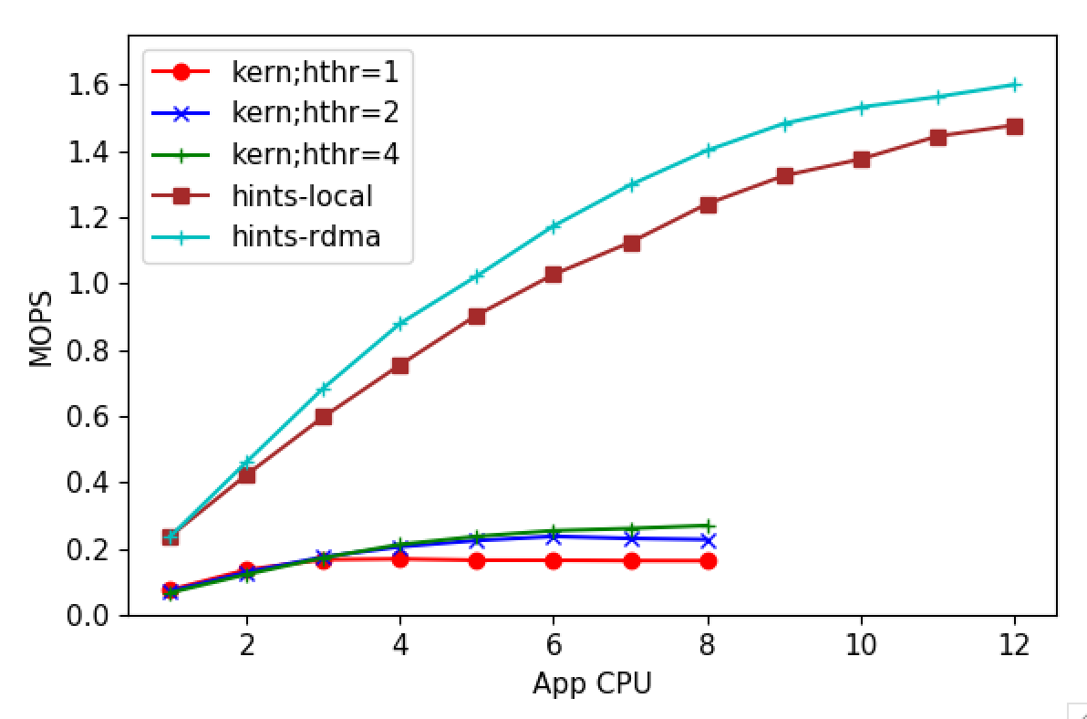
Fault performance

Slide 3
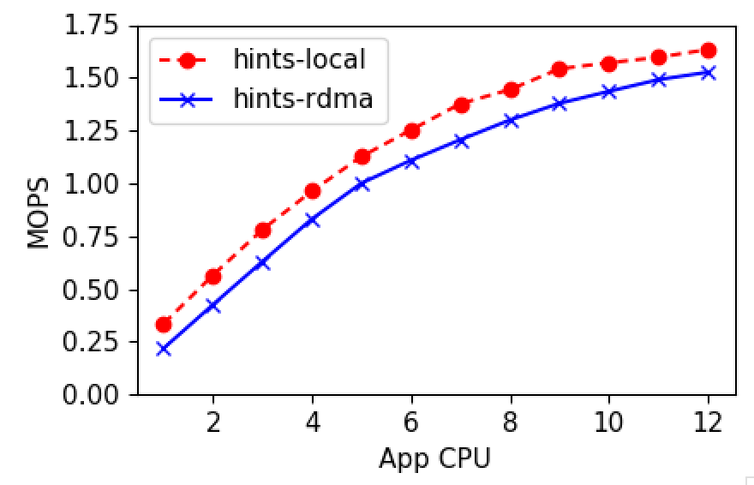
Fault performance

Slide 4
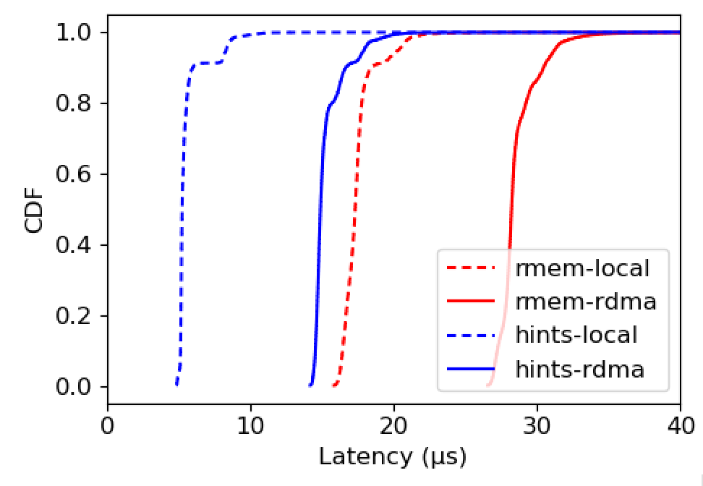
Fault performance

Slide 5
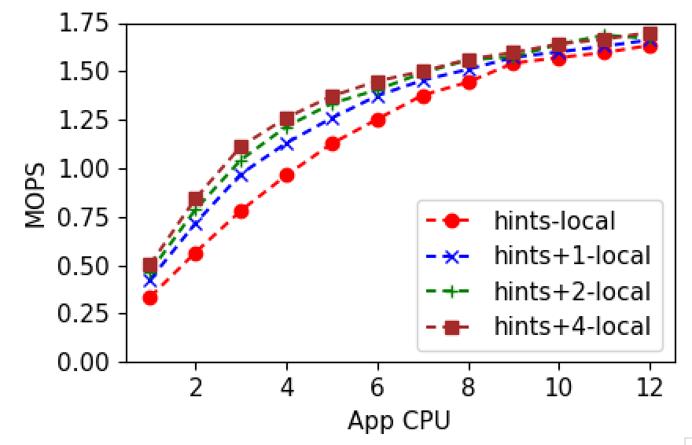
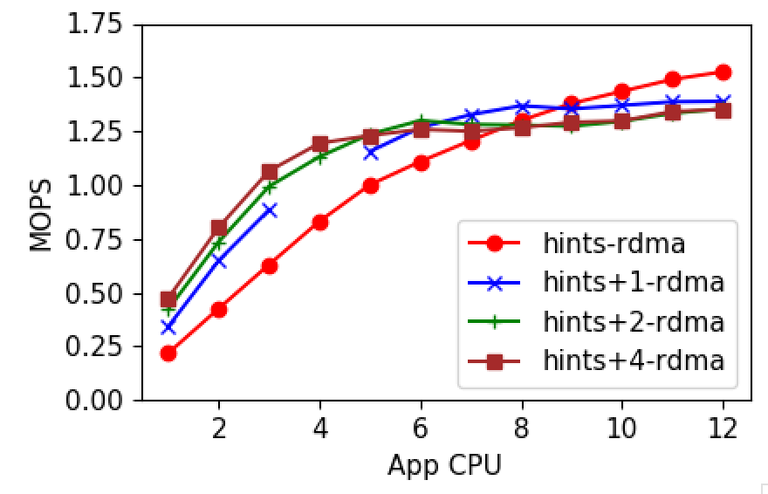
Fault read-ahead performance

Slide 6
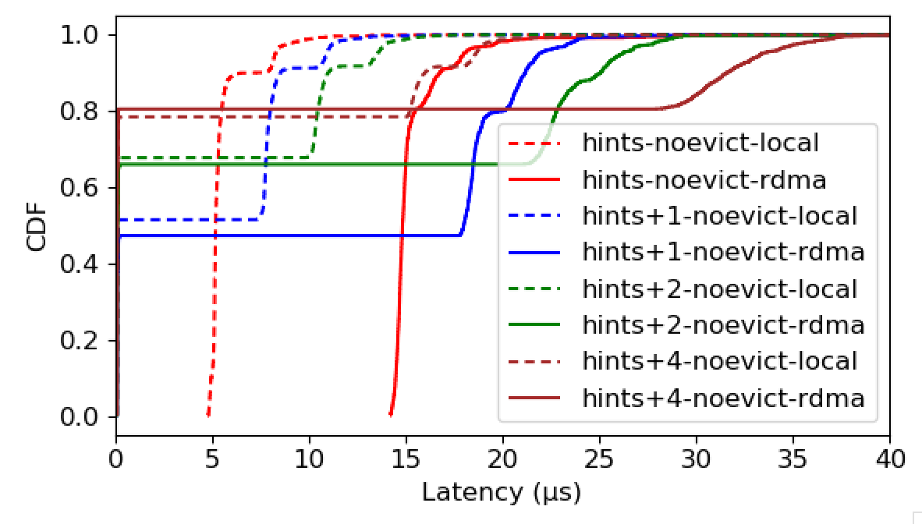
Fault read-ahead latencies

Slide 7
Eviction: LRU Lists
Page_node_t for each locally present page
Juggled around LRU lists
e.g., Hot, Warm, Cold like Memcached
Using hot bits set by hints
Memory Overhead
Saving index to the page node in page metadata
32-bit page metadata: 8 bits flags + 24 bits index
x MB metadata overhead for x GB registered memory
64GB local memory, no caps on registered memory
16M * 16B = 256 MB max for page nodes, alloc’d as needed
Done with implementation

Slide 8
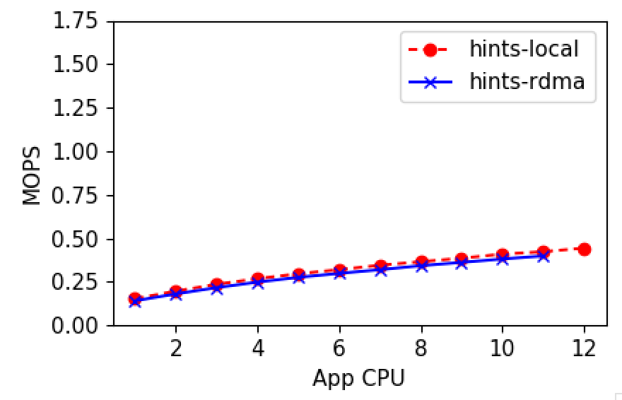
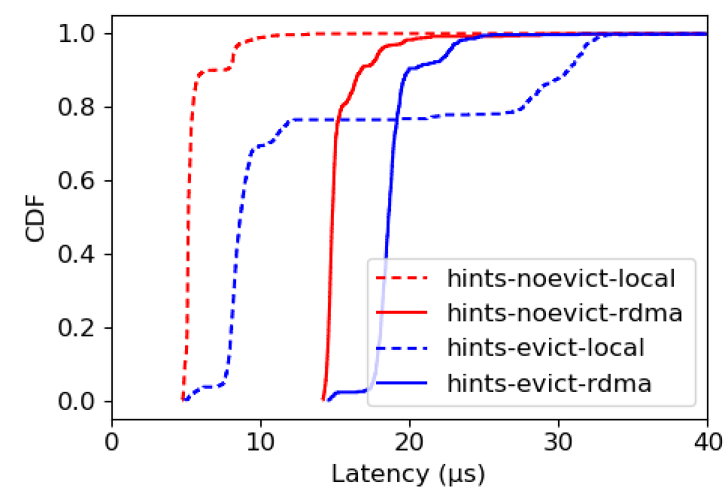
Eviction performance

Slide 9
Eviction batching
Eviction adds an extra syscall
Puts userspace at a disadvantage
Maybe not when hiding the latencies
Currently checks for evitable pages immediately following a candidate
Process_madvise
Does not support DONT_NEED
Found a patch for this support – Nadav again

Slide 10
Backtrace analysis

Slide 11
Next
Wrap up benchmarking with the new design
Get back traces for all apps/dataframe
Revert to the planned work – AIFM Dataframe & SiloDB

