Slide 1
Agenda
Faults performance – one more bottleneck
Fault read-ahead performance
Eviction batching
Requires two syscalls with TLB shootdowns
WP syscall: no batched call yet
Madv syscall: Process_madvise for both syscall & TLB batching
TLB shootdowns discussion
Fault stack trace analysis

Slide 2
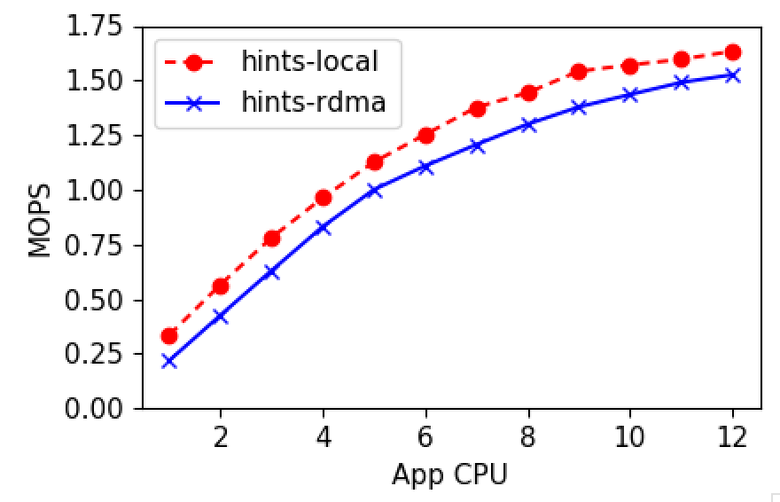
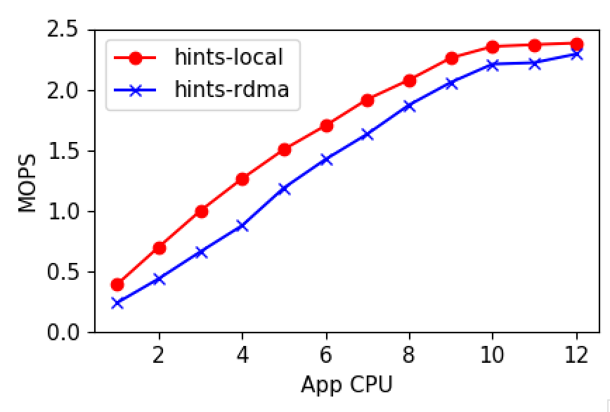
Faults performance
Notes:
Check Bimodal TODO

Slide 3
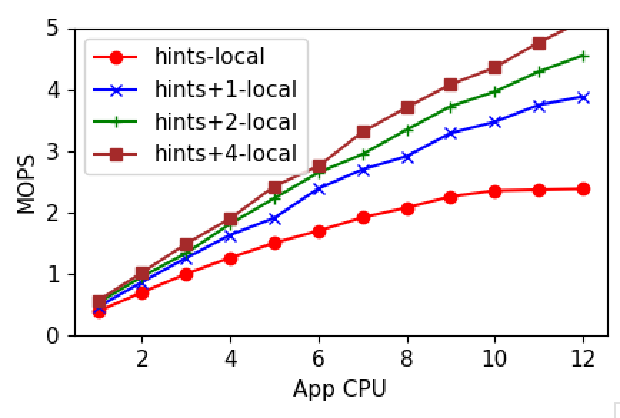
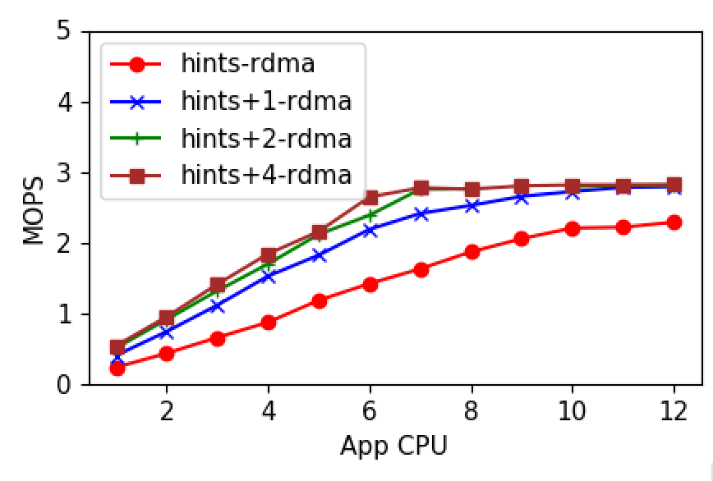
Fault read-ahead performance
Local
Remote

Slide 4
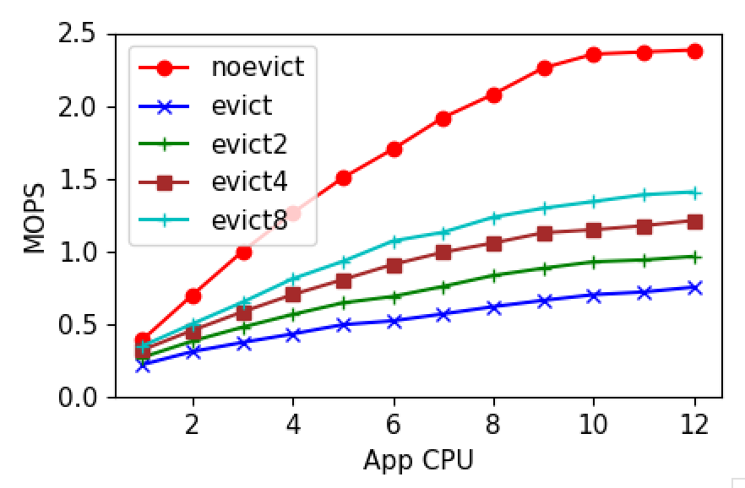
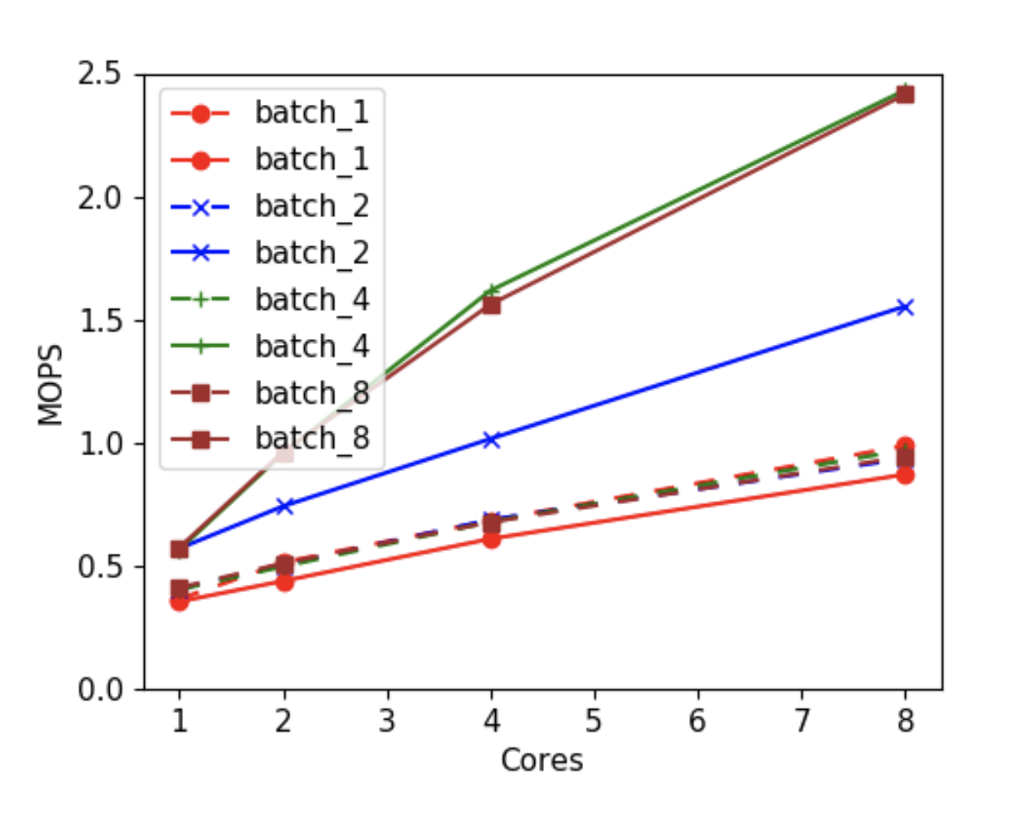
Process Madvise
Micro-benchmark
Eden Eviction (no write-back)

Slide 5
TLB shootdowns
All paging systems, not just Eden
At least one shootdown/flush (on all cores) per eviction
Either individual shootdowns or flush
Trade-off Scalability vs Application Performance
What if we flush every 100 pages?
Reducing page faults must be the main goal

Slide 6
Eviction policy
Hot, warm, cold lists
When to bump?
Synchronously during the hint
Asynchronously bump between lists based on hot flags
Does synchronous yield an advantage?

Slide 9
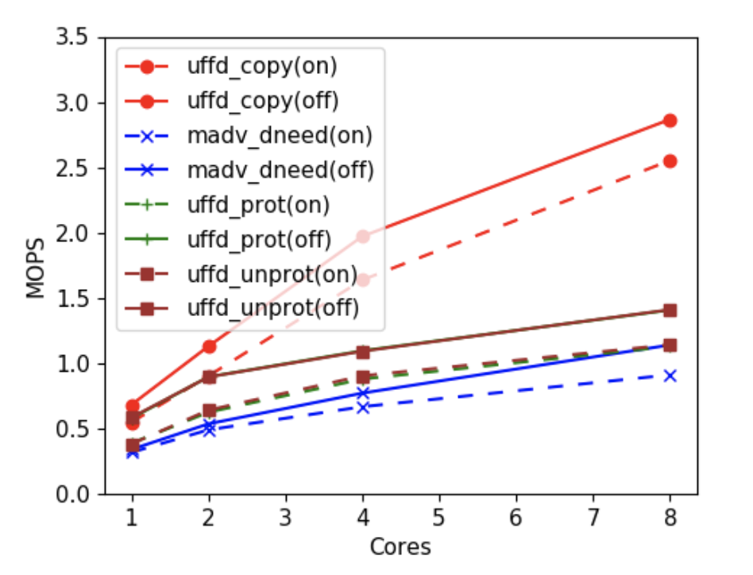
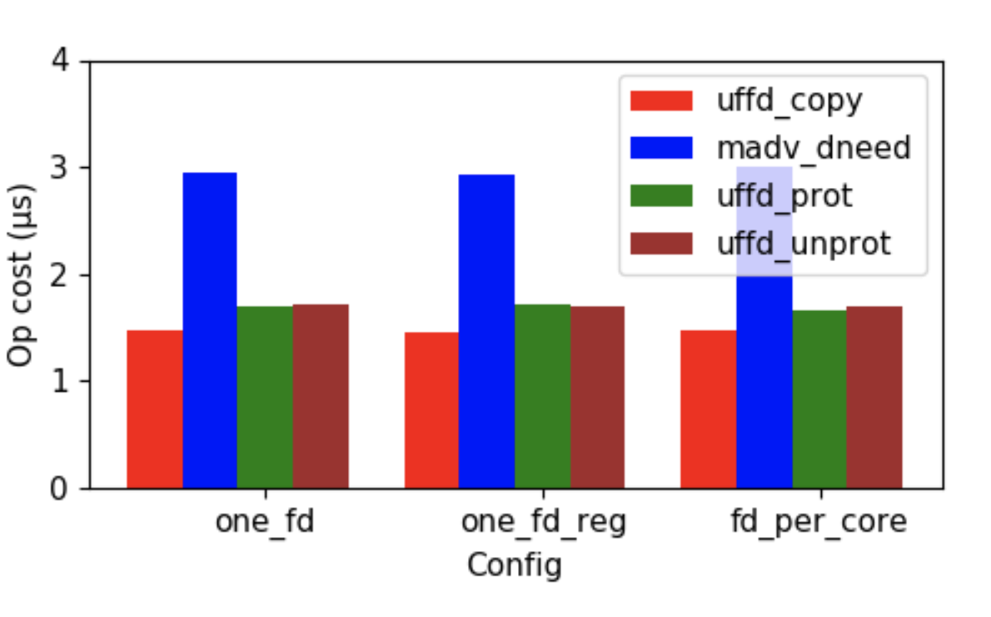
UFFD Ops Performance

Slide 10
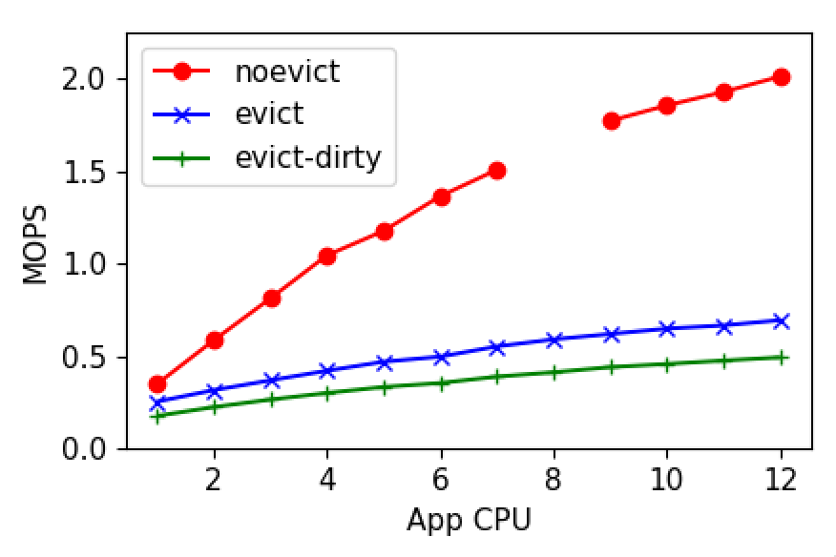
Eviction- two syscalls
Notes:
Scalability affected by TLB shootdowns

Slide 11
Backtrace analysis
Wish I had these before 291 proposals

