Slide 1
Agenda
Eviction performance
Fault stack trace analysis

Slide 2
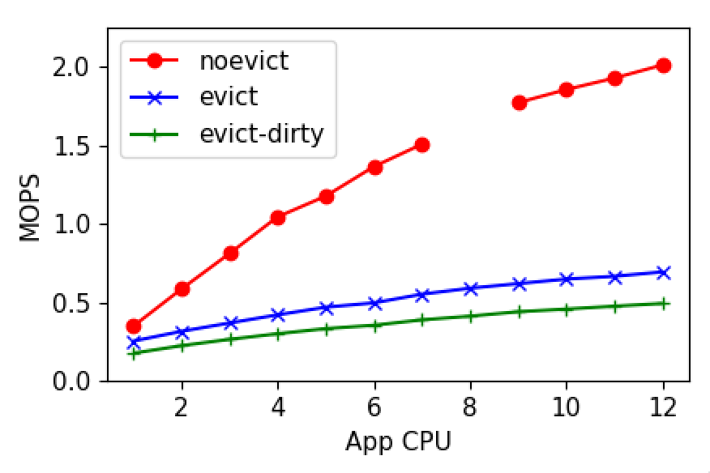
Eviction performance
Notes:
Scalability affected by TLB shootdowns

Slide 3
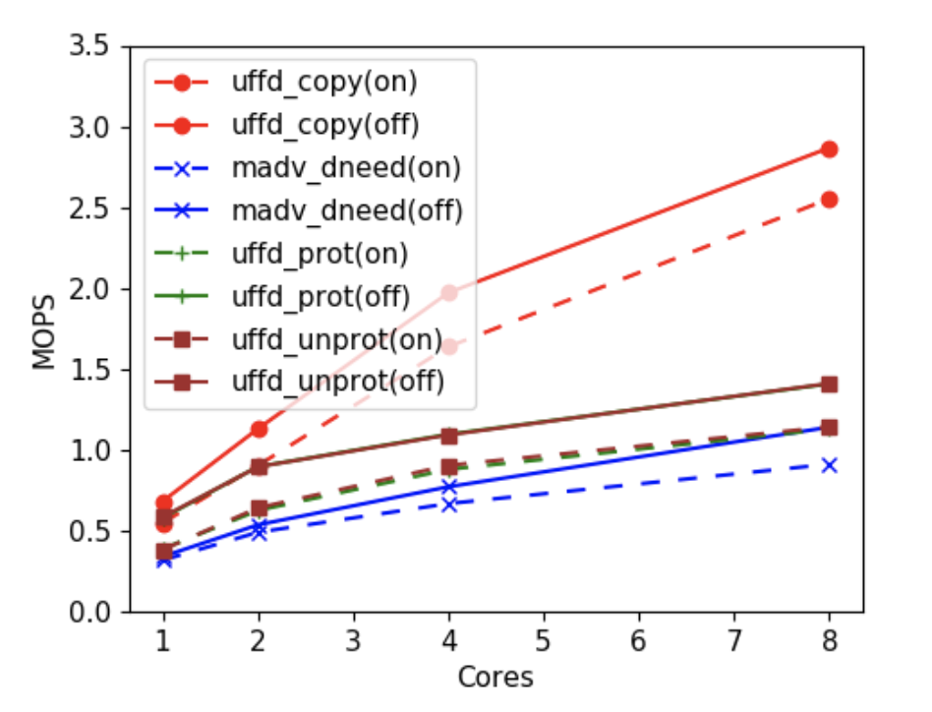
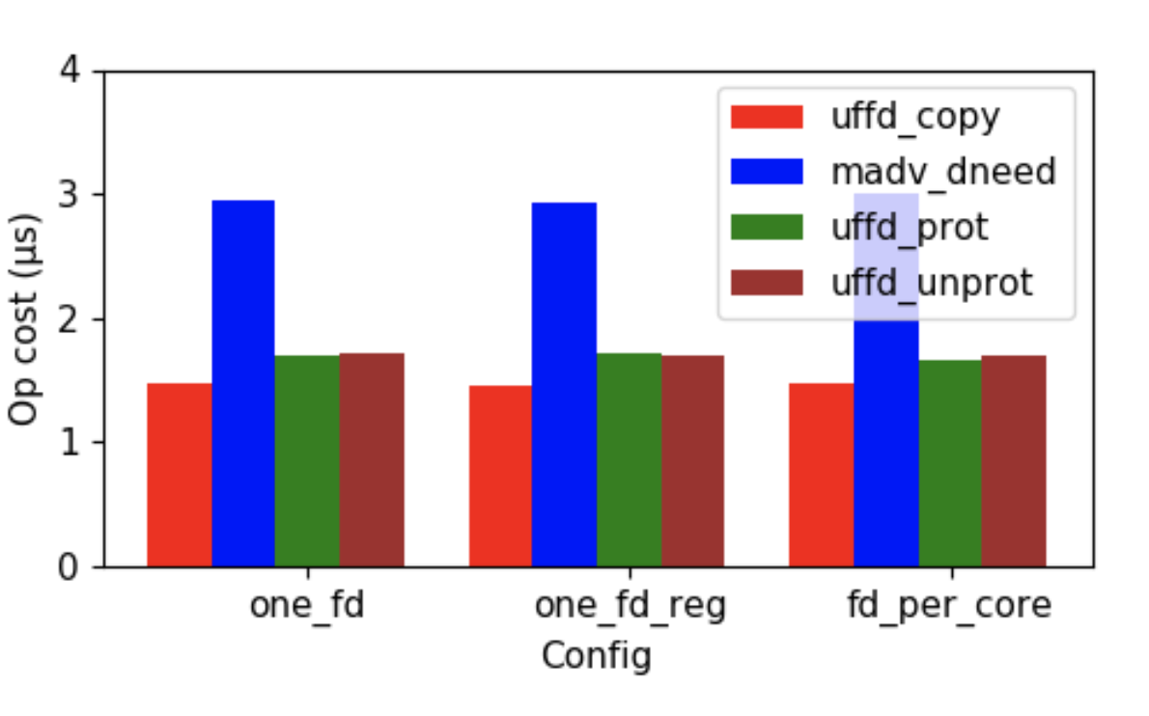
UFFD Ops Performance

Slide 4
Eviction batching
Eviction adds up to two extra syscalls
Puts userspace at a disadvantage
Need vectored eviction ops
Process_madvise for madvise
Write_protect vectored op

Slide 5
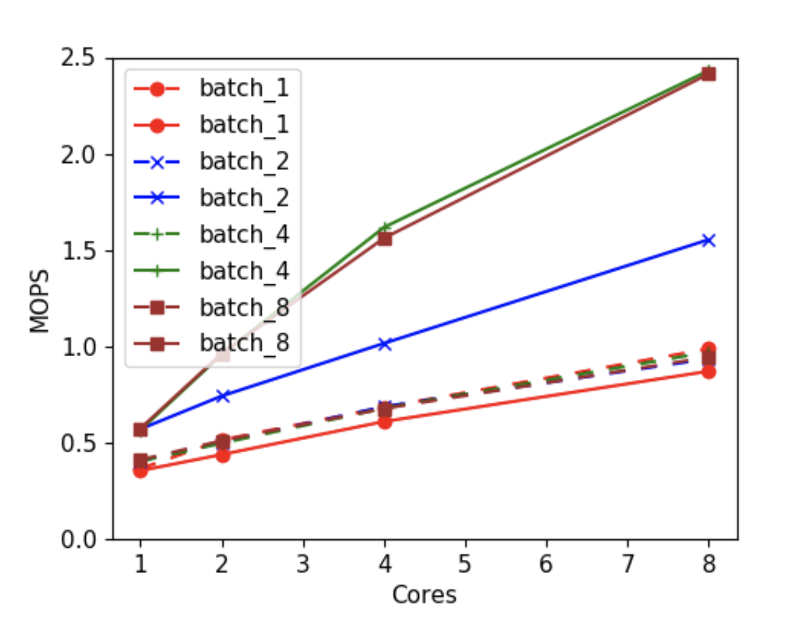
Process Madvise
Mostly integrated into eviction path…

Slide 6
But TLB flushes/shootdowns…
The ultimate scaling bottleneck
All paging systems suffer!
How does AIFM pay this cost?
Reducing page faults must be the main goal

Slide 7
Progress

Slide 8
Eviction policy
Hot, warm, cold lists
When to bump?
Synchronously during the hint
Asynchronously bump between lists based on hot flags
Does synchronous yield an advantage?

Slide 9
Backtrace analysis
Made a tool with local backend
Memory interposition through a LD_PRELOAD library or shenango shim
More traces: Dataframe, ray trace, etc.

