Slide 1
Plan
High-level items | Tasks | This Week
Supporting Hint API | Show that hint locations are few (in progress) | PARSEC on Kona – Yet to reason about numbers
 | Hotness tracking with Hints (in progress) | Benchmarking kona-based page checks Trying out a hotness-based eviction policy
 | Automatic injection of hints (not started)
Comparison with AIFM (& Fastswap) | Run Dataframes on AIFM & Kona (in progress) | Dataframes is running. AIFM in progress
 | Quantifying developer effort (in progress) | Noting AIFM changes for dataframes
More complex benchmarks | Run SiloDB (not started)
Uthreads (Performance) | Clearly showing Pthreads overheads (in progress) | Synthetic numbers with pthreads
Uthreads (Flexibility) | RSS-aware scheduling for Sort (not started)
…

Slide 2
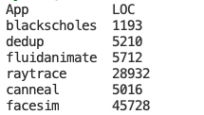
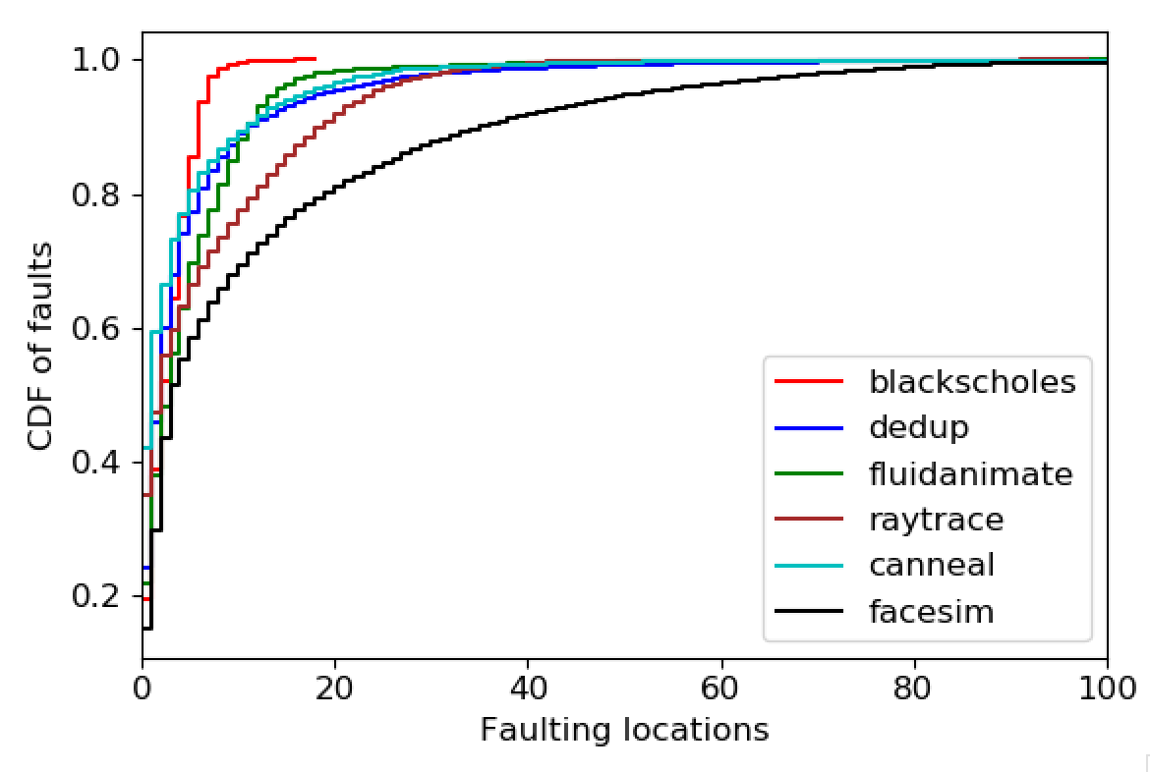
Fault locations (5% local mem)
Notes:
Fraction of lines of code on x-axis

Slide 3
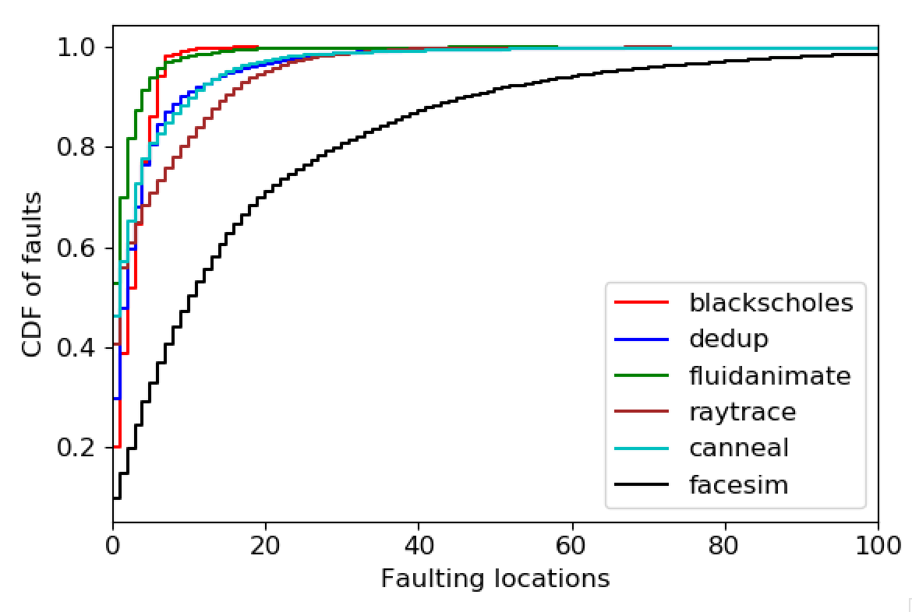
Fault locations (25% local mem)

Slide 4
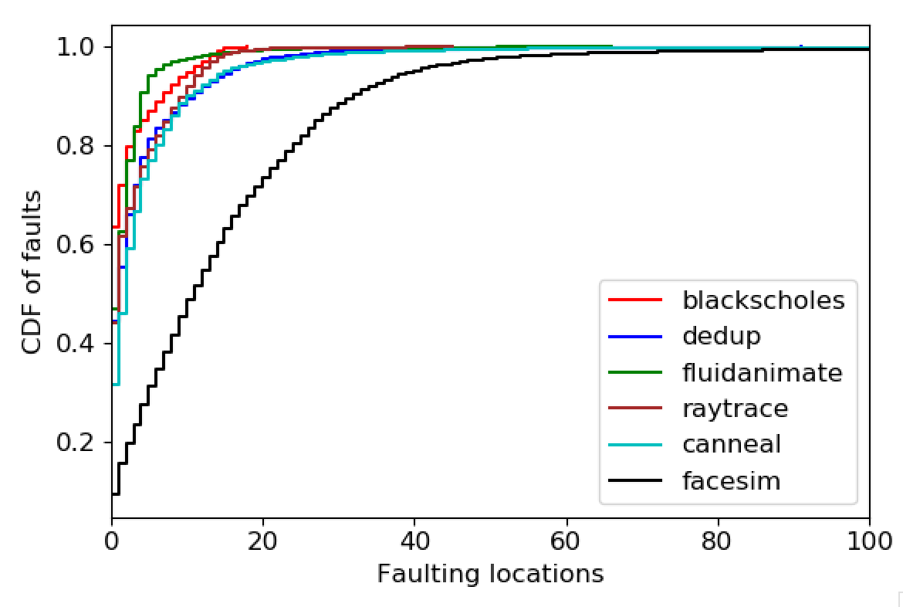
Fault locations (50% local mem)

Slide 5
Hints for hotness tracking
Other systems:
Fastswap and other kernel systems have page access bit
AIFM has far memory pointers – indirect reference
One use for the “hit” path
Requires kona-based checks
Cost of Page Checks | vDSO | Kona
Hit | 30 ns | 120ns (+/- 20)
Miss | 1.4 µs | 120ns (+/- 20)
Hit + set hot bit if not set | - | 160ns (+/- 20)

Slide 6
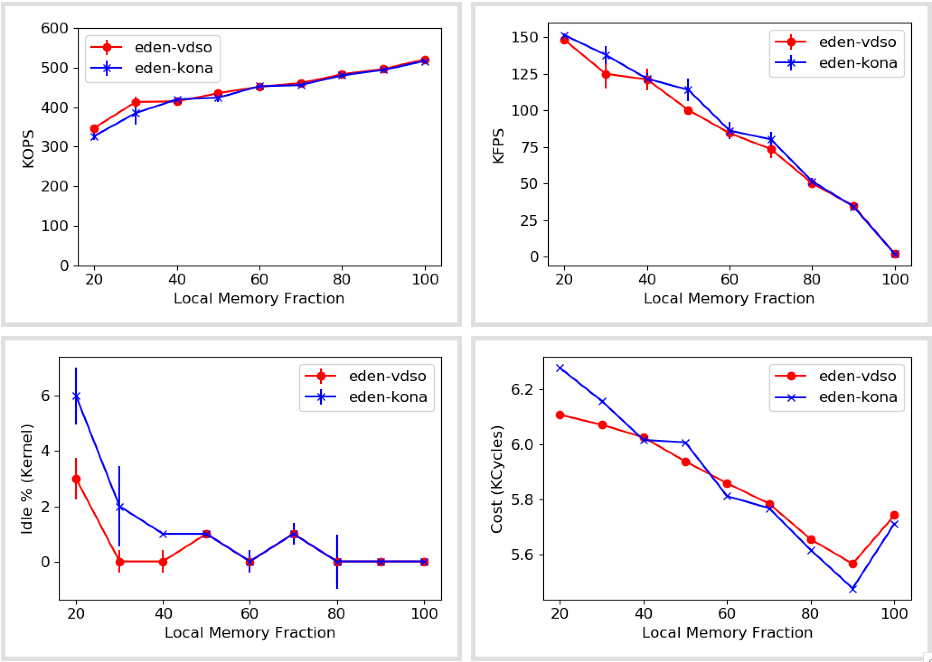
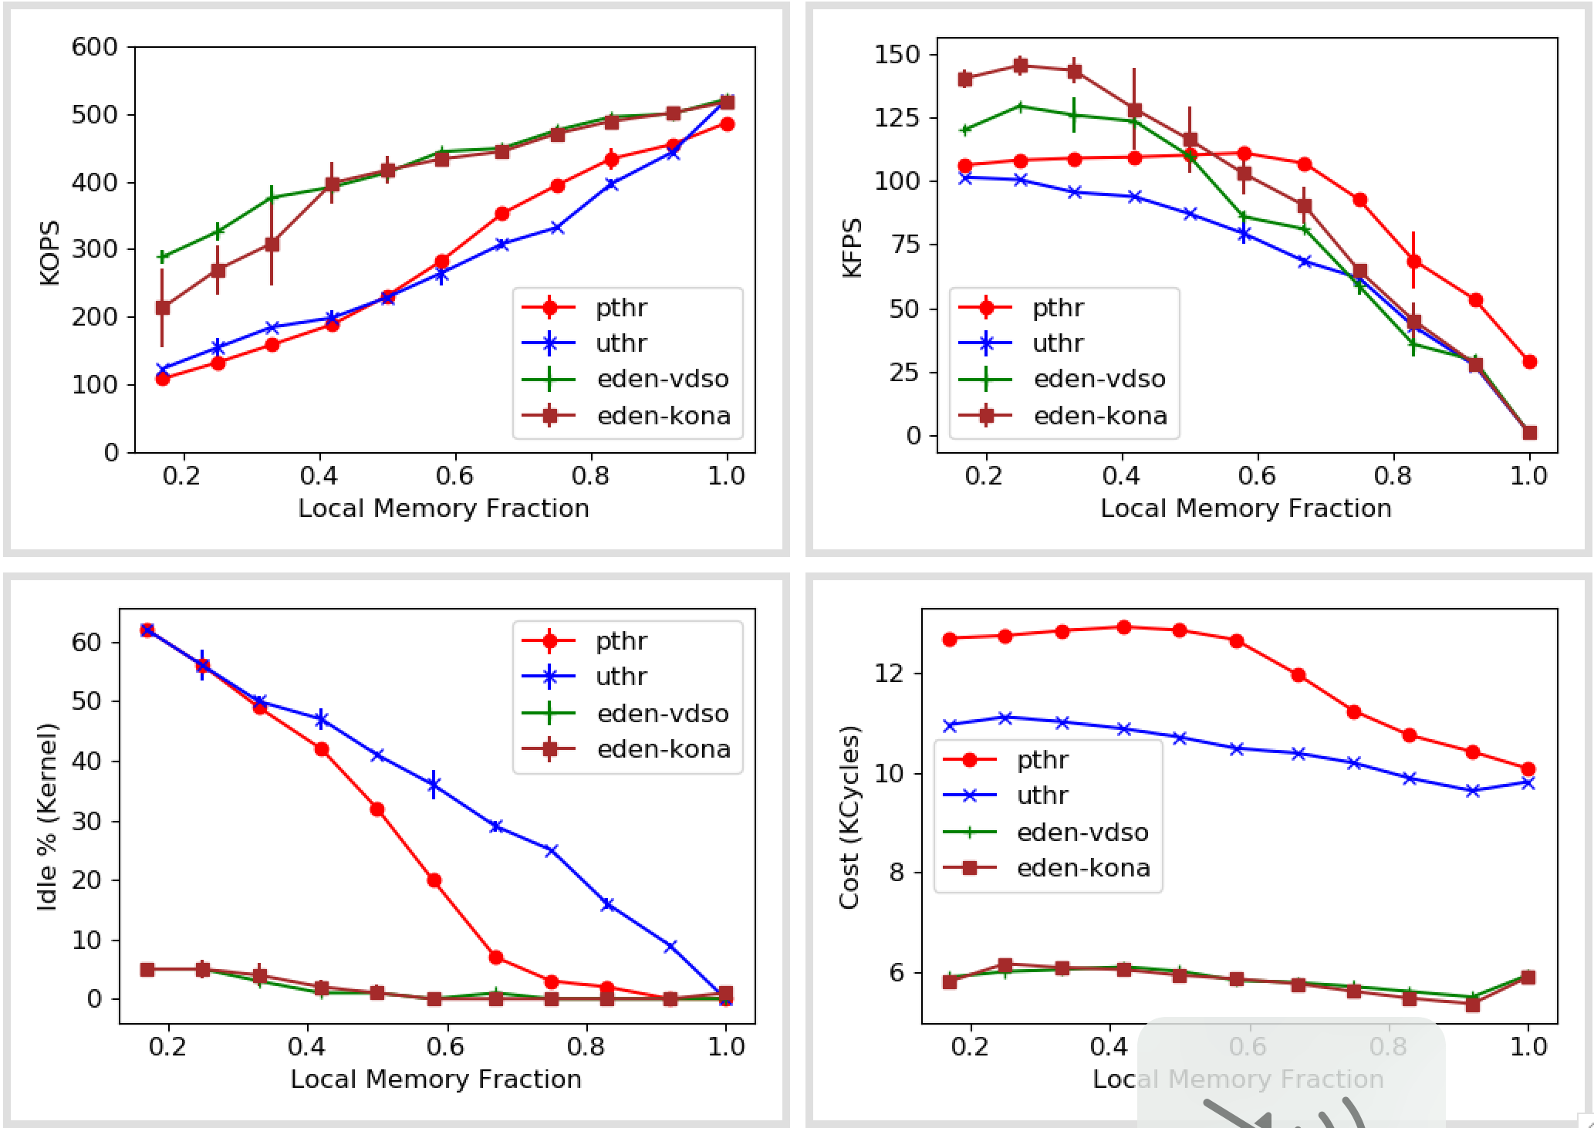
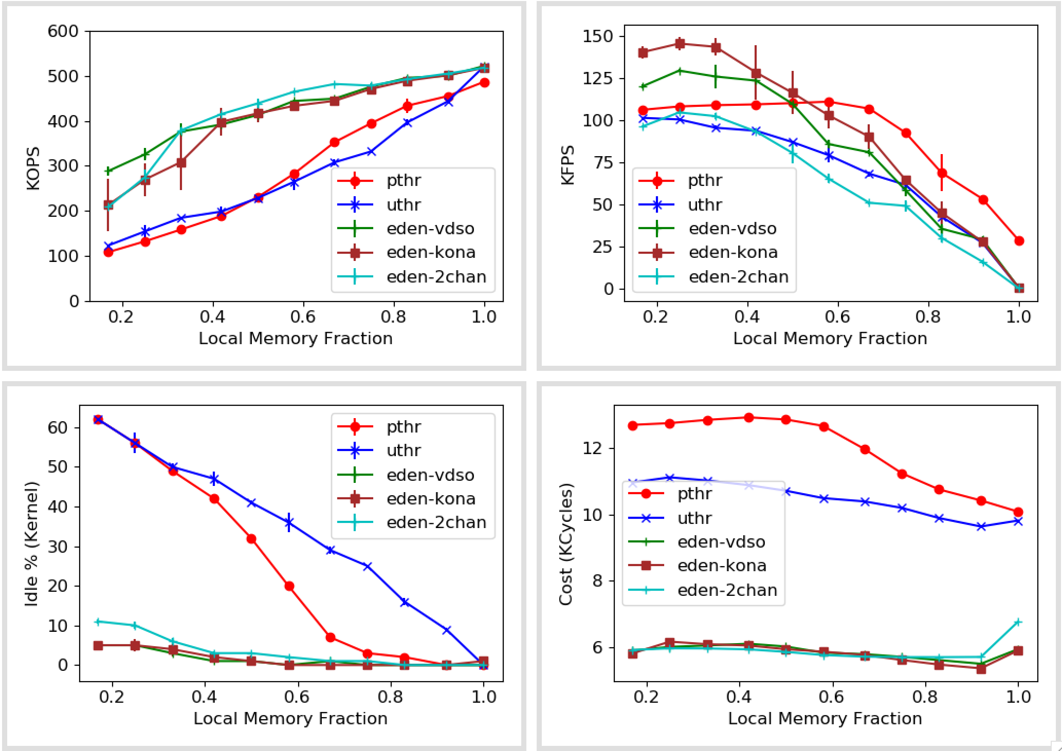
Synthetic numbers (With kona-based page checks)

Slide 7
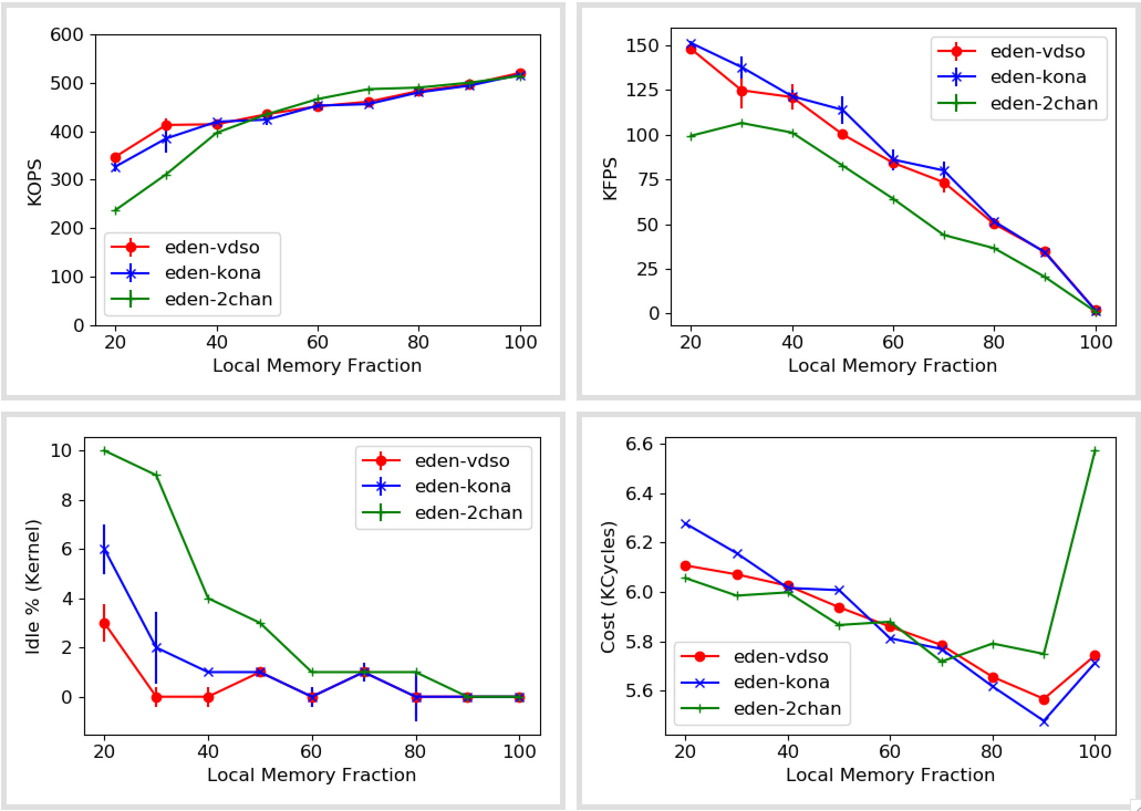
Synthetic numbers (With kona-based page checks and second-chance eviction)
Notes:
Need more work in explaining eviction

Slide 8
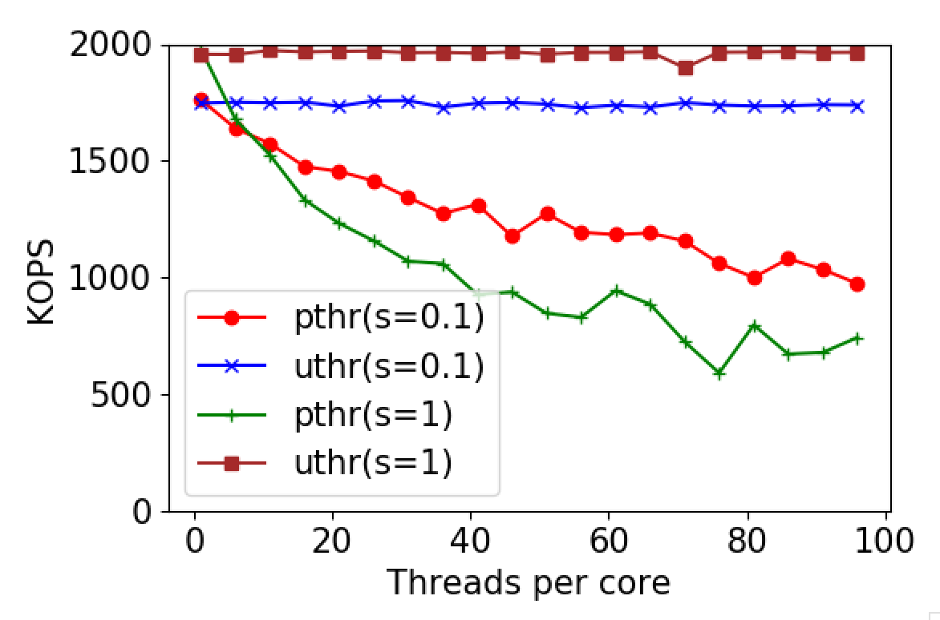
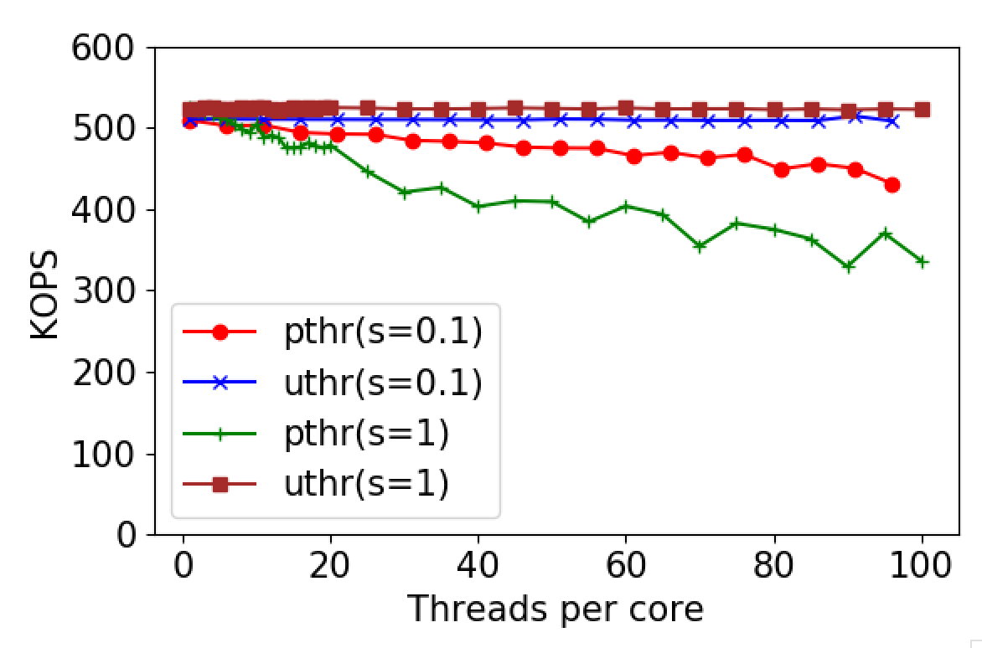
Pthreads vs Uthreads
1x Zip
5x Zip
Suspect: locking primitives
Sort doesn’t do much locking
Memcached, SiloDB, etc. wouldn’t allow comparison but can show degradation with pthreads
My guess is it’d be much worse for writes

Slide 9
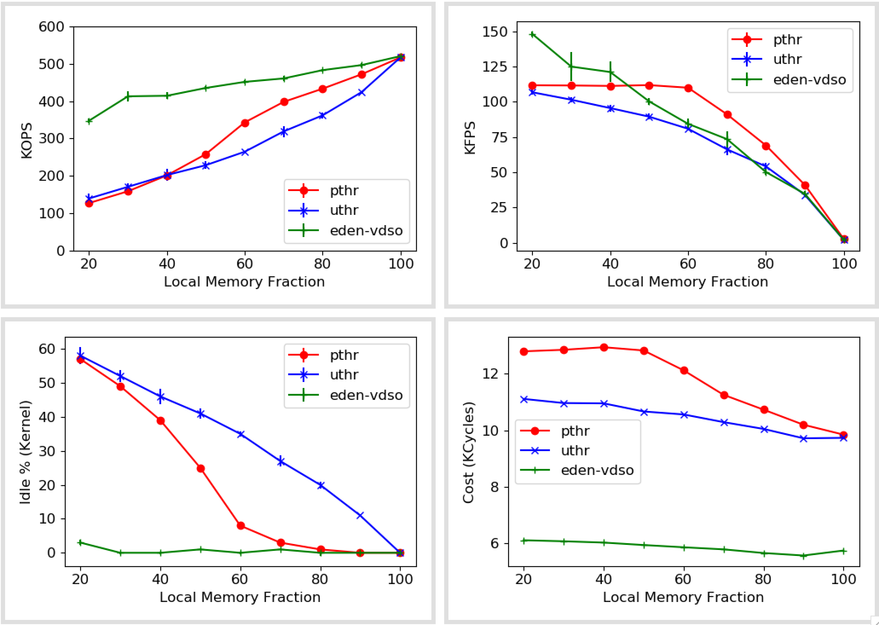
Synthetic numbers (With pthreads)
Pthreads=5/core
Uthr=40/core

Slide 10
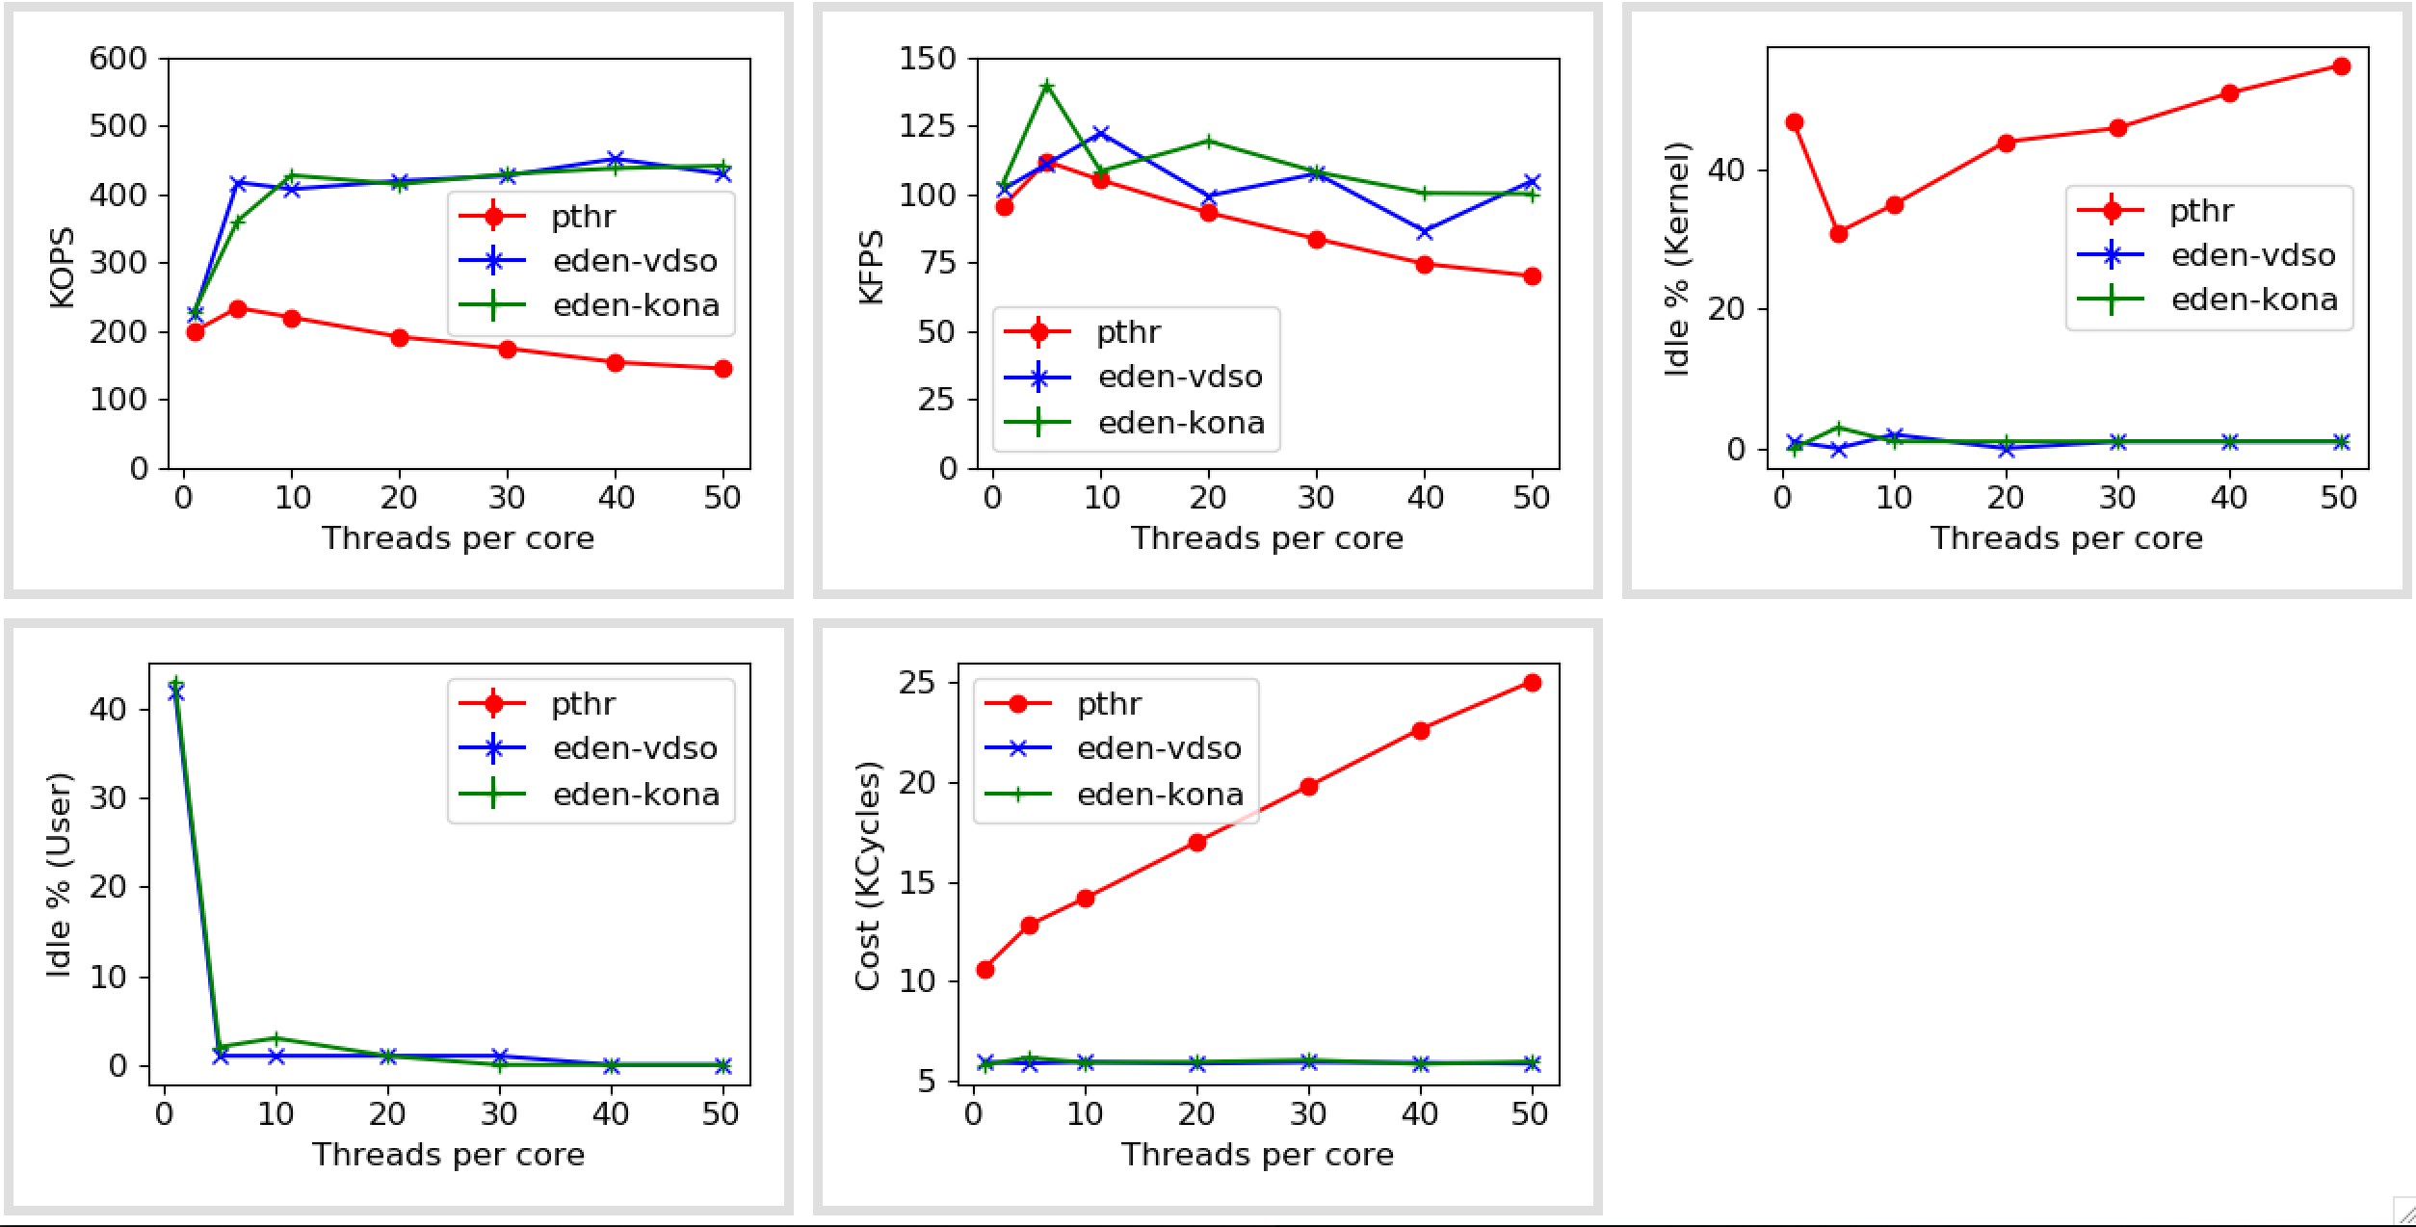
Pthreads vs Uthreads (at 50% local memory, zipfs=1)

Slide 11
In-memory databases
Databases (link) | Data model | Interface | TXN support | Known Available Benchmarks | Comments
Altibase | Relational | SQL | Yes
Hyrise | Relational | SQL | Yes |  | Research, Academic
RocksDB | KV Store | Get/Set | Yes |  | Popular
Impala | Hadoop | SQL, Other | No
Silo | Relational | Custom | Yes | TPCC, YCSB | Ported on Shenango
ClickHouse | Relational | SQL, Other | No | TPC-DS | OLAP database, Well-known
Dragonfly | KV Store | Get/Set | No
MariaDB | Relational | SQL | Yes | TPCC, TPC-DS | Commercial, Well-known
Memcached | KV Store | Get/Set | No
VoltDB | Relational | SQL | Yes |  | Only OLTP
https://dbdb.io

