Slide 1
Agenda
PARSEC with Kona
Improving the story of hints
Synthetic numbers with pthreads and Kona-based hints

Slide 2
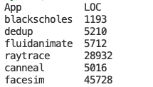
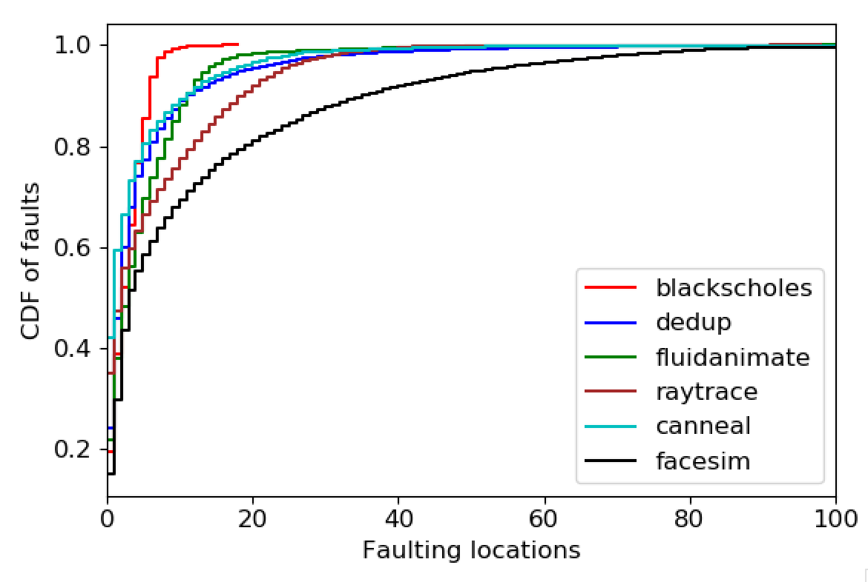
Fault locations (5% local mem)
Notes:
Fraction of lines of code on x-axis

Slide 3
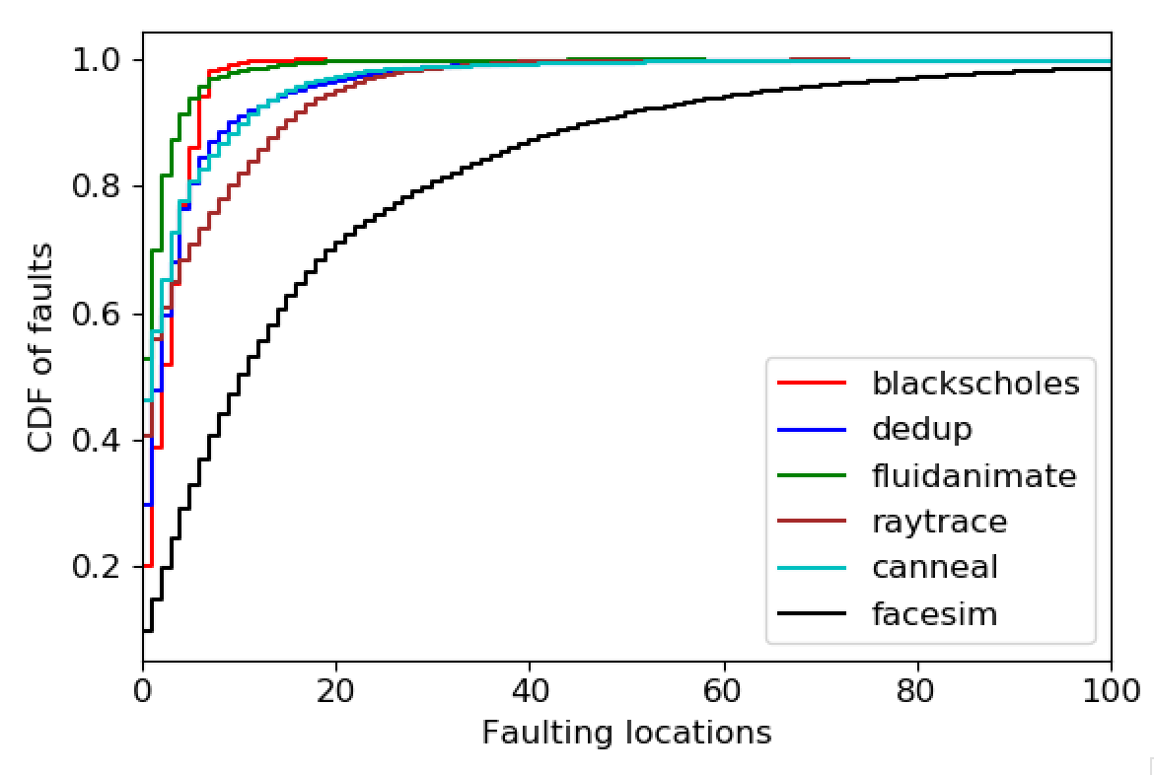
Fault locations (25% local mem)

Slide 4
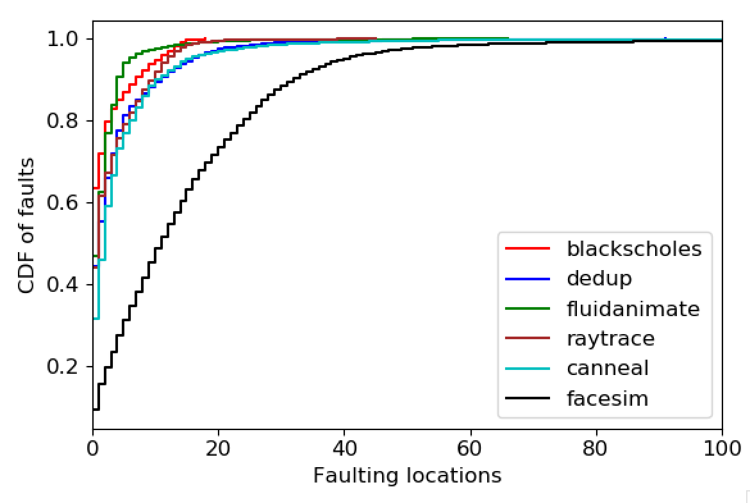
Fault locations (50% local mem)

Slide 5
Plan
Evaluation
Comparing Dataframes with AIFM and Fastswap
AIFM and Dataframes almost setup
Plan to include SiloDB
Resident-set aware scheduling for Sort
Annotations (today)
Automatically adding hints
Using hints for more: hotness tracking for better eviction
Idea is to contrast with AIFM – “similar” benefits with
less overhead (only at few code locations)
Much less programmer effort

Slide 6
Hints for hotness tracking
Other systems:
Fastswap and other kernel systems have page access bit
AIFM has far memory pointers – indirect reference
One use for the “hit” path
Requires kona-based checks
Cost of Page Checks | vDSO | Kona
Hit | 30 ns | 120ns (+/- 20)
Miss | 1.4 µs | 120ns (+/- 20)
Hit + set hot bit if not set | - | 160ns (+/- 20)

Slide 7
How to automatically annotate?
Challenges:
Finding the exact variable
Shared/pre-compiled libraries

Slide 8
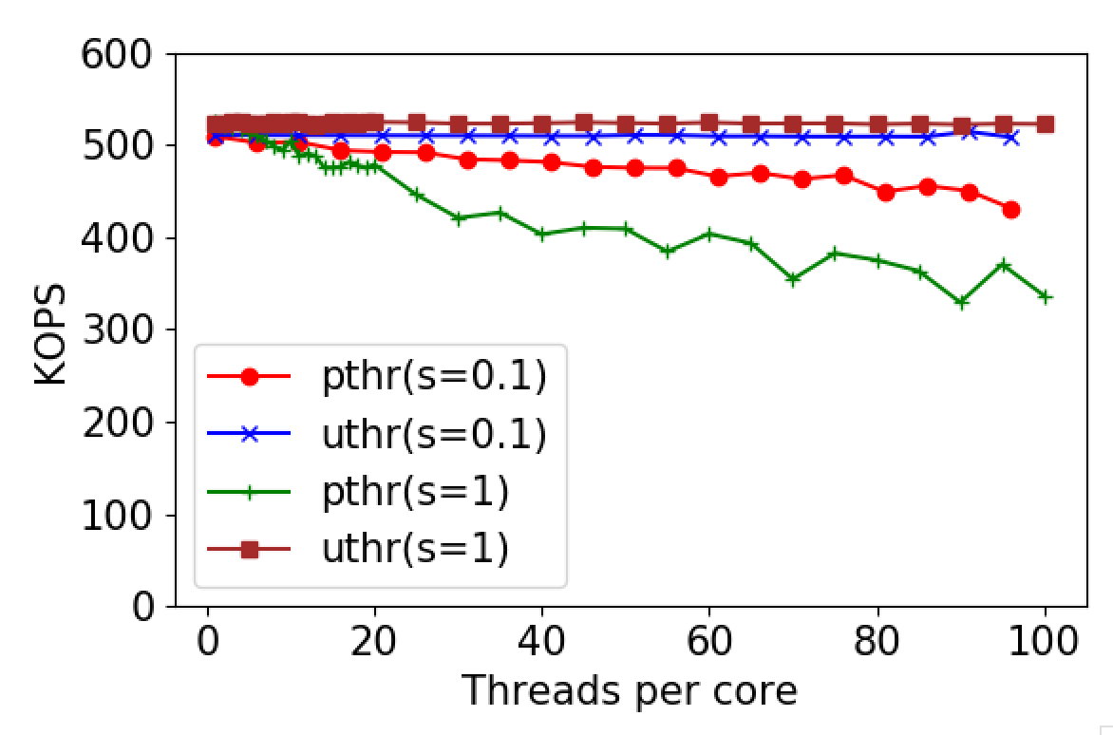
Concurrency
Suspect: sync primitives
Sort doesn’t do much locking
Memcached doesn’t allow apples comparison with Shenango
5xZip

Slide 9
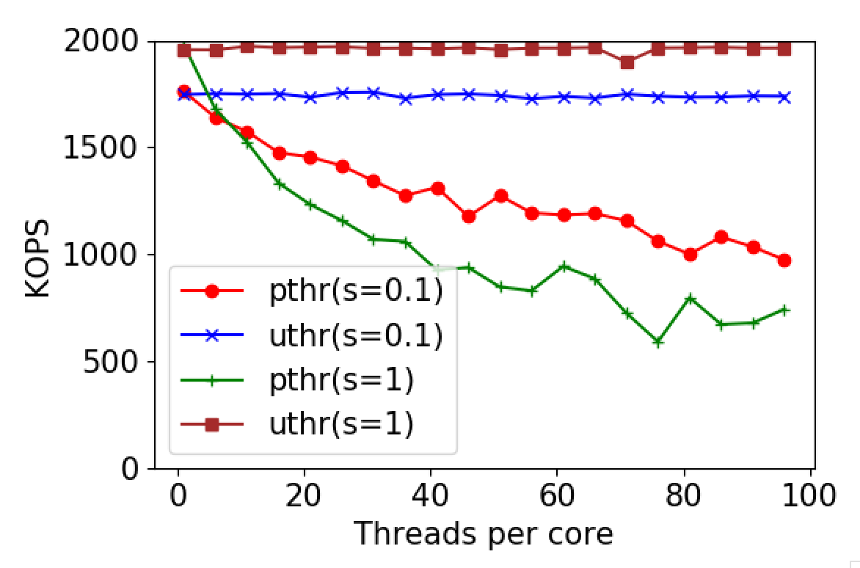
Concurrency
Suspect: sync primitives
Sort doesn’t do much locking
Memcached doesn’t allow apples comparison with Shenango
1xZip

Slide 10
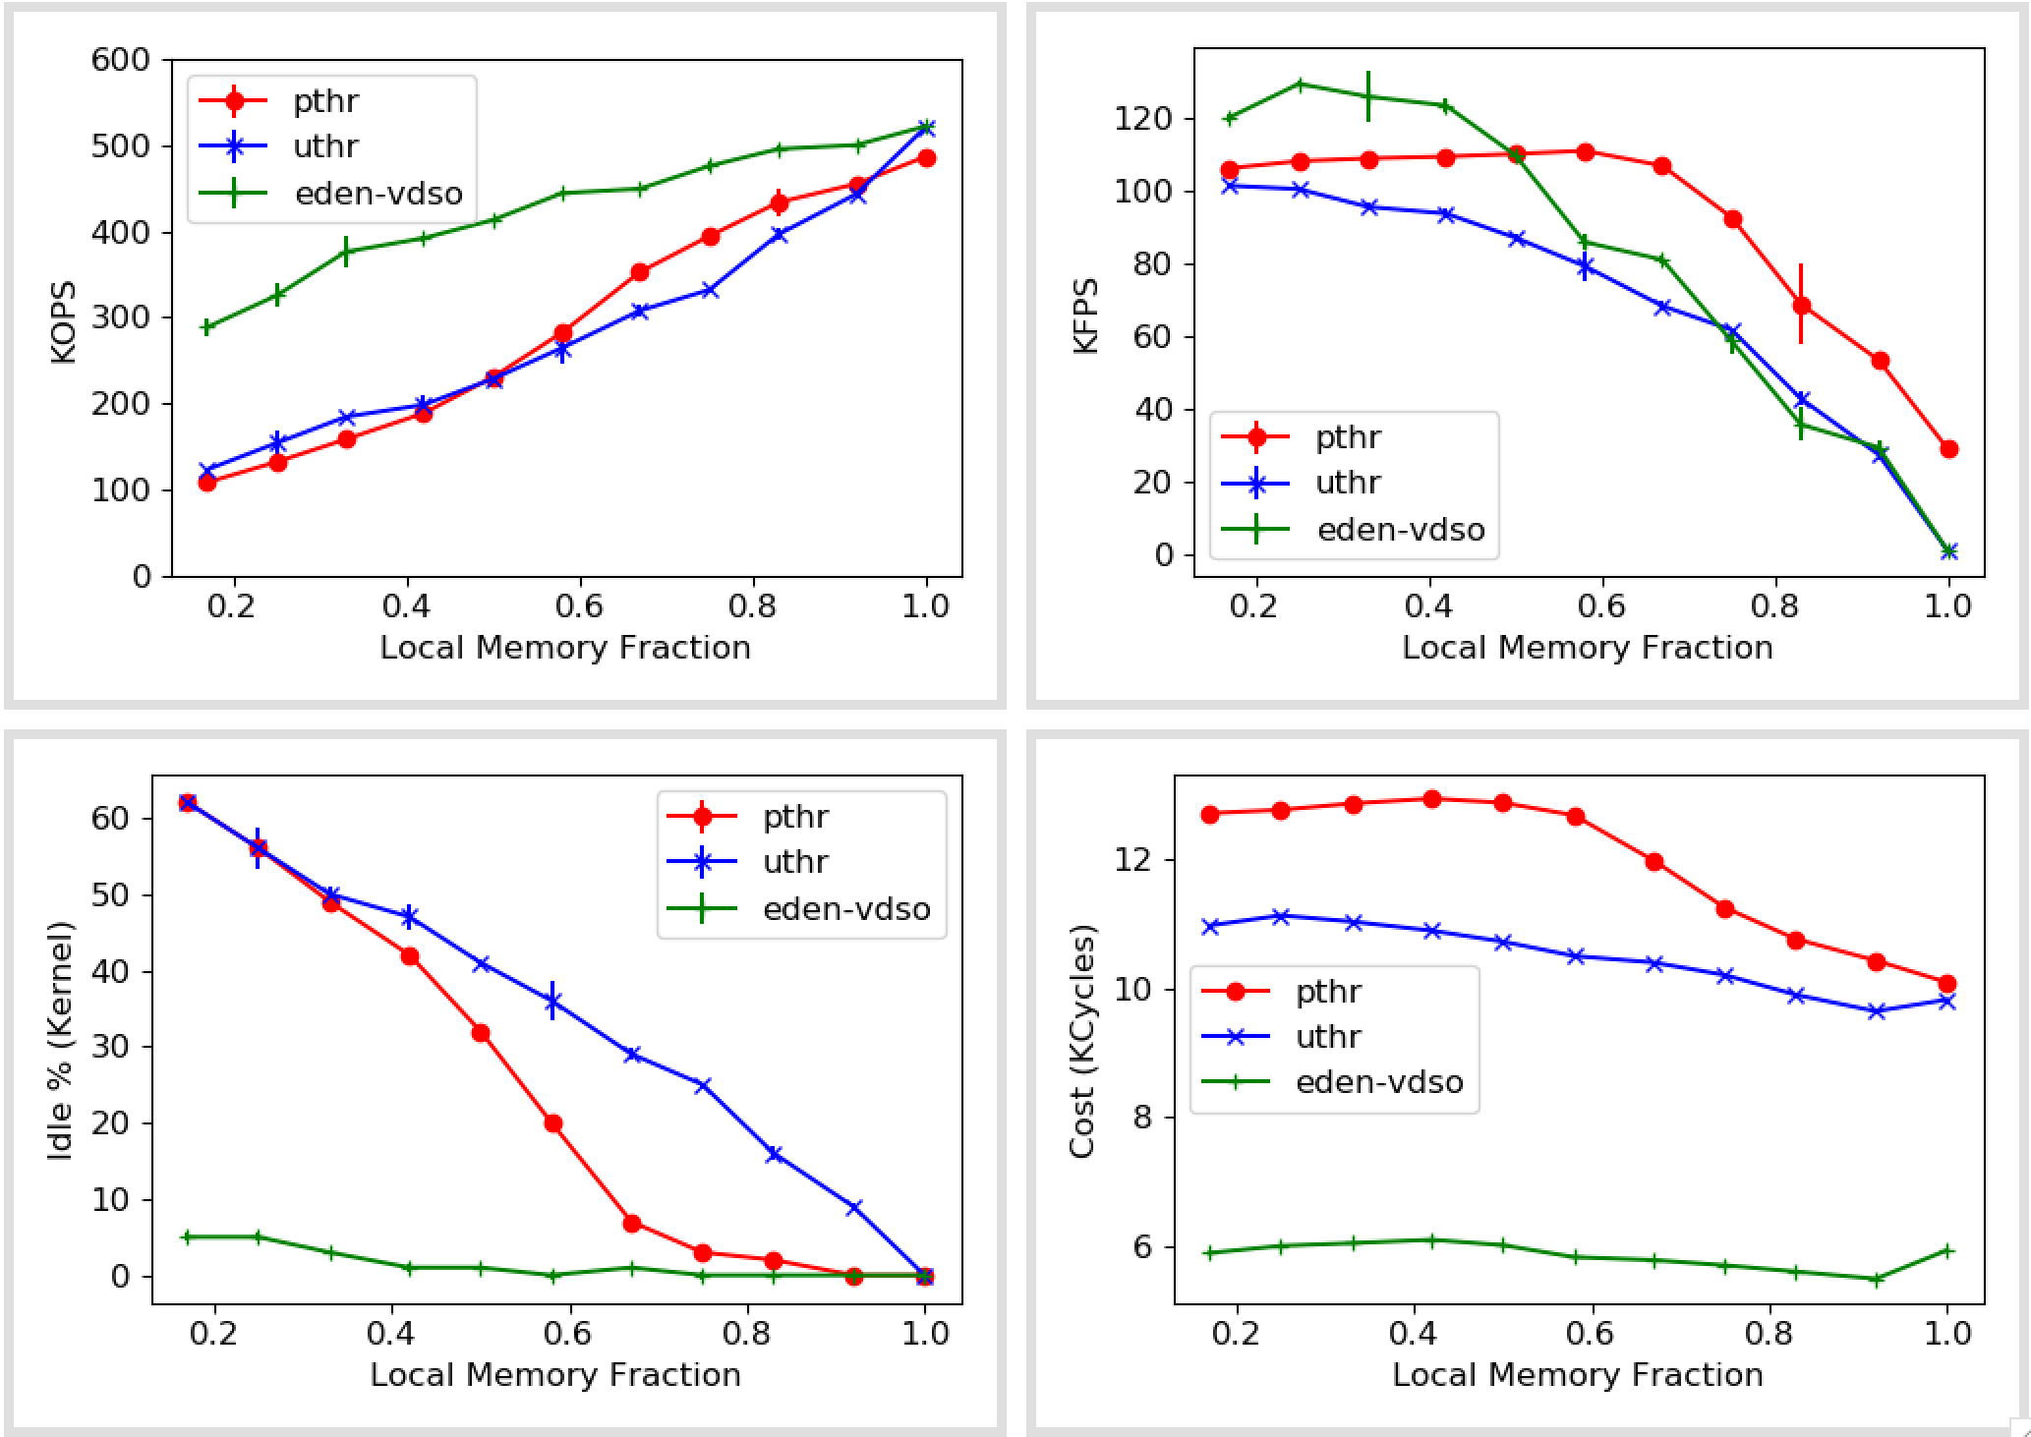
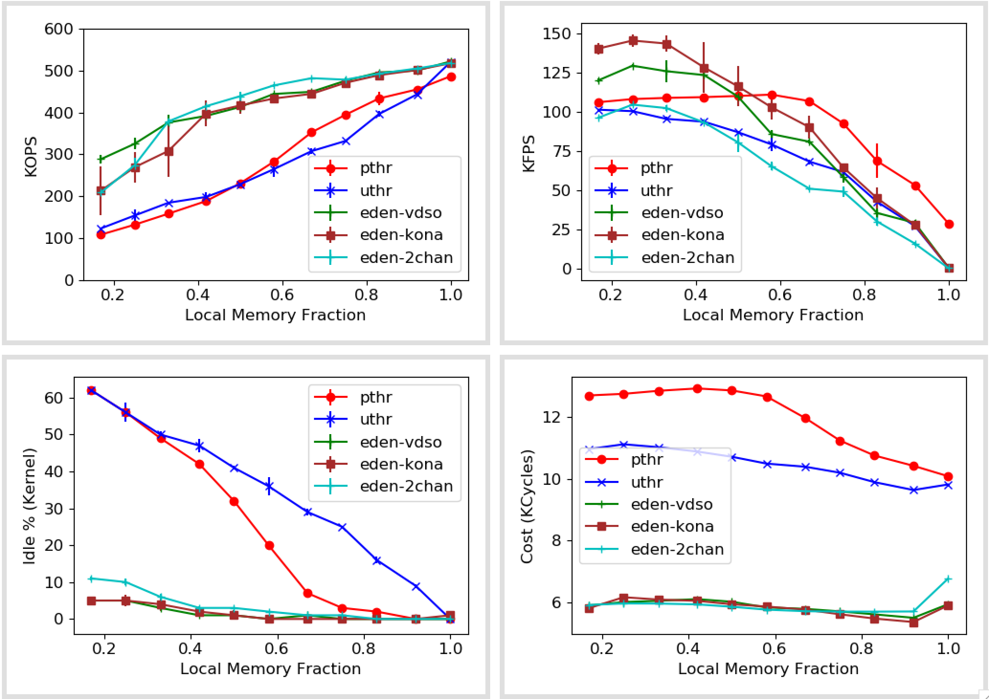
Synthetic numbers (With pthreads)

Slide 11
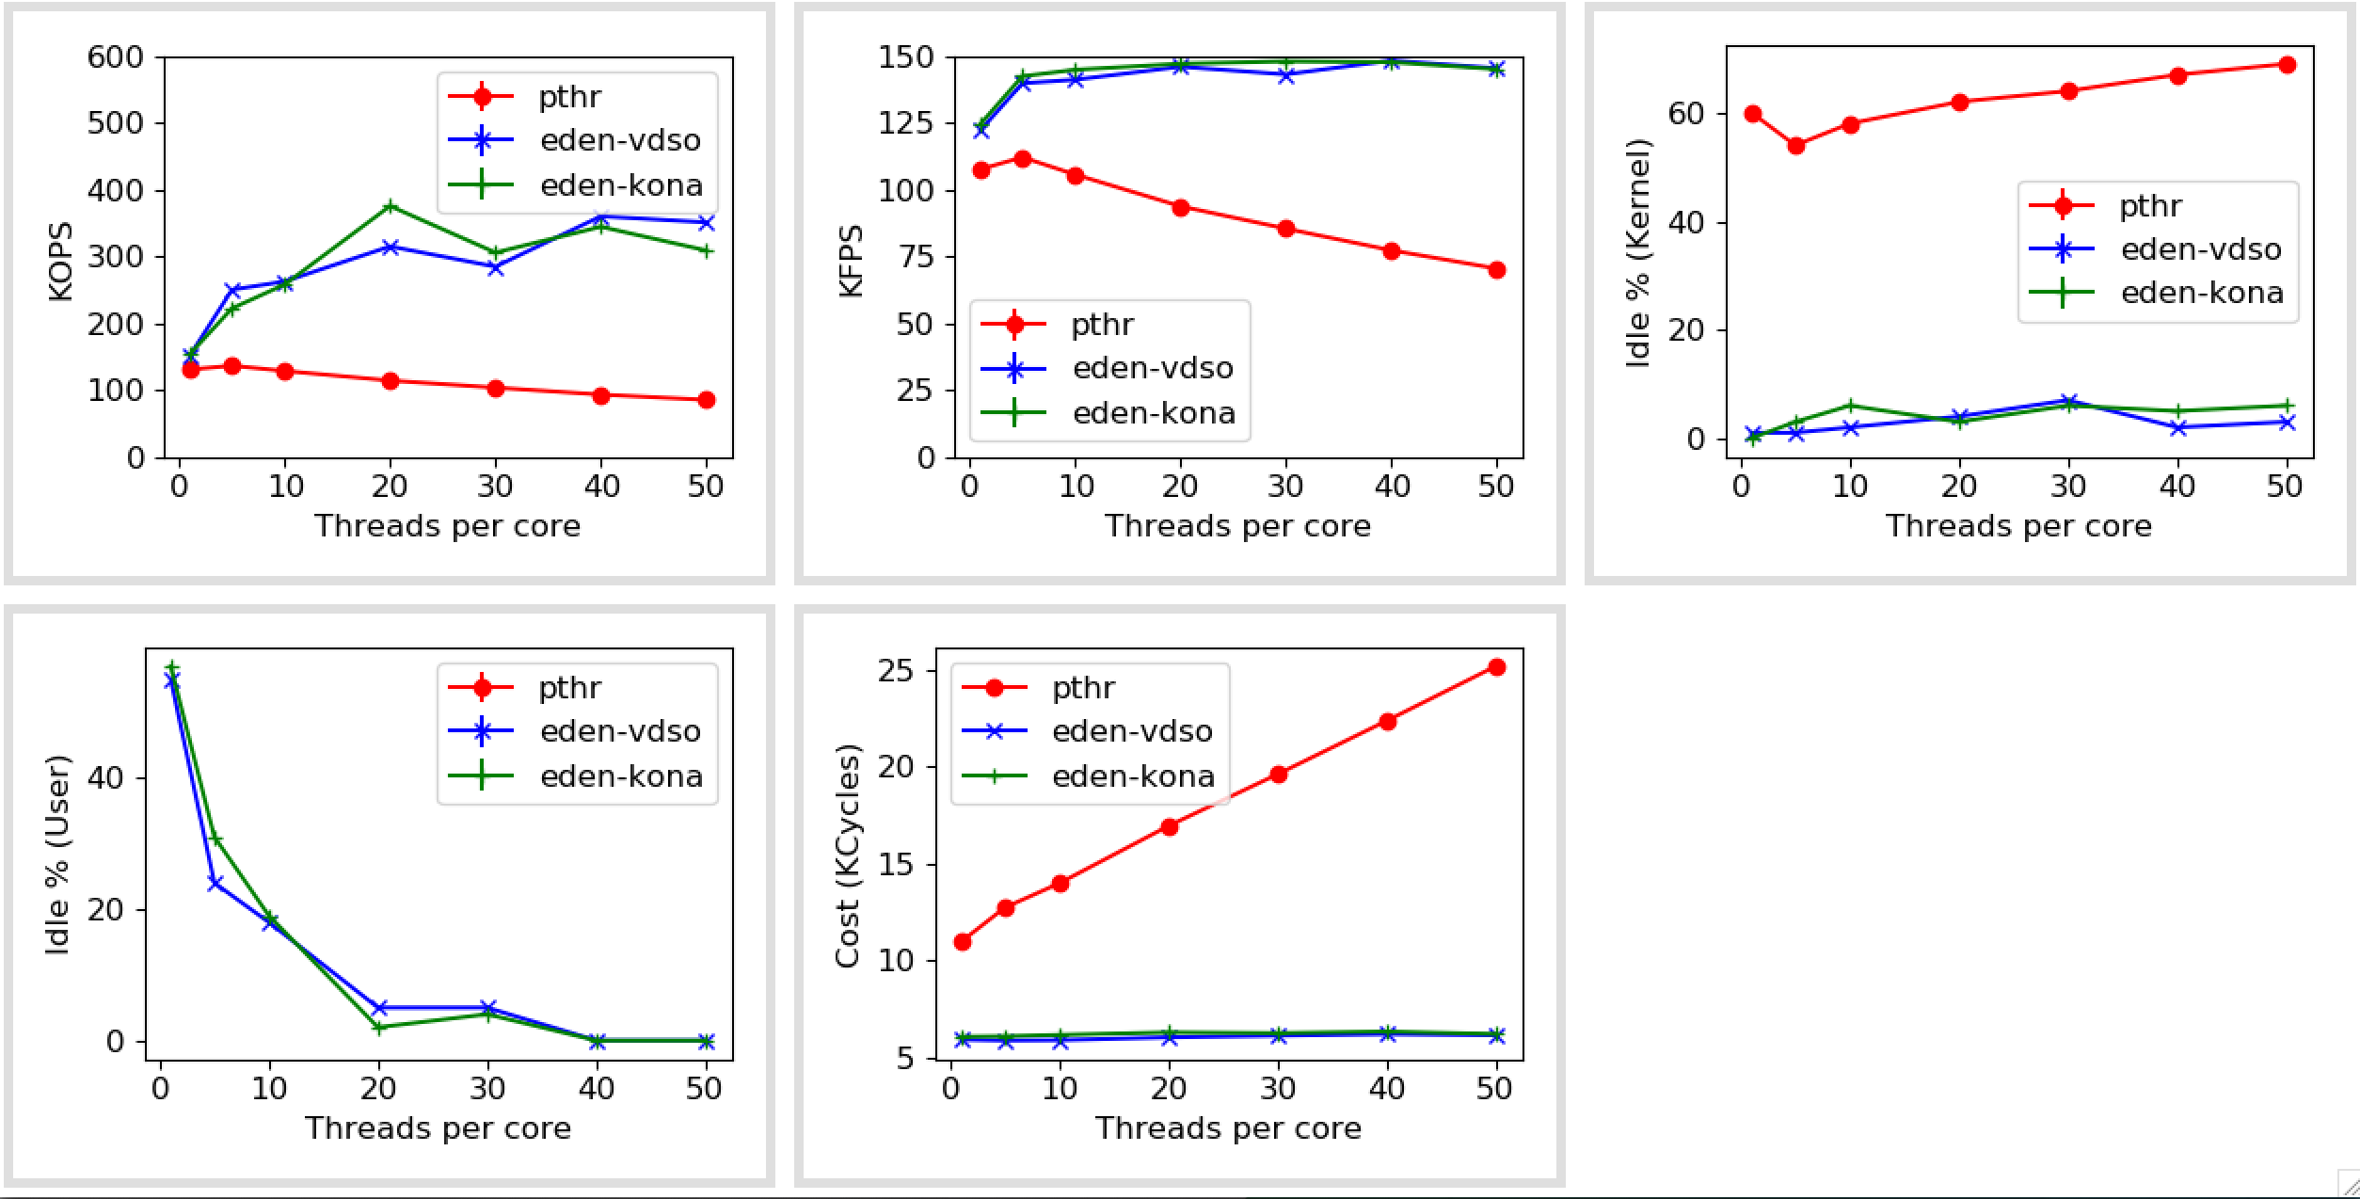
Synthetic numbers (Varying concurrency at 25% local memory)

Slide 12
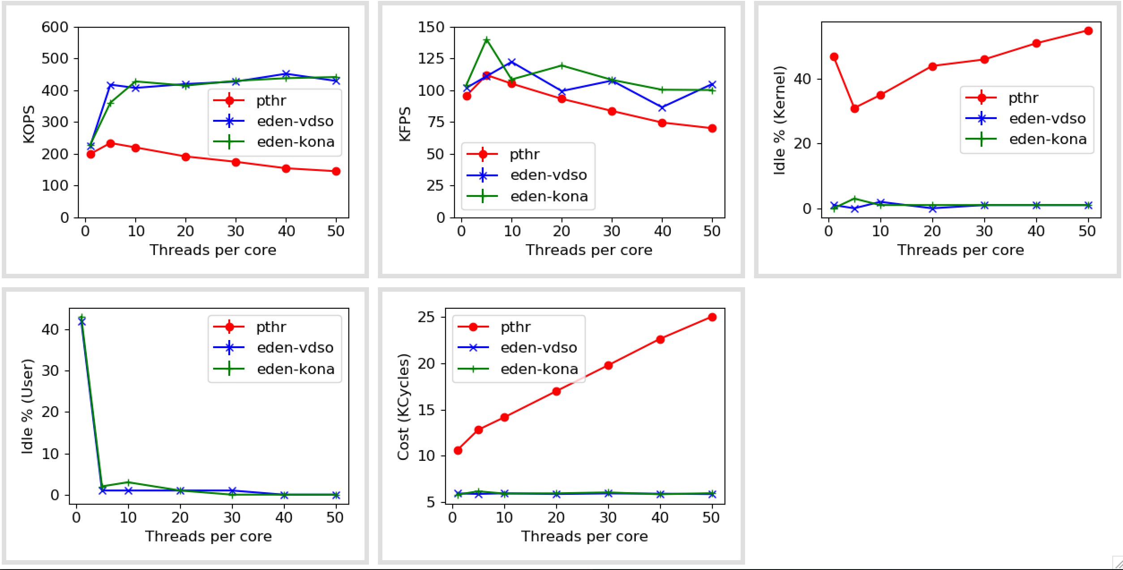
Synthetic numbers (Varying concurrency at 50% local memory)

Slide 13
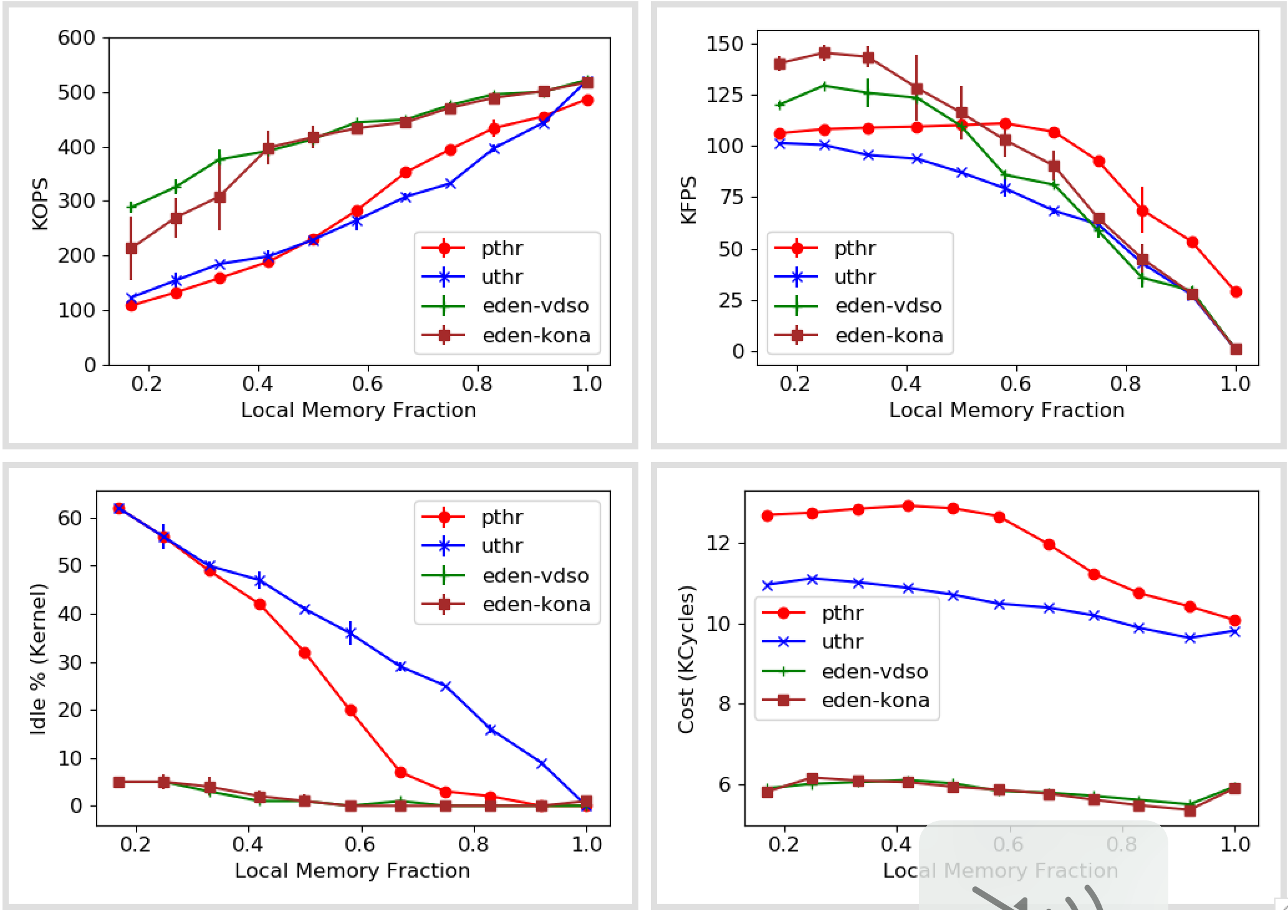
Synthetic numbers (With kona-based page checks)

Slide 14
Synthetic numbers (With kona-based page checks and second-chance eviction)

Slide 15
Synthetic numbers

Slide 16
Next
Dataframes on AIFM & Kona (with LOC numbers)
More work on hints
Invite Amy for Monday?

Slide 18
For Monday

Slide 19
Agenda
ASPLOS reviews/reaction
PARSEC with Kona
Hunt for In-memory databases

Slide 20
ASPLOS reviews
Reaction
List of action items
Plan for resubmission
Amy’s feedback

Slide 21
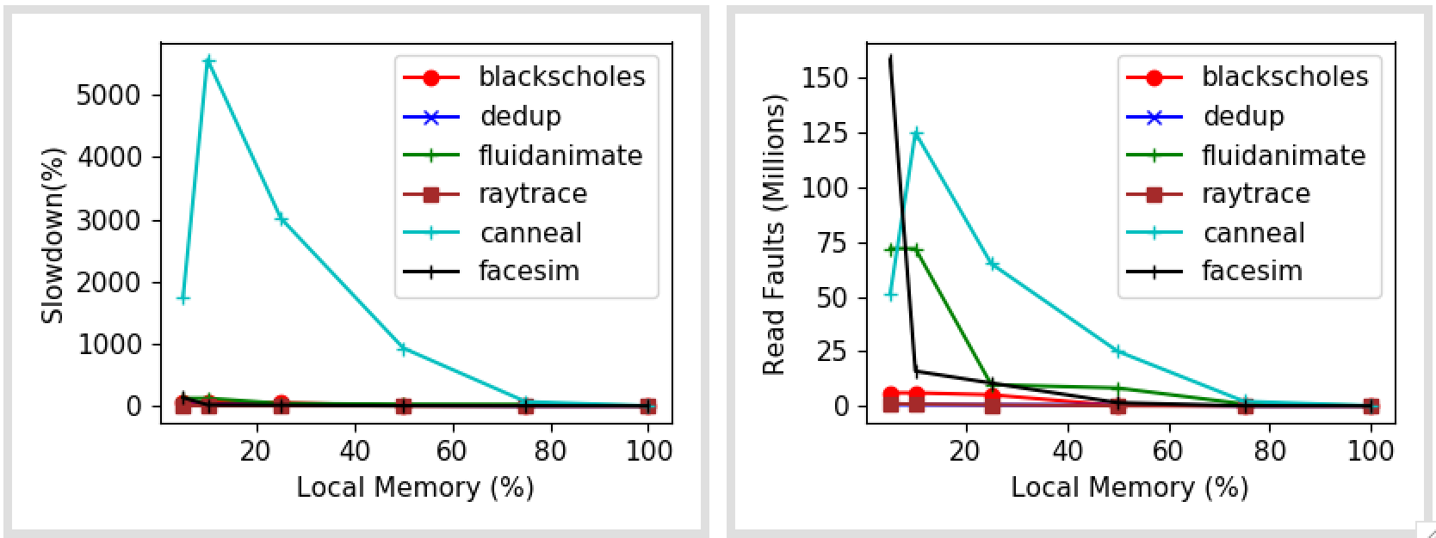
PARSEC on Kona

Slide 22
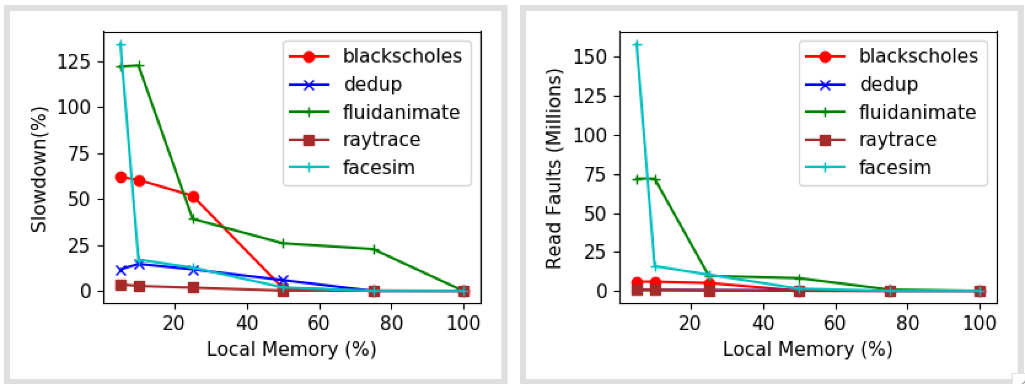
PARSEC with Kona

Slide 23
Fault locations (5% local mem)

Slide 24
Fault locations (25% local mem)

Slide 25
Fault locations (50% local mem)

Slide 26
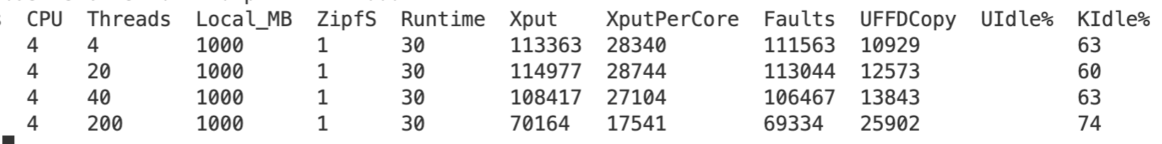
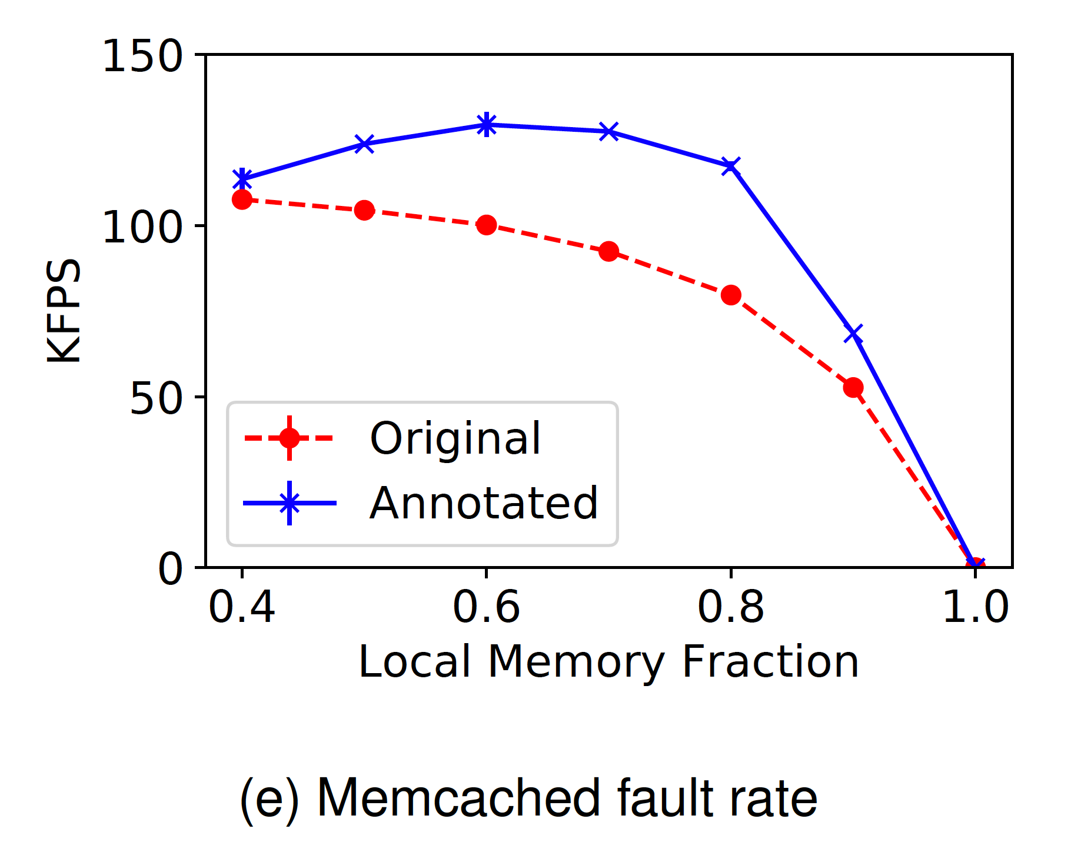

Slide 27
In-memory databases
Databases (link) | Data model | Interface | TXN support | Known Available Benchmarks | Comments
Altibase | Relational | SQL | Yes
Hyrise | Relational | SQL | Yes |  | Research, Academic
RocksDB | KV Store | Get/Set | Yes |  | Popular
Impala | Hadoop | SQL, Other | No
Silo | Relational | Custom | Yes | TPCC, YCSB | Ported on Shenango
ClickHouse | Relational | SQL, Other | No | TPC-DS | OLAP database, Well-known
Dragonfly | KV Store | Get/Set | No
MariaDB | Relational | SQL | Yes | TPCC, TPC-DS | Commercial, Well-known
Memcached | KV Store | Get/Set | No
VoltDB | Relational | SQL | Yes |  | Only OLTP
https://dbdb.io

Slide 28
On AIFM
Amy’s suggestion
Quantifying developer effort
Apps to compare to AIFM
Synthetic
C++ Dataframe library ← new app?

Slide 29
Space-bounded scheduling
Left-first, depth-first scheduling (no memory info)
LIFO work queues
Per-processor or global
Schedule thread with likely best resident set to finish faster
Similar to thread-RSS mapping
Limit fanout of ready threads at any point

Slide 30
Next
Dataframes on Eden
AIFM and Fastswap partly setup
SiloDB on Eden
Comparison with pthreads
Re-run apps with Kona-based page checks

