Slide 1
Agenda
PARSEC with Kona
Improving the story of hints
Synthetic numbers with pthreads and kona-based hints

Slide 2
Plan
High-level items | Tasks | This Week
Supporting Hint API | Show that hint locations are few (in progress) | PARSEC on Kona – Yet to reason about numbers
 | Hotness tracking with Hints (in progress) | Benchmarking kona-based page checks Trying out a hotness-based eviction policy
 | Automatic injection of hints (not started)
Comparison with AIFM (& Fastswap) | Run Dataframes on AIFM & Kona (in progress) | Dataframes is running. AIFM in progress
 | Quantifying developer effort (in progress) | Noting AIFM changes for dataframes
More complex benchmarks | Run SiloDB (not started)
Uthreads (Performance) | Clearly showing Pthreads overheads (in progress) | Synthetic numbers with pthreads
Uthreads (Flexibility) | RSS-aware scheduling for Sort (not started)
…

Slide 3
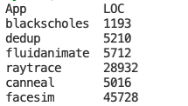
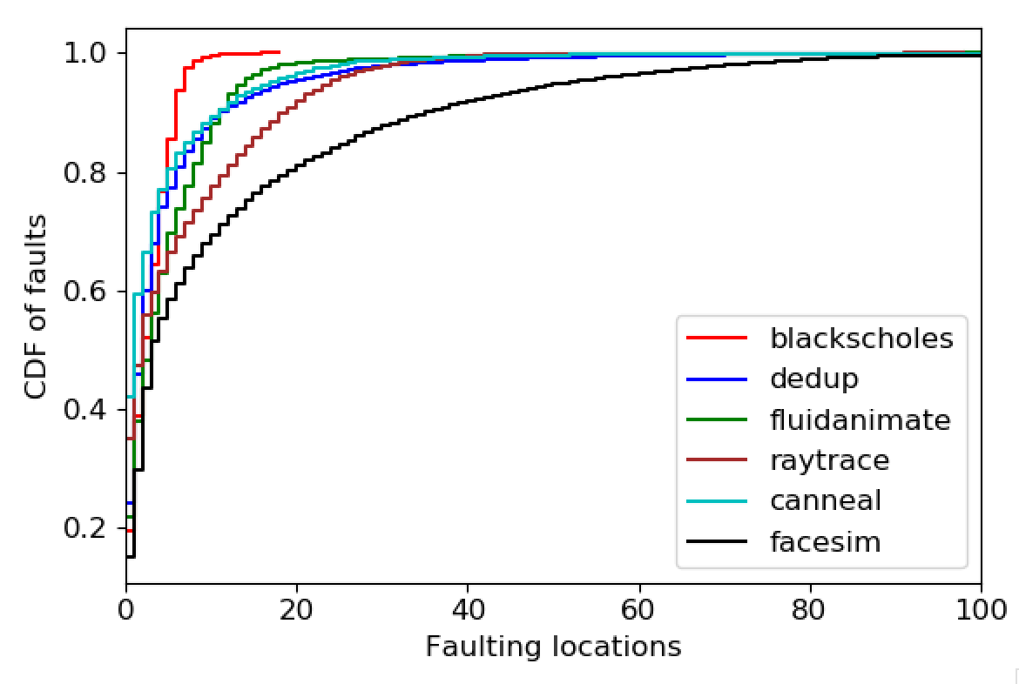
Fault locations (5% local mem)
Notes:
Fraction of lines of code on x-axis

Slide 4
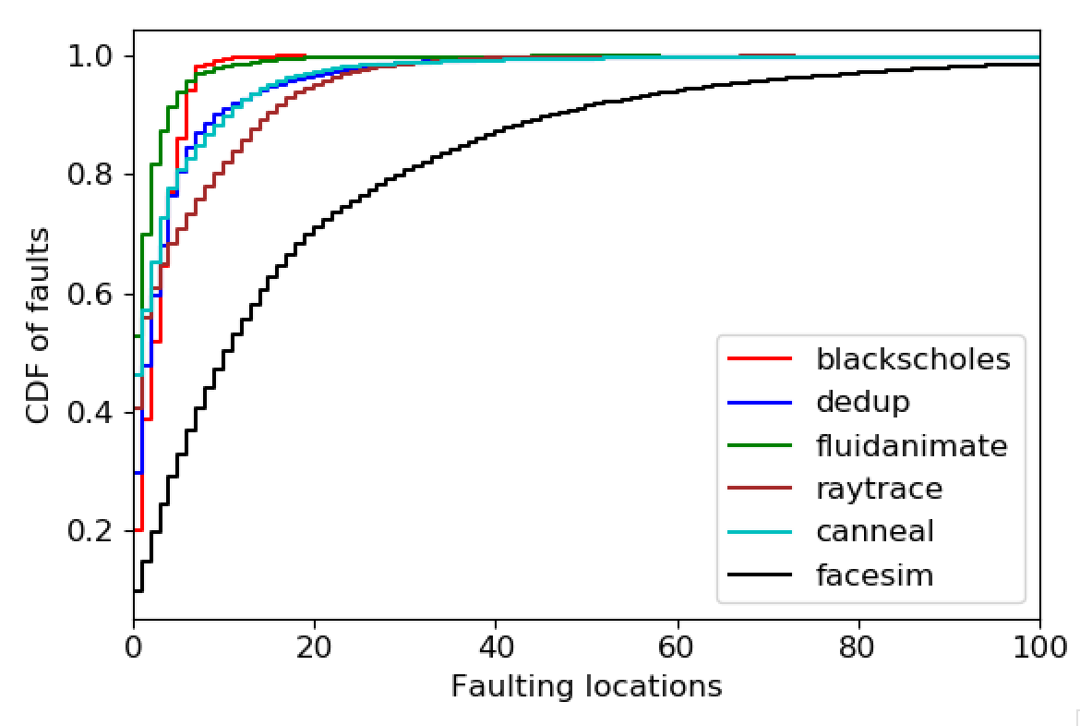
Fault locations (25% local mem)

Slide 5
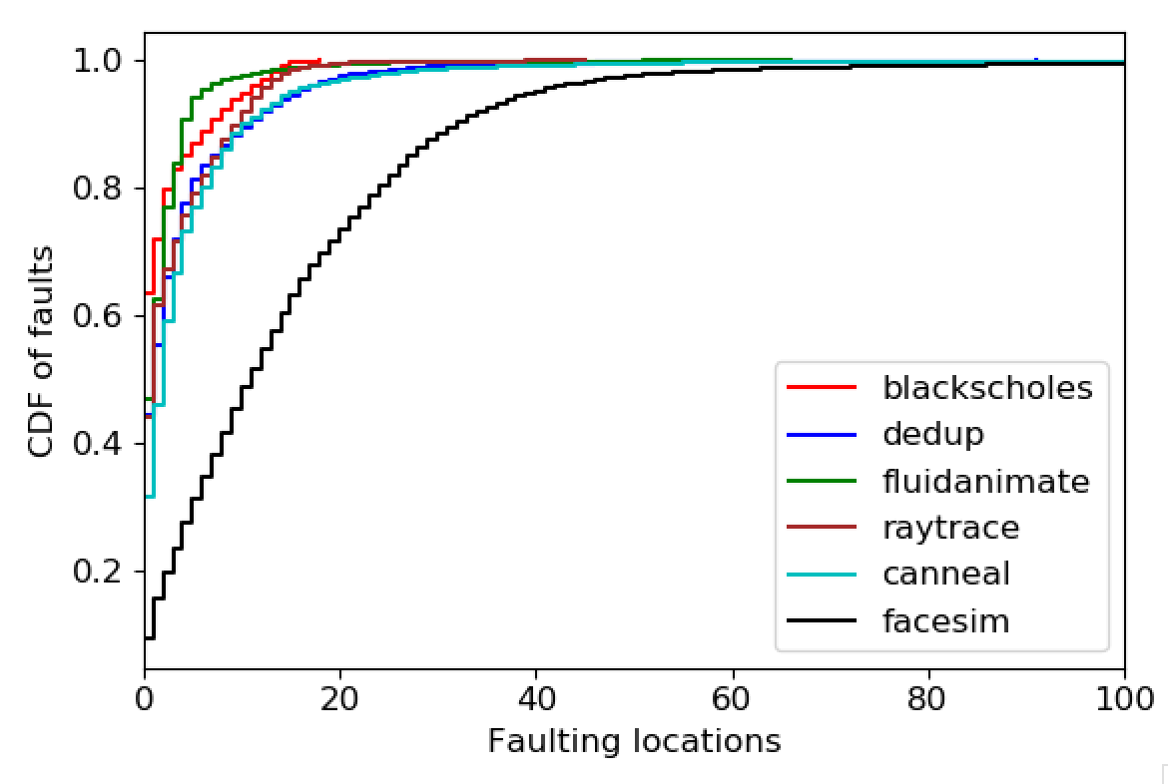
Fault locations (50% local mem)

Slide 6
Hints for hotness tracking
Other systems:
Fastswap and other kernel systems have page access bit
AIFM has far memory pointers – indirect reference
One use for the “hit” path
Requires kona-based checks
Cost of Page Checks | vDSO | Kona
Hit | 30 ns | 120ns (+/- 20)
Miss | 1.4 µs | 120ns (+/- 20)
Hit + set hot bit if not set | - | 160ns (+/- 20)

Slide 7
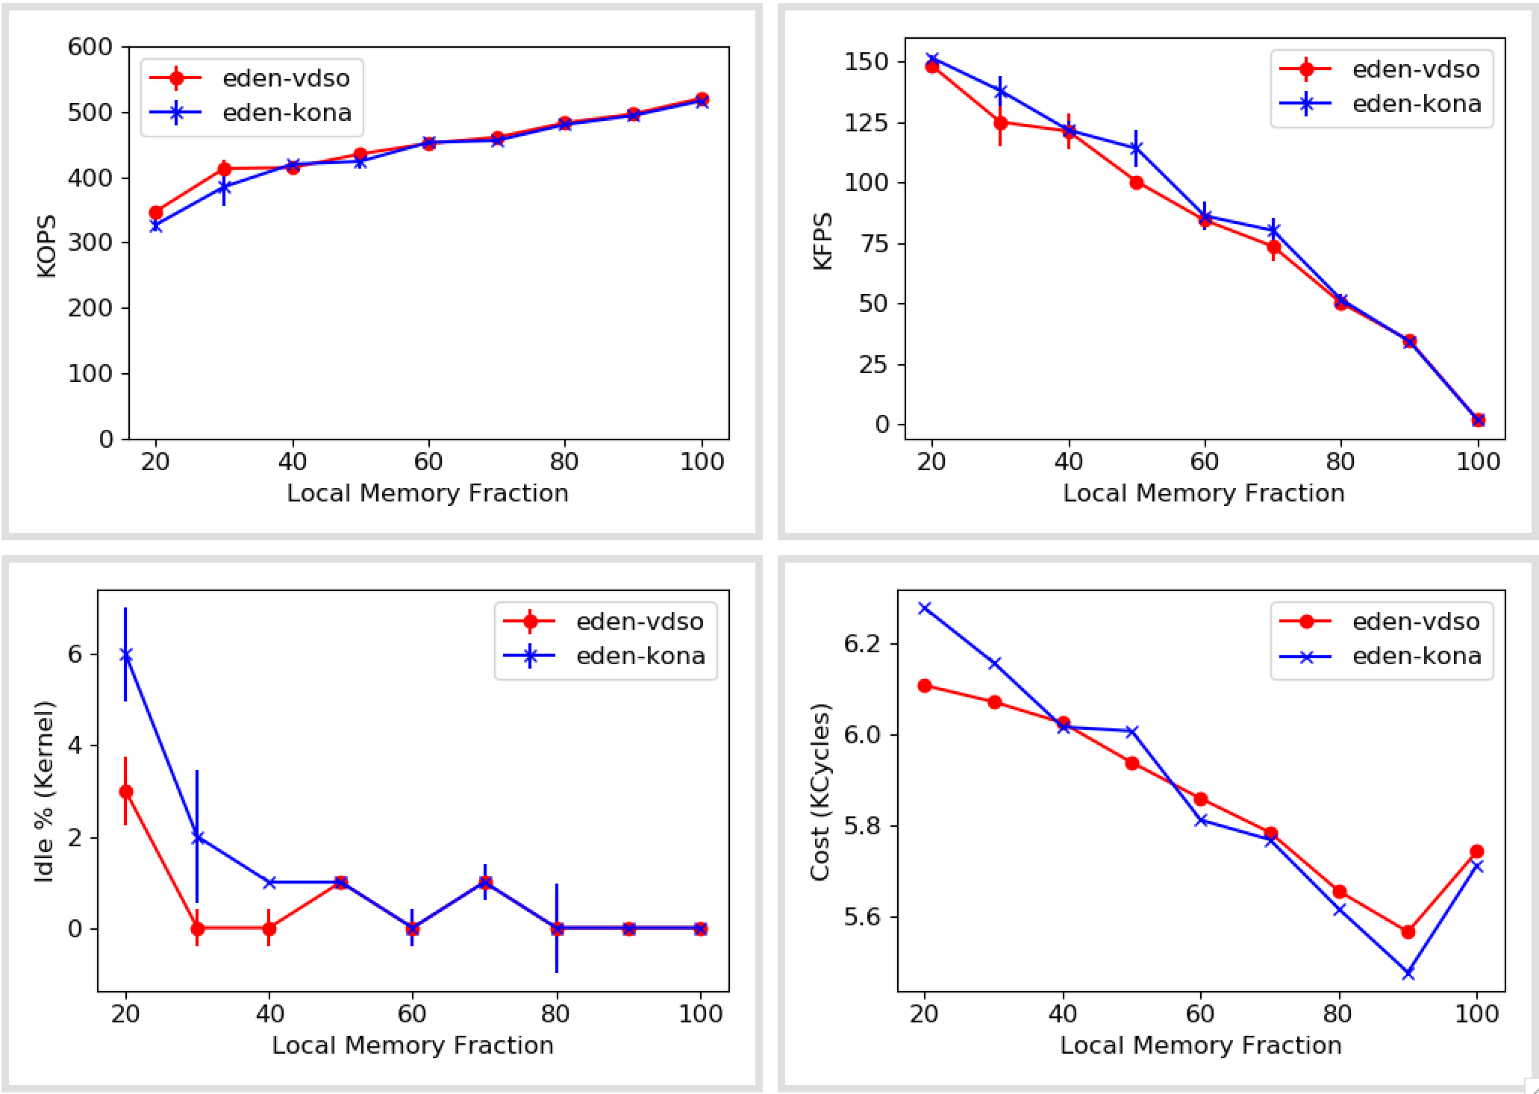
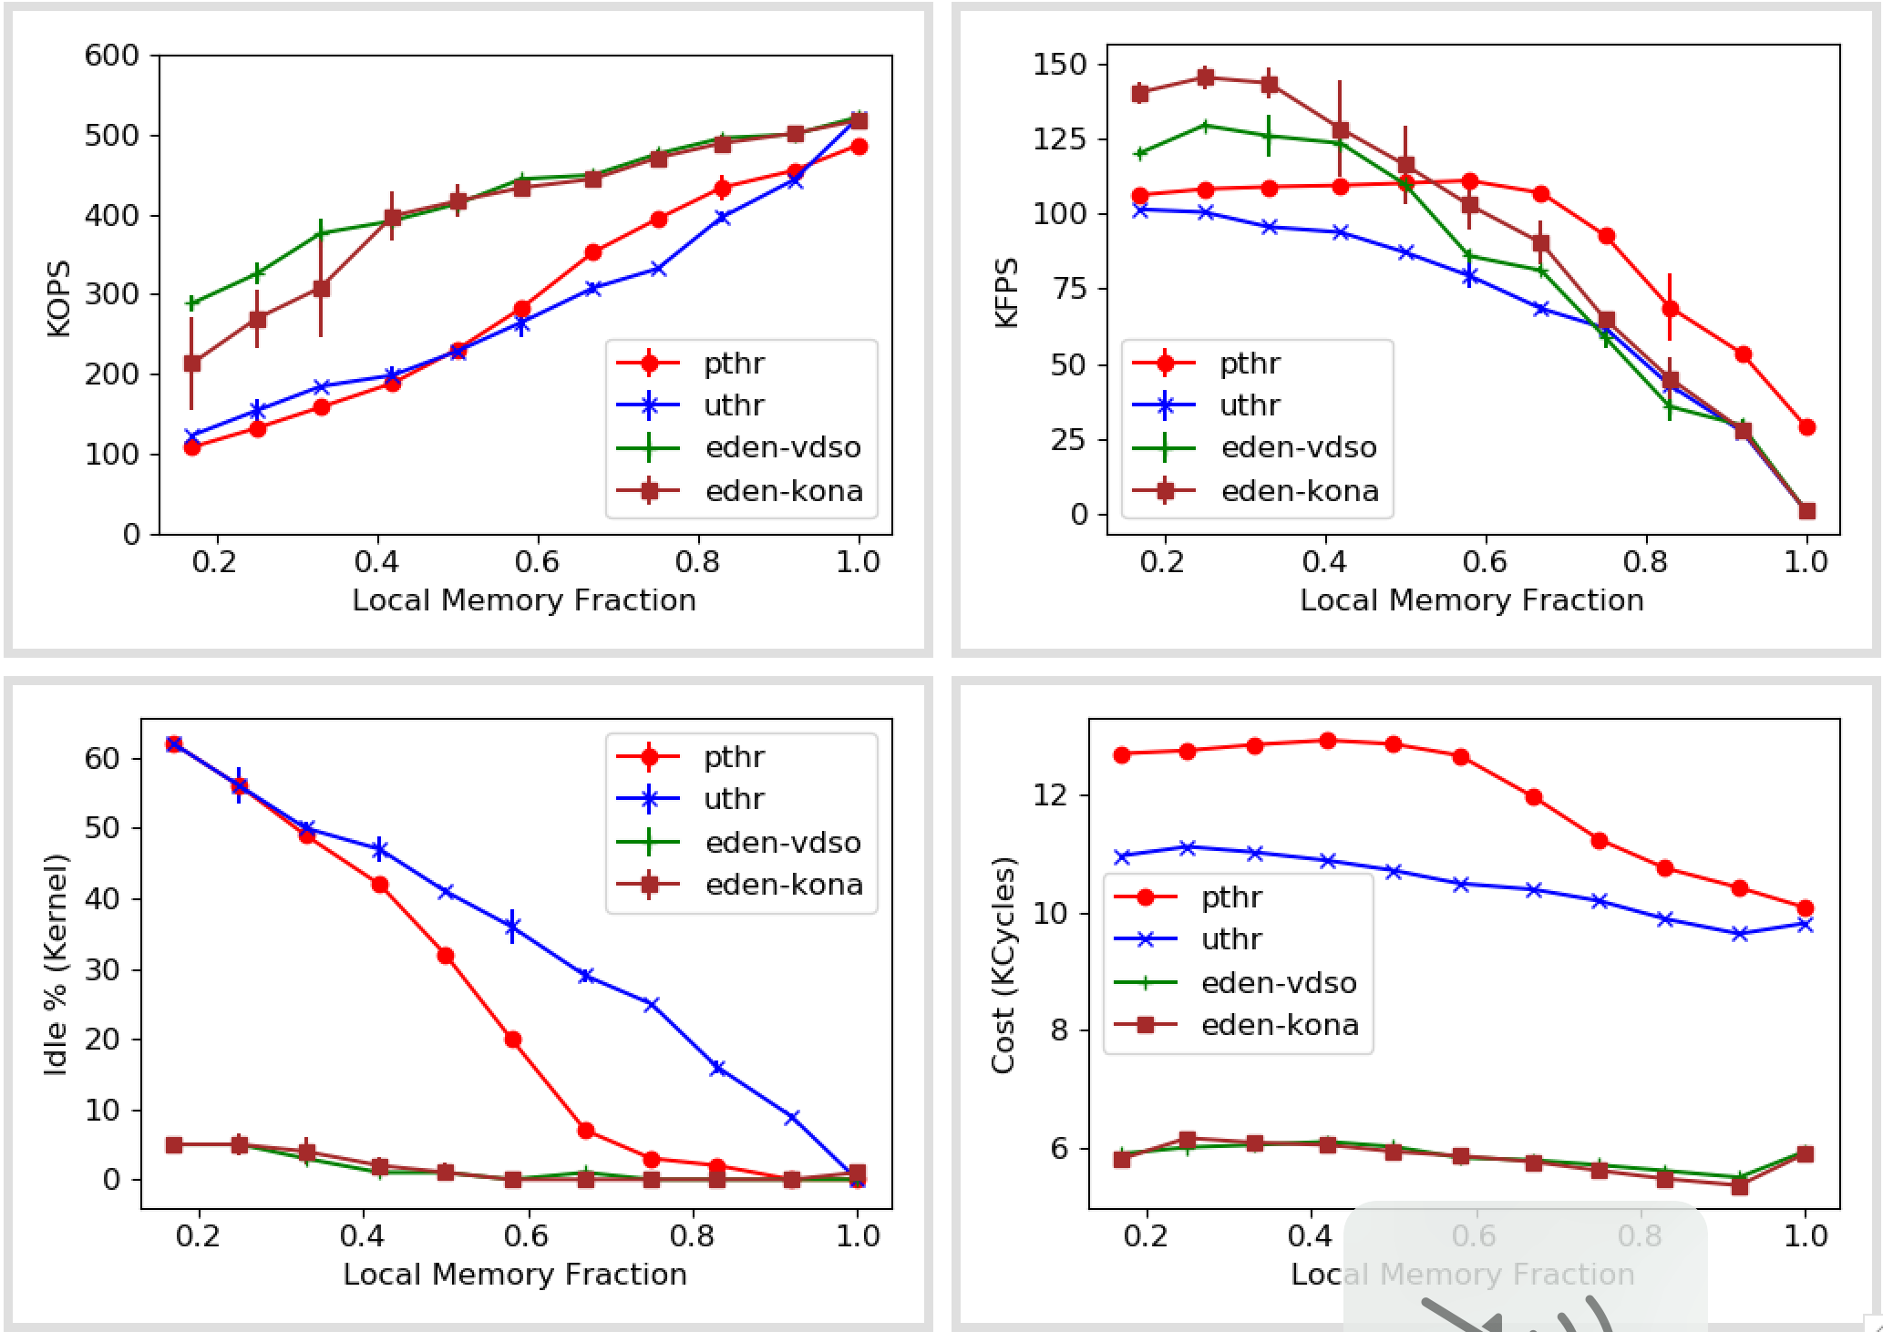
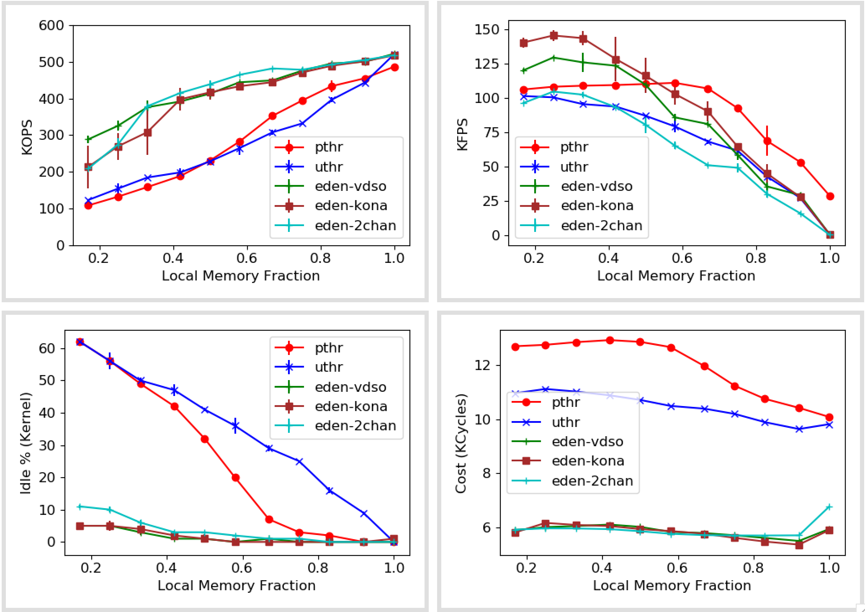
Synthetic numbers (With kona-based page checks)

Slide 8
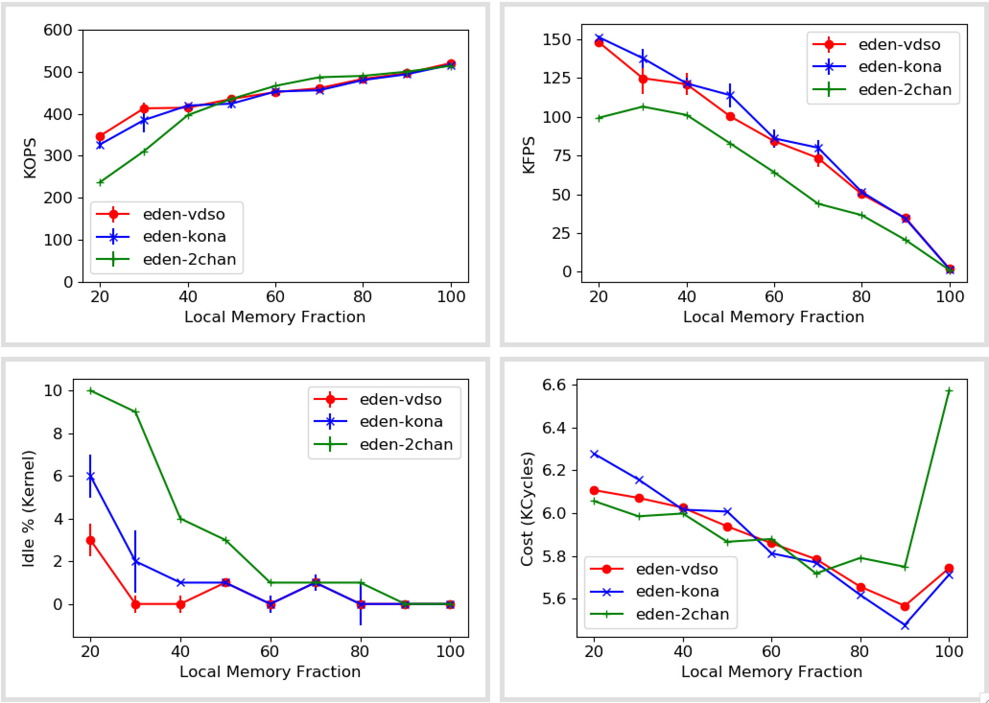
Synthetic numbers (With kona-based page checks and second-chance eviction)
Notes:
Need more work in explaining eviction

Slide 9
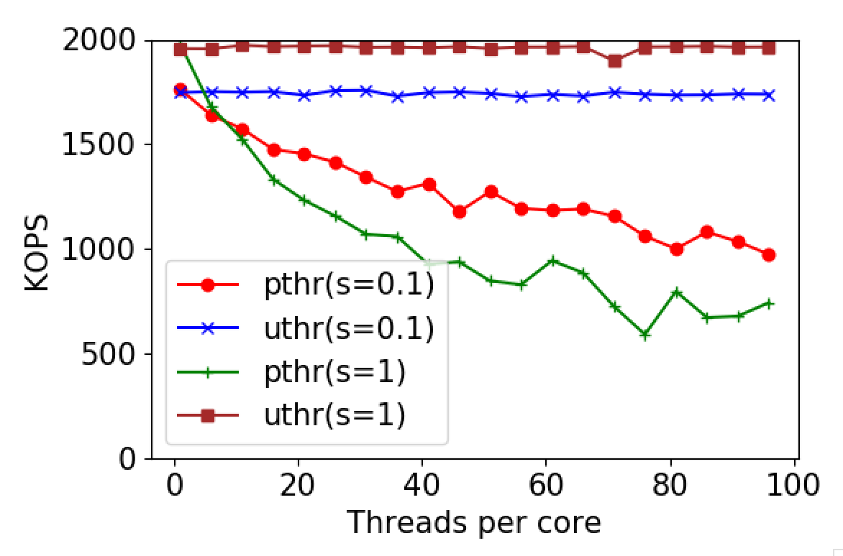
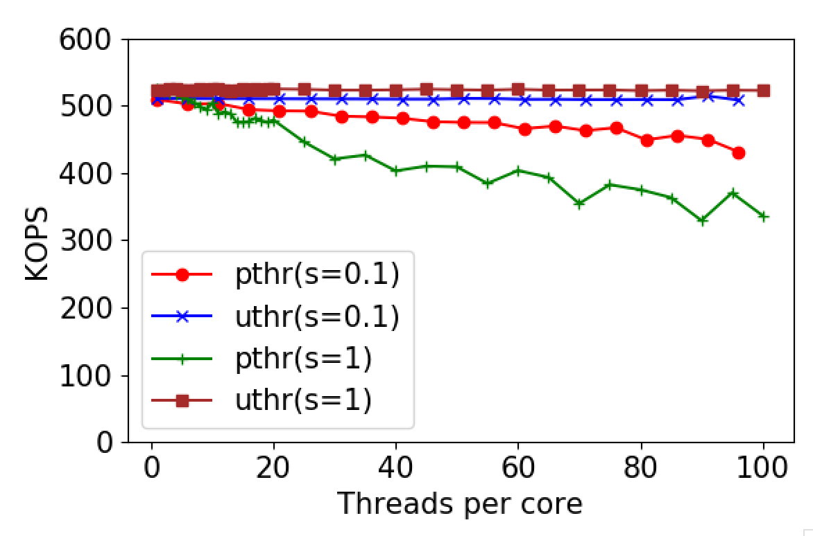
Pthreads vs Uthreads
1x Zip
5x Zip
Suspect: locking primitives
Sort doesn’t do much locking
Memcached, SiloDB, etc. wouldn’t allow comparison but can show degradation with pthreads
My guess is it’d be much worse for writes

Slide 10
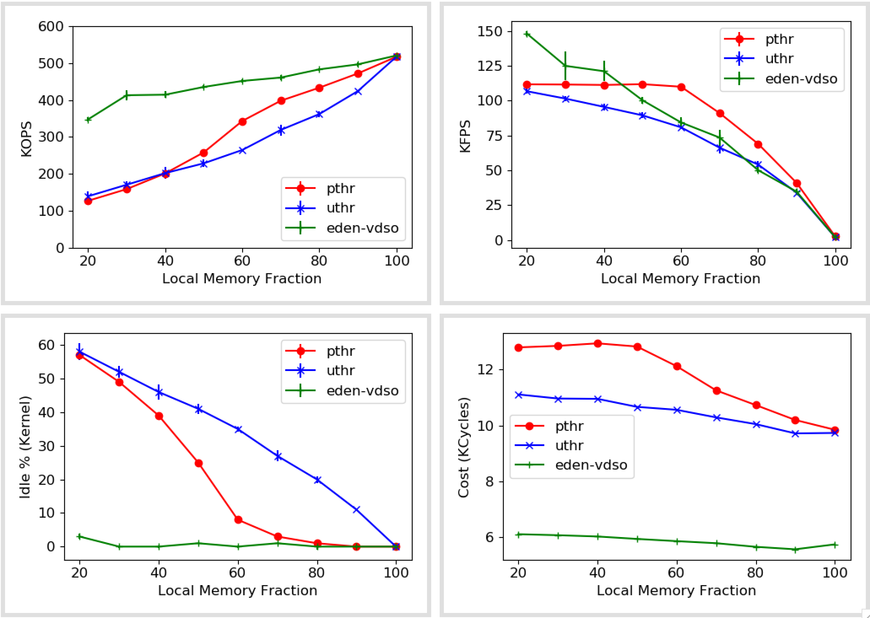
Synthetic numbers (With pthreads)
Pthreads=5/core
Uthr=40/core

Slide 11
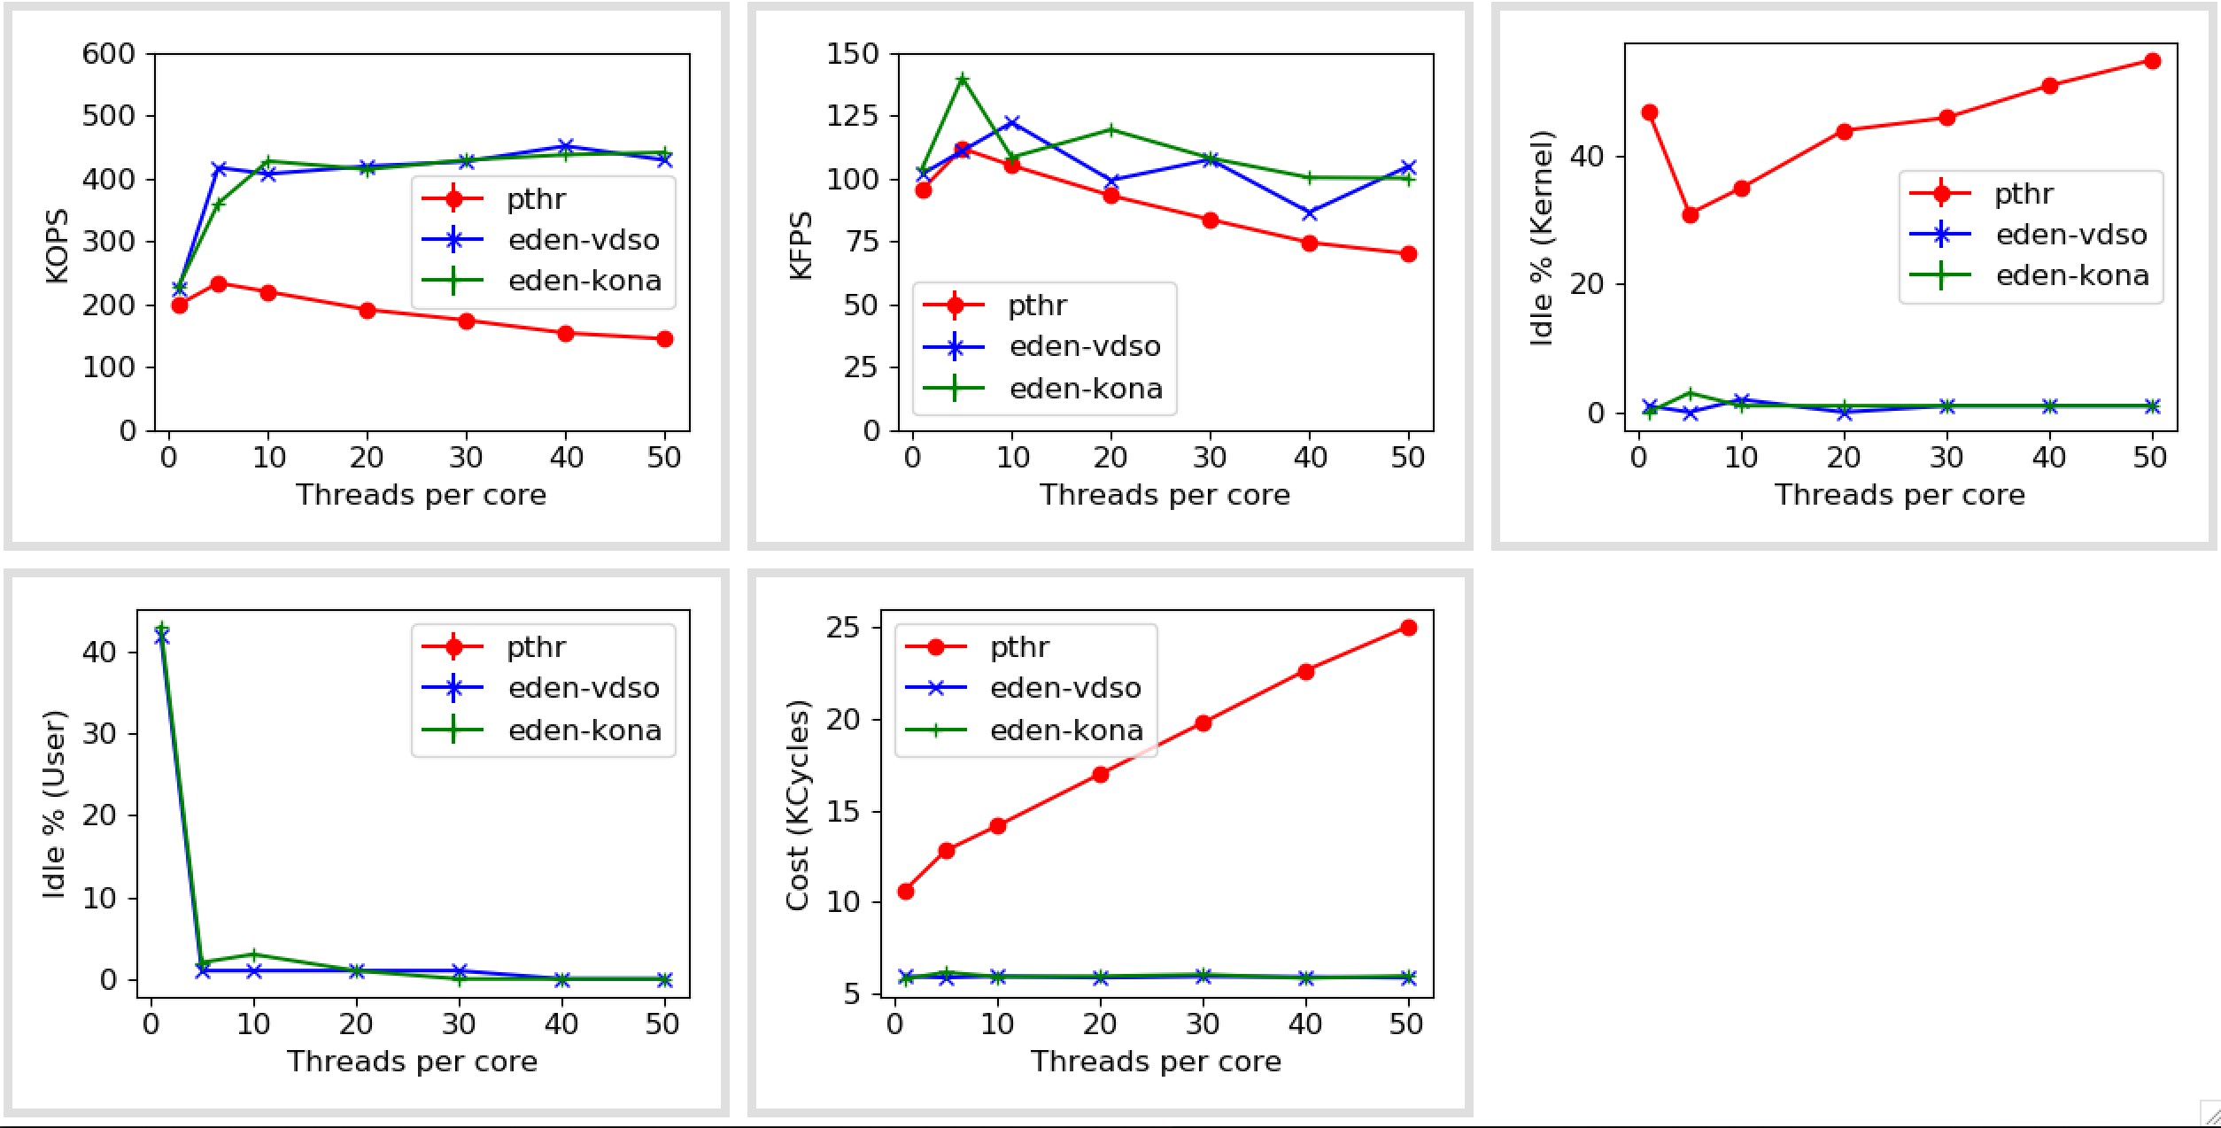
Pthreads vs Uthreads (at 50% local memory, zipfs=1)

Slide 12
In-memory databases
Databases (link) | Data model | Interface | TXN support | Known Available Benchmarks | Comments
Altibase | Relational | SQL | Yes
Hyrise | Relational | SQL | Yes |  | Research, Academic
RocksDB | KV Store | Get/Set | Yes |  | Popular
Impala | Hadoop | SQL, Other | No
Silo | Relational | Custom | Yes | TPCC, YCSB | Ported on Shenango
ClickHouse | Relational | SQL, Other | No | TPC-DS | OLAP database, Well-known
Dragonfly | KV Store | Get/Set | No
MariaDB | Relational | SQL | Yes | TPCC, TPC-DS | Commercial, Well-known
Memcached | KV Store | Get/Set | No
VoltDB | Relational | SQL | Yes |  | Only OLTP
https://dbdb.io

