Slide 1
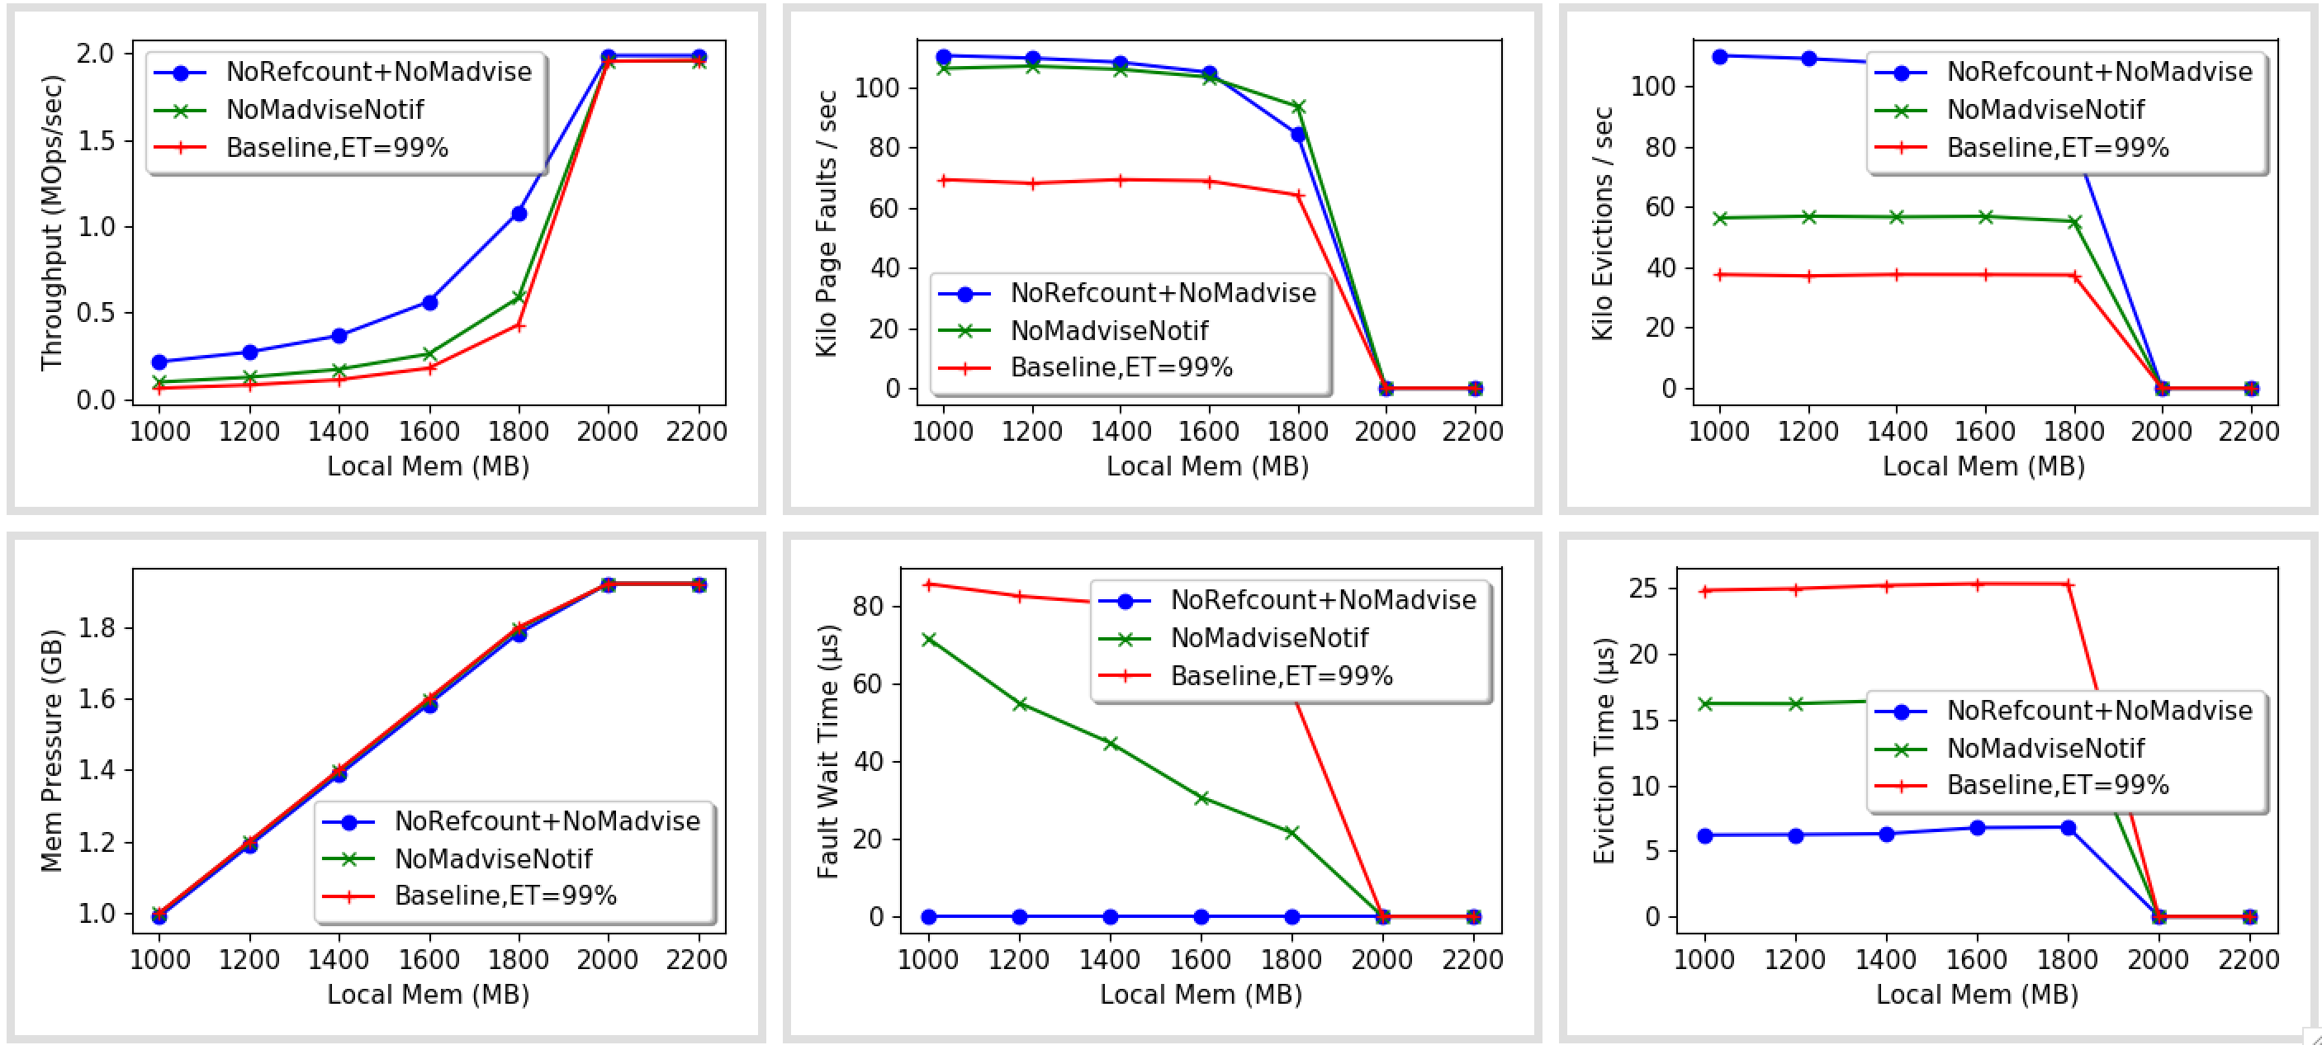
‘No-Dirtying’ Numbers

Slide 2
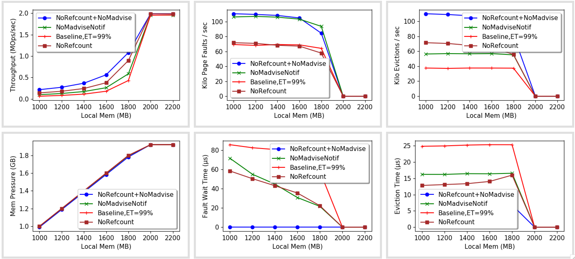
‘No-Dirtying’ Numbers

Slide 3
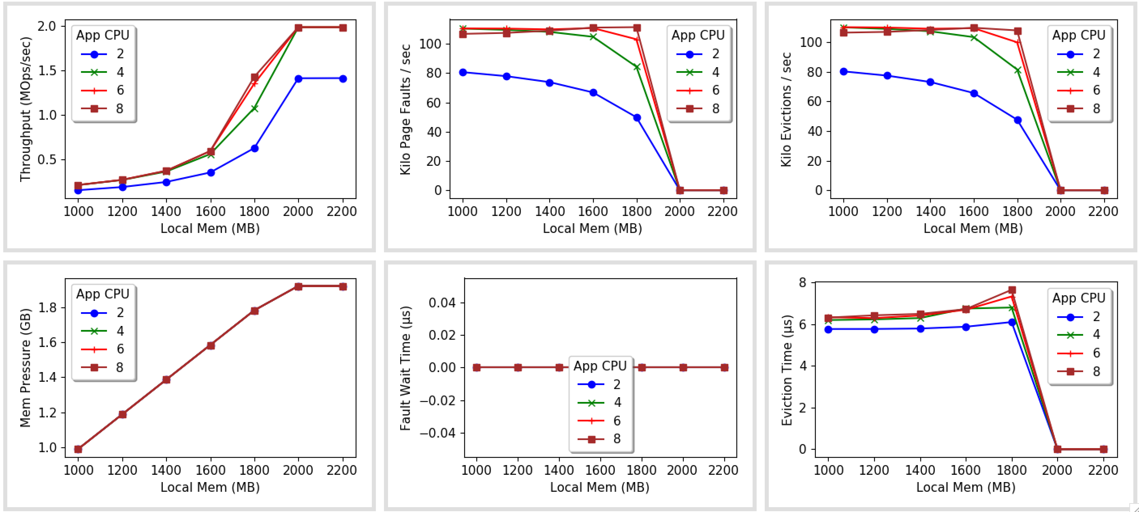
Varying CPU

Slide 4
Next

