Slide 1
Update
Wrote a simulator
Plan for emulating upcalls

Slide 2
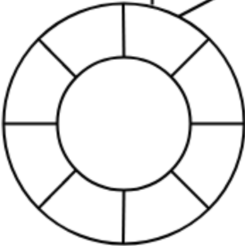
Simulator
app core
app core
kona core
workload core
app core
Token bucket rate limiter to enforce Kona capacity
app core

Slide 3
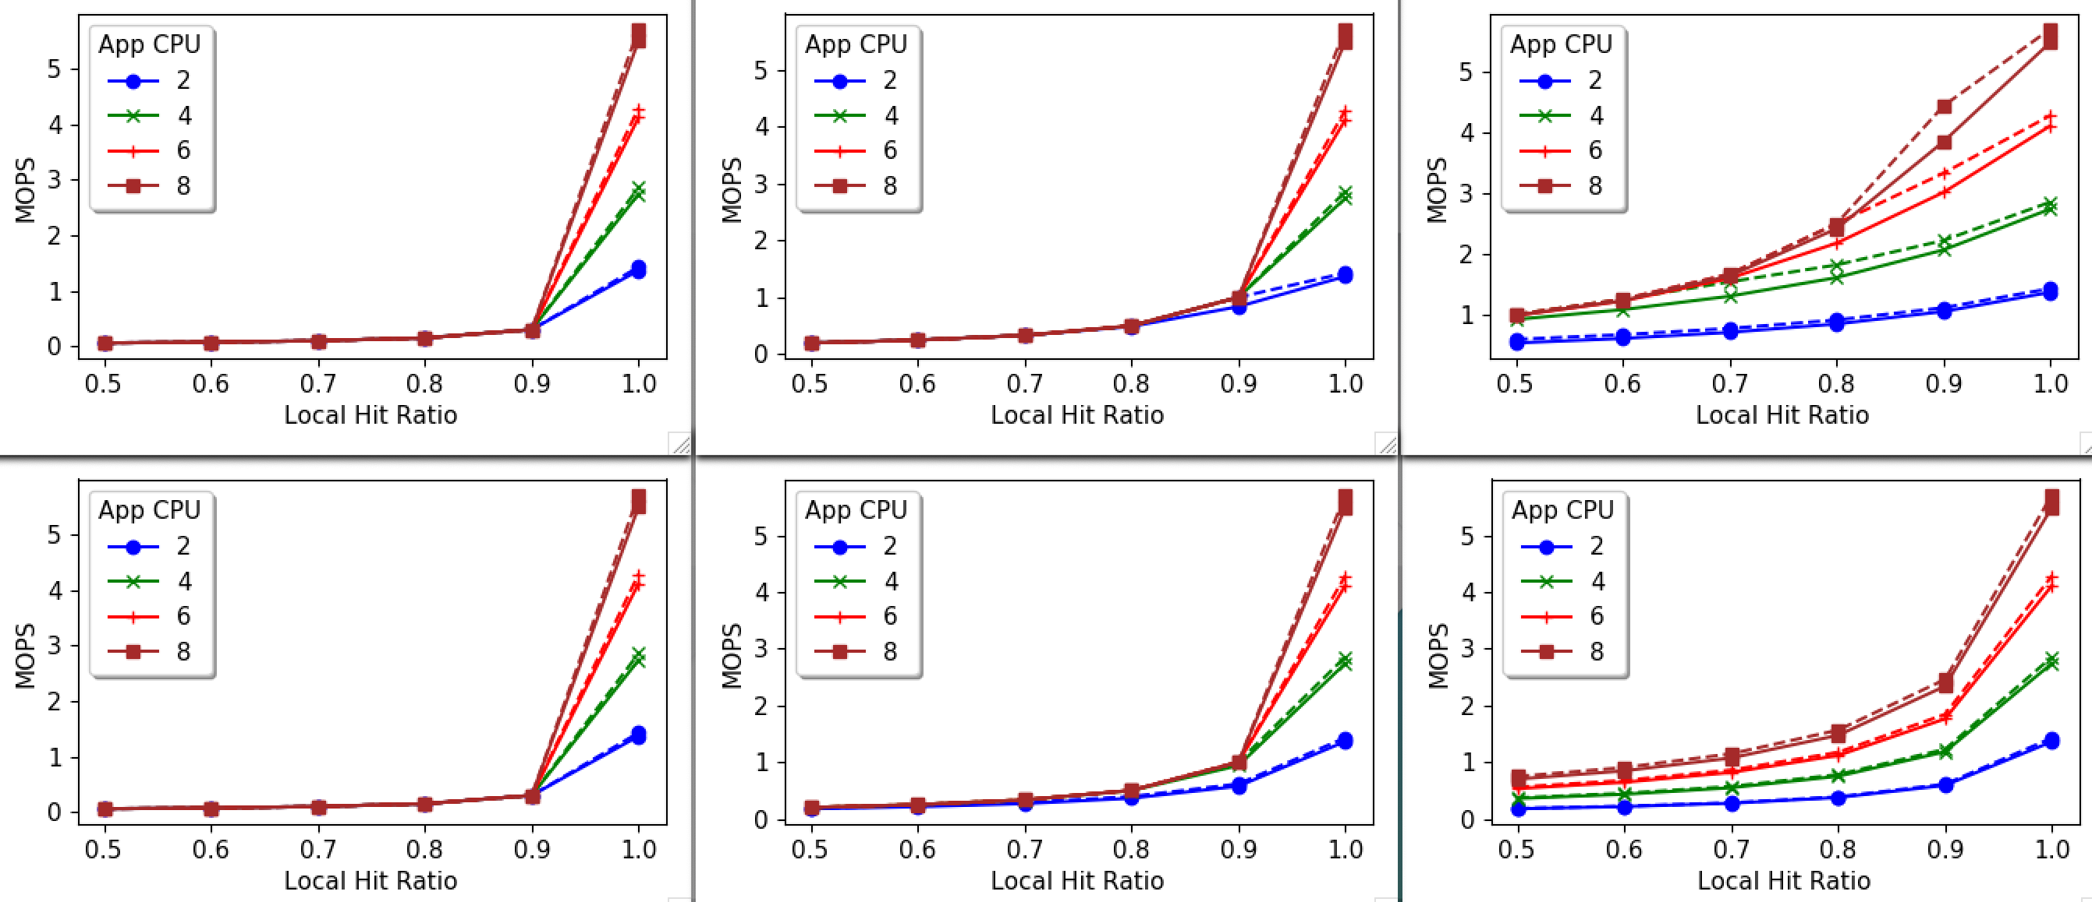
Model (--) vs Simulation (–)
Upcall
No
Upcall
Kona: 30k
Kona: 100k
Kona: 500k

Slide 4
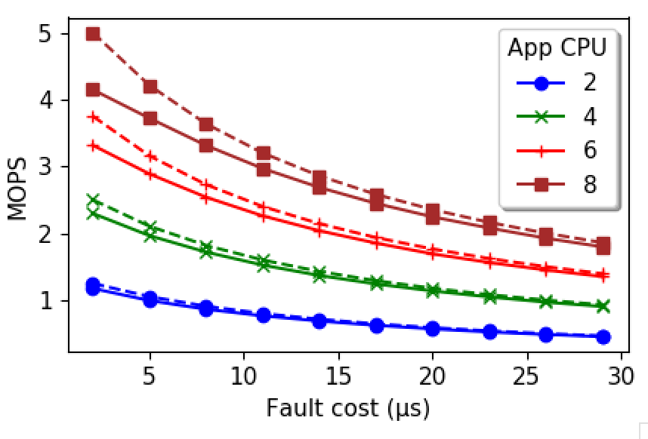
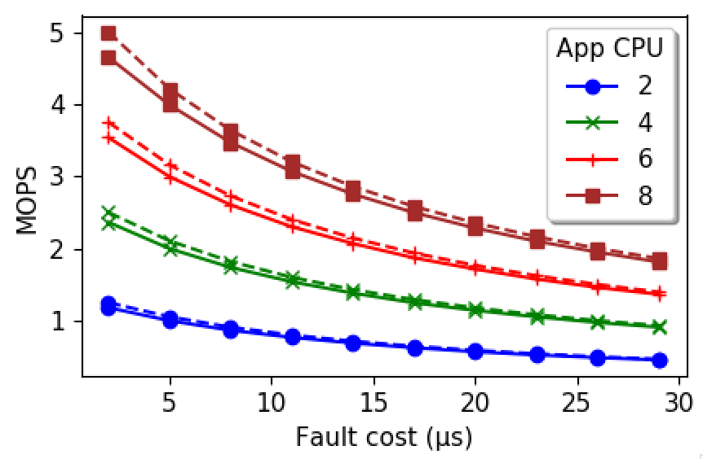
Issue: Kona burst size
Burst size = 1
Burst size = App CPU

Slide 5
Model (--) vs Simulation (–)
Upcall
No
Upcall
Kona: 30k
Kona: 100k
Kona: 500k

Slide 6
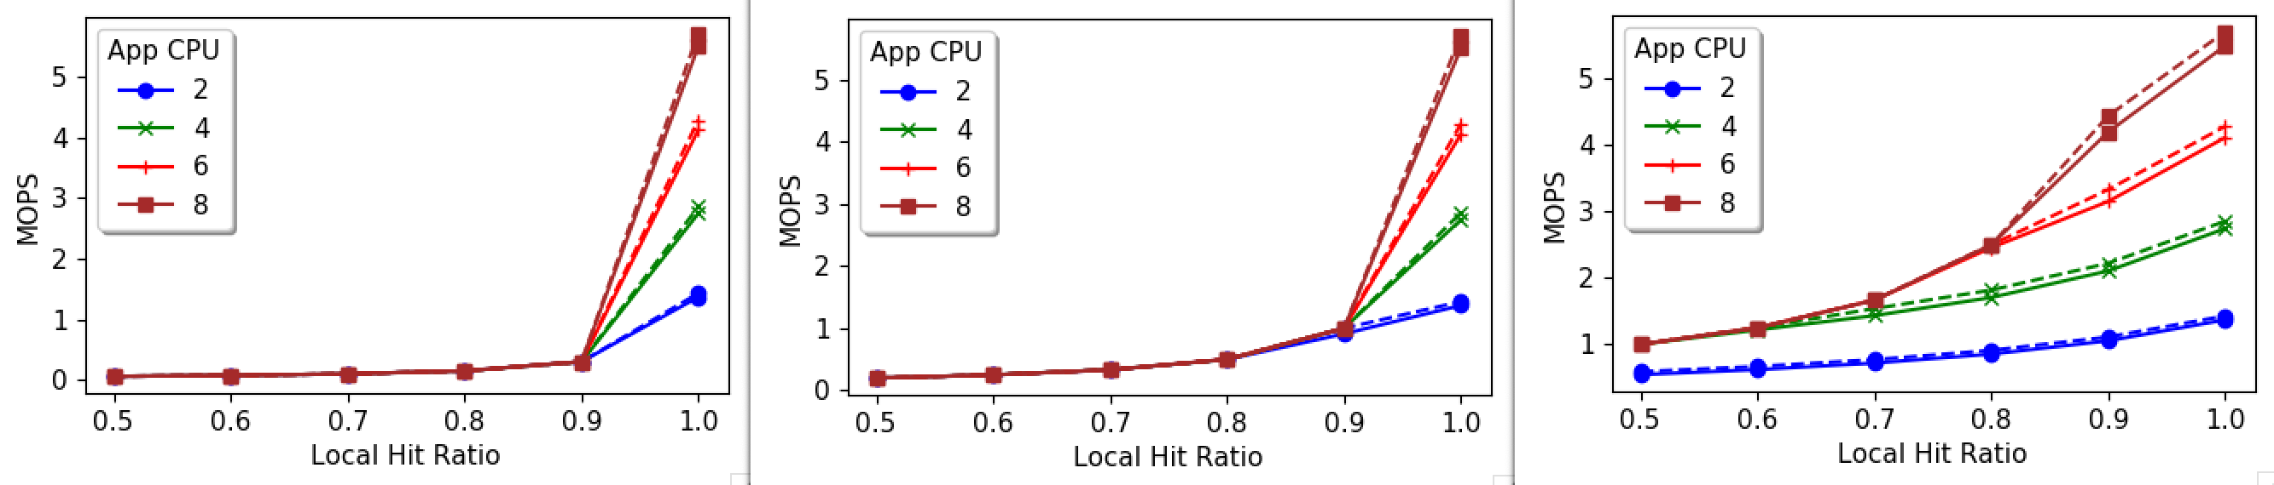
Model (--) vs Simulation (–)
Upcall
No
Upcall
Kona: 30k
Kona: 100k
Kona: 500k

Slide 7
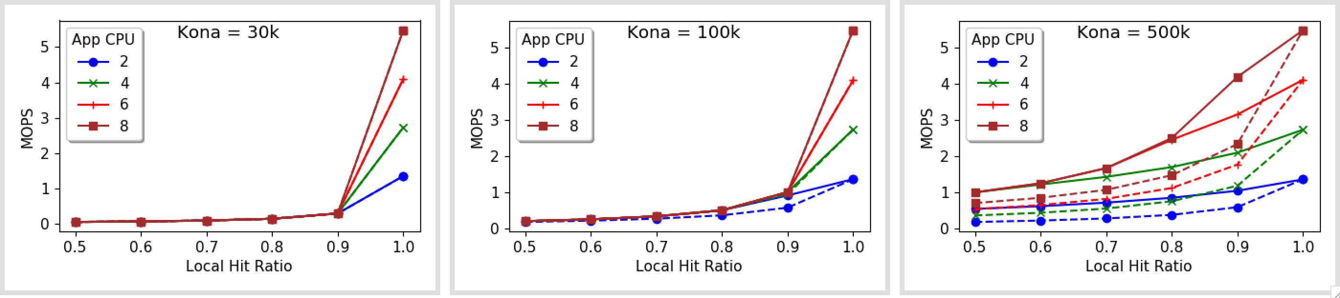
Upcalls : With (–) vs Without (--)

Slide 8
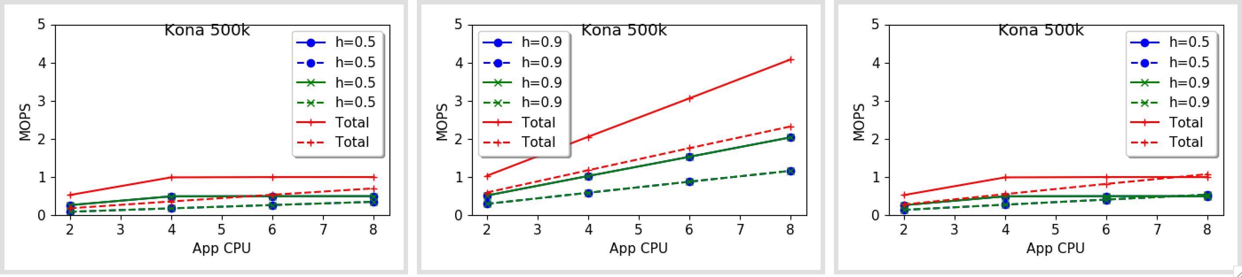
Two workloads: Basic

Slide 9
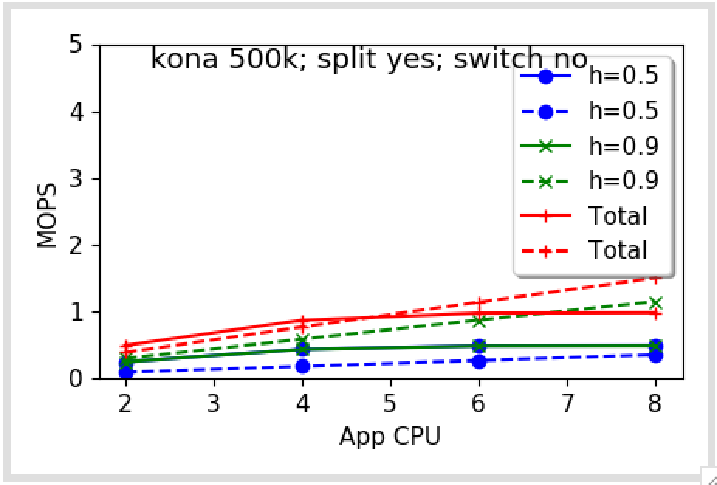
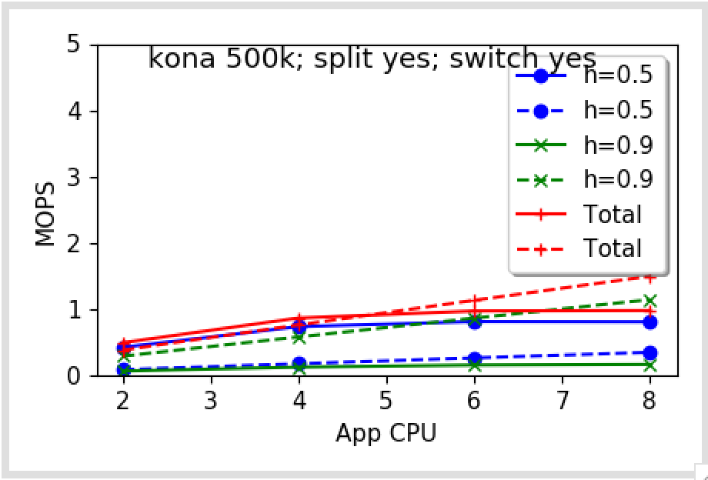
Two distributions

Slide 10
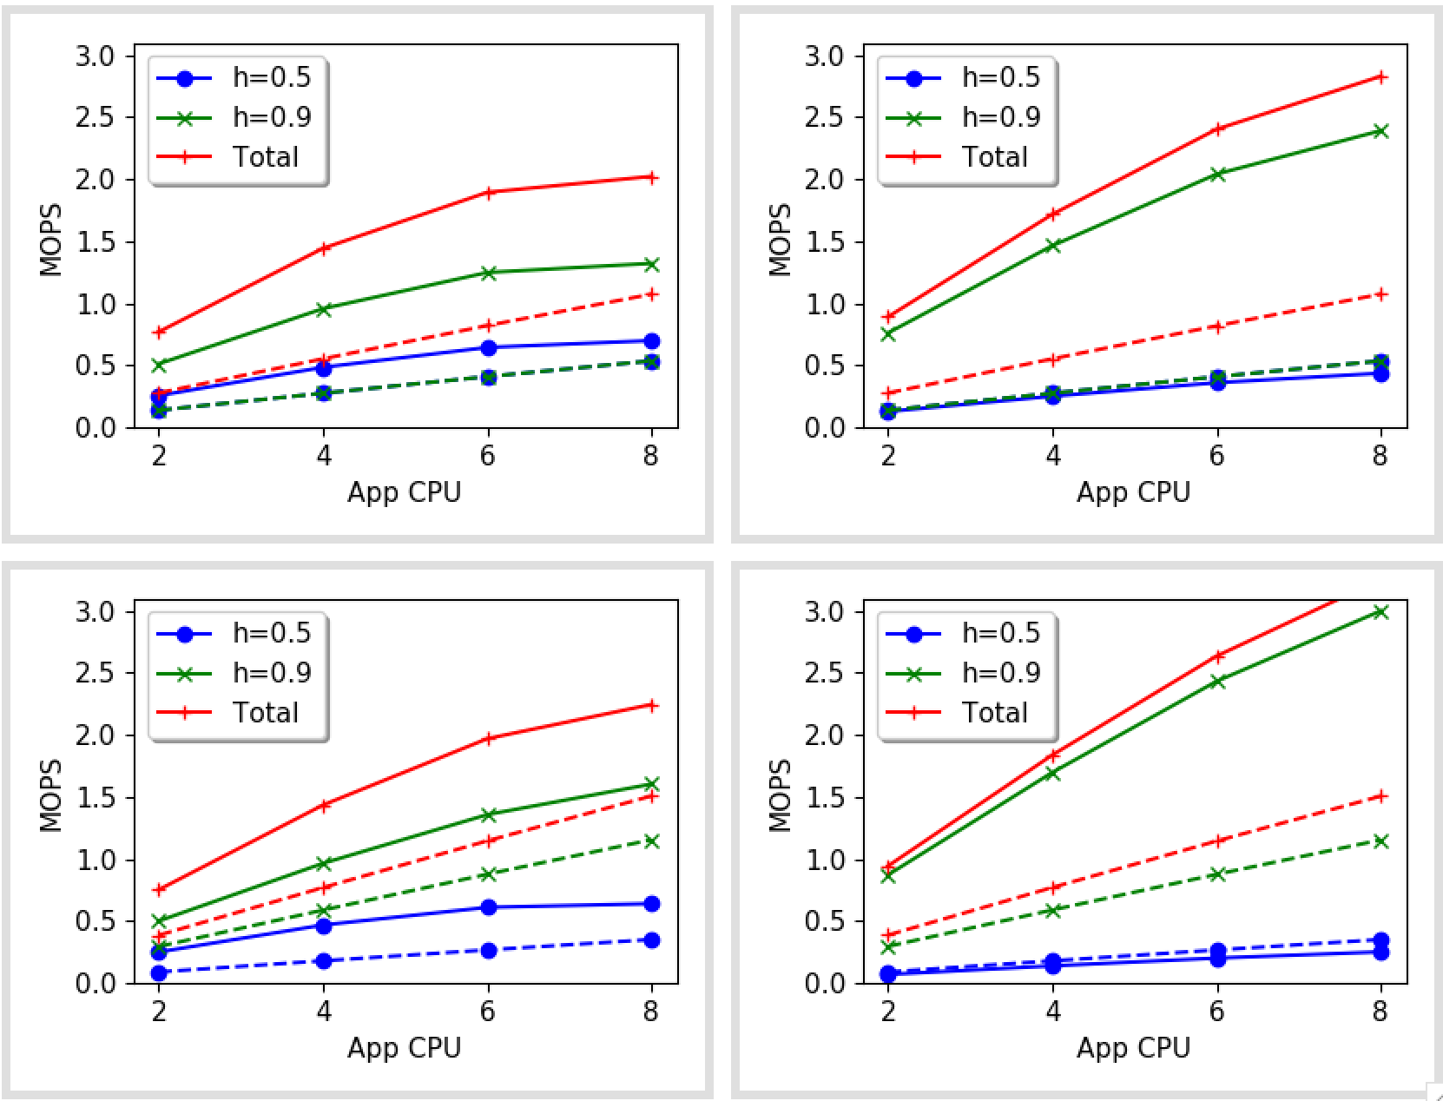
Kona = 500k
Observations:
Upcalls benefit all the cases
Left to right: dotted lines shouldn’t change
Top-down: dotted lines split
Upcalls achieve what split cores do – maybe that’s good?
Left to right: total and green go up, at the expense of blue. Why does blue go down?
Split NO YES
Switch NO YES

Slide 11
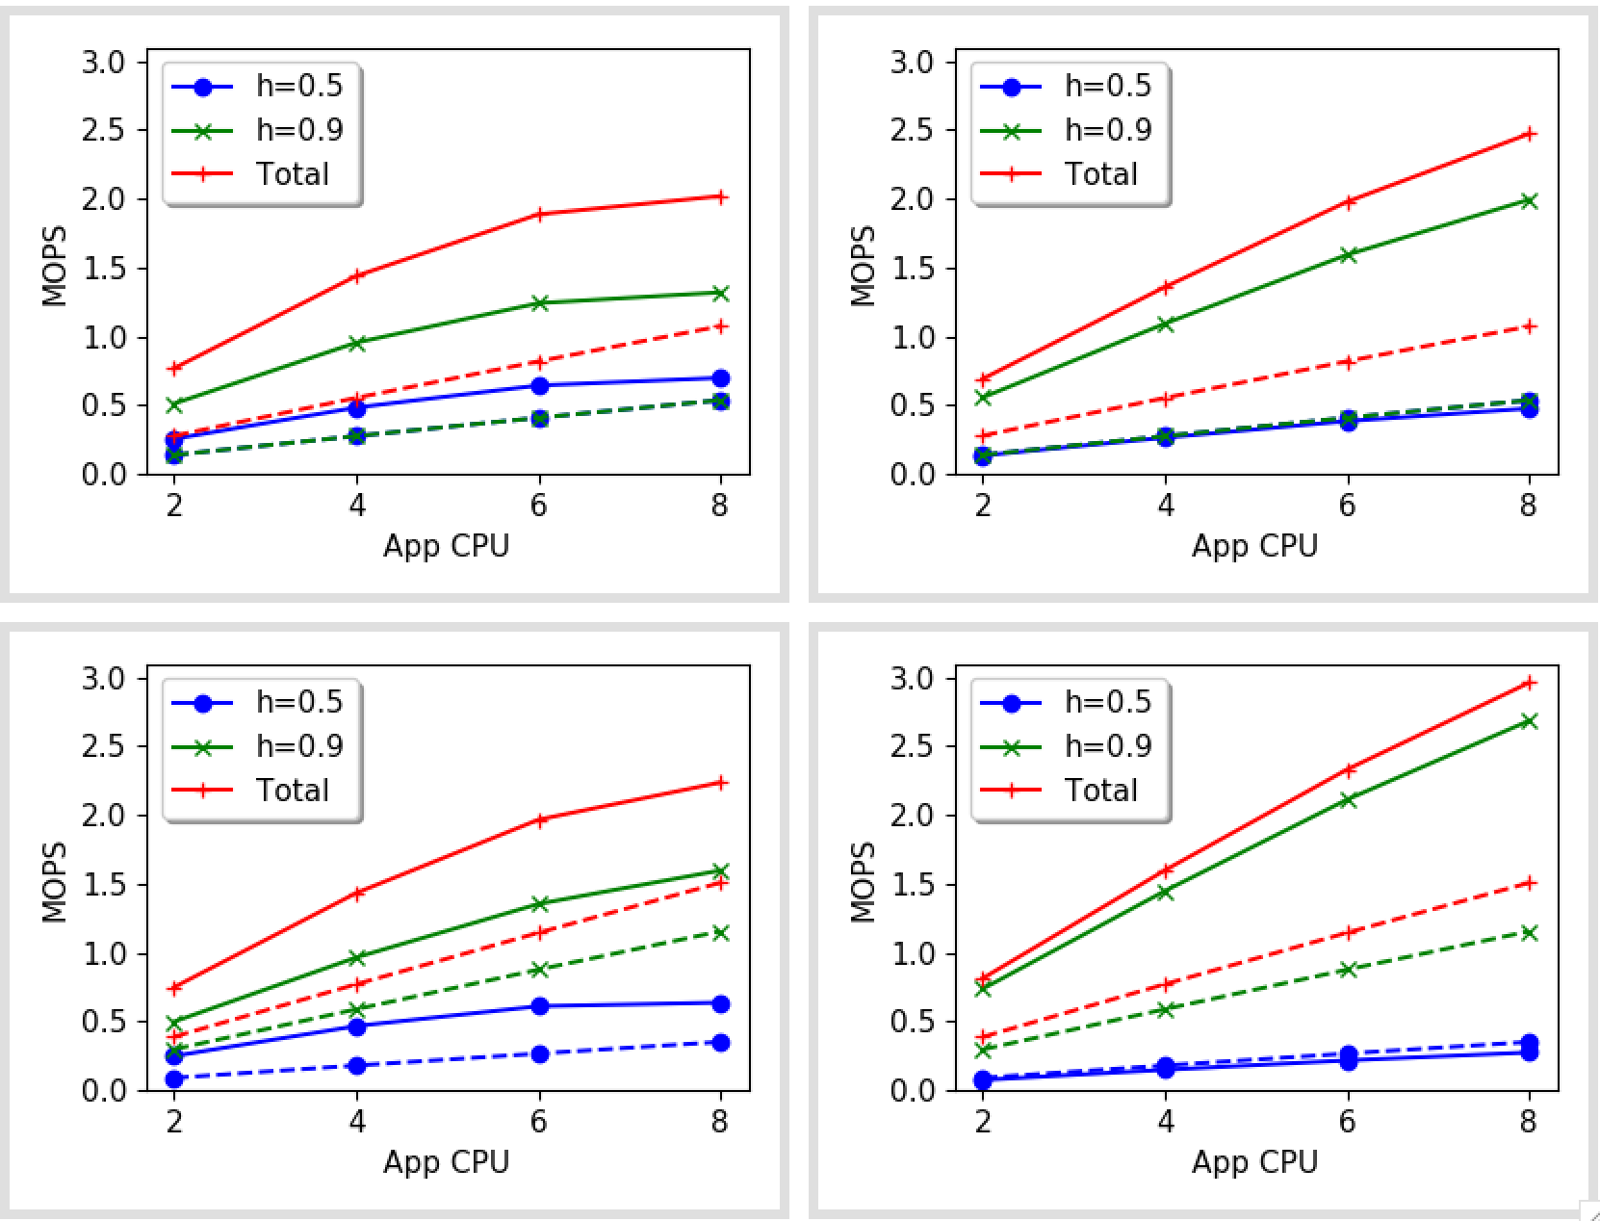
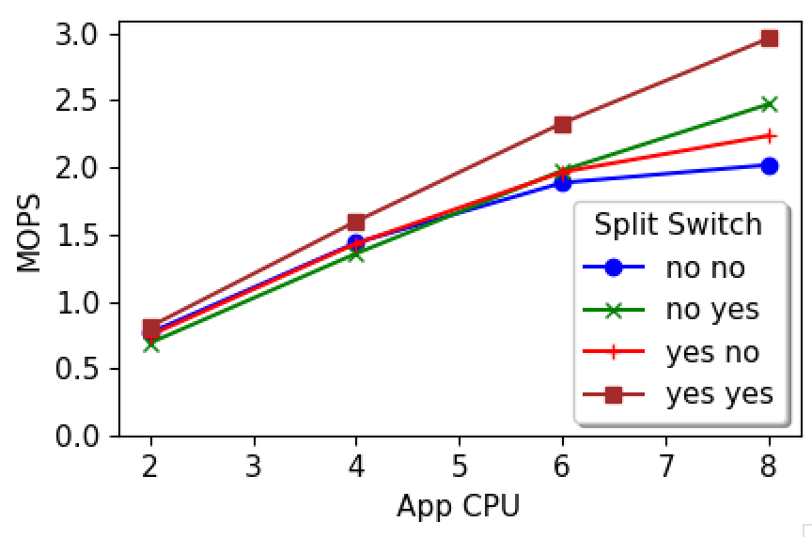
Kona = 500k (updated)
Take away:
Split and switch benefits are minimal with upcalls when kona can handle page faults?
Split NO YES
Switch NO YES

Slide 12
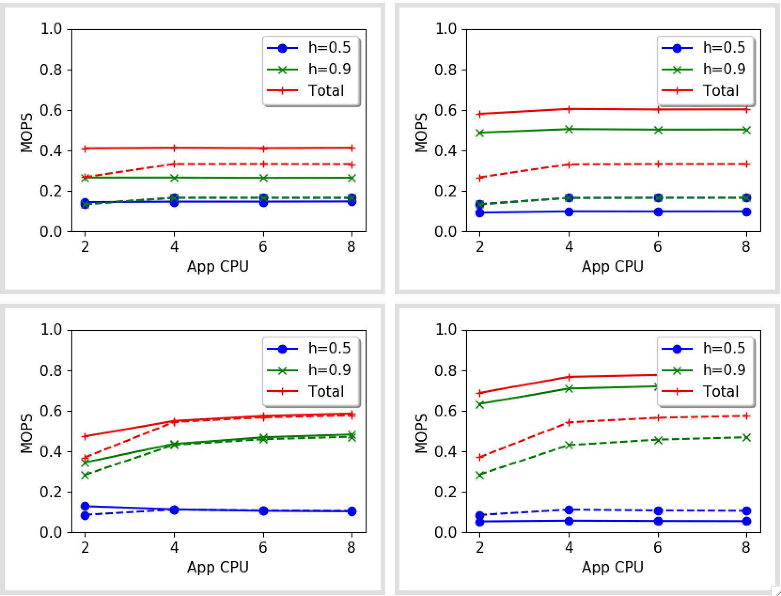
Kona = 100k
Observations:
Upcalls benefit all the cases
Left to right: dotted lines shouldn’t change
Top-down: dotted lines split
Upcalls achieve what split cores do – maybe that’s good?
Left to right: total and green go up, at the expense of blue. Why does blue go down?
Split NO YES
Switch NO YES

Slide 13
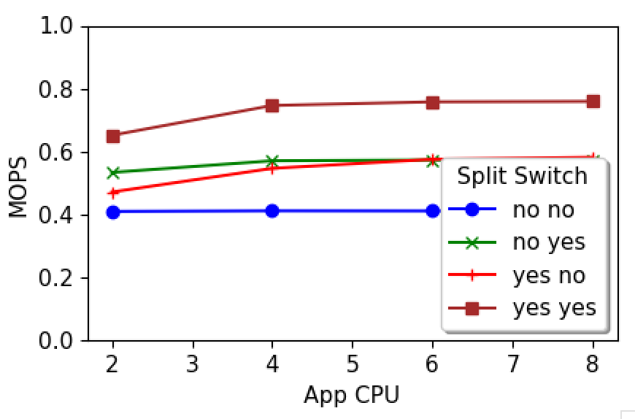
Kona = 100k
Take away:
How does split and switch help?
Split NO YES
Switch NO YES

Slide 14
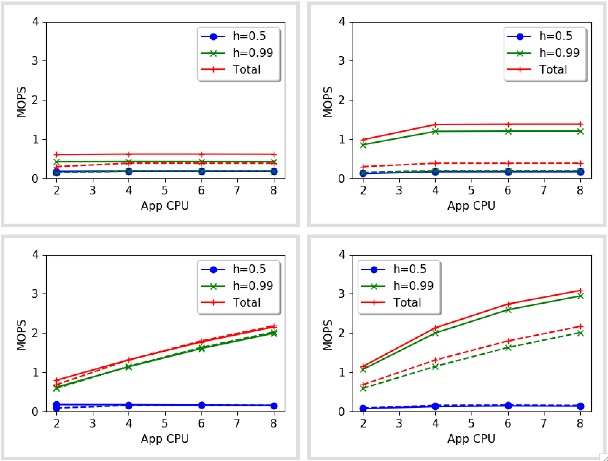
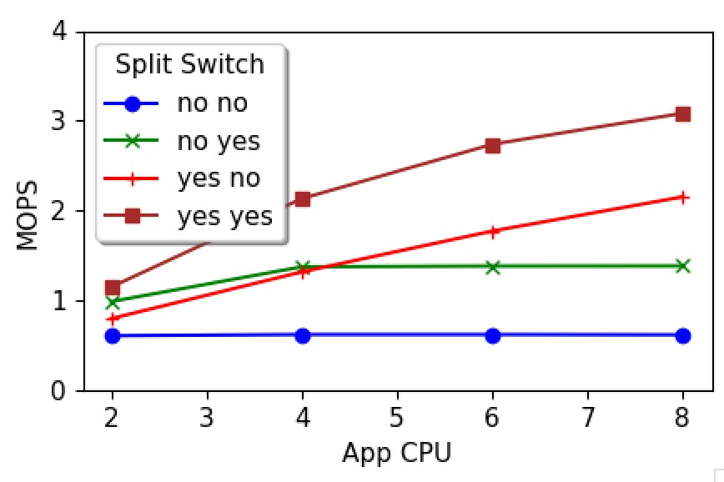
Kona = 100k
Increasing hit ratio
Split NO YES
Switch NO YES

Slide 15
Plan for December
prefetch_page() vDSO call – test & integrate with Memcached
Graph benchmark
Couple more pages to paper?

