Slide 1
Agenda
Meeting with Amy
PARSEC with Kona
Hunt for In-memory databases
Insights from “space-efficient scheduling” papers

Slide 2
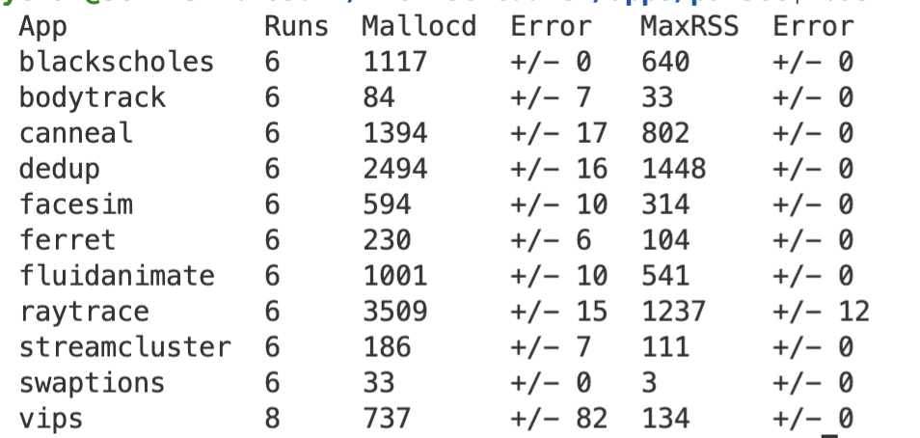
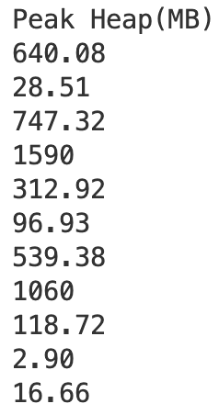
Memory footprint variance
Kona
Heaptrack
Heaptrack on Kona challenging – both intercepting with LD_PRELOAD
Still debugging seg faults with Kona for apps at <100% local mem
Notes:
TODO try heaptrack on Kona
TODO Look at variance across multiple runs
Look closely at vips

Slide 3
Amy’s feedback
Automatic polling vs switching threads
Static hinting vs no-hinting
Profile-guided optimizations
Either/or – nothing scheduler can do
Scheduler makes the call
Alternative could be idling or just switching to a “better” thread
Based on per-thread memory pressure/working set?
Or per-thread fault rate: stop switching if it is faulting more?
Will probably converge on the space-efficient literature
Our previous thought: find other examples before I optimize for Sort

Slide 4
In-memory databases
Benchmarks
TPC-C (OLTP)
TPC-H/TPC-DS (OLAP)
Are there any representative microbenchmarks?
Substrates
Silodb (TPC-C in Caladan, modeled in Persephone) – To read
SAP HANA (tried on CXL)
Plan to explore VLDB, SIGMOD, ASPLOS, ISCA for examples

Slide 5
Misc

Slide 6
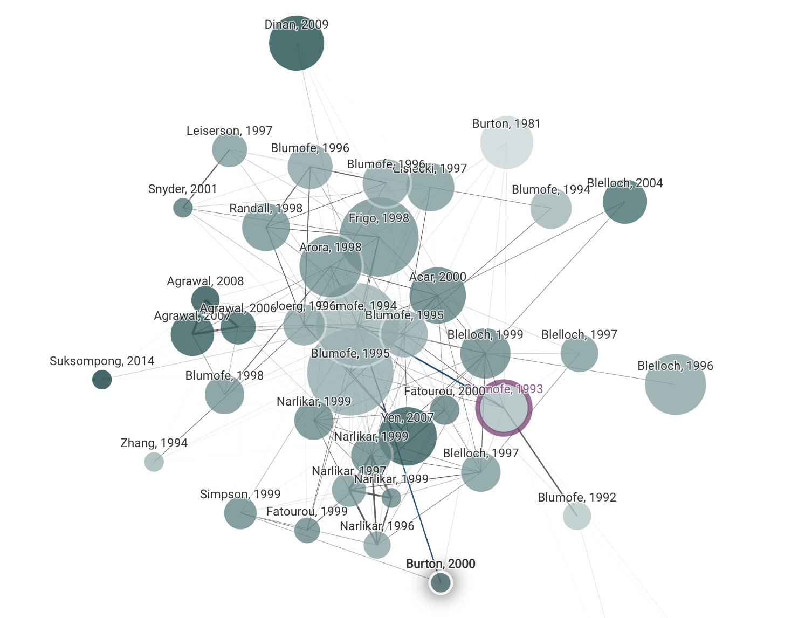
Space-efficient scheduling
Parallel programs take more memory than sequential counterparts
Applies for remote memory
Batch style apps: matmul, parallel sort, image processing, etc.
Previous solutions based on DAG analysis, mostly theoretical
Notes:
Ray
Anyscale (startup)

Slide 7
Facebook’s CXL workloads
Web. “Web implements a Virtual Machine with Just-In-Time (JIT) compilation and runtime system to serve web requests from end-users”
Cache. “Cache is a large distributed-memory object caching service lying between the web and database tiers for low-latency data-retrieval”
Data Warehouse. “This service manages and coordinates the execution of long and complex batch queries on data across a cluster. A query served by this service can consume terabytes of memory and may take days to complete”
Notes:
First two like Synthetic and Memcached
Series of big SQL joins?
Extreme memory setups like 1:4 configuration is useful in flexible server design with DRAM as a small-sized local node and CXL-Memory as a large but cheaper memory.

Slide 8
TODOs
PARSEC on Kona
Use cases: look at some in-memory/graph processing databases
Keep reading some past literature
Space-efficient scheduling
NUMA data distribution/scheduling

Slide 9
Misc

Slide 10
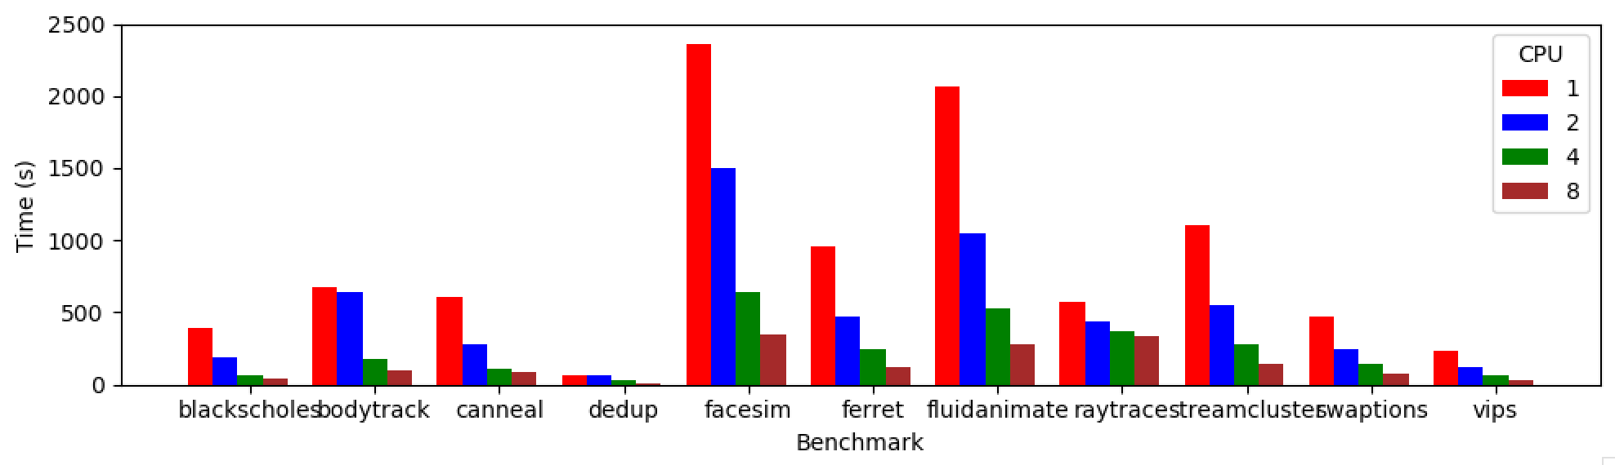
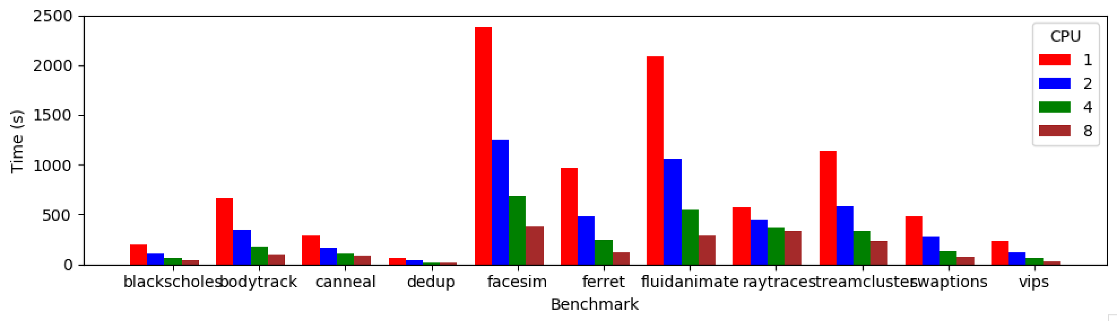
PARSEC Performance
1 pthread/core
4 pthreads/core

Slide 11
PARSEC Performance
1 pthread/core

