Slide 1
Agenda
ASPLOS reviews/reaction
PARSEC with Kona
Hunt for In-memory databases
Insights from “space-efficient scheduling” papers

Slide 2
ASPLOS reviews
Reaction
List of action items
Plan for resubmission
Amy’s feedback

Slide 3
Action items

Slide 4
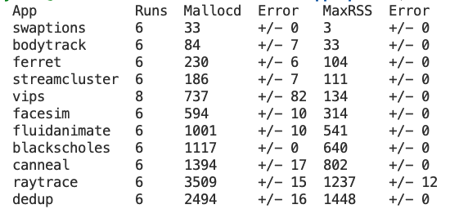
PARSEC on Kona
Kona profile for bottom five
Didn’t look at Vips

Slide 5
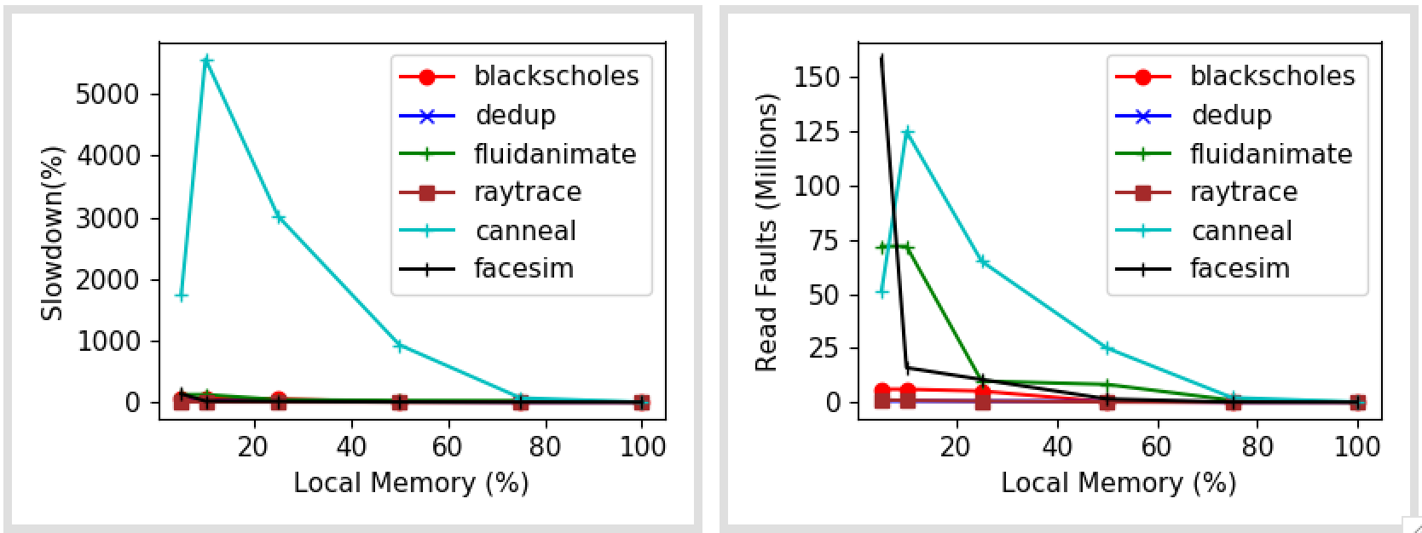
PARSEC on Kona

Slide 6
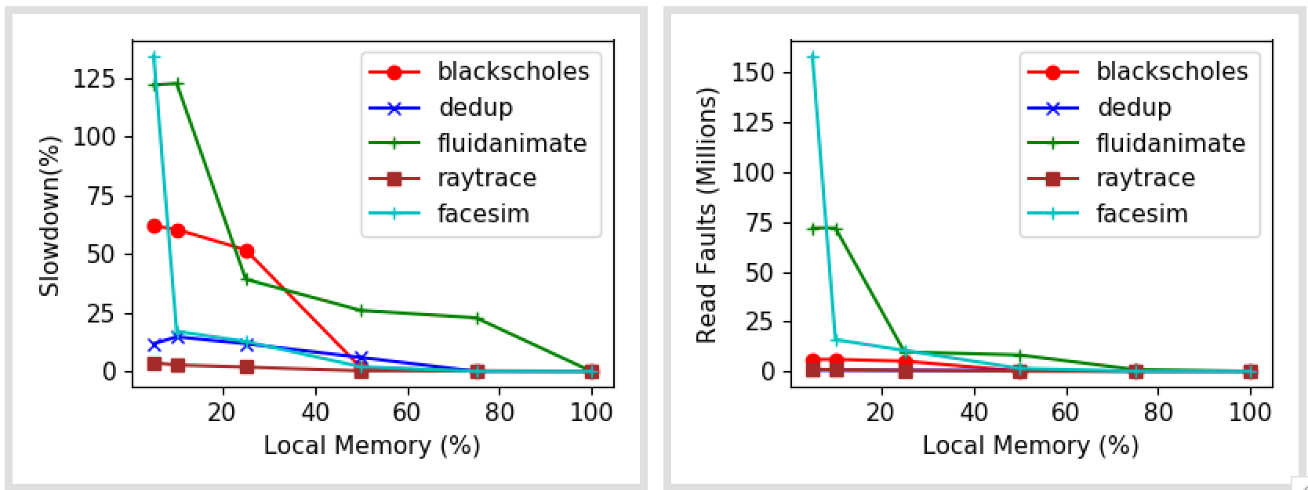
PARSEC with Kona

Slide 7
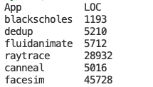
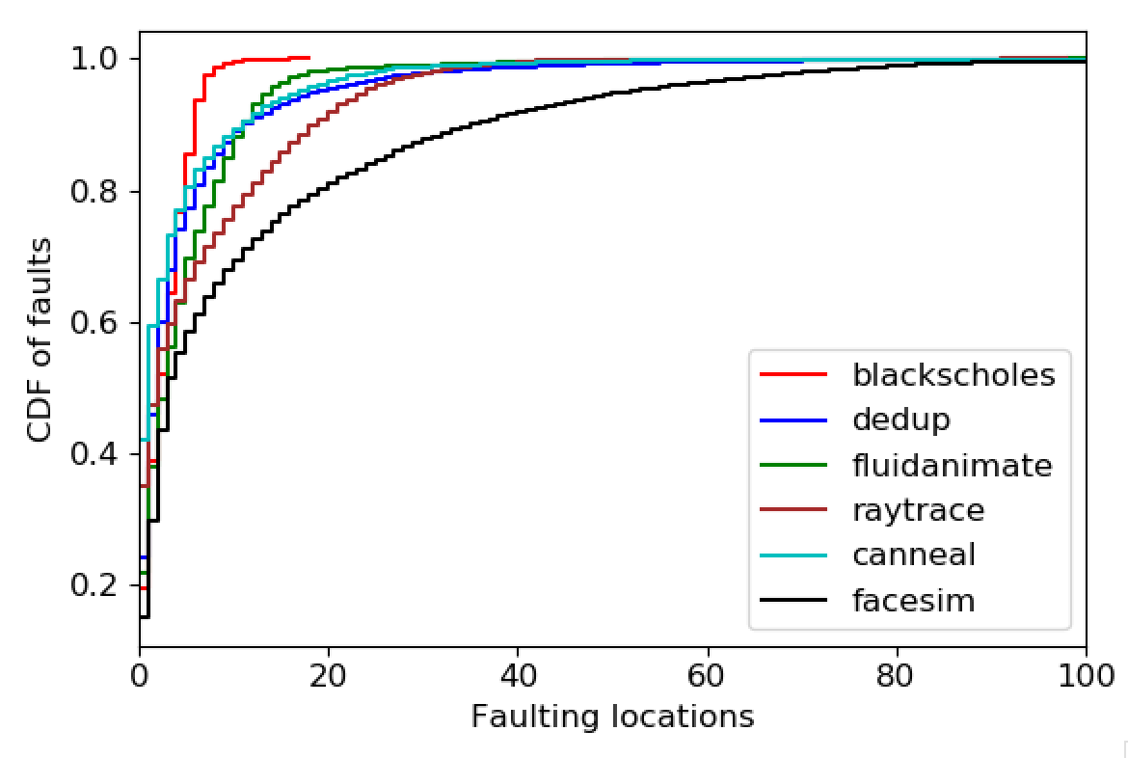
Fault locations (5% local mem)
Upper bound for changes for Eden
In LOC terms

Slide 8
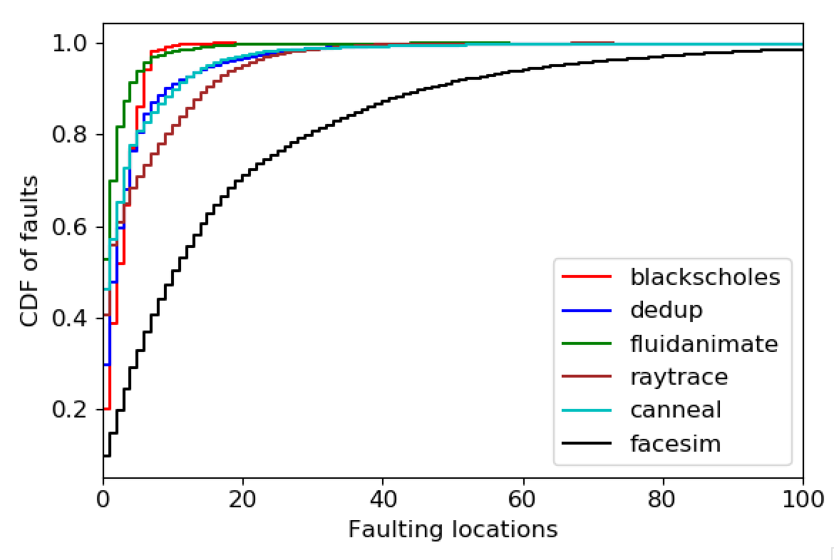
Fault locations (25% local mem)

Slide 9
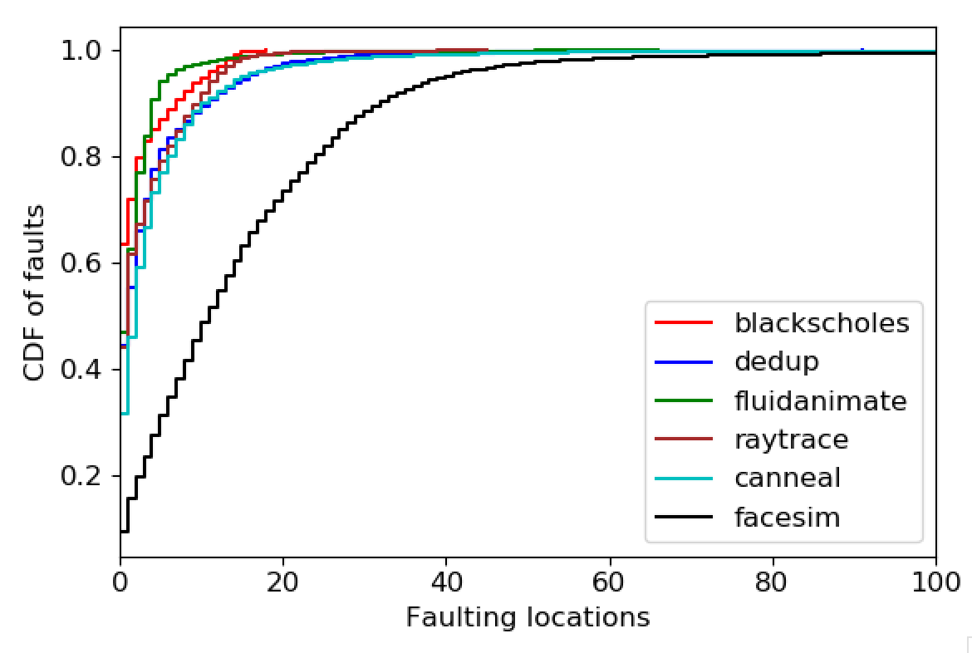
Fault locations (50% local mem)

Slide 10
How to automatically annotate?
Is there a way to point out variable?
Quantifying the annotation effort
For canneal:

Slide 11
In-memory databases
Databases (link) | Data model | Interface | TXN support | Known Available Benchmarks | Comments
Altibase | Relational | SQL | Yes
Hyrise | Relational | SQL | Yes |  | Research, Academic
RocksDB | KV Store | Get/Set | Yes |  | Popular
Impala | Hadoop | SQL, Other | No
Silo | Relational | Custom | Yes | TPCC, YCSB | Ported on Shenango
ClickHouse | Relational | SQL, Other | No | TPC-DS | OLAP database, Well-known
Dragonfly | KV Store | Get/Set | No
MariaDB | Relational | SQL | Yes | TPCC, TPC-DS | Commercial, Well-known
Memcached | KV Store | Get/Set | No
VoltDB | Relational | SQL | Yes |  | Only OLTP
https://dbdb.io

Slide 12
On AIFM
Amy’s suggestion
Quantifying developer effort
Apps to compare to AIFM
Synthetic
C++ Dataframe library ← new app?

Slide 13
Space-bounded scheduling
Left-first, depth-first scheduling (no memory info)
LIFO work queues
Per-processor or global
Schedule thread with likely best resident set to finish faster
Similar to thread-RSS mapping
Limit fanout of ready threads at any point

Slide 14
Next
Fault locations for PARSEC
New apps: SiloDB, AIFM Dataframe library
Invite Amy to Monday’s meeting?

