Slide 1
Exploiting Concurrency for Practical Memory Disaggregation
Anil Yelam†, Nadav Amit*, Radhika Niranjan Mysore*, Marcos K. Aguilera*, Alex C. Snoeren†
† UC San Diego
*VMware Research

Slide 2
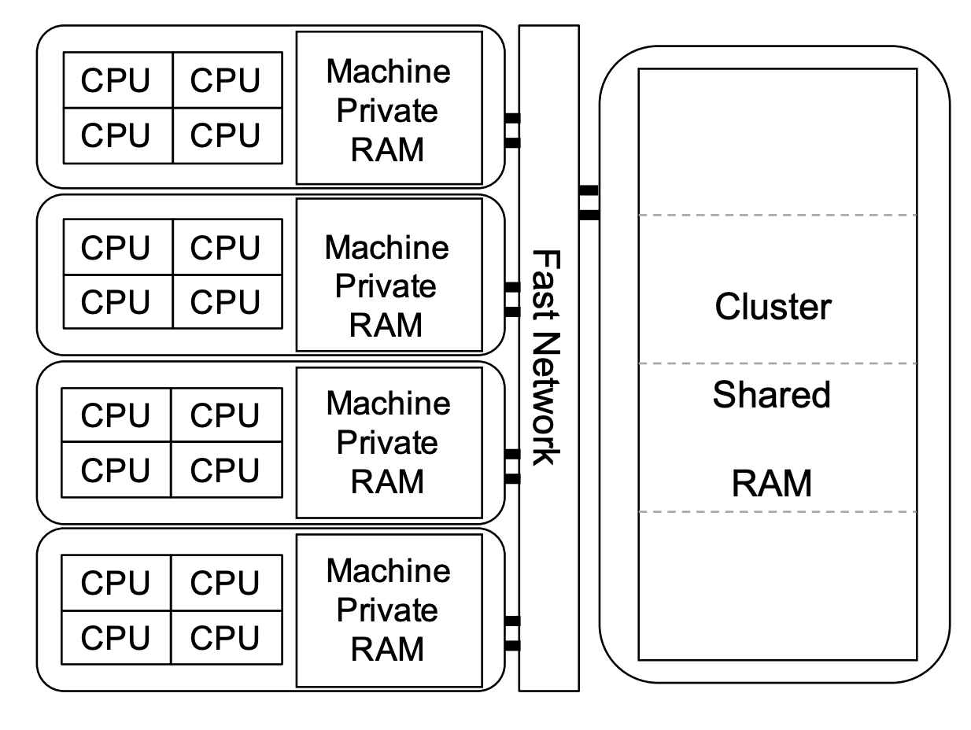
Remote/Disaggregated Memory
Decoupled pools of compute and memory connected by a low-latency network
+
–
Memory efficiency and scale-out benefits
Performance penalty of the slower remote memory accesses

Slide 3
Retaining native performance
Usual go-to: Minimize remote accesses with caching
Another approach: hide remote accesses
Efficiently expose parallelism within the application e.g., Threads
Hide the remote accesses with other (runnable) threads
Complements caching – more so with less locality

Slide 4
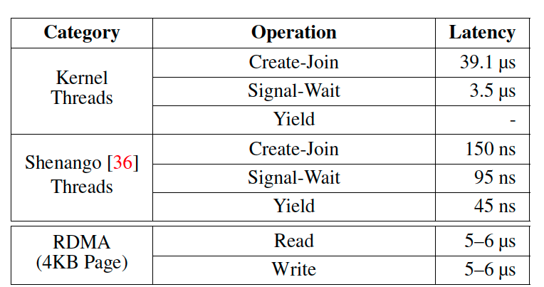
Existing solutions
Solution | No application porting | Concurrency friendly
Kernel Paging-based Systems General, low-level virtual memory interface Schedule kernel threads on page misses Example: Infiniswap | ✅ | ❌
Userspace Systems Custom object-based, language-specific interface Schedule lightweight “green threads” Example: AIFM | ❌ | ✅

Slide 5
A better solution
Solution | No application porting | Concurrency friendly
Kernel Paging-based Systems General, low-level virtual memory interface Schedule kernel threads on page misses Example: Infiniswap | ✅ | ❌
Userspace Systems Custom object-based, language-specific interface Schedule lightweight “green threads” Example: AIFM | ❌ | ✅
Eden | ✅ | ✅

Slide 6
Eden: Idea
User-level Threads
+
Paging-based Remote Memory
Application
Scheduler
Virtual Memory Interface
Local Memory
Kernel
Paging Handler
But simply combining existing systems doesn’t work due to the transparent & blocking page fault interface
Network
Transport
Remote Memory

Slide 7
Asynchronous Page Faults
With kernel upcalls, like Scheduler Activations
+
–
–
–
Application
1
2
4
Maintains transparency (to the application)
Scheduler
Virtual Memory Interface
Local Memory
Kernel
Paging Handler
Restrictive interface
Dumb scheduler – ignorant of page handling policies
3
Network
Transport
Complex kernel implementation
Remote Memory

Slide 8
Asynchronous Page Faults
Eden’s approach: Two key design choices
Preempt kernel page faults with user-provided hints
Service pages (i.e., remote memory handling) from userspace
Application
1
Scheduler
Paging Handler
2
4
Virtual Memory Interface
Local Memory
Kernel
3
Network
Transport
Remote Memory

Slide 9
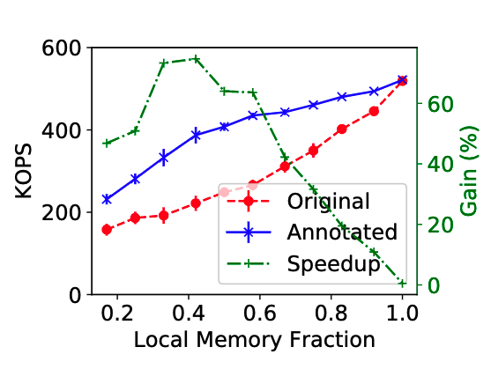
Eden’s contributions
A user-level remote memory design that provides light-weight scheduling and a familiar memory interface.
Developed API and tools for easy, low-overhead page fault hinting
Integrated Shenango with an userfaultfd remote memory manager for page fault-aware scheduling
Evaluated with three applications, showing 52-75% gain in realistic settings
Todo: labels to with/without Eden

Slide 10
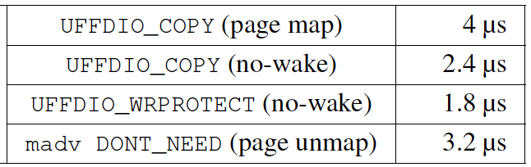
Userfaultfd Primer
App Threads
App Threads
App Threads
Kernel
UFFD Handler
Page faults routed to and serviced in userspace
Supports write-protecting and removing pages as well
Latency overhead: ~3µs*
fd = Userfaultfd()
malloc()/rmalloc()
UFFDIO_REGISTER(fd)
Page fault
poll(fd)
Thread wake
UFFDIO_COPY(fd)
UFFDIO_WRITEPROTECT(fd)
madvise(DONT_NEED)

Slide 11
Userfaultfd-based Remote Memory
App Threads
App Threads
App Threads
Kernel
UFFD Handler
fd = Userfaultfd()
malloc()/rmalloc()
Back UFFD regions with remote memory
UFFDIO_REGISTER(fd)
Page fault
Remote Memory
poll(fd)
Fetch pages using RDMA
Thread wake
UFFDIO_COPY(fd)
UFFDIO_WRITEPROTECT(fd)
Write pages back during eviction
madvise(DONT_NEED)
Notes:
Other implementational details:
Only heap goes in remote memory. LD_PRELOADing would make it transparent
Simple eviction policy, threshold at 99%
Static design with 3 threads/cores

Slide 12
Eden’s Remote Memory Handler
Basic page handling
Userfaultfd fault path
Page directory
Eviction on memory pressure
Read/writes with 1-sided RDMA
Only heap goes in remote memory
Application
Paging Handler
1
2
4
Local Memory
Kernel
UFFD
3
Network
Transport
Memory Server

Slide 13
Eden’s Remote Memory Handler
Basic page handling
Userfaultfd fault path
Page directory
Eviction on memory pressure
Read/writes with 1-sided RDMA
Only heap goes in remote memory
Our additions:
Extended page handling for user-notified faults
Per-core user fault QPs
Application
Paging Handler
1
Fault QPs
4
Local Memory
Kernel
UFFD
3
Network
Transport
Memory Server

Slide 14
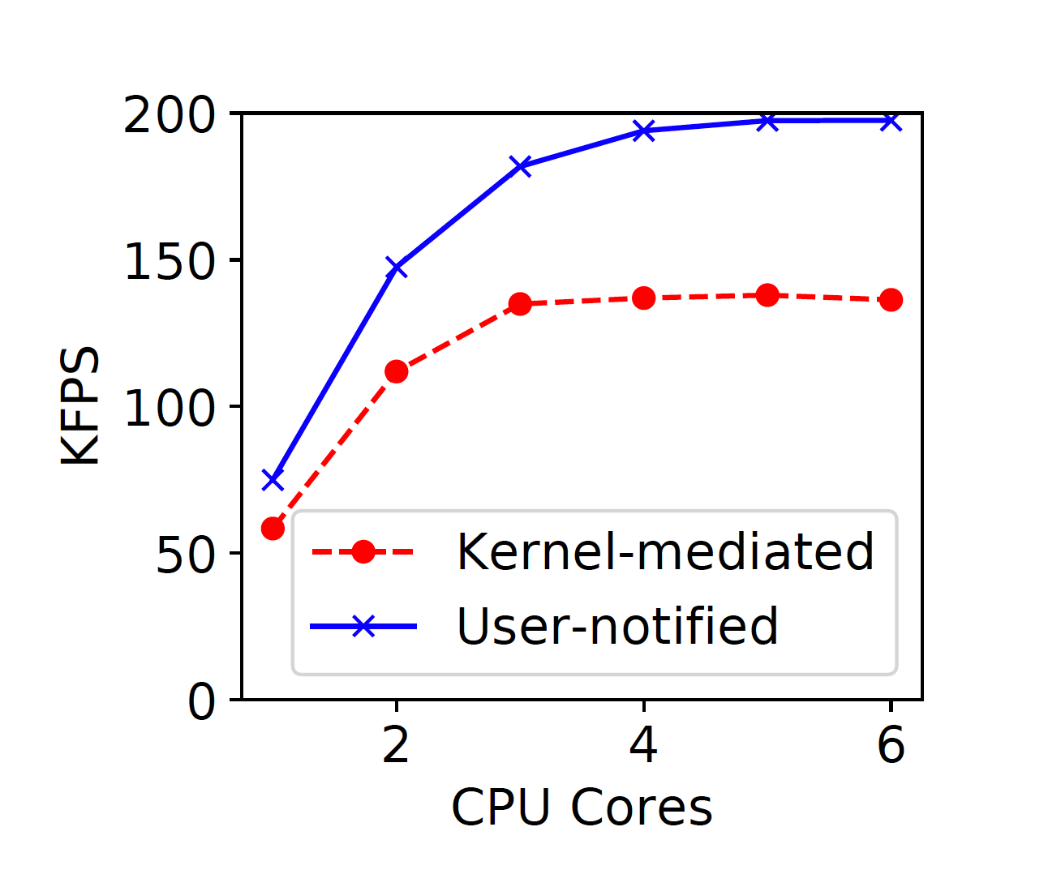
Eden’s Remote Memory Handler
Basic page handling
Userfaultfd fault path
Page directory
Eviction on memory pressure
Read/writes with 1-sided RDMA
Only heap goes in remote memory
Our additions:
Extended page handling for user-notified faults
Per-core user fault QPs
Faster page fault handling!
(no overhead of waking threads)

Slide 15
Eden’s Scheduler
User-level threading library
We build on Shenango:
Threads scheduled locally on each core
Run to completion
Load balancing through work stealing
POSIX–like threading & synchronization API
Our additions:
Fault annotations (hints) API
Fault-aware scheduling
Application
Scheduler
POSIX API
Fault Hints API
Kernel

Slide 16
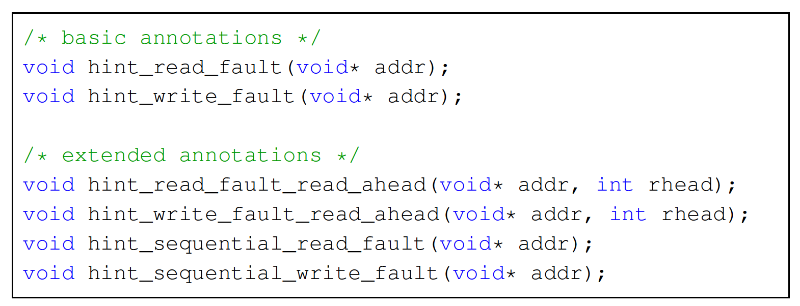
Fault Annotations
Enabling scheduler to preempt the kernel-mediated page faults
Can be extended to hint more things e.g., read-ahead
Scheduler still needs to confirm each hint at runtime: page fault checks
Notes:
Thinking about couroutines instead of threads

Slide 17
Fault Annotations: Overhead
Low-overhead, particularly on hits
mincore() too expensive
We wrote vDSO kernel routines that perform the memory operations whose resulting faults are a no op in the kernel.
is_page_mapped(addr) | is_page_mapped_and_writeable(addr)
For page existence | For page write-protection
Load (movb addr,reg) | Non-modifying store (andb 0xFF, addr)
Hit cost: 30 ns
Miss cost: 1.4 μs (+/- 0.2 μs)

Slide 18
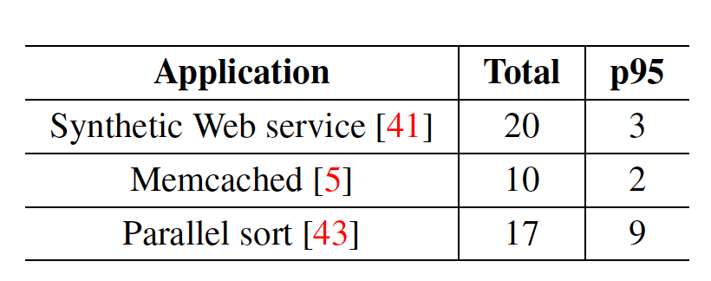
Fault annotations: Programmer Effort
Not too many.
Not too hard to locate.
Built a workflow to assist in finding faulting locations:
Propagate instruction pointers (IPs) from kernel to handler (via Userfaultfd faults)
Random sampling in the handler
addr2line:IPs → Code locations

Slide 19
Fault-aware scheduling
If the hint was a false-alarm, return. Otherwise:
Place thread aside
Send fault on the request queue (or poll if it is full)
Schedule from the ready queue
After servicing fault:
Handler adds on the response queue
Scheduler monitors them between threads
Adds the faulted thread back to ready queue

Slide 20
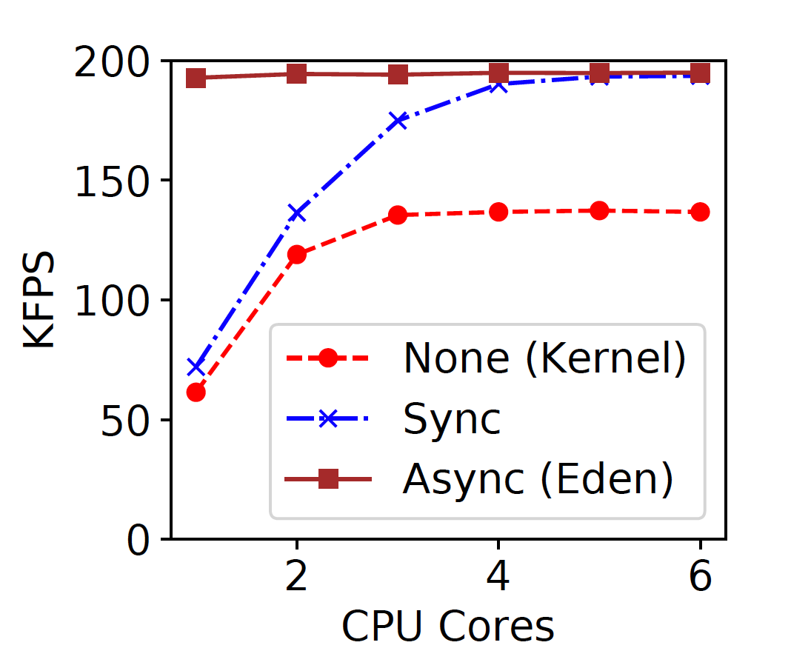
Eden: The whole picture
Typical
Application
Scheduler
Paging Handler
POSIX API
Fault Hints API
1
Fault QPs
Local Memory
Kernel
UFFD
Network
Transport
Enabling async page faults
(Eden saturates page fault rate with one core)
Memory Server

Slide 21
Evaluation
Synthetic Webservice (AIFM)
Memcached
Parallel Sort

Slide 22
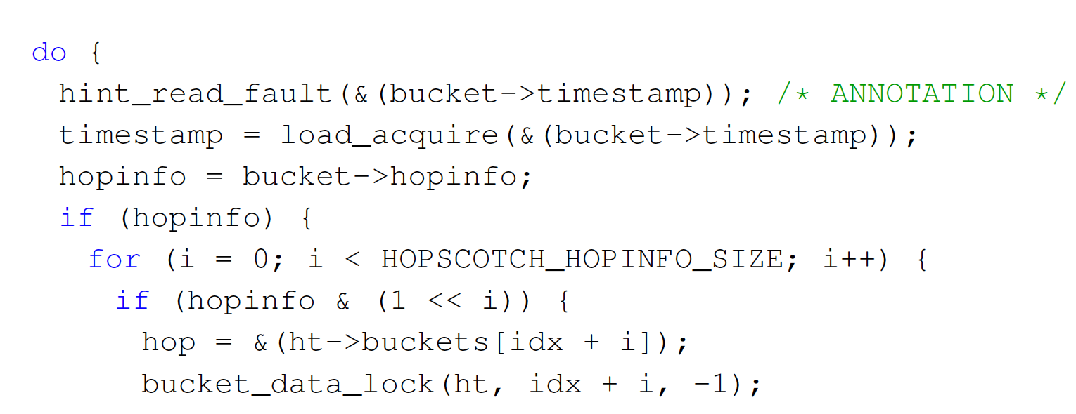
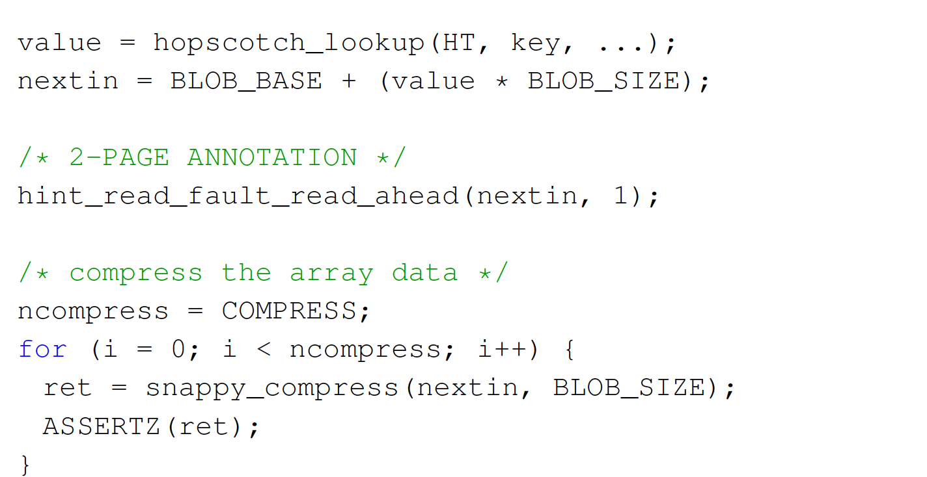
Synthetic Webservice
On each client request:
Hopscotch lookup
Snappy compress an image (8KB)
~5 µs per request
Setup
4 CPU cores
10M keys, 400K images
6 GB memory footprint
Skewed (zipf s=1) workload
Annotations

Slide 23
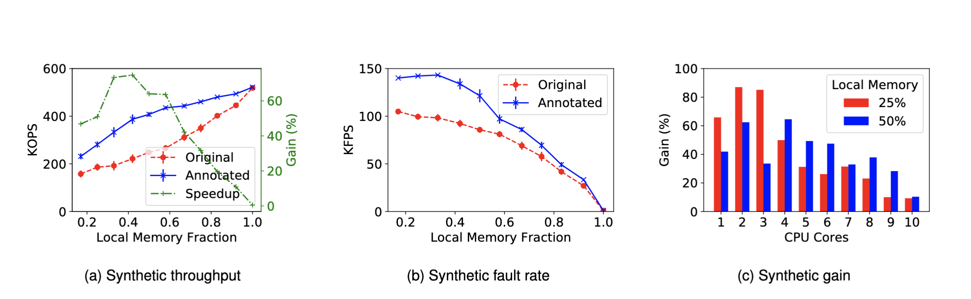
Synthetic Webservice

Slide 24
Memcached
Hash buckets with linked list of items
10M (20-byte, 80-byte) KV items
2 GB memory footprint
Zipf s=1 skewed client
Turned off LRU lists
2 annotations, one each on read and write path

Slide 25
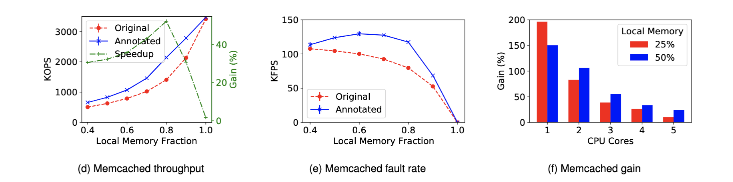
Memcached

Slide 26
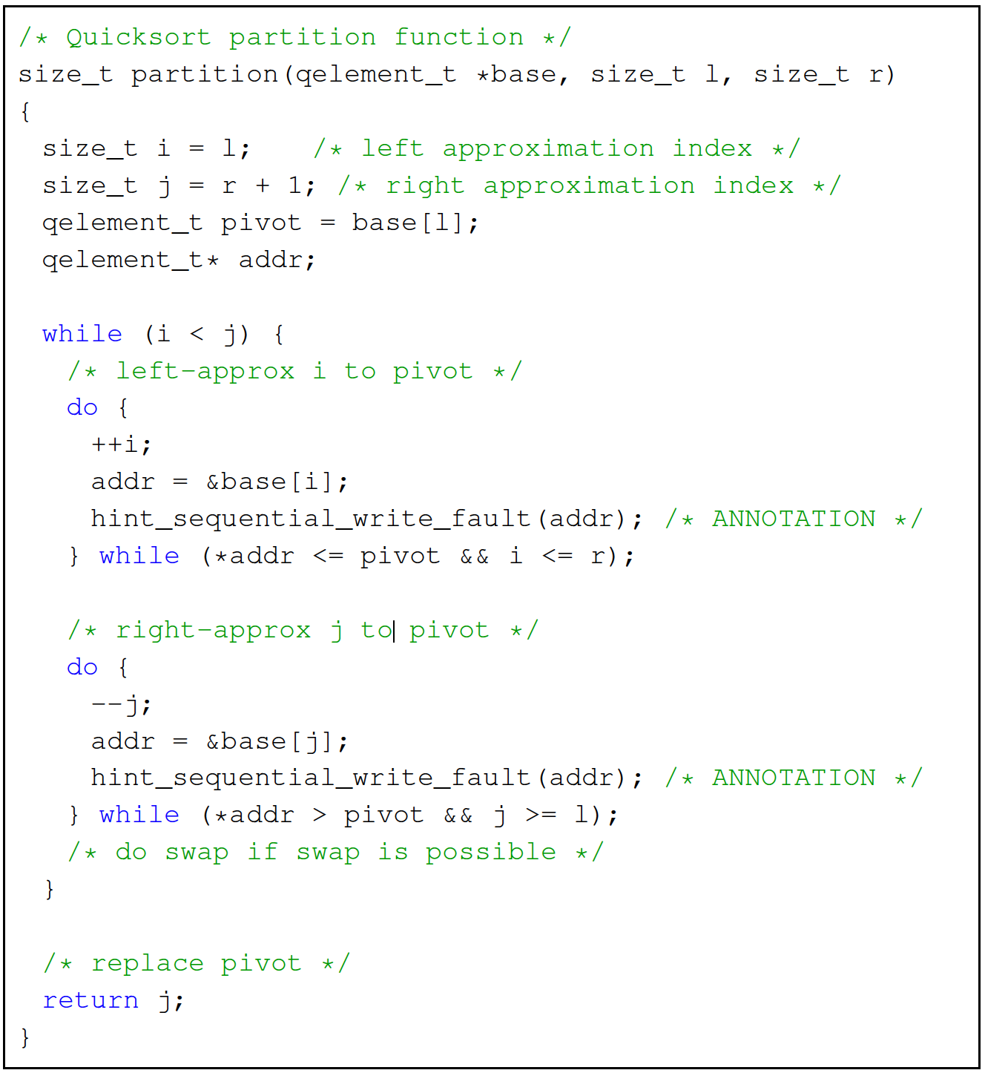
Parallel Sort
Parallel sorting with regular sampling
Local sort on input chunks
Merge sorted chunks
Copy sorted data into input buffer
Shenango ported & annotated
4 GB buffer, 25% local
Annotations

Slide 27
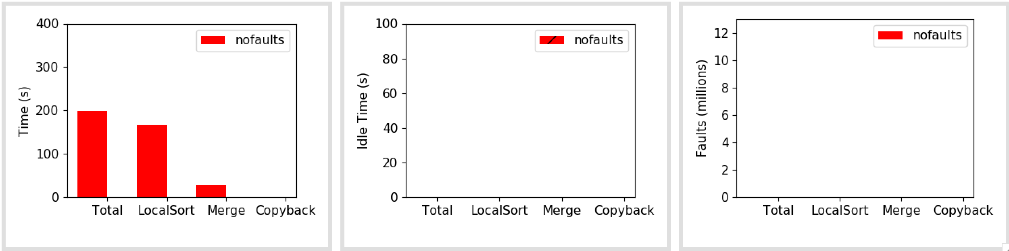
Parallel Sort
100% local memory baseline

Slide 28
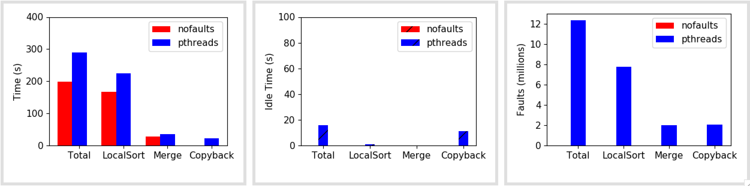
Parallel Sort
With Pthreads

Slide 29
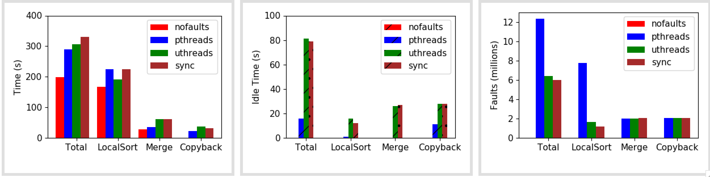
Parallel Sort
Shenango-port and “synchronous” Eden annotations

Slide 30
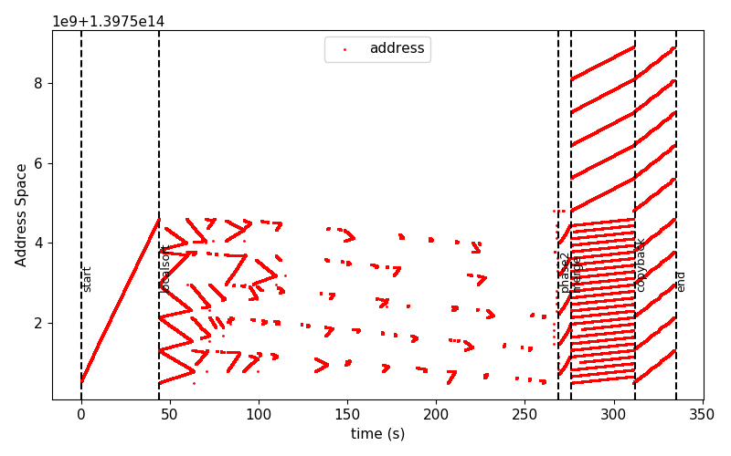
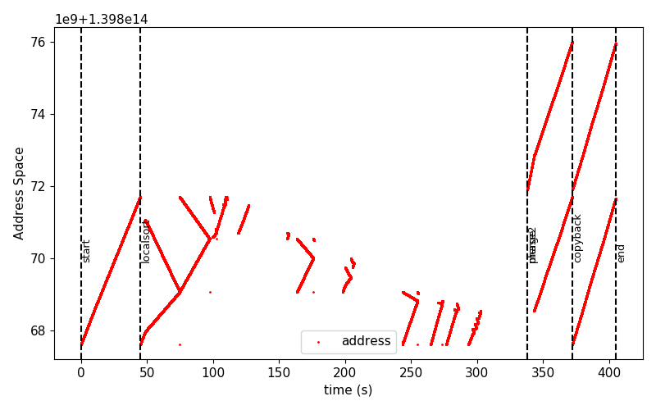
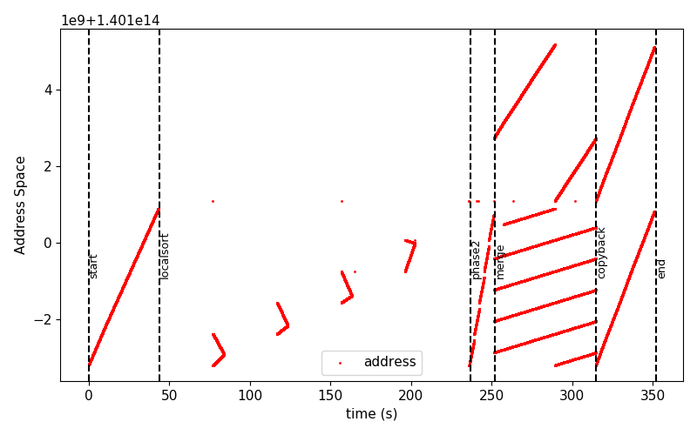
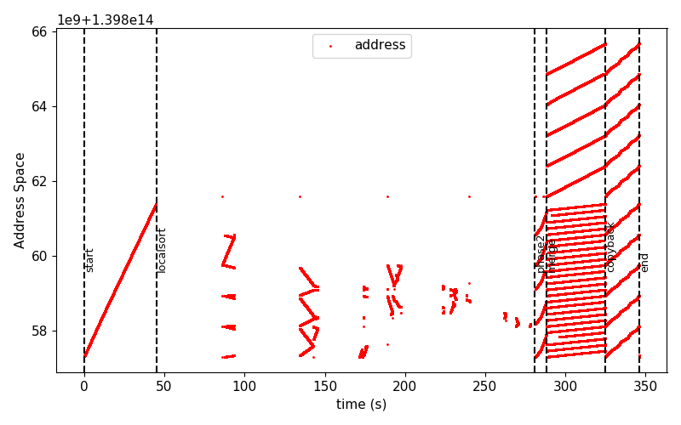
Sort Faults
t = 5, pthreads
t = 1
t = 5, shenango

Slide 31
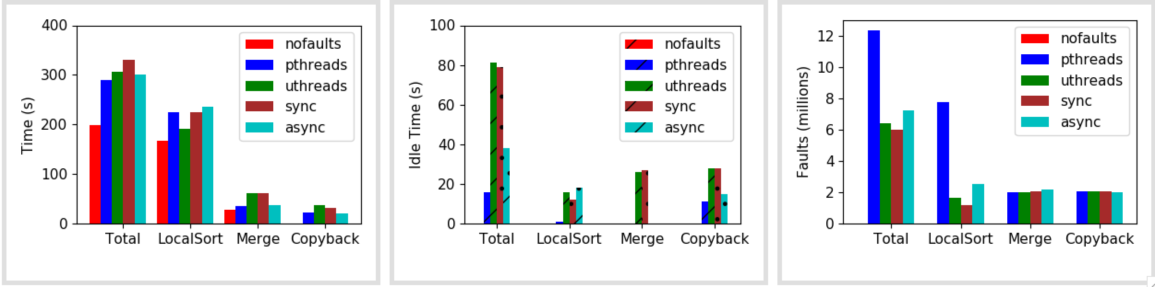
Parallel Sort
Eden annotations

Slide 32
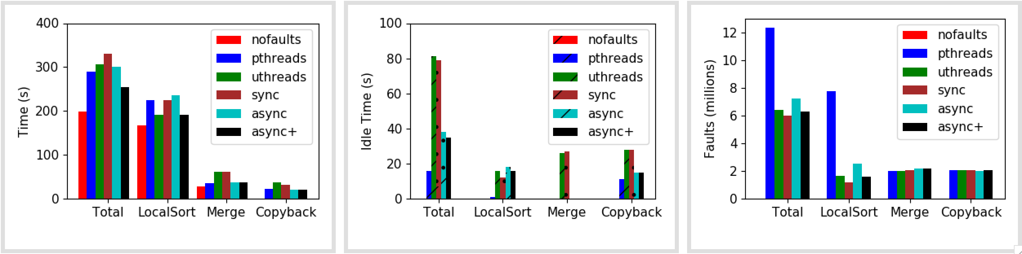
Parallel Sort
Removing localsort annotations
12% faster!

Slide 33
Limitations & Future
Concurrency is not beneficial for all apps e.g., Sort
Page fault rate bottleneck
No accounting for remote memory handler CPU usage yet
Tools for selectively adding hints based on performance impact
Tighter co-design of scheduler and remote memory
Shenango could control handler CPU based on demand
Locality-aware scheduling in Shenango

Slide 34
Questions

Slide 35
Explorations summary
 | Within application | Multiple apps
Local Scheduling (single node) | Cache-aware scheduling Run to completion vs. time-slicing LIFO vs FIFO work queues Scheduling in batches (gang scheduling, co-scheduling, etc.) Space-efficient scheduling Use cases: batch apps, in-memory databases | Like Caladan, but with local memory as another resource? Use cases: A mix of latency-sensitive and batch apps
Cluster scheduling (Rack-scale) | Task scheduling for a single job Use cases: distributed in-memory object stores, in-memory databases | Far memory-aware scheduling like Fastswap Fastswap issues: coarse-grained modeling, no account for temporal variations, oblivious to applications, only batch apps, etc. Use cases: ?
General observation being local memory is yet another scarce and contended resource
Should we be targeting CXL?
Hard question is finding relevant use cases

Slide 36
Current status
Lots of brainstorming/reading
PARSEC benchmark with Eden
Converging on in-memory databases as a major use case
TPC-C with Silodb?
Notes:
Small scale joins,

