Slide 1
Agenda
PARSEC with Kona
Insights from “cache-aware scheduling” papers
Facebook’s CXL apps

Slide 2
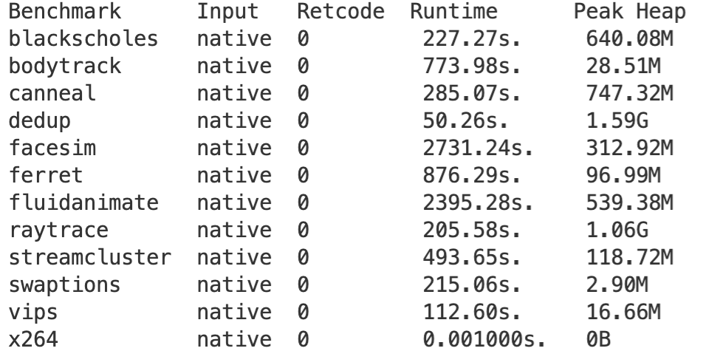
PARSEC Apps
Memory footprints
Compute-intensive
C/C++ apps – C++ requires some legwork
Ran Dedup with Kona
Notes:
TODO Get memory footprint for more threads

Slide 3
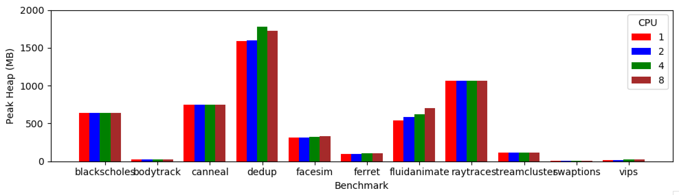
Memory footprint

Slide 4
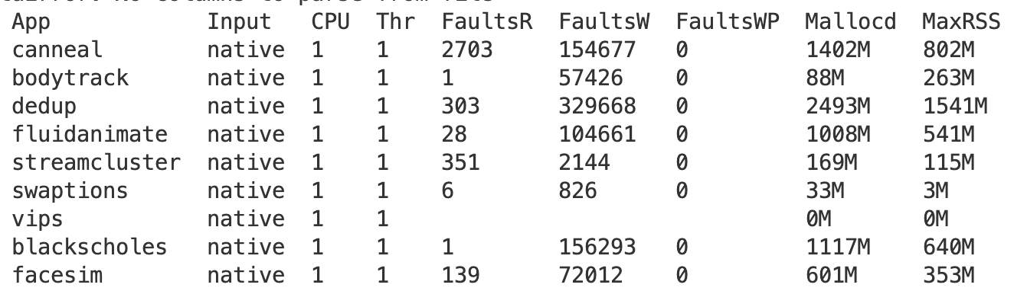
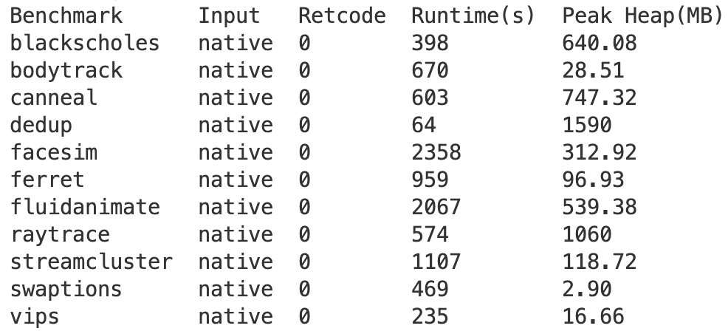
Memory captured with Kona
Kona
Heaptrack
Notes:
Kona not handling the madvise free from app very well

Slide 5
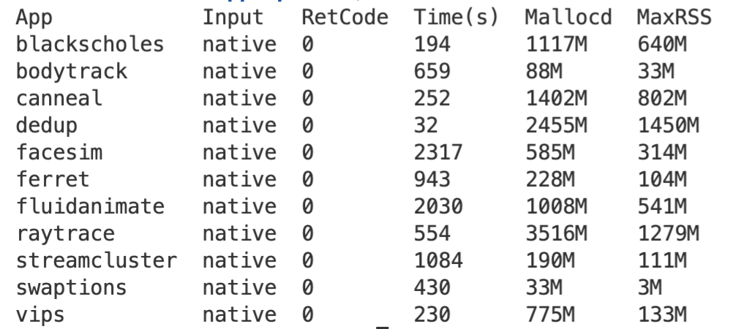
Memory captured with Kona
Heaptrack
Kona
Working on Kona profiles, a lot of them crashing in different local memory settings
Notes:
TODO try heaptrack on Kona
TODO Look at variance across multiple runs

Slide 6
Cache-aware scheduling
Saving processor-local cache hit rate
LIFO queuing, FIFO stealing
Mailbox queues – maintain affinity
Shared cache:
Co-scheduling threads in batches
Maintain batch queues instead of threads
Notes:
Takeaway is that there are certain heuristics that work b

Slide 7
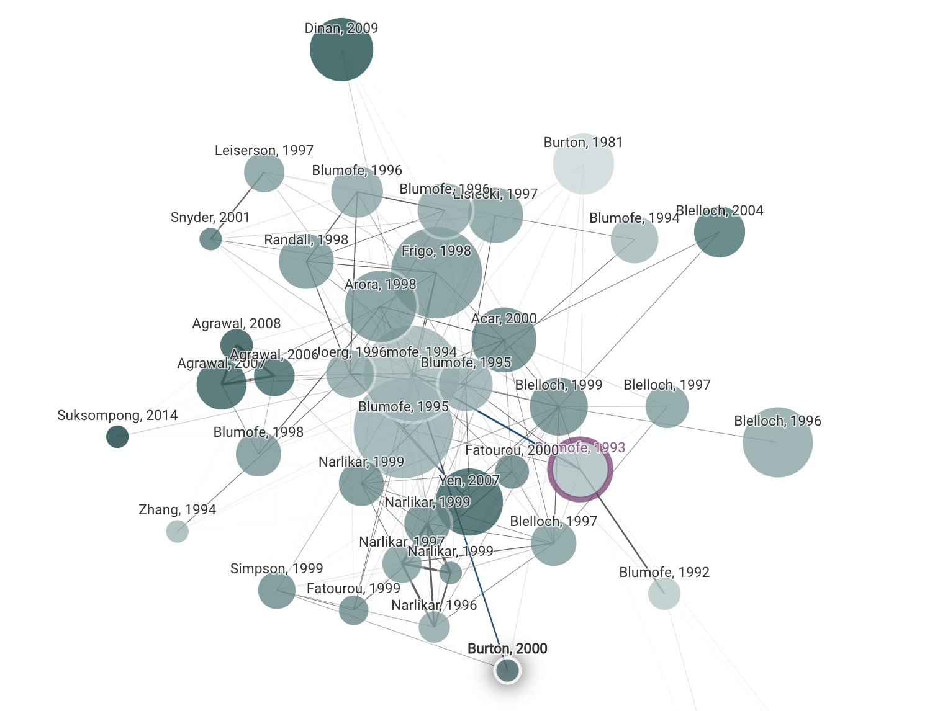
Space-efficient scheduling
Parallel programs take more memory than sequential counterparts
Applies for remote memory
Batch style apps: matmul, parallel sort, image processing, etc.
Previous solutions based on DAG analysis, mostly theoretical
Notes:
Ray
Anyscale (startup)

Slide 8
Facebook’s CXL workloads
Web. “Web implements a Virtual Machine with Just-In-Time (JIT) compilation and runtime system to serve web requests from end-users”
Cache. “Cache is a large distributed-memory object caching service lying between the web and database tiers for low-latency data-retrieval”
Data Warehouse. “This service manages and coordinates the execution of long and complex batch queries on data across a cluster. A query served by this service can consume terabytes of memory and may take days to complete”
Notes:
First two like Synthetic and Memcached
Series of big SQL joins?
Extreme memory setups like 1:4 configuration is useful in flexible server design with DRAM as a small-sized local node and CXL-Memory as a large but cheaper memory.

Slide 9
TODOs
PARSEC on Kona
Use cases: look at some in-memory/graph processing databases
Keep reading some past literature
Space-efficient scheduling
NUMA data distribution/scheduling

Slide 10
Misc

Slide 11
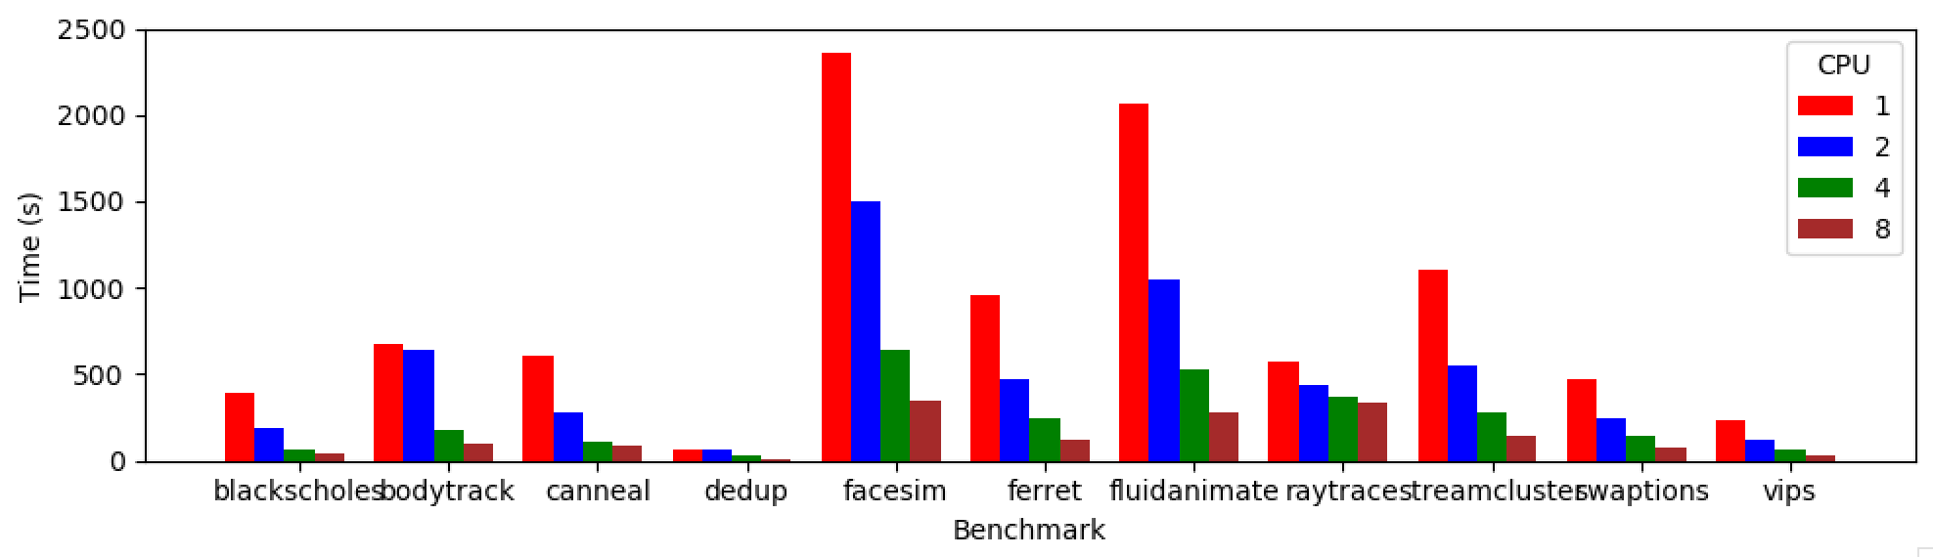
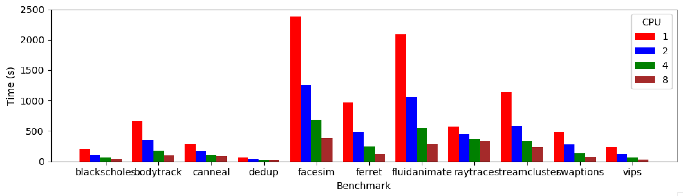
PARSEC Performance
1 pthread/core
4 pthreads/core

Slide 12
PARSEC Performance
1 pthread/core

