Slide 1
Topics
My project
PL2
Nsight

Slide 2
Backdrop
Racklette effort – towards co-scheduling
Disaggregated setting
Centralized, all-aware scheduler for balanced resource utilization
Remote Memory work – Kona/Kailua
Memory disaggregation platform with userspace (remote) memory management
Goal: Finding co-scheduling opportunities in a rack-scale, remote memory setting

Slide 3
Recent (co)Schedulers
Within the host.
Examples: Shenango/Caladan - Co-scheduling CPU/Network
Light-weight threads for fine-grained, microsecond-scale scheduling
Hints from Network, LLC, Memory Bandwidth, etc.

Slide 4
Shenango/Caladan + Remote Memory
Perhaps with help from Kailua
How exactly does it help? That’s the question.
Scheduler is aware of local/remote memory
Scheduler can associate threads with the pages they’re waiting for
Scheduler can differentiate application and remote memory traffic and can balance it somehow?
Hints about the network/memory server contention

Slide 5
Immediate steps
Run Shenango + Memcached baseline on transparent Kona and look at the source of tail-latencies.

Slide 6
Questions/Comments
E.g., why not work with AIFM?

Slide 7
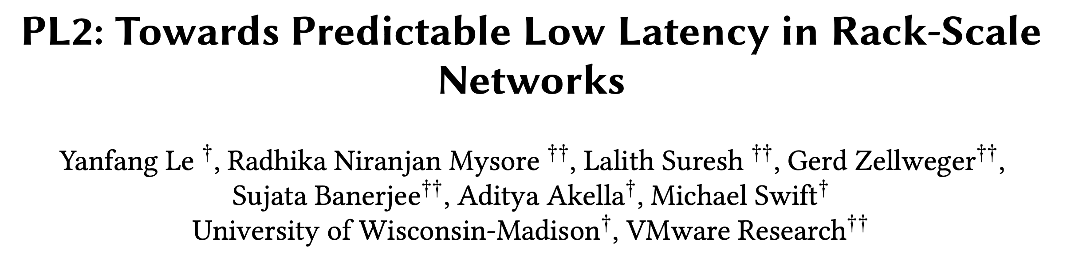

Slide 8
PL2: Motivation
Low-latency transport for intra-rack
Exploiting rack-scale
Single Programmable Switch
And designing for rack-scale
Ultra-low latencies
Simpler implementation – accelerator friendly
Low-level – Transport agnostic
Notes:
Hardly the best person for the job;

Slide 9
PL2: Background
Long line of Datacenter Transports
Better control over and improved in-network hardware
DCTCP, TIMELY – QCN bit, NIC timestamps.
NDP – Forward headers
HPCC – In-network telemetry
Faster networks
NDP, Homa – receiver-driven
Fastpass – centralized scheduler
PL2 takes a switch-based centralized approach and avoids some overheads.

Slide 10
Scheduling on the Switch
Cannot be complex due to hardware
Divide scheduling b/w the switch and the host
Simple timeslot reservation scheme for inbound and outbound ports

Slide 11
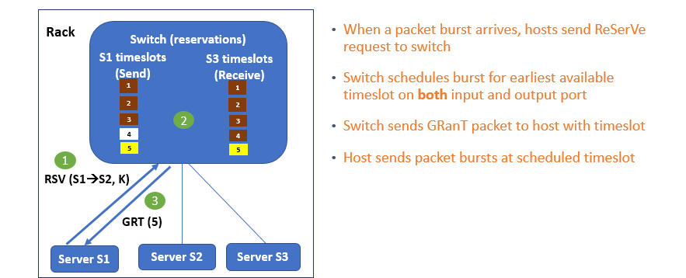
Switch component

Slide 12
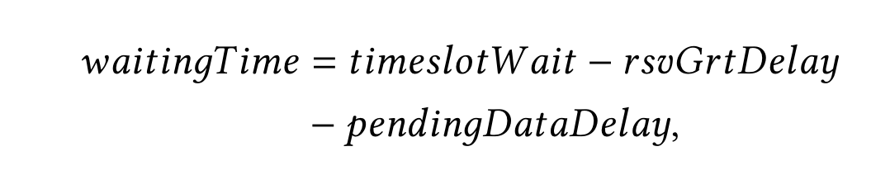
Host component
Host calculates wait time and schedules at appropriate timeslot
When the load is light, send unsolicited burst with RSV

Slide 13
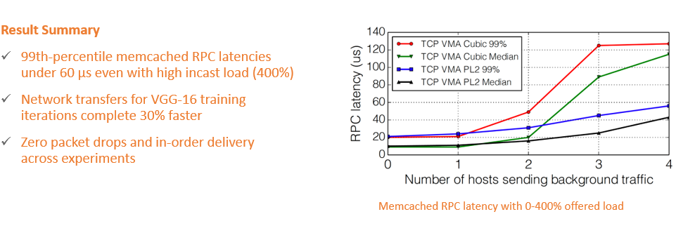
Results

Slide 14
Limitations
Utilization – packet burst size
Overhead of RSV/GRT vs HOL blocking
In-network priorities
Co-existence with Inter-rack traffic
Scalability with flows – not evaluated

Slide 15
Questions/Discussion

