Slide 1
Background
User-level thread scheduler for Remote Memory
Hiding remote memory latencies
Exploring co-scheduling opportunities e.g., memory allocation
Goal: Shenango + Kona
Application: Memcached

Slide 2
Shenango + Kona
Compile & run-time integration ✅
Running memcached experiments 🏃‍♂️

Slide 3
Workflow
Memcached SET request
New Shenango Thread
Calls Kona malloc() for new slab
Kona contacts Rack controller, returns
During page access, app faults
Kona’s fault handler gets the fault event
Kona’s poller thread handles RDMA response
Kernel returns from page fault
Proceed..
Eviction runs separately.

Slide 4
Current Settings (may need an update)
Memcached-Kona
12 kthreads
Local memory: 100 MB
Evict Threshold: 80 MB
Client
12 kthreads
1M preloaded KV pairs
Uniform request distribution, 2% SET
Takes ~90MB in Memcached server

Slide 5
Numbers
Could not get to the plots yet.

Slide 6
Next
Throughput/latency numbers with different eviction thresholds
Perhaps different/bigger workloads as well

Slide 7
Update
Research collaboration
Looped in Marcos!
Started getting some numbers from Shenango+Kona

Slide 8
Setup
b1640
Rack Controller
b1630 (Cores)
Memcached Process
Memory
Server
Shenango
IO Core
User Threads
Kona Threads
Poller
User faults
Eviction
Shenango Runtime
b1607
Memcached
Client
Shenango
NIC (DPDK +RDMA)

Slide 9
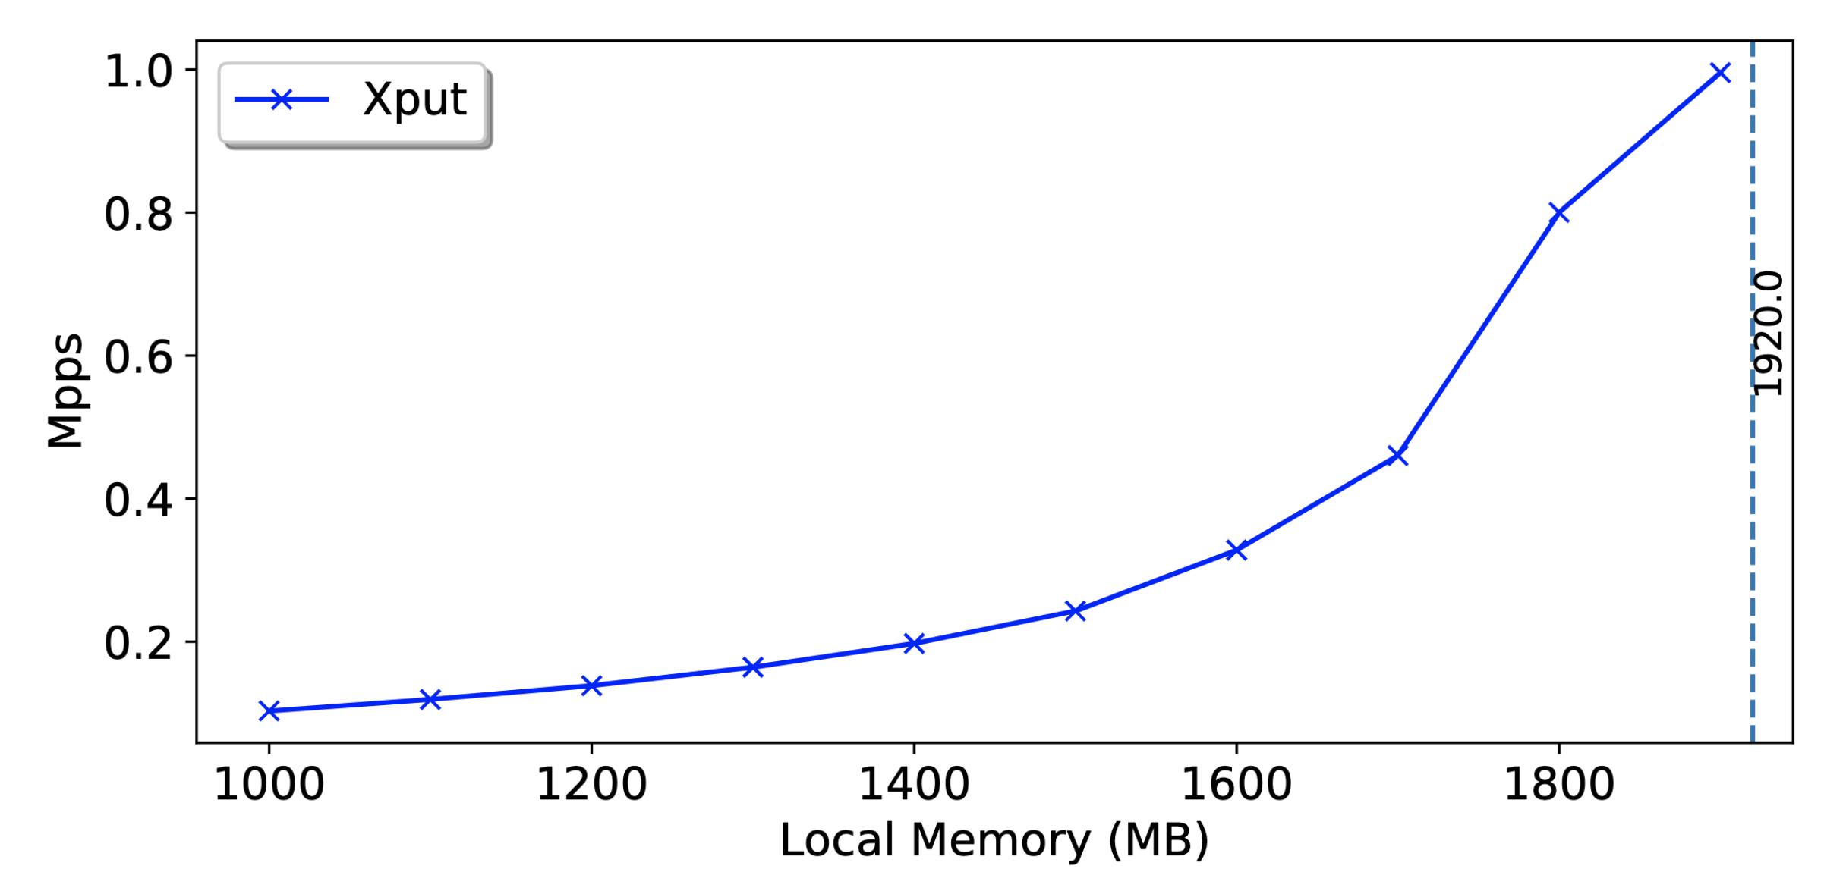
Throughput
Offered load: 1Mpps
Total memory footprint: ~2GB
TODO: Add exp parameters

Slide 10
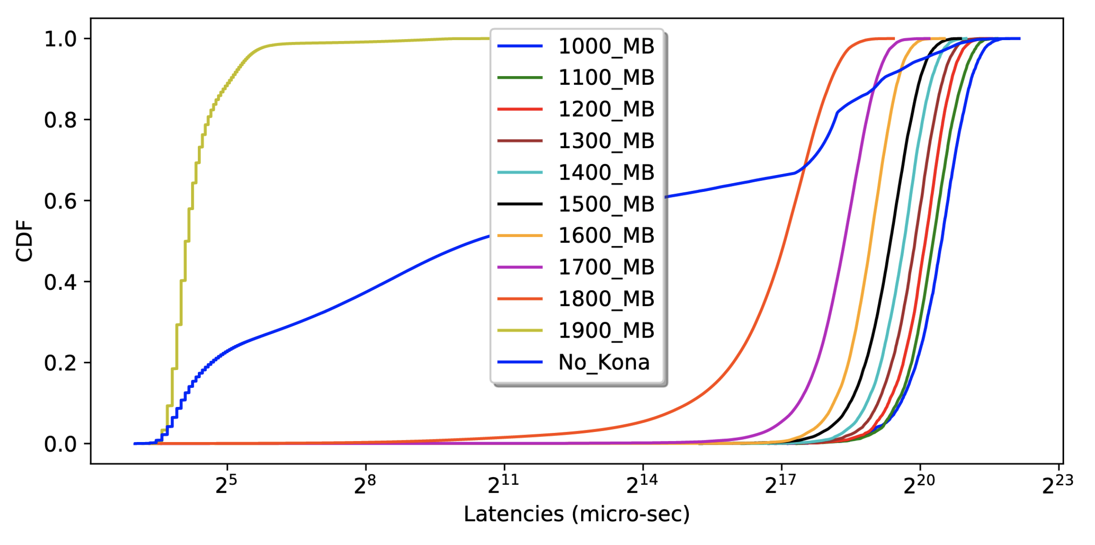
Latencies

