Slide 1
Plan for Upcalls
Implementing non-blocking page faults:
Unblock page faults in the kernel ✅
Solution: Insert prefetch_page vDSO call at fault locations
Returns to the caller without triggering a page fault
Yield thread to Scheduler
Scheduler posts the page fault to Kona ✅
Solution: Change Kona to accept faults from scheduler
Scheduler runs another thread but monitors the fault response queue
On fault response, put the thread in ready state

Slide 2
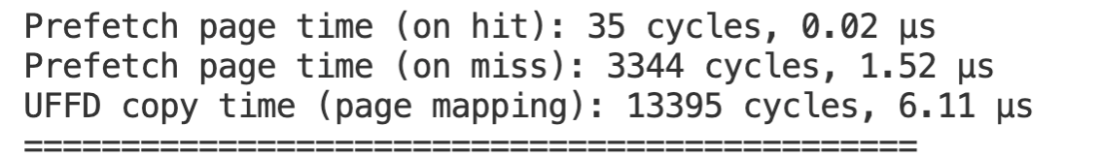
How prefetch_page works
Fault from a known location. If faulting from this location, handle it differently
i.e., return to the vDSO location
No work done in the kernel with userfaults
Essentially a fast mincore() call

Slide 3
New fault interface
App
Kona
Remote memory server
Scheduler
Kernel

Slide 4
App-notified faults, or app-faults
App
Kona
Remote memory server
Scheduler
Kernel

Slide 5
App-notified faults, or app-faults
App
Interface
Kona
Remote memory server
Scheduler
Kernel

Slide 6
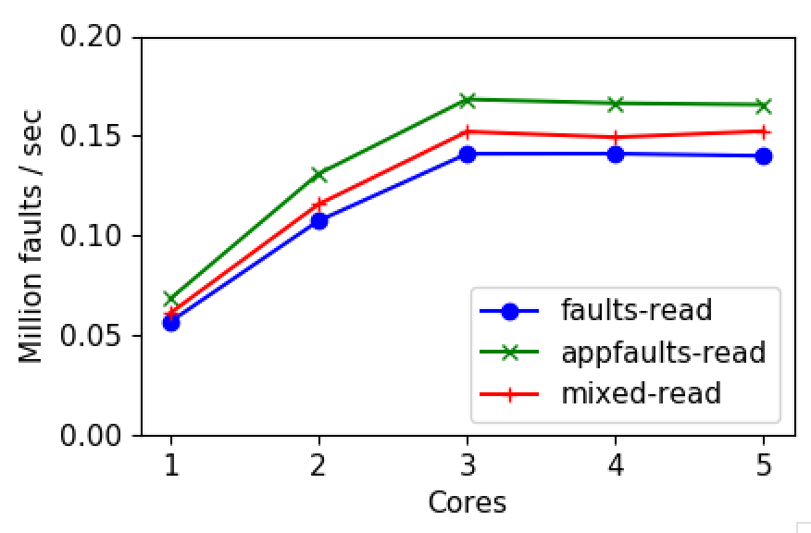
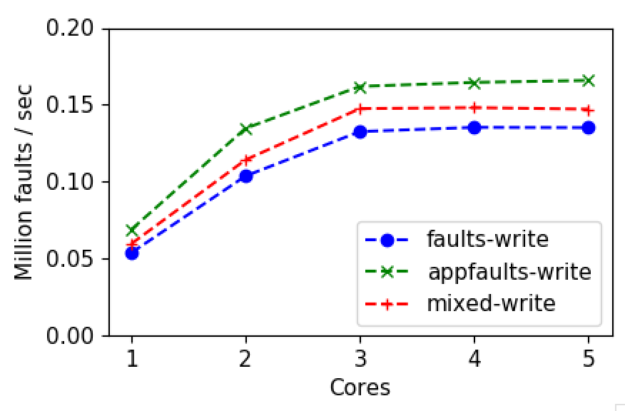
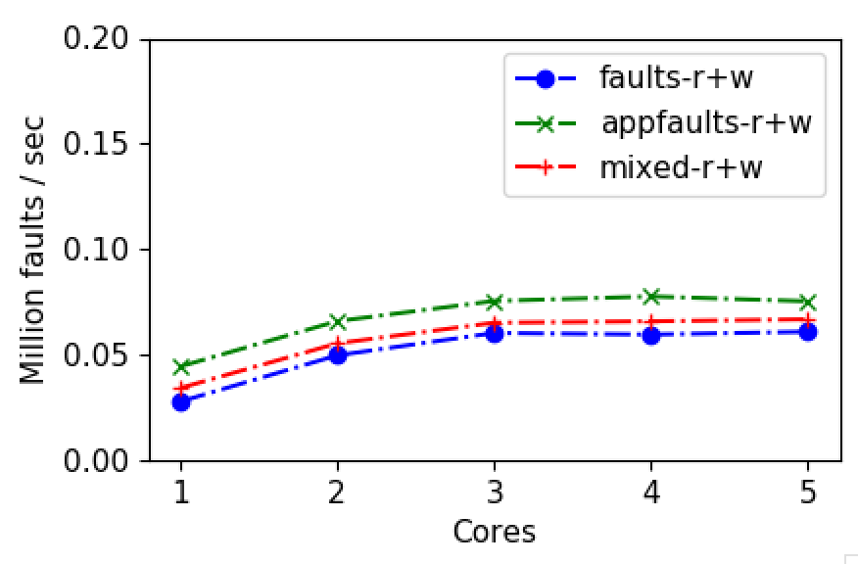
Throughput on different fault paths

Slide 7
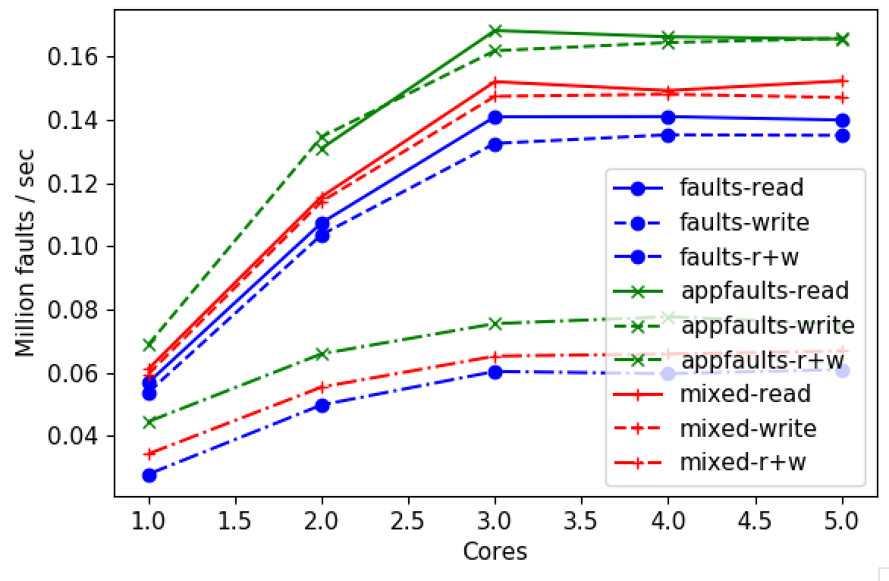
Throughput on different fault paths

Slide 8
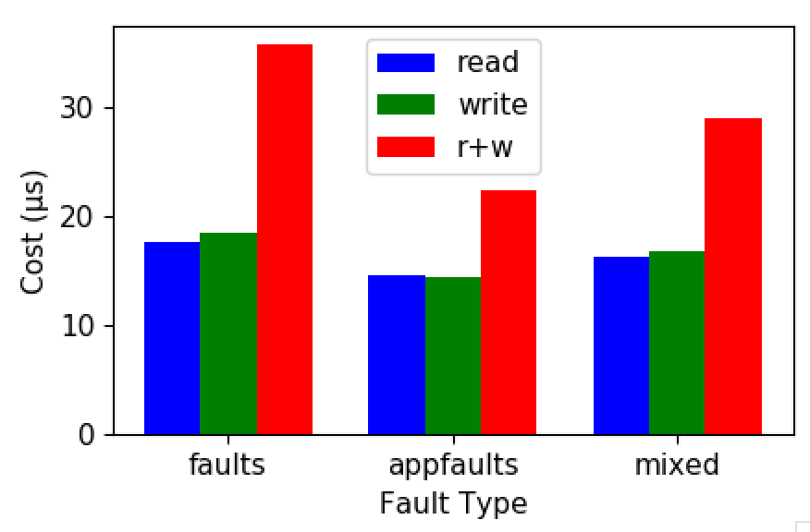
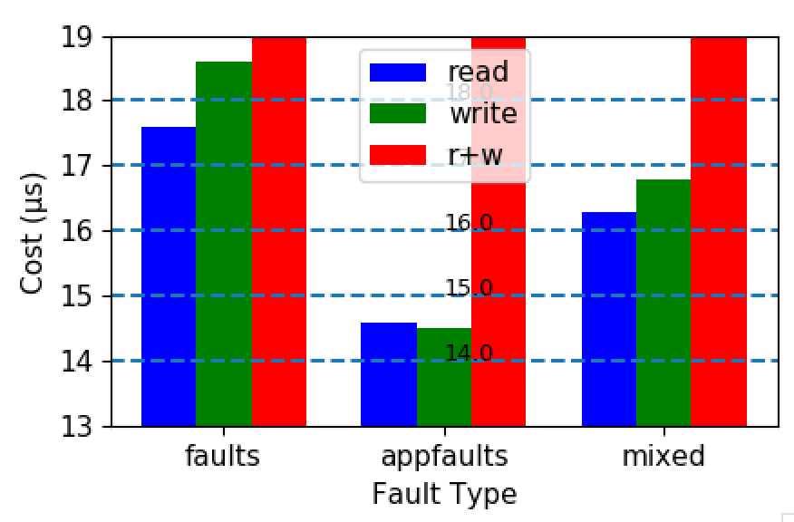
Page fault cost: light load
zoomed-in

Slide 9
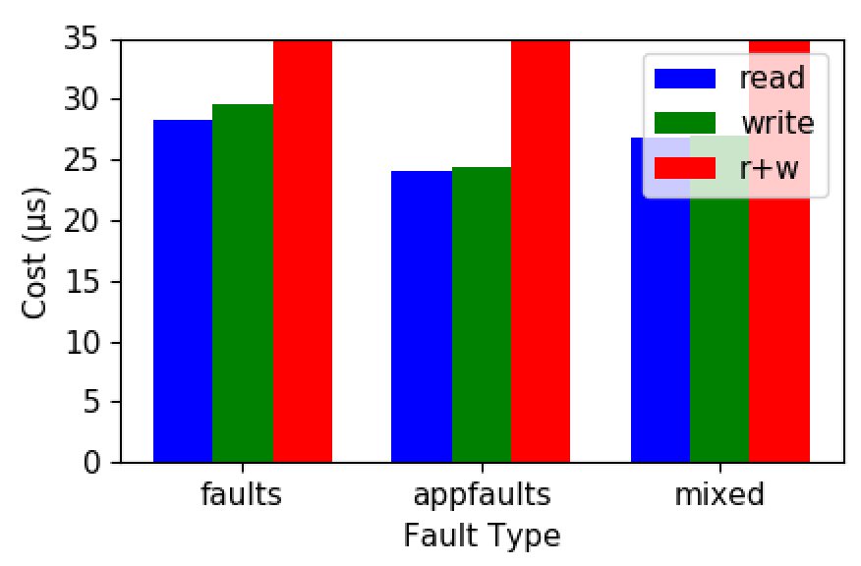
Page fault cost: light vs heavy load

Slide 10
Next
Proper handling of concurrent app-faults
Integrate app-faults with Scheduler
Get back to Memcached benchmarks

Slide 11
Plan for the next few months
Want to target NSDI, Apr 20th.
What’s in scope?
Story: A holistic userspace remote memory system that includes scheduling and maintains traditional interfaces
Focus on introducing mechanisms that enable this.
Simulation results to show the potential
Real benchmarks with Memcached (and ideally one other real workload)
Can’t compare to other systems though

Slide 12
Plan for the next few months
Want to target NSDI, Apr 20th.
What needs to be done?
Jan
Finish up work in the scheduler
Replicate simulation results for Memcached
Feb
Unavailable for the most part. Writing?
Mar
Another workload: GAP benchmark (Mar?)
Filling the gaps

Slide 13
Long term plan/out of scope?
Local scheduling for multiple apps
Both Shenango and Nadav’s Kona can support multiple apps
Improving memory system
Kona can certainly be written better
Replacing Kona with Nadav’s Kona
Tight-coupling scheduler+memory systems
Basically, re-writing kernel in userspace?
Improving Kernel’s userfault API
Allows co-scheduling resources?

Slide 15
Simulations

Slide 16
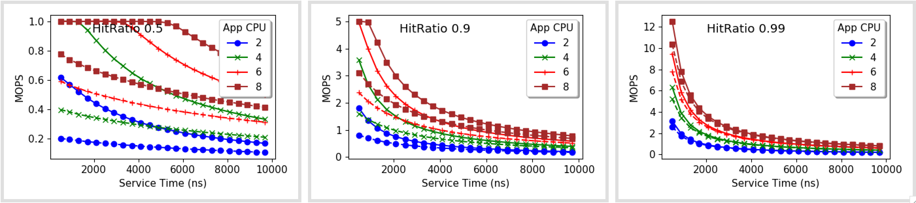
Varying request service time

Slide 17
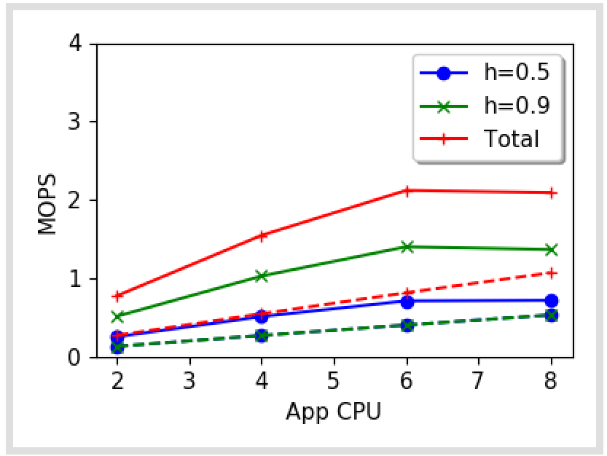
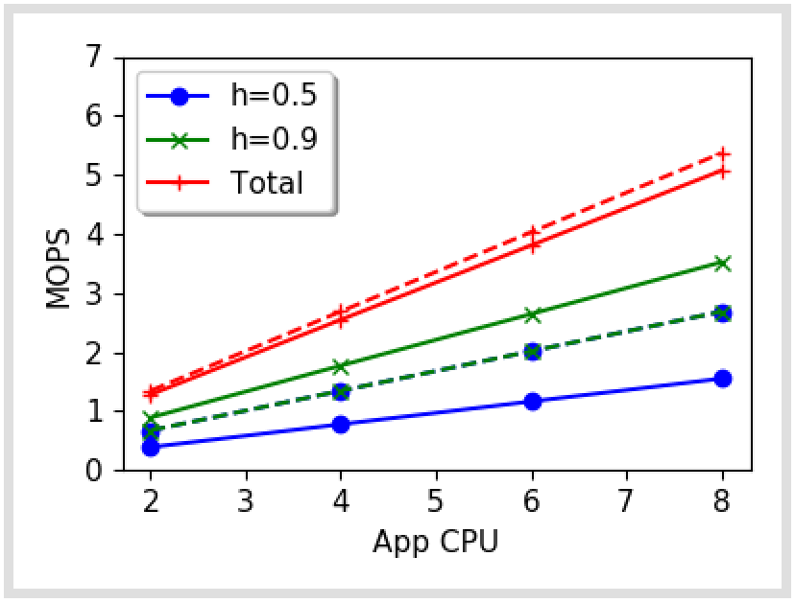
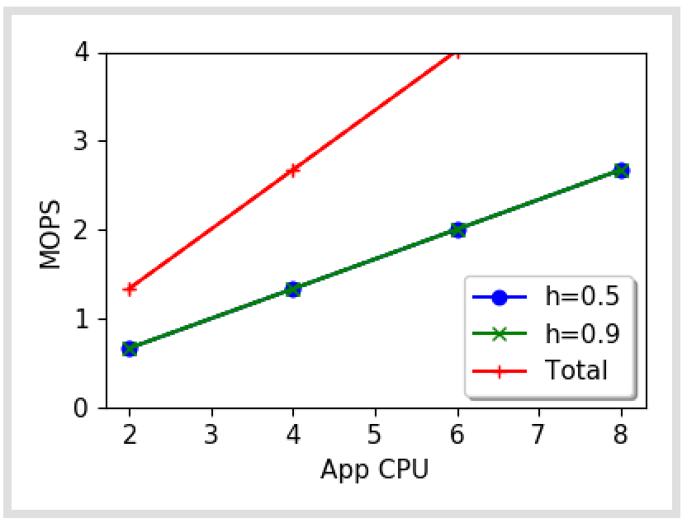
What’s causing the split?
Regular
Upcall overhead = 0
Essentially same hit
and miss path

Slide 18
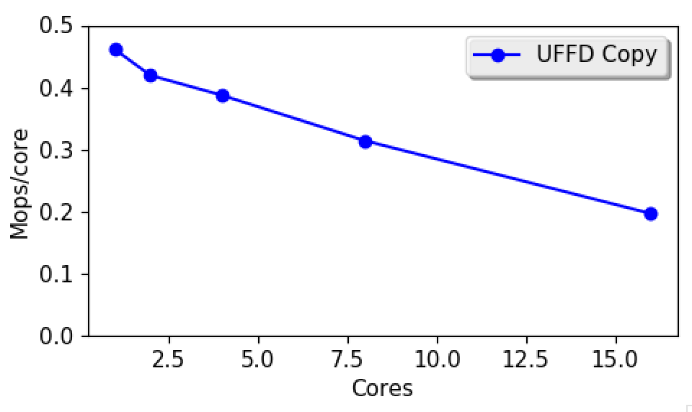
UFFD-copy scalability

