Slide 1
Topics
Fastswap
Paper feedback
Abstract submission

Slide 2
Fastswap setup
Fastswap
Plugs in as a swap device; all process memory remote
Changes to local using cgroups
Dedicated eviction core; but switches to all core-eviction (benchmarks, thresholds?)
Vanilla Memcached
From shenango’s branch; similar options
No “page dirtying” changes yet
Memaslap client
Similar sized workload: 20B key, 80B val, 10M kv pairs
Uniform access: sectioned into windows, random access for each
Lot of concurrency (i.e., connections)

Slide 3
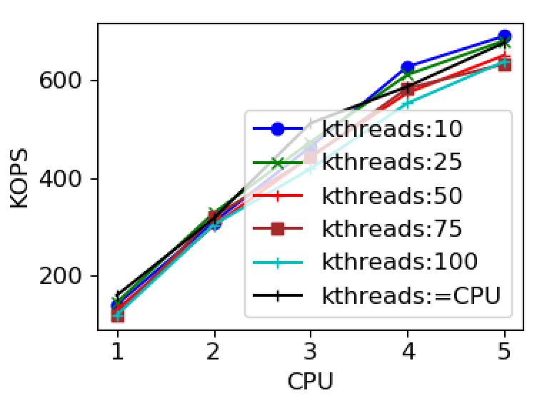
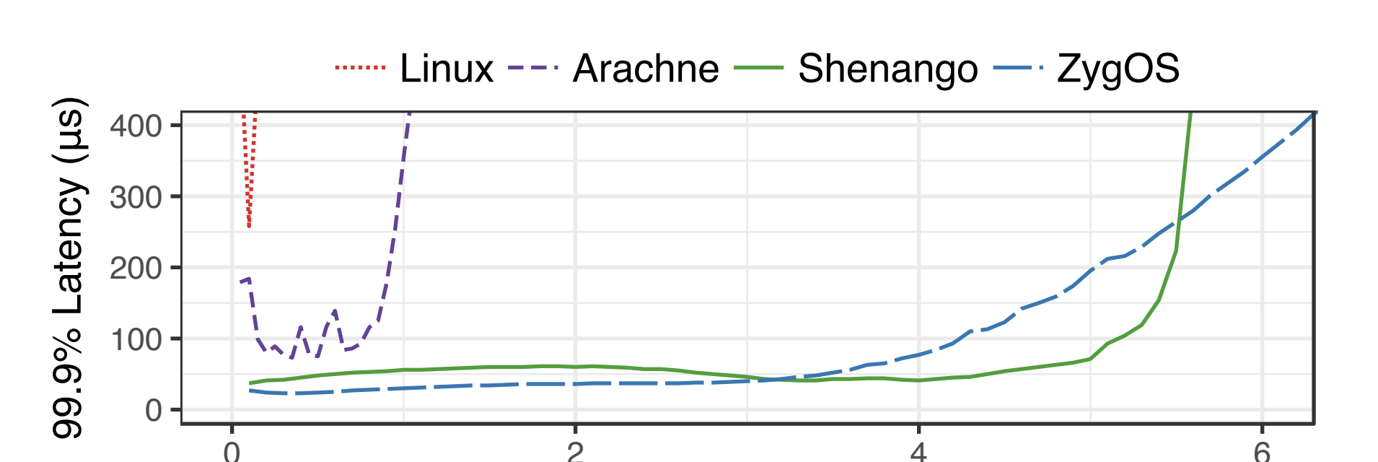
Native performance

Slide 4
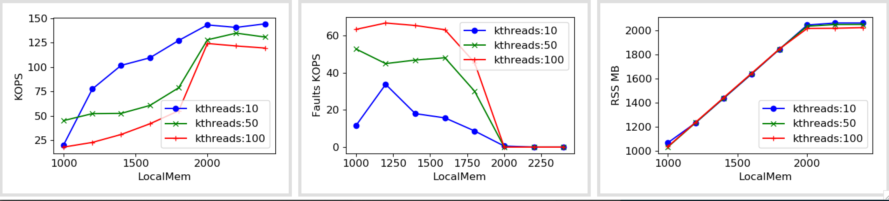
Fastswap (1 core)

Slide 5
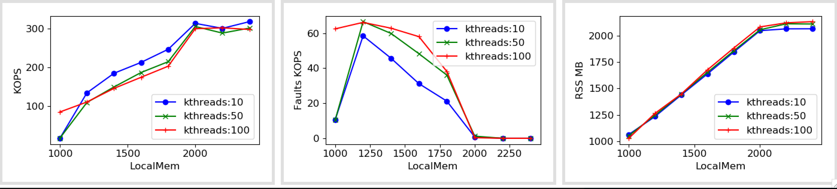
Fastswap (2 core)

Slide 6
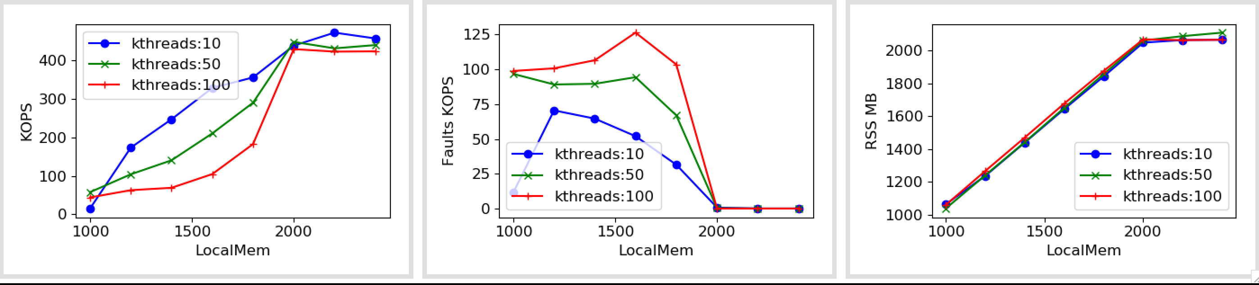
Fastswap (3 core)

Slide 7
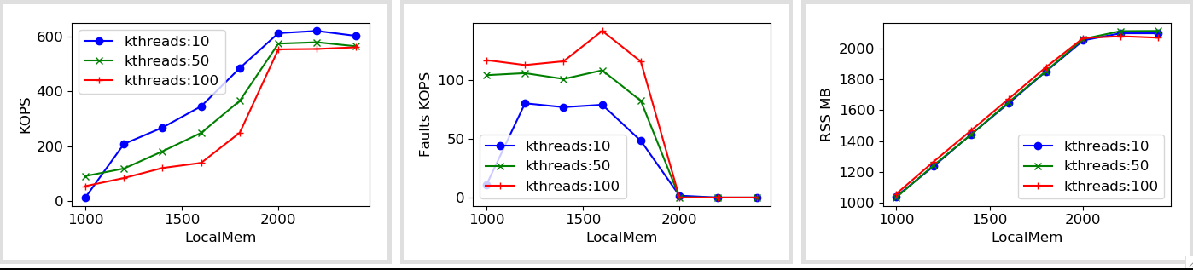
Fastswap (4 core)

Slide 8
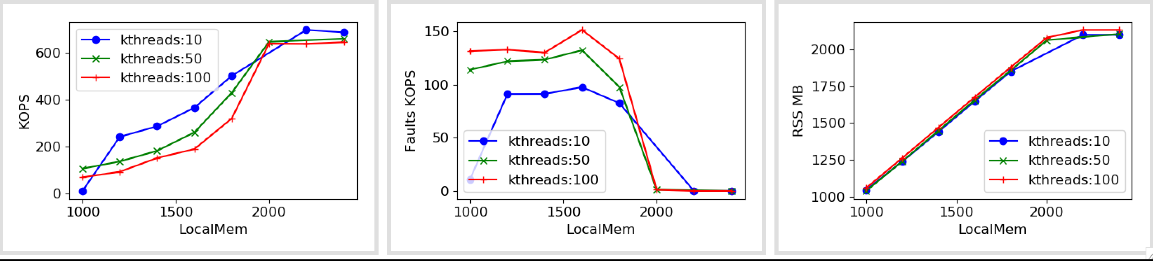
Fastswap (5 core)

Slide 9
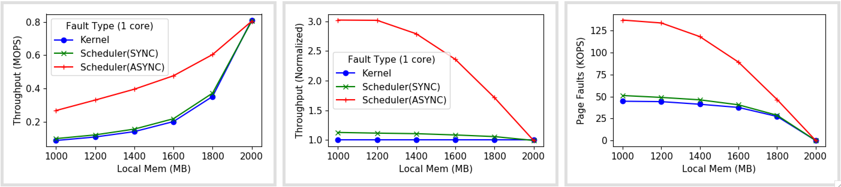
Shenango (1 core)

Slide 10
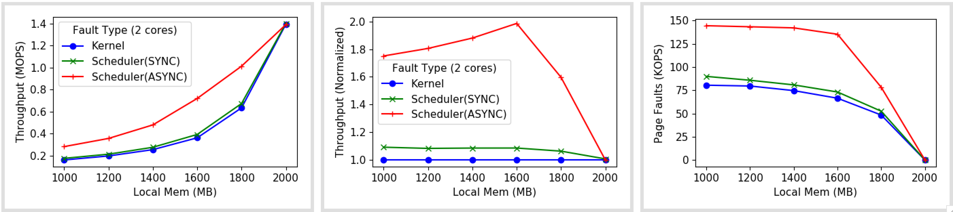
Shenango (2 cores)

Slide 11
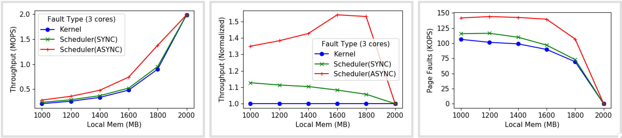
Shenango (3 cores)

Slide 12
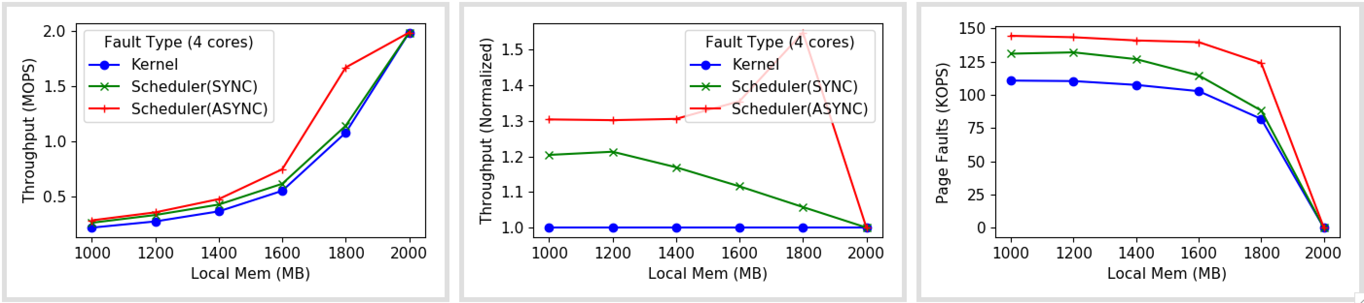
Shenango (4 cores)

Slide 13
Comparison

Slide 14
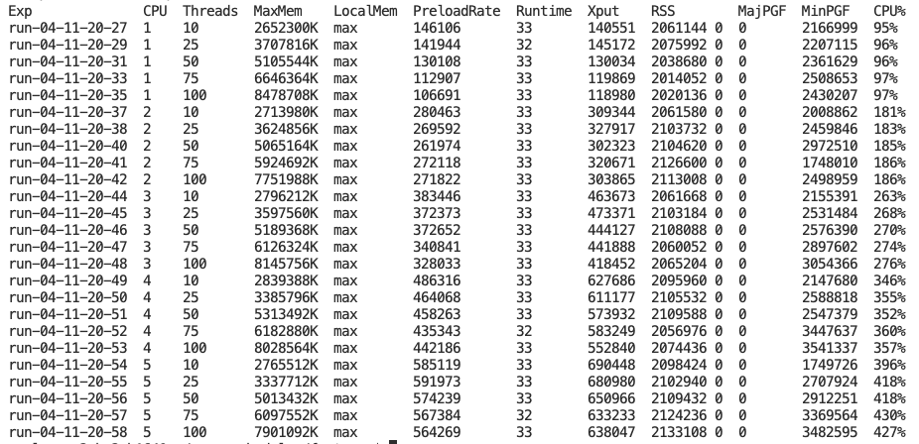
Baseline numbers

Slide 15
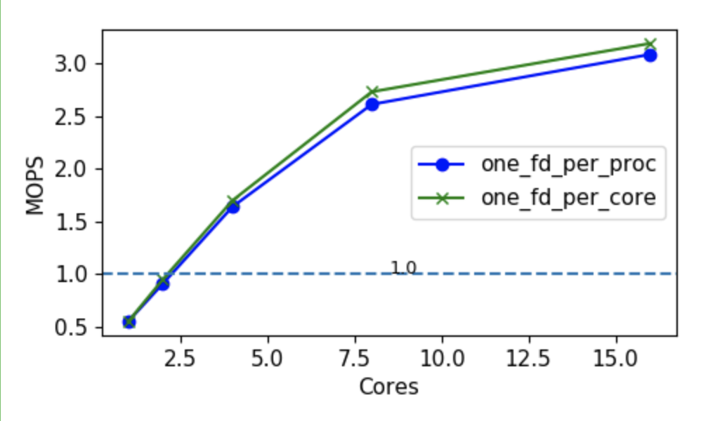
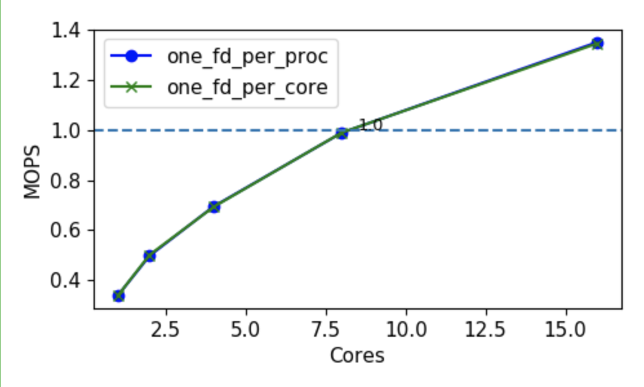
Kona scalability

